Slide 1
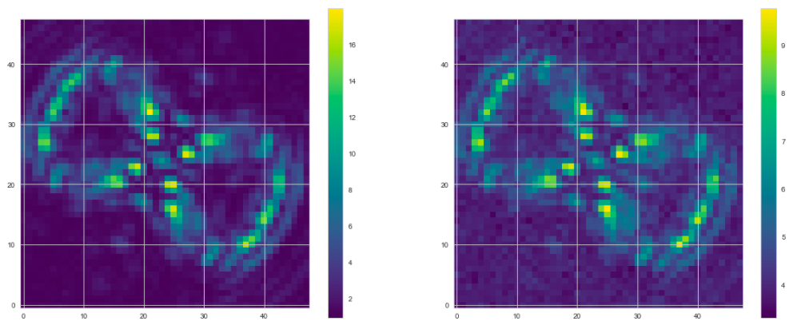
OS5 total exposure times stretched by factor of 10
No traps
No zodi/exozodi
No cosmic rays
Reduction method: “optimal/gaussian extraction”
Average reference star
Average target star w/ planet

Slide 2
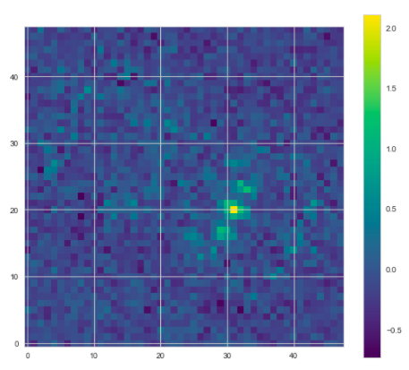
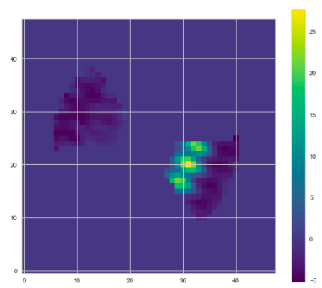
Convolved residual with position-dependent matched filter library
Residual after RDI

Slide 3
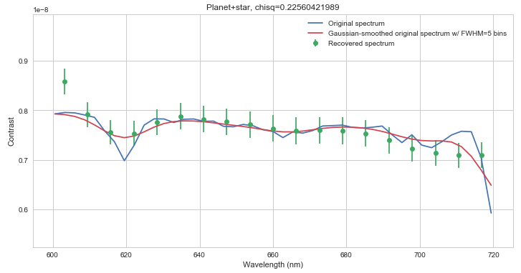
Noiseless case
Noisy case
Data points are matched filter maxima for each slice (post RDI).
Error bars are RMS within convolved residual image (post RDI).
Contrast scale on recovered spectrum is forced so that measured spectrum has same average as input spectrum.
In blue: original spectrum from Cahoy et al 2010
In red: spectrum convolved with spectrometer’s response function at R=50 (assumed gaussian)
Number of green data points or slices corresponds to number of pixels across microspectrum (assumed 2 px per FWHM for each single spectral resolution element).

