Slide 1
Coronagraph Rapid Imaging Spectrograph in Python (CRISPY)
Maxime Rizzo, Tyler Groff, Neil Zimmerman & Goddard IFS Lab,
Ewan Douglas (MIT/Cahoy Lab)
WFIRST Data Analysis Group Presentation
Feb 2nd, 2017

Slide 2
What’s CRISPY?
A software suite that can simulate the WFIRST Integral Field Spectrograph
Can be used in conjunction with a Coronagraph PSF model for end-to-end simulation
3D Science scenes -> extracted data cubes

Slide 3
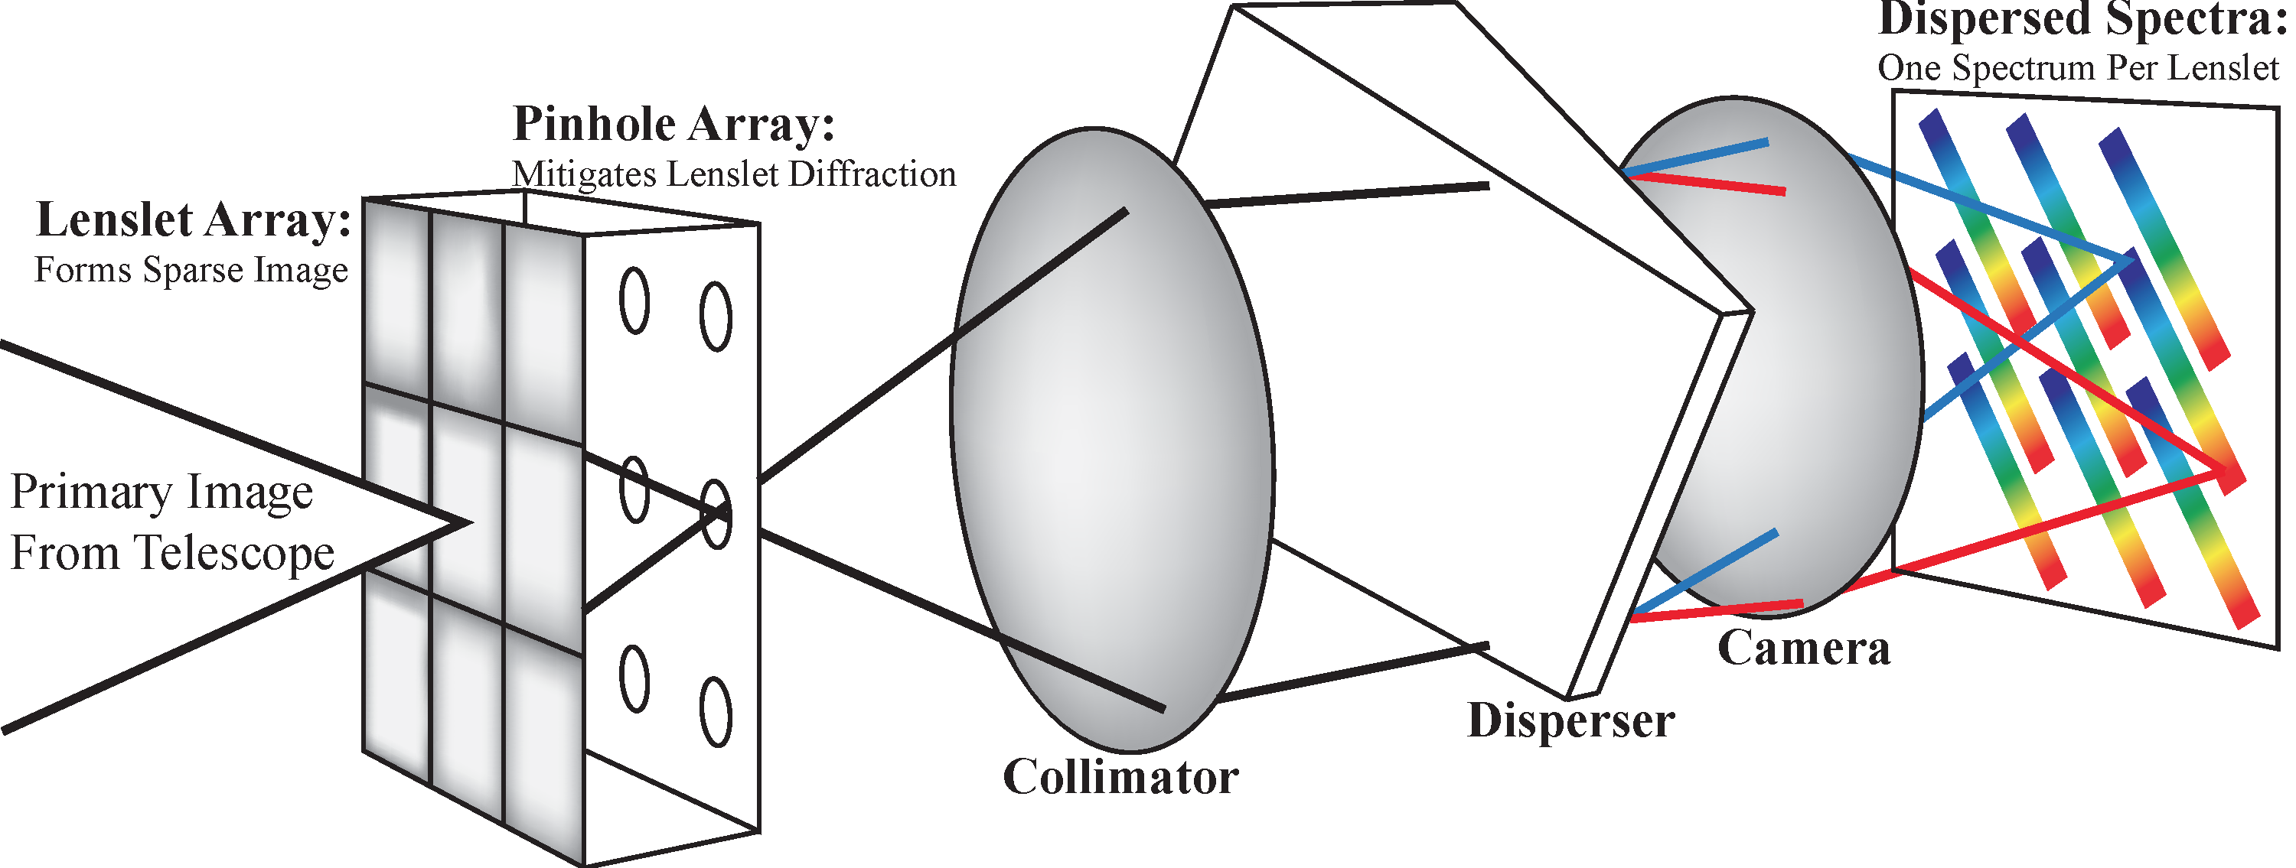
Integral Field Spectrograph
Lenslet sampling is based on size of telescope
“PSFLet”: PSF for each lenslet spectrum measured on the detector

Slide 4

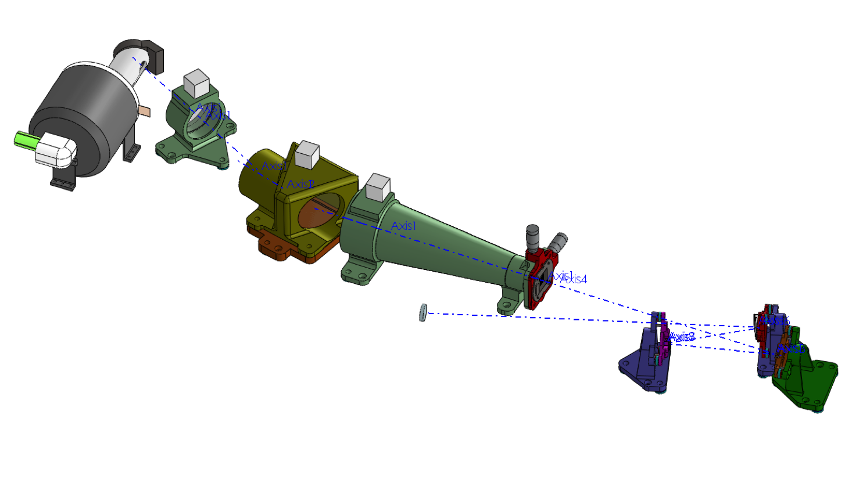
WFIRST IFS
Major Contributions
On-orbit wavefront control
Low spectral crosstalk
Passive speckle suppression
Major Objectives
Demonstrate on-orbit spectral characterization of exoplanets
IWA = 3 λ/D
OWA = 10 λ/D
R50, 600-970nm
Basic Parameters
R50, 3 bands spanning 600-970 nm
2 lenslets per λ/D
Photon counting EMCCD

Slide 5
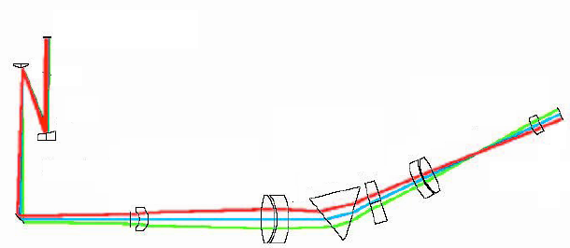
WFIRST IFS Optics
Current bandpasses (600-970nm) allow for refractive design
First CaF2 optic reduces size of relay elements
Unique to the PISCES and WFIRST designs
Minimizes wavefront error at each field point
Cost: non-common wavefront across the FOV
PISCES Optical Design
Current Flight Analog

Slide 6
Purpose of CRISPY
Distribute to community to test extraction routines
“Toy” model
Use internally for flight IFS tradeoffs & sensitivity analysis

Slide 7
Software layout
Astrophysical
Scene
Haystacks
Generate broadband cube
w/ POPPY CGI model(s) or JPL PROPER model
Diffractive
Propagation
Semi-Empirical IFS convolution
Propagate through IFS
Generate detector map
Realistic calibration fields
CCD behavior models
Add noise sources
Wavelength calibration
and update
Data reduction pipeline
Post-processing/extraction

Slide 8
Haystacks
Realistic models of extrasolar systems led by A. Roberge
Local and exo-zodiacal dust
Modeled planetary spectra
Background stars & galaxies
Broad wavelength range
Can even model moons around planets!
Code already has a few existing self-consistent architectures
Solar system twin
‘Endor’ system with Jupiter-like planet and Earth-like moon
Can vary inclination angle, distance, sampling, zodis, etc

Slide 9
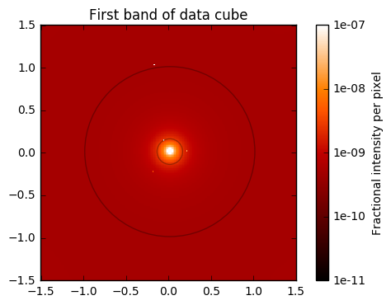
Haystacks cube for WFIRST filter
Solar system cube seen face-on at 5pc

Slide 10
Input scene parsing
Sample at 4x diffraction limit (0.01425”).
Generate tilted wavefronts for each wavelength from relatively bright (i.e. >5e-11 contrast) sources in scene
Apply webbpsf Fraunhofer SPC model (currently testing Fresnel domain model)
Sum post-coronagraph electric field intensities
Record same-color on-axis reference target diffraction pattern
Store as wavelength vs. intensity cube
Document instrument configuration and model choices in in FITS header
Future:
Add approximation of (post-correction) wavefront error
Full wavelength coverage
Library of PSFs vs. all angles for rapid reconstruction of new scenes

Slide 11
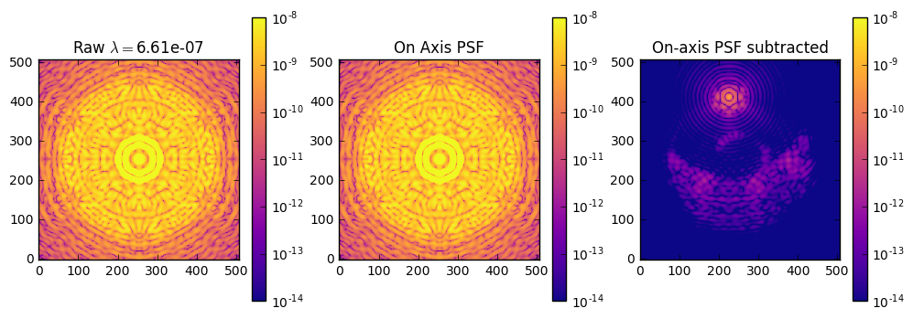
POPPY simulations

Slide 12
IFS propagation
Remap each slice of input cube onto lenslet array
1 square portion of scene = 1 square lenslet
For each lenslet and wavelength, determine X Y location in detector plane using polynomial function of (X,Y,λ)
Add oversampled PSFlet on oversampled detector plane at correct position
Rebin onto final detector sampling

Slide 13
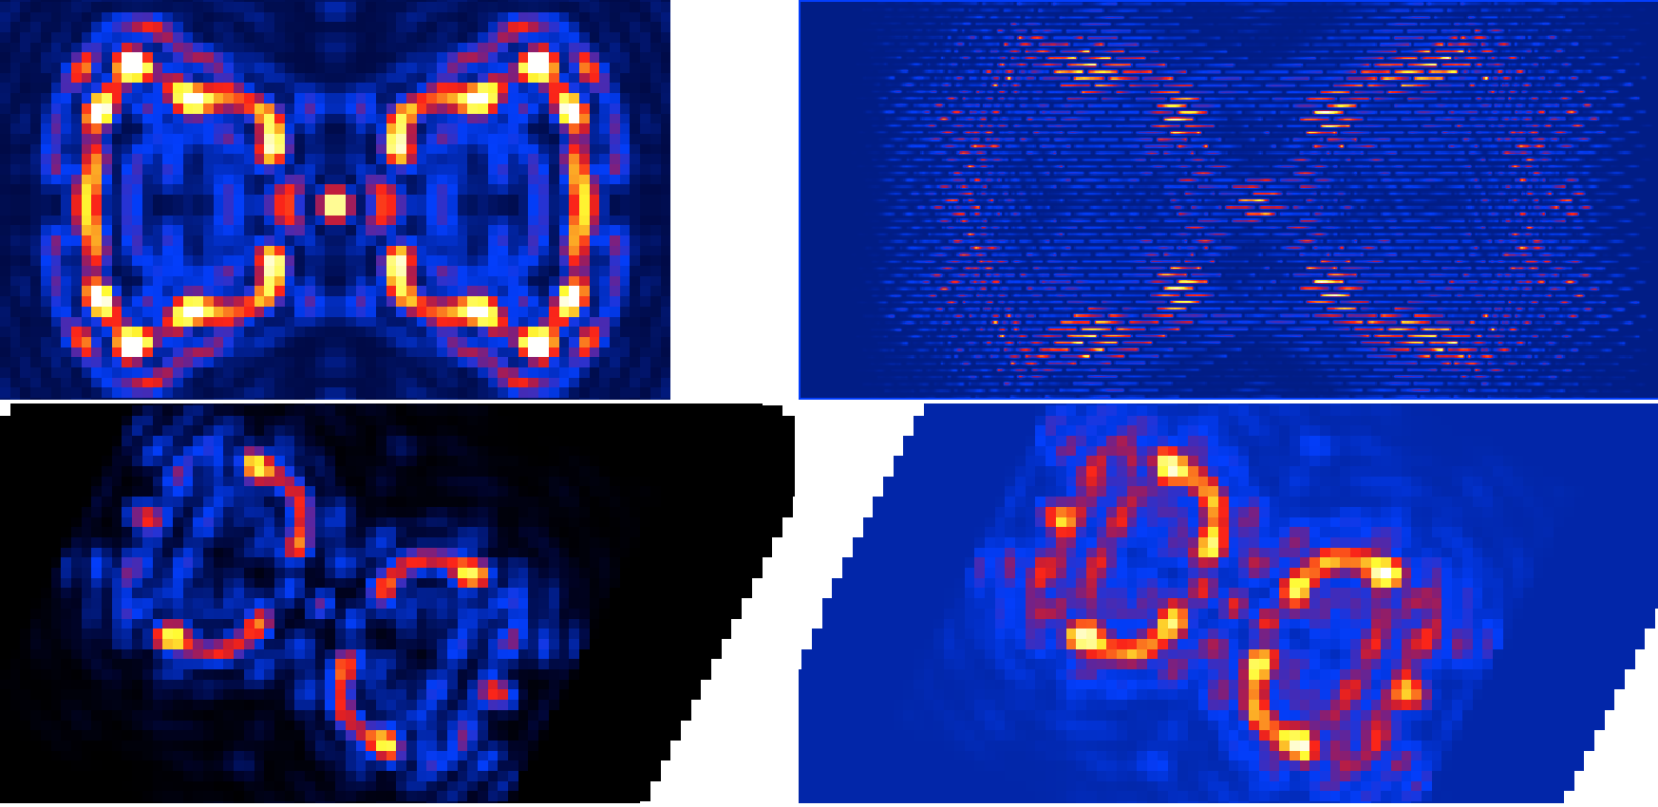
Example
Cube of inputs to the IFS
IFS detector map
Optimal extraction
Least-squares extraction

Slide 14
Detector noise: approach
Deliver software with standard Gaussian/Poisson noise sources
Work on implementation of noise specific to EMCCDs
Work with JPL/MIT on Python implementation of traps sims for the future

Slide 15
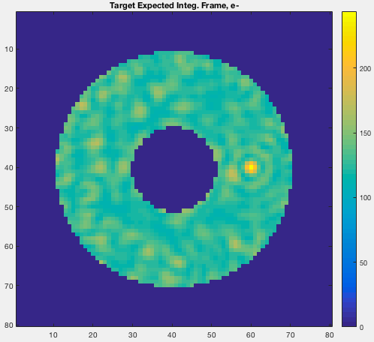
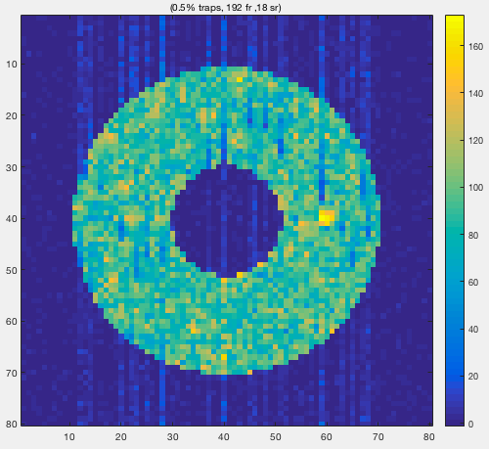
Traps code example
Traps code from JPL/Bijan Nemati

Slide 16
IFS wavelength calibration
Generate monochromatic flatfields to determine wavelength/pixel relationship for each lenslet spectrum
Optimization routine to fit polynomial function to lenslet positions for each wavelength
From PSFLet ‘diversity’ across the field, generate high-resolution simulated PSFLets in different regions of the image; equivalent to assuming we have very good knowledge of PSFLets
Create ‘polychrome’ cubes with model PSFLets at all the correct locations

Slide 17


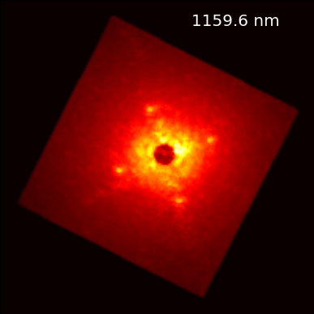
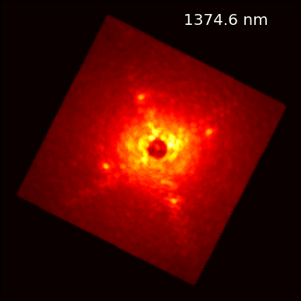
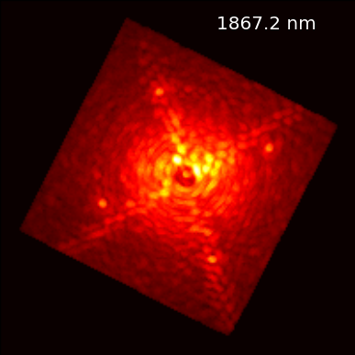
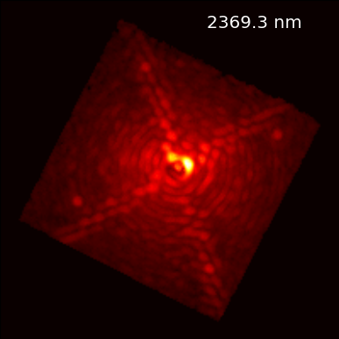

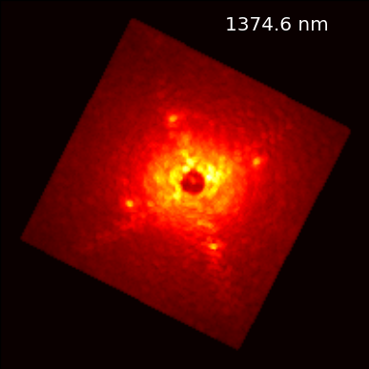

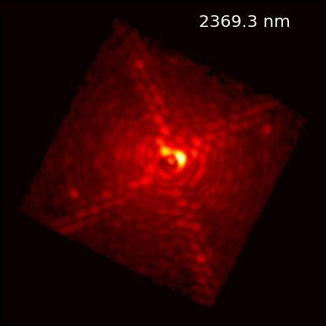
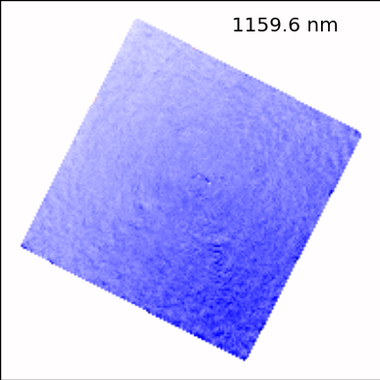
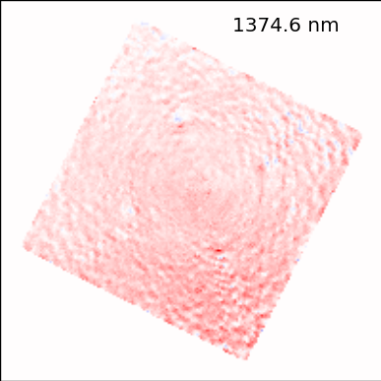
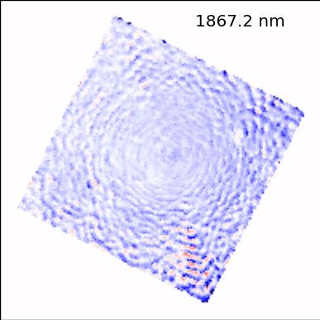
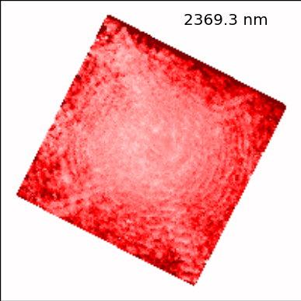
CHARIS: Impact of Image Registration
Update
No
Update

Slide 18
Wavelength calibration update
Able to test in-flight calibration correction scenarios -> inform flight observing requirements, stability tolerances, etc
Implementing CHARIS single-wavelength update strategy, but investigating other possibilities

Slide 19
Data reduction pipeline
Using Tim Brandt/CHARIS DRP framework
Optimal extraction
Least-squares fitting with prior knowledge of PSFLets (using the polychrome cube)
Implementing GPI and other methods as well for comparison
Fully compatible and tested with PISCES testbed at HCIT

Slide 20
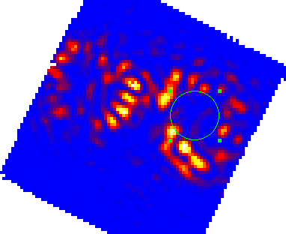
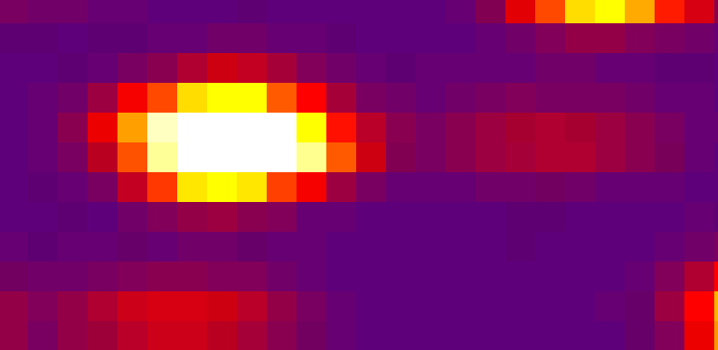
WFIRST Wavefront Control on-orbit
Reduced Image from PISCES demonstrator
For WFIRST we must achieve contrasts of ~1x10⁻⁹ in the IFS
Necessitates digging a dark hole with the IFS itself
The IFS must auto-reduce data cubes on-orbit
Efficient Dark Holes
Sensitive to Alignment Errors in the IFS
Stability of the IFS is key to success
Misalignment of spectrograph
Misalignment of image on detector
Design Approach
Demonstrate stability of the spectrograph
Be able to calibrate image registration
Raw IFS Image with monochromatic Dark Hole

Slide 21
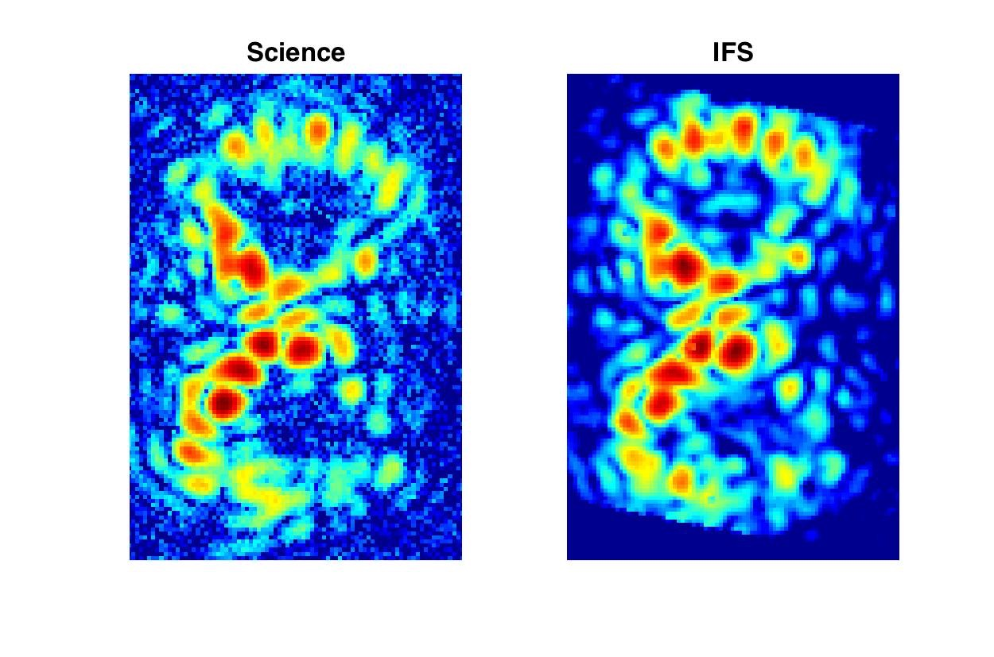
PISCES example

Slide 22
Post-processing
Expected to add a simple module for extraction methods such as KLIP
Open to suggestions and assistance

Slide 23
Goddard IFS team planned trade-offs
Sensitivities of reduced cube on various IFS parameters:
PSF sampling at detector
Effective spectral resolution (# pixels vs resolving power)
Data extraction method
Accuracy of wavelength calibration
Orientation of dispersion direction with respect to serial readout

Slide 24
Status
All essential elements working
Need to establish benchmarks and sanity checks
Currently proof-reading, writing unit tests, writing docs & notebooks
Need to implement a few more routines:
Wavelength calibration updates
Detector noise
Will add post-processing module

