Slide 1
IFS observing scenarios and spectral extraction
Maxime Rizzo
Neil Zimmerman
Tyler Groff
NASA GSFC
March 2017

Slide 2
Observing scenario
Using simulation inputs from J. Krist
47 Uma scenario with wavelength-resolved Bowtie Shaped Pupil in IFS band 2
On-source time is ~100,000 seconds (27 hours)
Individual frames are taken at 100 seconds cadence

Slide 3
Observing scenario
Using simulation inputs from J. Krist
47 Uma scenario with wavelength-resolved Bowtie Shaped Pupil in IFS band 2
On-source time is ~100,000 seconds (27 hours)
Individual frames are taken at 100 seconds cadence
Planet with variable contrast, Cahoy et al. spectrum
Both roll angles are averaged, so no ADI available

Slide 4
IFS simulation
Assume throughput from J. Krist
Flight sampling: 2 lenslets per lam/D @ 600nm
Standard detector noise from Harding et al 2016 (no traps)
All PSFLets assumed Gaussian, width known
Cube reduction method not best method available (conservative) -> can still be improved by doing least-squares fit

Slide 5
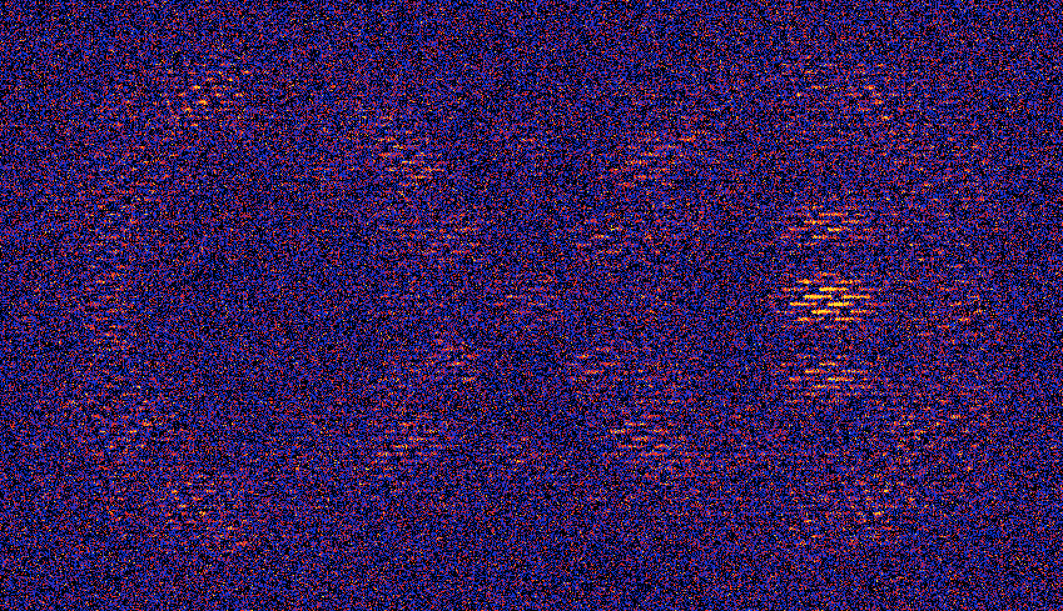
Simulate noisy IFS raw images

Slide 6
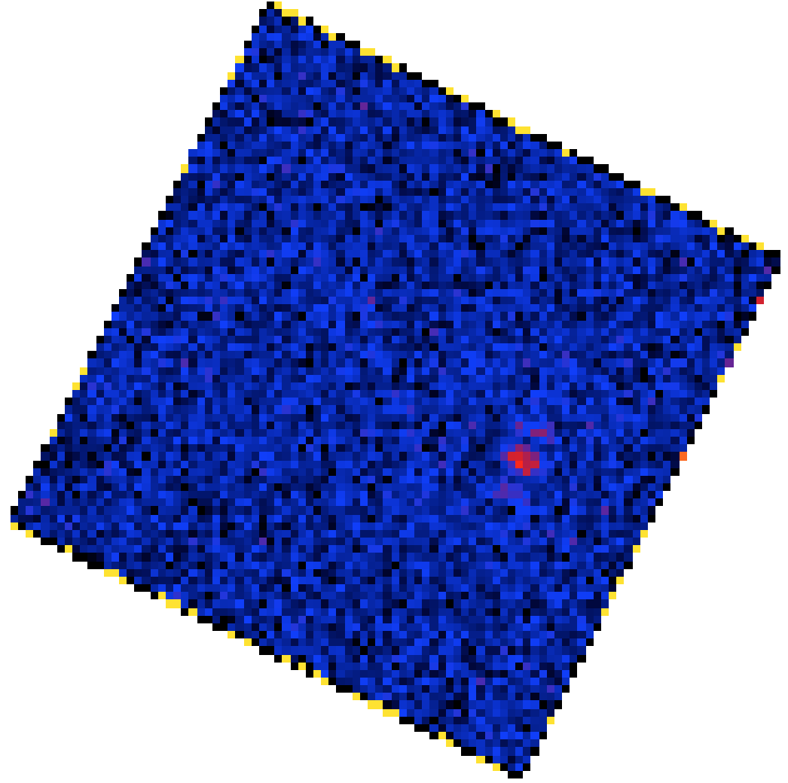
Reduce IFS cubes
Subtract reference star cube to get residual
Use a lenslet flatfield to divide the cube

Slide 7
Extract spectrum
Construct matched filter for entire cube, assume planet position is already known
Apply matched filter on mirror side of dark hole for “off” measurement
Apply matched filter on planet position to get an “on” measurement
Spectrum = on - off

Slide 8
What is the uncertainty?
Summed matched filter coefficients, to get “effective area” for each slice := npix
Calculate standard deviation of all pixels within dark hole, in each slice of residual cube:= std
Noise := sqrt(2*npix)*std
Factor of 2 because we subtracted the off position

Slide 9
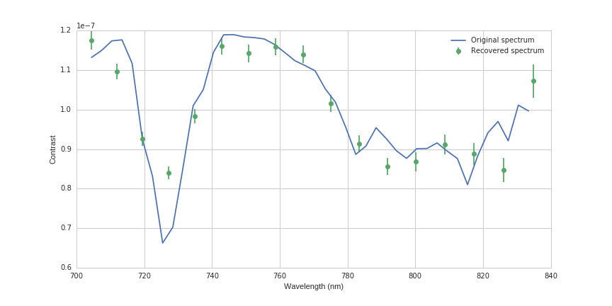
Results: Contrast 1e-7

Slide 10
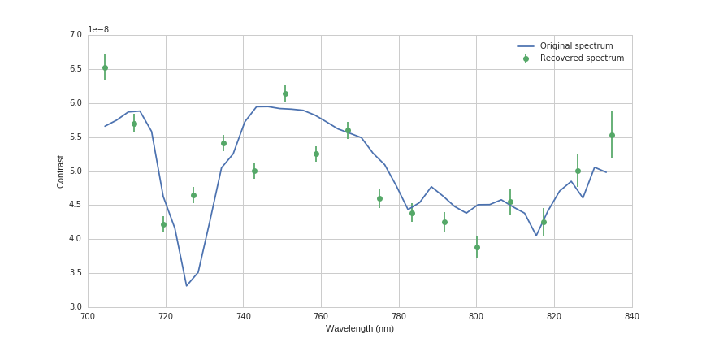
Results: contrast 5e-8

Slide 11
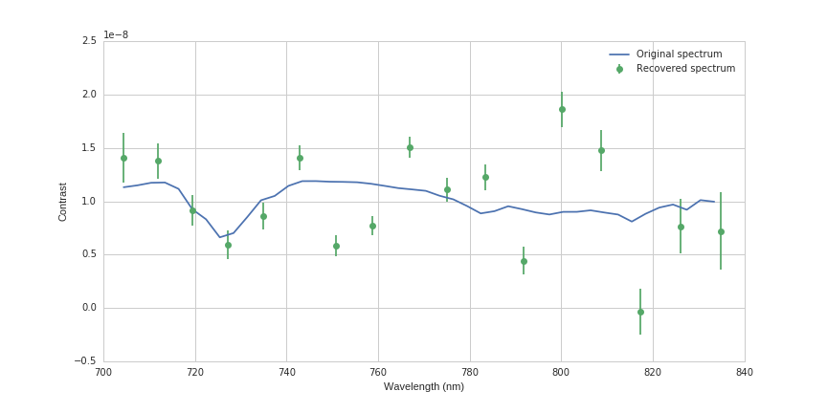
Results: contrast 1e-8

Slide 12
Notes
No post-processing whatsoever yet; have an SDI routine in hand for future implementation
Noise/errorbar implementation could be changed to simply run the simulation N times, and observe the std on the resulting spectrum (future todo)

Slide 13
Conclusions
We now have a formalism that can process J. Krist simulation cubes automatically, and allows us to compare between various design parameters
Ready to use on more up-to-date simulation cubes

