Slide 1
Lenslet flatfield
Maxime Rizzo
NASA GSFC
May 2017

Slide 2
Suggested calibrations

Slide 3
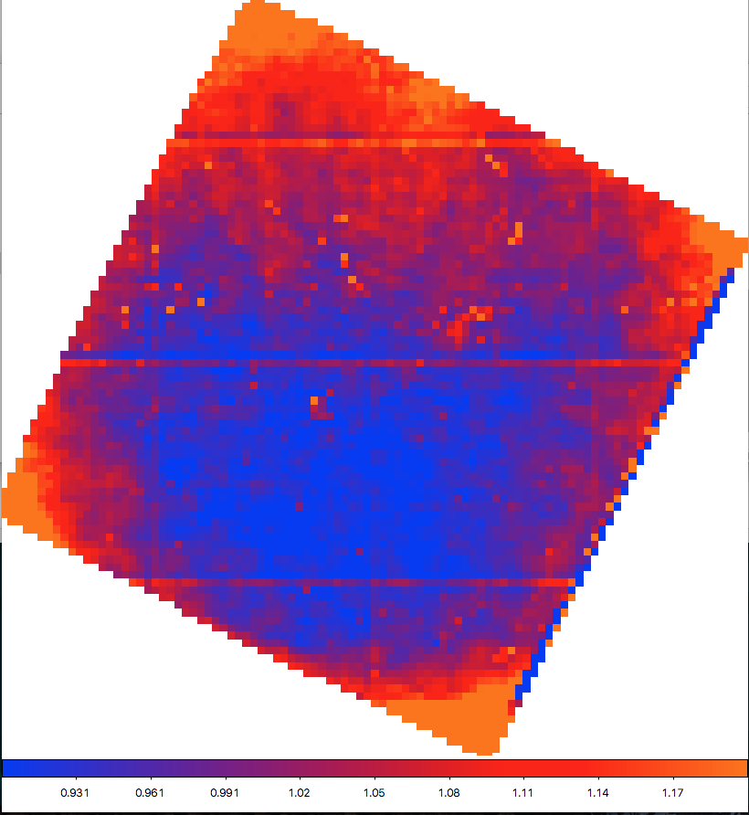
Lenslet flatfield

Slide 4
Suggested calibrations
Before each run:
Monochromatic flat at a few wavelengths to check the calibration (will add an ’apply’ keyword to apply or not the new calibration)
Full broadband flat
Inspect the residuals of the full broadband flat, make sure they are <5-10% and homogeneous across entire dark hole
Will add manual adjustment of wavelength calibration

