Slide 1
CRISPY Coronagraph Rapid Imaging Spectrograph in Python
Maxime Rizzo
Ewan Douglas
& Goddard IFS lab

Slide 2
What is it?
A software suite that can simulate the WFIRST Integral Field Spectrograph
Can be used in conjunction with a Coronagraph PSF model for end-to-end simulation
3D Science scenes -> extracted data cubes

Slide 3
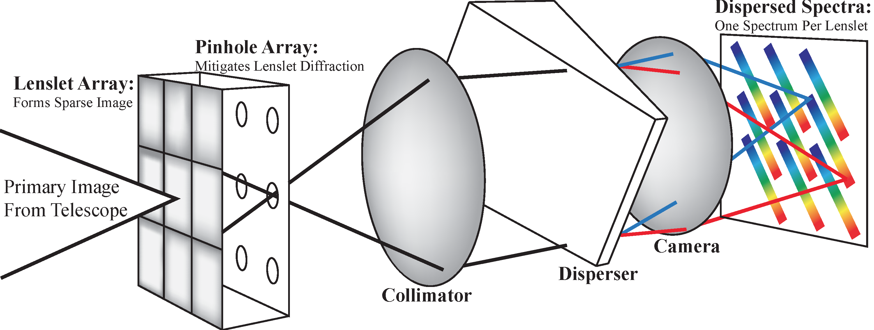
Integral Field spectrograph
Lenslet sampling is based on size of telescope PSF
“PSFLet”: PSF for each lenslet spectrum measured on the detector

Slide 4
Purpose
Distribute to community to test extraction routines
Use internally for flight IFS tradeoffs & sensitivity analysis

Slide 5
Software layout
Haystacks
Generate broadband cube
w/ POPPY CGI model or JPL model
Realistic calibration fields
Propagate through IFS
Generate detector map
Add noise sources
Wavelength calibration
and update
Data reduction pipeline
Post-processing/extraction
Python 2.7/Python 3.5 compatible
Most parts are parallelized

Slide 6
IFS propagation
Remap each slice of input cube onto lenslet array
1 square portion of scene = 1 square lenslet
For each lenslet and wavelength, determine X Y location in detector plane using polynomial function of (X,Y,lam)
Add oversampled PSFlet on oversampled detector plane at correct position
Rebin onto final detector sampling

Slide 7
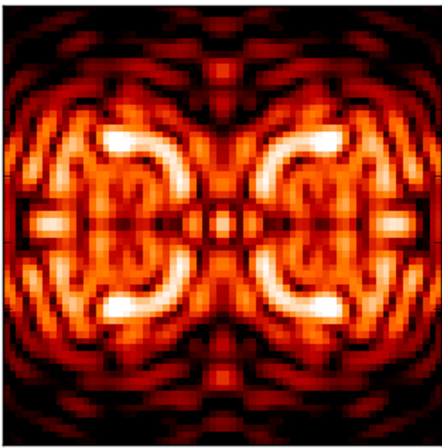
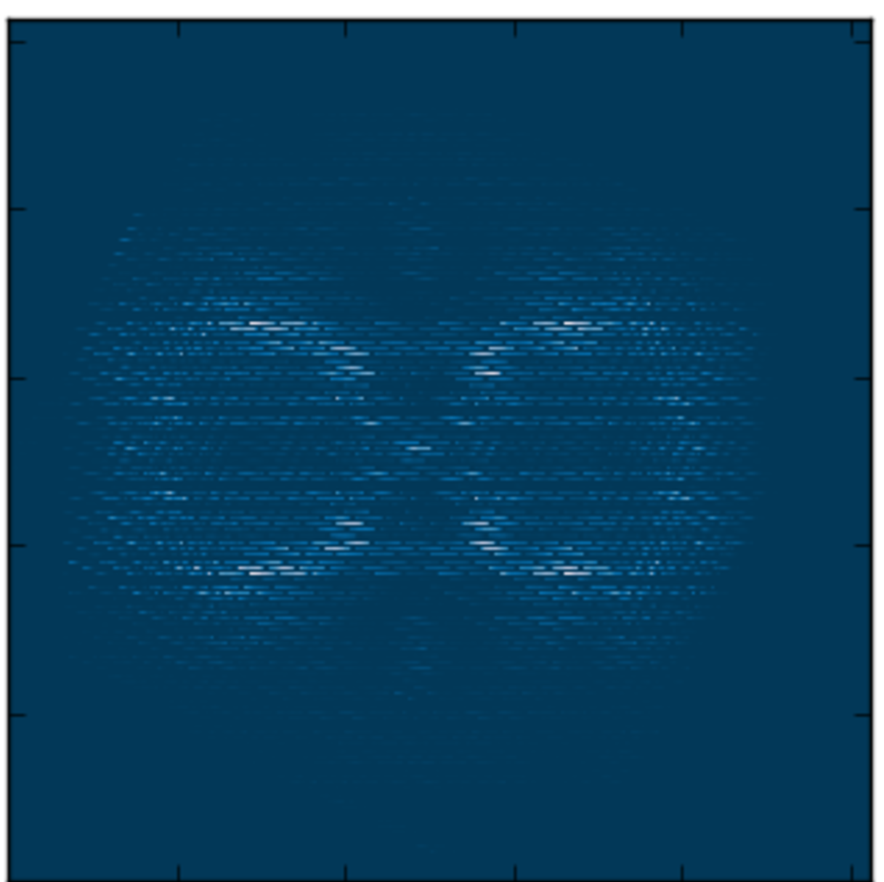
Example
Multi-wavelength on-axis SPC PSF
IFS detector frame

Slide 8
Detector noise: approach
Deliver software with standard Gaussian/Poisson noise sources
Work on implementation of noise specific to EMCCDs
Work with JPL/MIT on Python implementation of traps sims for the future

Slide 9
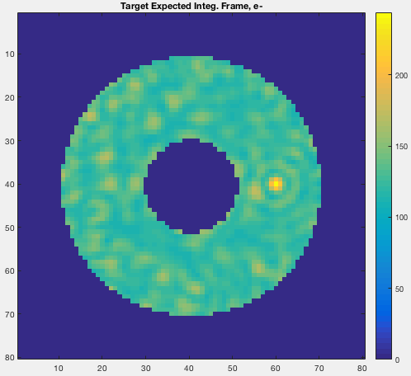
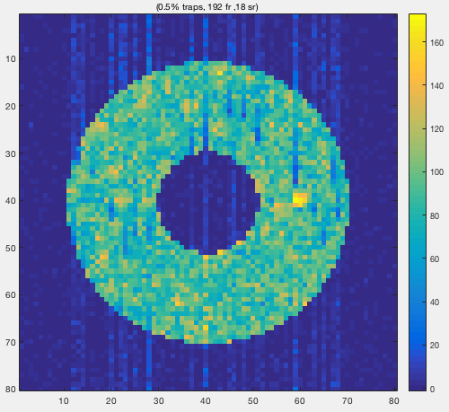
Traps code example
Traps code from JPL/Bijan Nemati

Slide 10
Wavelength calibration
Generate monochromatic flatfields to determine wavelength/pixel relationship for each lenslet spectrum
Optimization routine to fit polynomial function to lenslet positions for each wavelength
From PSFLet sampling ‘diversity’, generate high-resolution PSFLets in different regions of the image; equivalent to assuming we have very good knowledge of PSFLets
Create ‘polychrome’ calibration cubes with model PSFLets at all the correct locations

Slide 11
Wavelength calibration update
Able to test in-flight calibration correction scenarios -> inform flight observing requirements, stability tolerances, etc
Implementing CHARIS single-wavelength update strategy, but investigating other possibilities

Slide 12
Data reduction pipeline
Using Tim Brandt/CHARIS DRP framework
Optimal extraction
Least square fitting with prior knowledge of PSFLets (using the polychrome cube)
Implementing GPI and other methods as well for comparison
Fully compatible and tested with PISCES testbed at HCIT

Slide 13
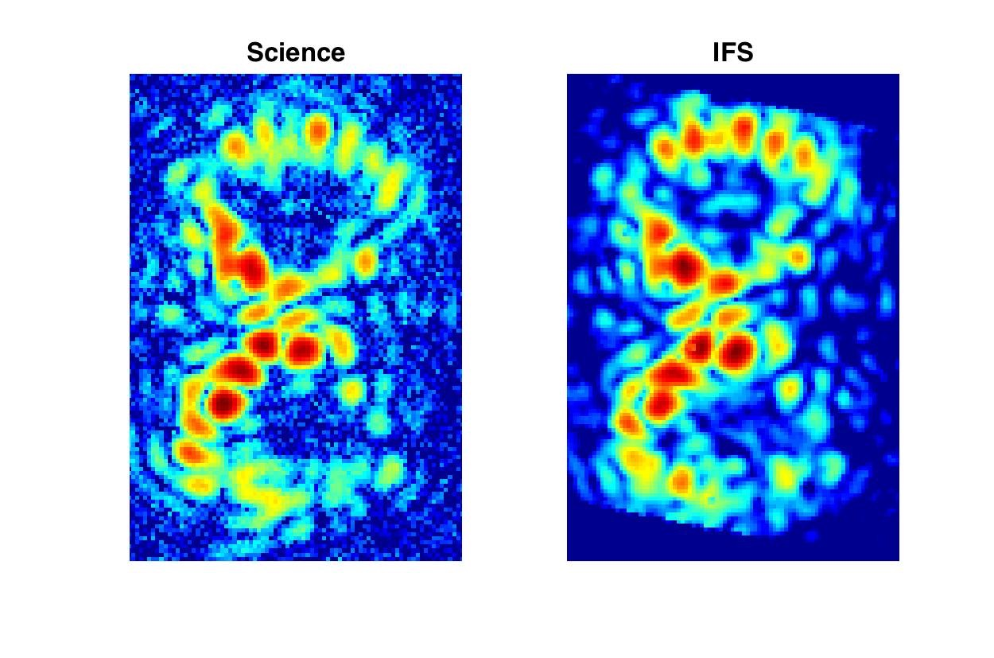
PISCES example

Slide 14
Post-processing
Expected to add a simple module for KLIP extraction
Open to suggestions

Slide 15
Goddard IFS team planned trade-offs
Sensitivities of reduced cube on various IFS parameters:
PSF sampling at detector
Effective spectral resolution
Data extraction method
Accuracy of wavelength calibration
Orientation of dispersion direction with respect to serial readout

Slide 16
Status
All essential elements working
Currently proof-reading, writing unit tests, writing docs & notebooks
Need to implement a few more routines:
Wavelength calibration updates
Detector noise
Examining how many wavelengths bins are sufficient within input cube to generate smooth IFS micro-spectra
Will add post-processing module

