Slide 1
BRAINWARE UNIVERSITY
Student Performance & Attendance Analyzer
A Python Desktop Application with GUI, File Handling & Charts
Project Information
Presented By
Course: Problem Solving Using Python
Course Code: MCA17400
Programme: Master of Computer Applications (MCA)
Session: 2026 – 2027
Department: Computer Science & Applications
Student Name: Jyoti Boiragi
University Id: BWU/MCA/26/004
Class / Section: MCA / Section A
Submitted To: Rahul Kumar Ghosh(Assistant Prof.)
University: Brainware University, Kolkata

Slide 2
MCA17400: PROBLEM SOLVING USING PYTHON
2/12
Introduction & Problem Statement
Introduction
The Problem We Are Solving
• In colleges, teachers need to manage student marks and attendance every semester.
• Calculating totals, percentages, and grades by hand takes a lot of time.
• This project is a simple Python desktop app that does all these calculations automatically.
• It stores student records, checks low attendance, and creates simple visual charts.
• Human Mistakes: Manual calculation often causes small errors in totals and grades.
• Wrong Inputs: People can mistakenly enter negative numbers or marks over 100.
• Missing Low Attendance: It is hard to quickly spot students who have attendance below 75%.
• No Visual View: Plain numbers in paper registers don't show how the whole class is performing.
Student Performance & Attendance Analyzer | Brainware University

Slide 3
MCA17400: PROBLEM SOLVING USING PYTHON
3/12
Objectives & Scope of the Project
Main Objectives
Scope of the Project
✔ Easy Data Entry: Enter student roll, name, 4 subject marks, and attendance via a simple GUI.
✔ Automatic Grade Calculation: Calculate Total, Average, Percentage, and Grade (A, B, C, D, F).
✔ Attendance Alert: Instantly warn if attendance is below 75%.
✔ Data Persistence: Save all records into a CSV file and read them back anytime.
✔ Visual Graphs: Create Bar Chart, Line Graph, and Histogram with one click.
• Subjects Covered: 4 fixed MCA subjects (Python, DBMS, AI, JavaScript).
• Marking System: Each subject is out of 100 marks (Total: 400).
• Attendance Limit: Fixed 75% rule for university exam eligibility.
• Target Users: Teachers, lab examiners, and students.
• Environment: Standalone offline desktop app (no internet or heavy database needed).
Student Performance & Attendance Analyzer | Brainware University

Slide 4
MCA17400: PROBLEM SOLVING USING PYTHON
4/12
Existing System vs Proposed System
Old / Manual Method (Paper & Excel)
Our Proposed Python System
✗ Slow and repetitive manual calculation.
✗ Accidental typing errors are not caught (e.g. entering 150 marks).
✗ Hard to filter out low-attendance students quickly.
✗ Making charts requires multiple manual steps in spreadsheets.
✗ Paper records can be lost or damaged easily.
✔ Instant calculation of Total, Average, and Grade.
✔ Stops wrong inputs with a clear error popup dialog.
✔ One click shows all students with attendance below 75%.
✔ Draws 3 clear graphs automatically with Matplotlib.
✔ Saves everything cleanly in a CSV file on your computer.
Student Performance & Attendance Analyzer | Brainware University

Slide 5
MCA17400: PROBLEM SOLVING USING PYTHON
5/12
Technologies & Libraries Used
Python 3
Tkinter
CSV Module
CORE LANGUAGE
The main programming language used for logic, classes, and calculations.
USER INTERFACE (GUI)
Builds the desktop window, entry fields, buttons, and popup dialogs.
FILE HANDLING
Writes student records row-by-row into a CSV file for permanent storage.
NumPy
Pandas
Matplotlib
FAST MATH & STATS
Calculates class average, highest score, and lowest score easily.
DATA READING
Reads the CSV file as a clean table and reloads student data into the app.
GRAPHS & CHARTS
Generates the Bar Chart, Line Graph, and Histogram image files.
Student Performance & Attendance Analyzer | Brainware University

Slide 6
MCA17400: PROBLEM SOLVING USING PYTHON
6/12
System Architecture & How It Works
Step 1: User Input (GUI)
User types Roll, Name, Marks in 4 subjects, and Attendance in the Tkinter window.
Step 2: Validation Check
The app checks if roll and marks are valid numbers between 0 and 100. If not, shows an error.
Step 3: Processing & OOP
Creates a Student object, calculates Total, Average, Percentage, and Letter Grade (A-F).
Step 4: Output, CSV & Graphs
Displays results in text area, saves records to students.csv, and draws 3 charts on demand.
Student Performance & Attendance Analyzer | Brainware University

Slide 7
MCA17400: PROBLEM SOLVING USING PYTHON
7/12
Implementation: Student Class & Grade Rules
The Student Class
How Grade Rules Work
class Student:
def __init__(self, roll, name, marks, att):
self.roll = roll
self.name = name
self.marks = marks
self.attendance = att
self.total = sum(marks.values())
self.average = np.mean(list(marks.values()))
self.percentage = self.average
self.grade = self.calculate_grade()
# Calculates letter grade
def calculate_grade(self):
if self.percentage >= 80: return 'A'
elif self.percentage >= 70: return 'B'
elif self.percentage >= 60: return 'C'
elif self.percentage >= 50: return 'D'
else: return 'F'
• Grade A: Percentage is 80% or higher.
• Grade B: Percentage is between 70% and 79.9%.
• Grade C: Percentage is between 60% and 69.9%.
• Grade D: Percentage is between 50% and 59.9%.
• Grade F (Fail): Percentage is below 50%.
• Attendance Rule: If attendance is strictly less than 75%, it marks as Low Attendance.
Student Performance & Attendance Analyzer | Brainware University

Slide 8
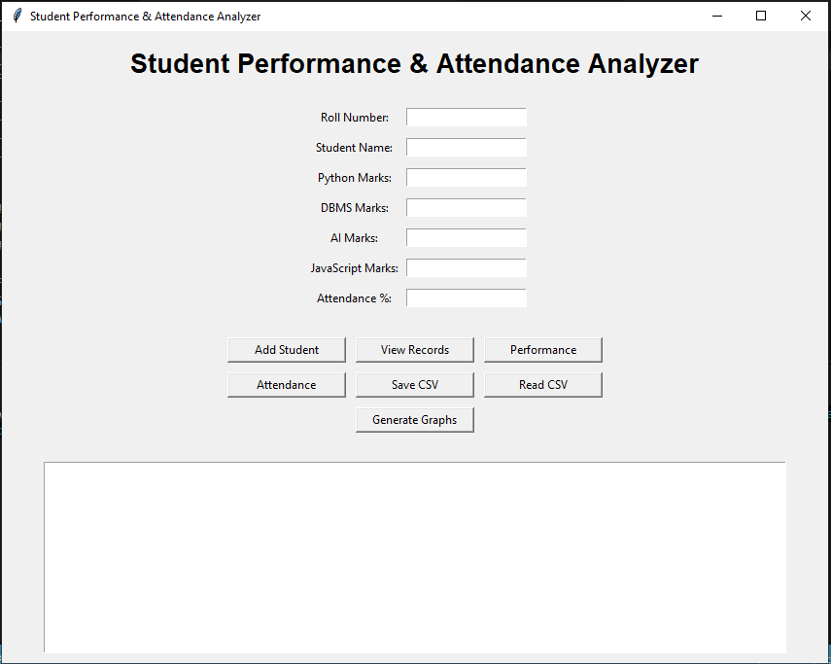
MCA17400: PROBLEM SOLVING USING PYTHON
8/12
Application Interface (GUI)
Simple & Clean Controls
Main Application Screen
• Input Boxes: For Roll, Student Name, 4 Subject Marks, and Attendance %.
• Add Student Button: Validates and saves the student in memory.
• View Records: Lists all students in the bottom text box.
• Performance Button: Ranks students and shows Class Average, Highest, and Lowest.
• Attendance Button: Lists all students with attendance below 75%.
• Save & Read CSV: Keeps data safe in a file.
• Generate Graphs: Pops up the 3 visual charts.
Student Performance & Attendance Analyzer | Brainware University

Slide 9
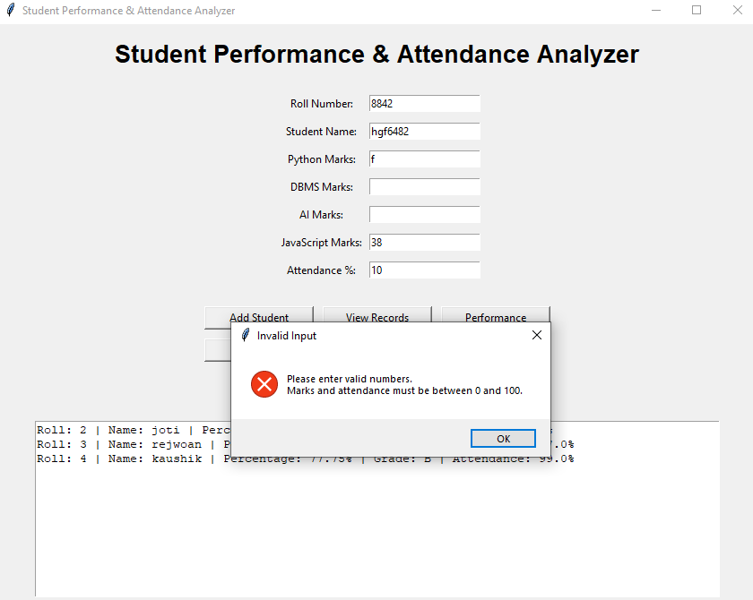
MCA17400: PROBLEM SOLVING USING PYTHON
9/12
Testing & Input Error Handling
What We Tested (All Passed)
Error Dialog Popup
1. Valid Student: Added successfully, total and grade calculated correctly. (Pass)
2. Letters in Marks: Typing 'abc' instead of marks shows an error dialog. (Pass)
3. Out of Range Marks: Marks below 0 or above 100 are rejected immediately. (Pass)
4. Empty Name: Forgetting student name shows a warning. (Pass)
5. Low Attendance (e.g. 55%): Immediately shows a warning message. (Pass)
6. Save and Reload: Data saved to CSV is fully recovered on restart. (Pass)
Student Performance & Attendance Analyzer | Brainware University

Slide 10
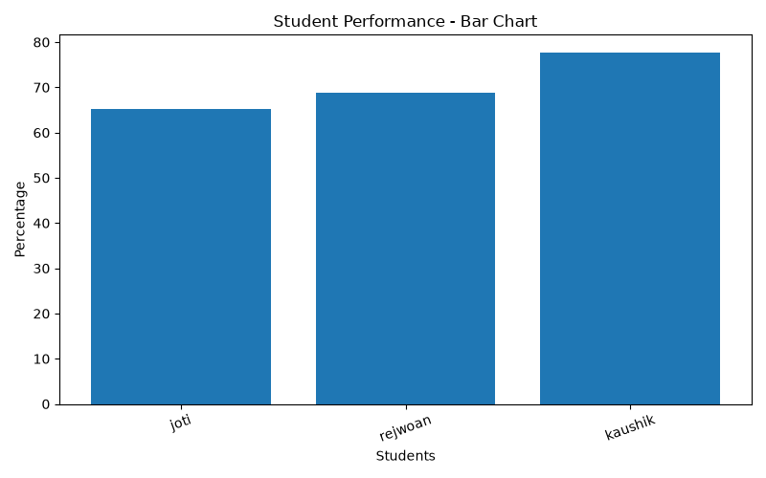
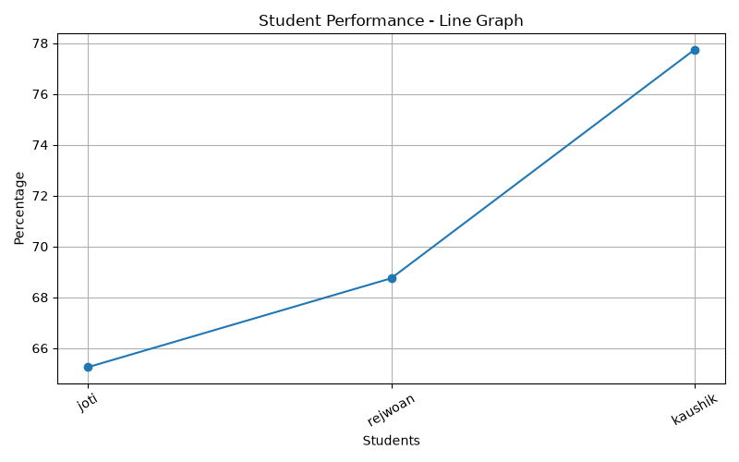
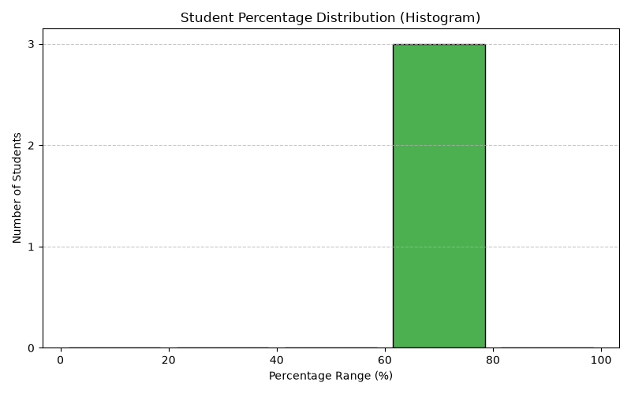
MCA17400: PROBLEM SOLVING USING PYTHON
10/12
Visual Results: 3 Matplotlib Graphs
1. Bar Chart
2. Line Graph
3. Histogram
Compares marks of each student side by side.
Shows the mark trend with clear dots & grid lines.
Groups students into score ranges (0-20, 20-40, 40-60, 60-80, 80-100%).
Student Performance & Attendance Analyzer | Brainware University

Slide 11
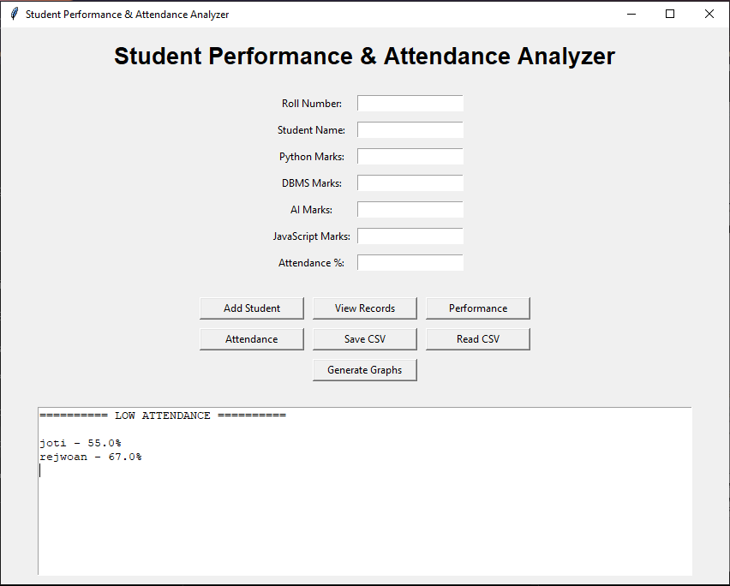
MCA17400: PROBLEM SOLVING USING PYTHON
11/12
Results: Performance Ranking & Attendance
Class Ranking & Statistics
Low Attendance Defaulters List
Student Ranking: Automatically ranks students from 1st to last by percentage.
Example Ranks:
1. Kaushik – 77.75% (Grade B)
2. Rejwoan – 68.75% (Grade C)
3. Joti – 65.25% (Grade C)
NumPy Class Statistics:
• Class Average: 70.58%
• Highest Percentage: 77.75%
• Lowest Percentage: 65.25%
Identified students with attendance below 75%: Joti (55.0%) and Rejwoan (67.0%).
Student Performance & Attendance Analyzer | Brainware University

Slide 12
MCA17400: PROBLEM SOLVING USING PYTHON
12/12
Conclusion & Future Enhancements
Conclusion
Future Enhancements & References
✔ The project successfully automates student performance evaluation and attendance monitoring.
✔ It applies core Python syllabus concepts: Classes, Lists, Dictionaries, Exceptions, CSV, Pandas, NumPy, and Matplotlib.
✔ The GUI makes it simple and practical for teachers to use without typing terminal commands.
✔ All calculations, graphs, and file operations were tested and verified.
Future Scope:
• Use SQLite Database instead of CSV for large data.
• Add dynamic subjects and edit/delete buttons.
• Export printable PDF report cards with university logo.
References:
1. Python Official Documentation (docs.python.org)
2. Tkinter GUI Documentation & Tutorials
3. Pandas & NumPy Official Guides
4. Matplotlib Visualization Library (matplotlib.org)
Student Performance & Attendance Analyzer | Brainware University

