Slide 1
Testing solutions for LabVIEW
applications
Áron Szabó
Advisor: Dr. Zoltán Micskei

Slide 2

Unit testing and LabVIEW
Unit testing is testing of individual hardware or software units or groups of related units
LabVIEW is a system engineering software tool
  rapid development and prototyping
  testing systems, measurement solutions
  other industrial applications.
Unit testing for LabVIEW applications?
2

Slide 3
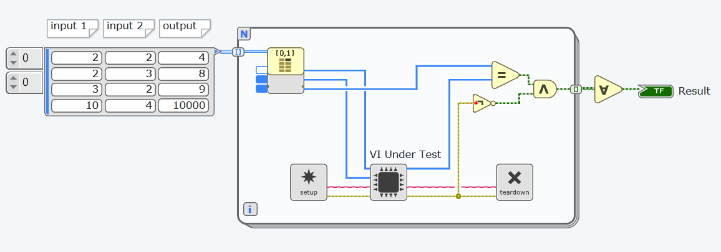
Unit testing in LabVIEW
Existing LabVIEW testing frameworks
Creating tests resource-effectively
Test generating solutions
3

Slide 4
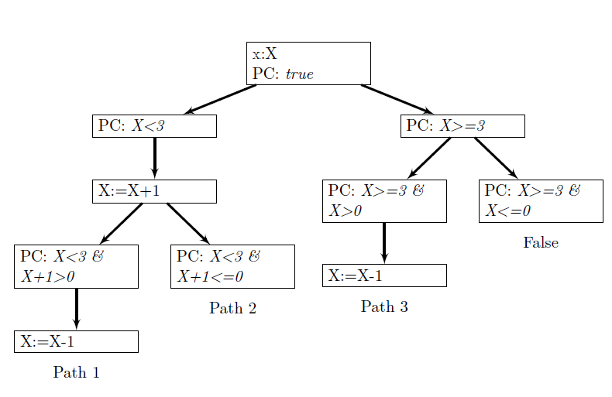
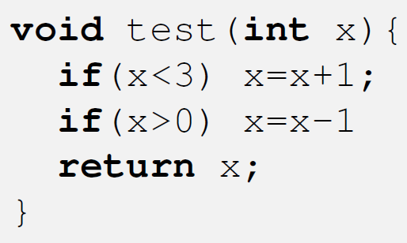
Symbolic Execution
Running the program with symbolic input variables
Discover all possible execution paths
Define sets of input variables to reach an execution path
4

Slide 5
Designing the tool
Goal: a unit test generation tool for LabVIEW VIs
In the scope of BSc thesis: define test inputs using symbolic execution
With a limited feature set: few essential operators and program structures
Output: list of execution paths, their path conditions and calculated symbolic variables
5

Slide 6
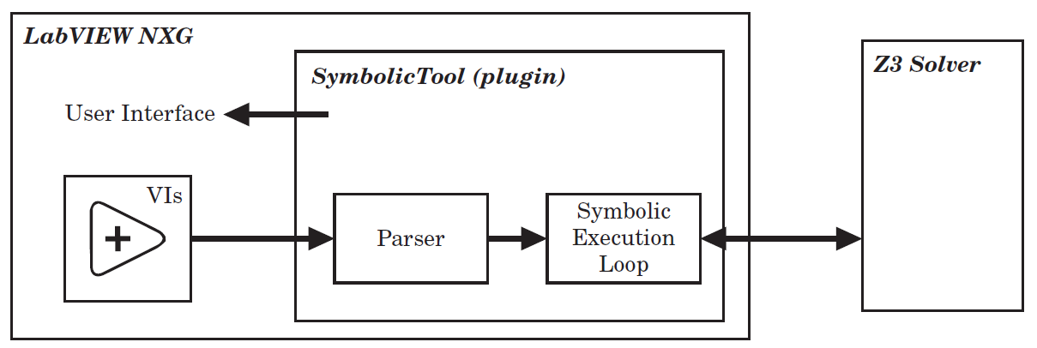
Architecture
Conversion of the LabVIEW program:
data-flow VIs → imperative representation
Symbolic Execution Loop
Constraint solver to calculate the input values from each path constraint
6

Slide 7
Implementation
LabVIEW NXG: .NET API for object model, plugin
Tool written in C#
Parser
  BFS-like algorithm on LabVIEW model
  building an internal object model
Symbolic Execution Tree
  fork on branching statements
  finished executions in leafs
  DFS-like algorithm
Constraint Solver: Call Microsoft Z3 Solver
7

Slide 8
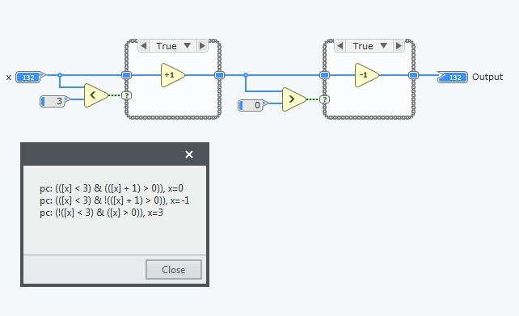
Evaluation
A = [x];
B = 3;
C = 0;
D = (A < B);
IF D Then
E = (A + 1);
ELSE
E = A;
End IF
F = (E > C);
IF F Then
G = (E - 1);
ELSE
G = E;
End IF
[Output] : G;
Successful execution for demo LabVIEW programs
All defined requirements satisfied
Supports basic operators and structures
8

Slide 9
Summary
Unit-testing and LabVIEW
Cost-effective testing of industrial applications
Symbolic Execution
Design and implementation of the tool
  Parser: data-flow → imperative
  Symbolic Execution Loop
  Constraint Solver
9

Slide 10
Summary
There is a sentence in your thesis: „One of them was automatic unit test generation, which in my opinion is not very effective on its own: generating tests with some inputs and exercising the output (which comes from an execution of the program) says very little.” How does your solution help overcome this concern?-effective testing of industrial applications
9

Slide 11
Summary
Is there any plan to make the product available to wider audience (end users or developers)?
9

Slide 12
Summary
Is there any particular reason you put all the operators in one class, instead of deriving a new class for each?
9

