Slide 1
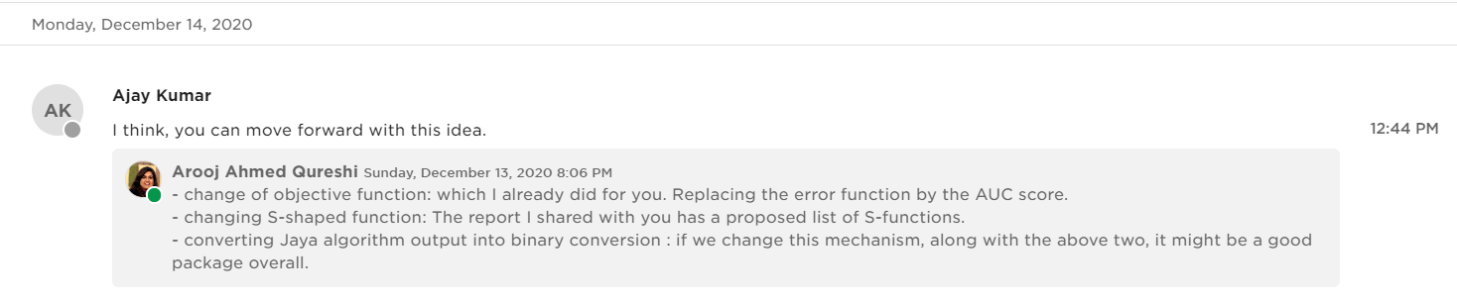
Second Deliverable

Slide 2
Parameters
Objective Function
AUC score
Error Function
S-shaped Function [added now]
7 functions added in the report [pages 5-7]
Binary Conversion [page 7]
Random_r [report_1 method]
Default_r [new method]

Slide 3
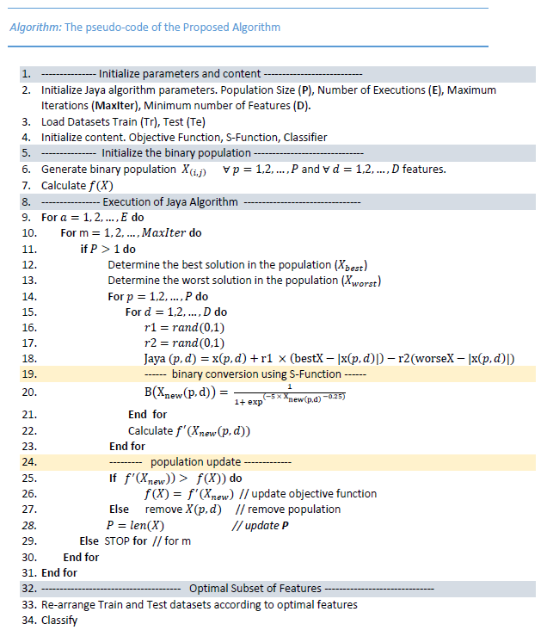
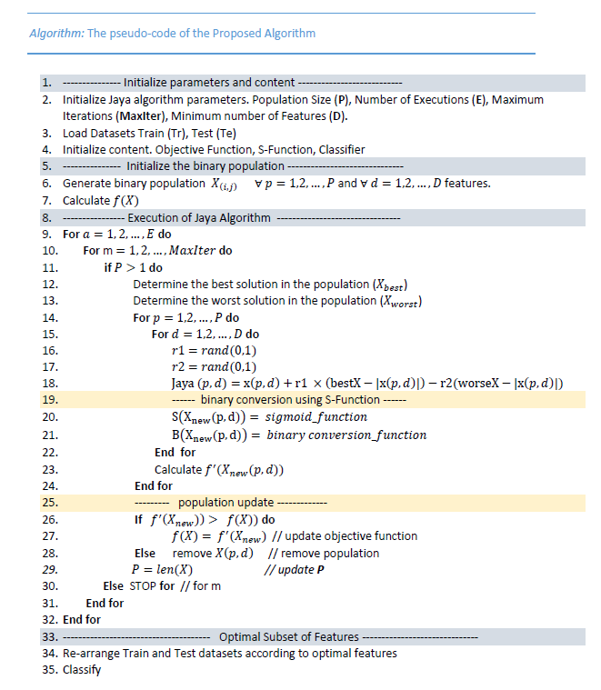
Algorithm
Previous Report
New Report

Slide 4
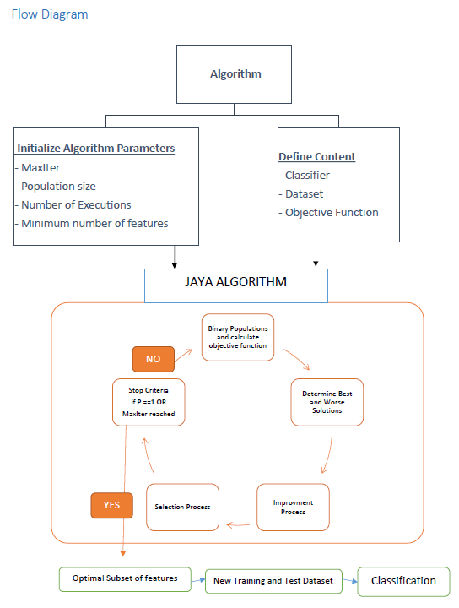
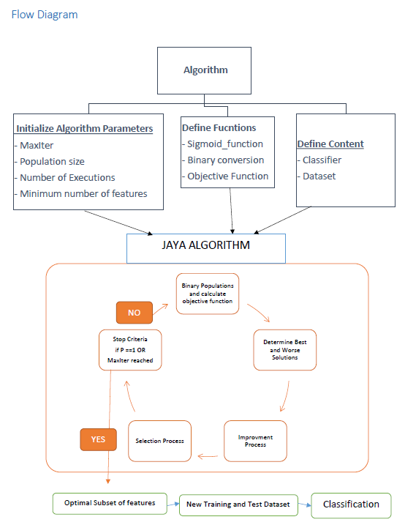
Flowchart
Previous Report
New Report

Slide 5
Results
Check reports

