Slide 1
Introduction to CUDA
Muhammad Usman
GCUF

Slide 2
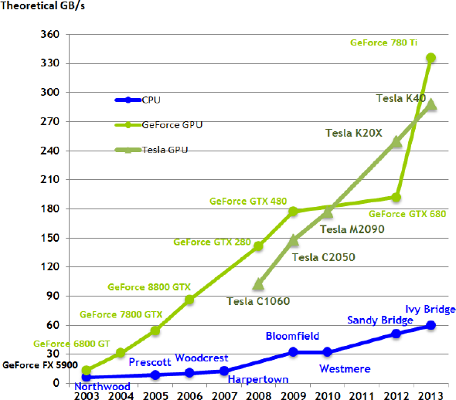

Slide 3
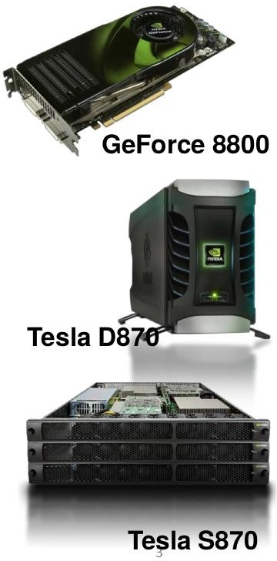
GPUs deliver hundreds GFLOPS on compiled parallel C applications
Available in laptops, desktops, and clusters
GPU parallelism is doubling every year
Programming model scales transparently
Data parallelism
Programmable in C with CUDA tools
Multithreaded SPMD model uses application data parallelism and thread parallelism.
[SPMD = Single Program Multiple Data]

Slide 4

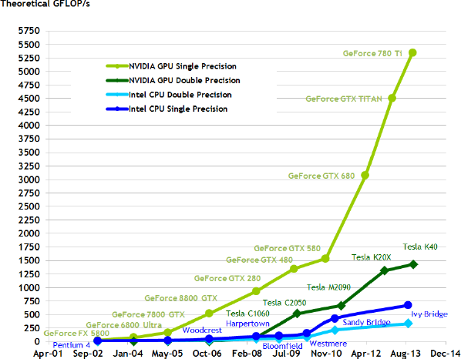

Slide 5
Introduced in 2007 with NVIDIA Tesla architecture
“C-like” language to express programs that run on GPUs using the compute-mode hardware interface
Relatively low-level: CUDA’s abstractions closely match the capabilities/performance characteristics of modern GPUs (low abstraction distance)
Note: OpenCL is an open standards version of CUDA
CUDA only runs on NVIDIA GPUs
OpenCL runs on CPUs and GPUs from many vendors

Slide 6

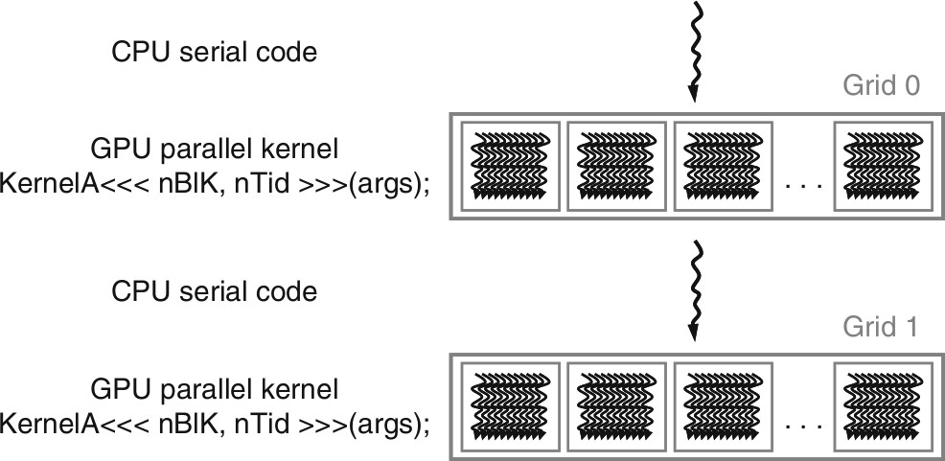
Compute Unified Device Architecture
Integrated host+device app C program
Serial or modestly parallel parts in host C code
Highly parallel parts in device SPMD kernel C code

Slide 7

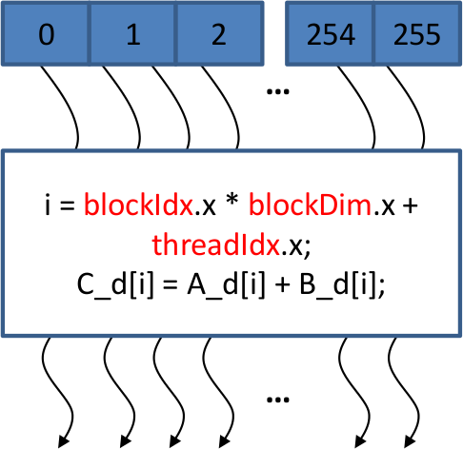
A CUDA kernel is executed by an array of threads
All threads run the same code (the SP in SPMD)
Each thread has an ID that it uses to compute memory
addresses and make control decisions

Slide 8
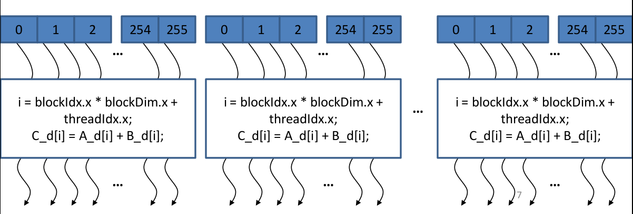
Divide monolithic thread array into multiple blocks
Threads within a block cooperate via shared memory, atomic operations and barrier synchronization, ...
Threads in different blocks cannot cooperate

Slide 9
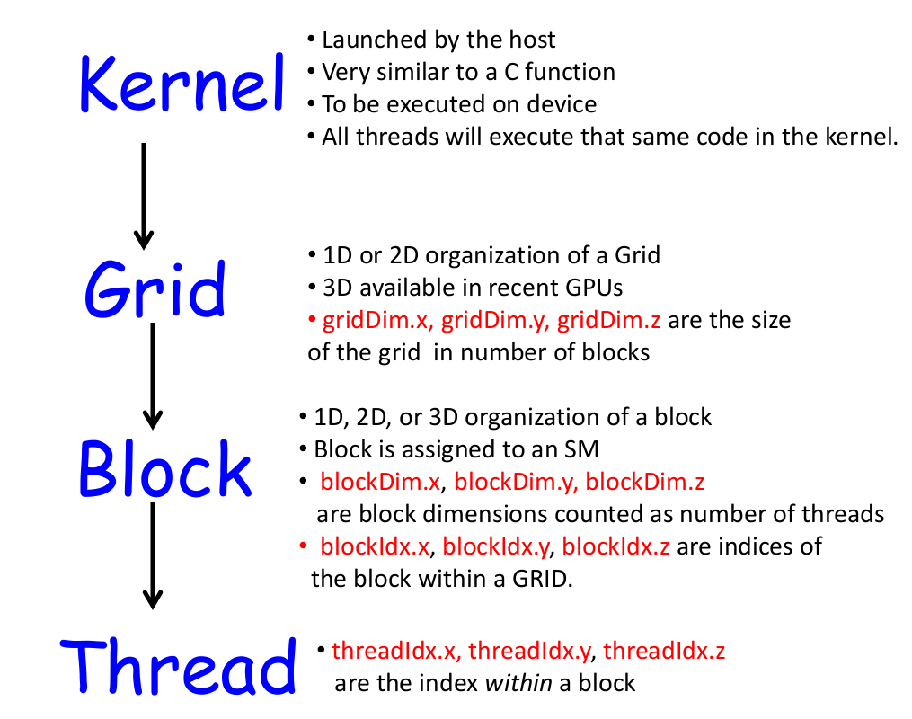

Slide 10

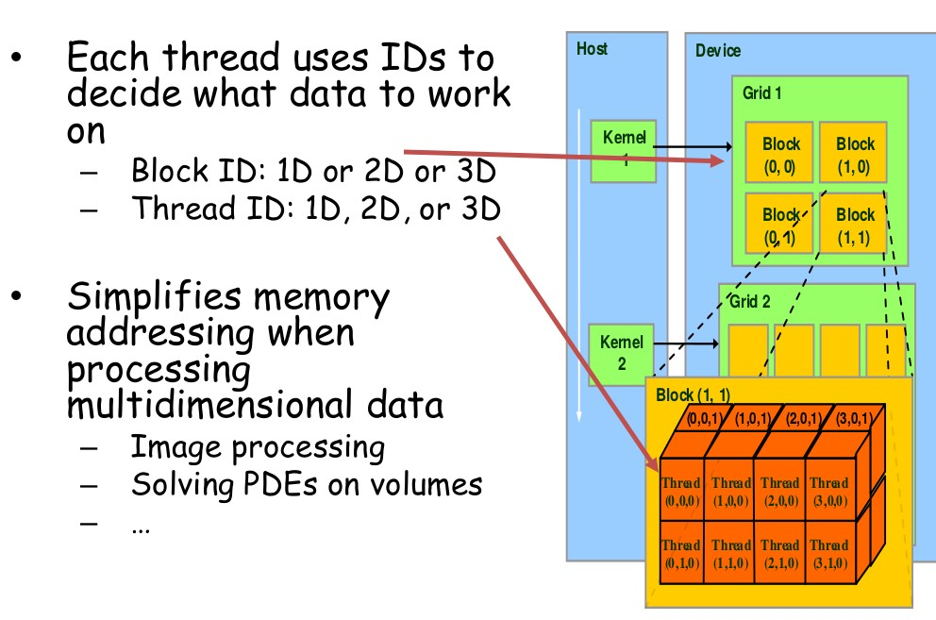

Slide 11
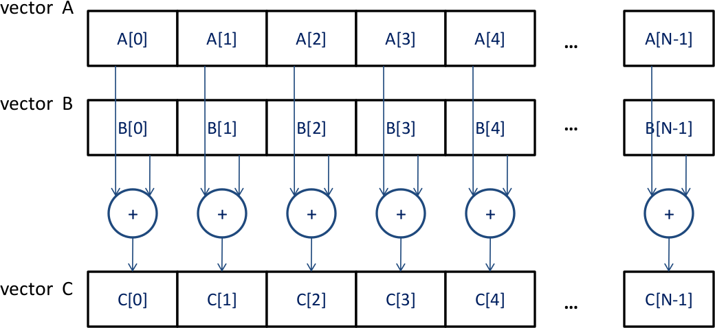

Slide 12
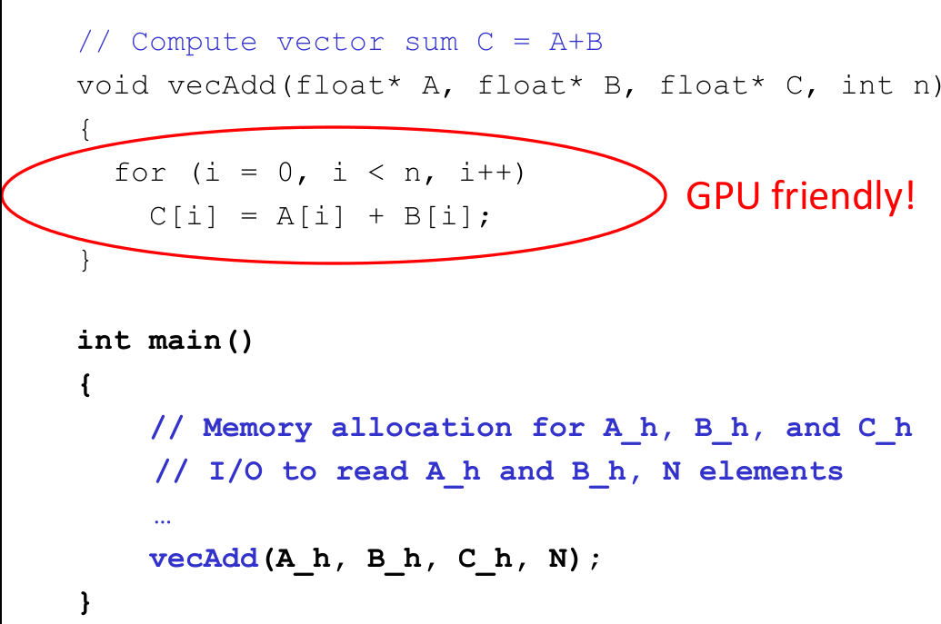

Slide 13
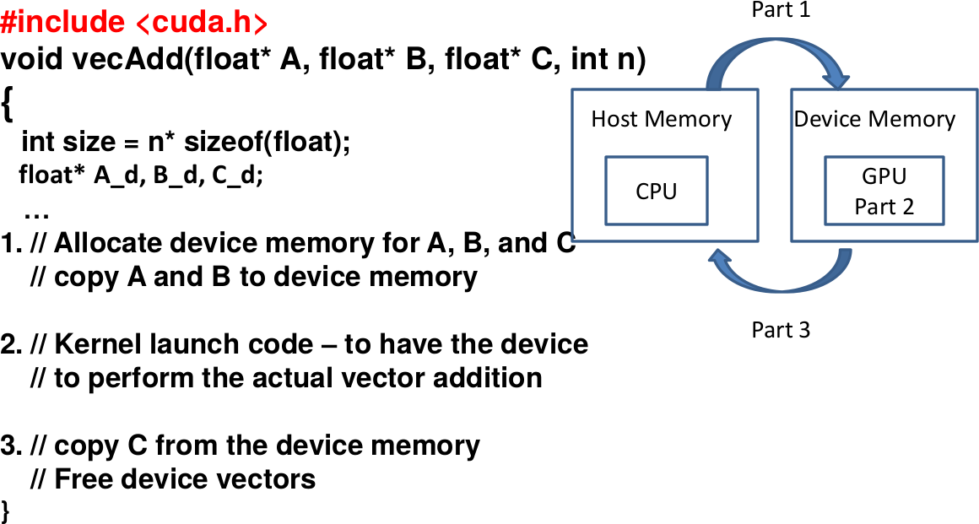

Slide 14
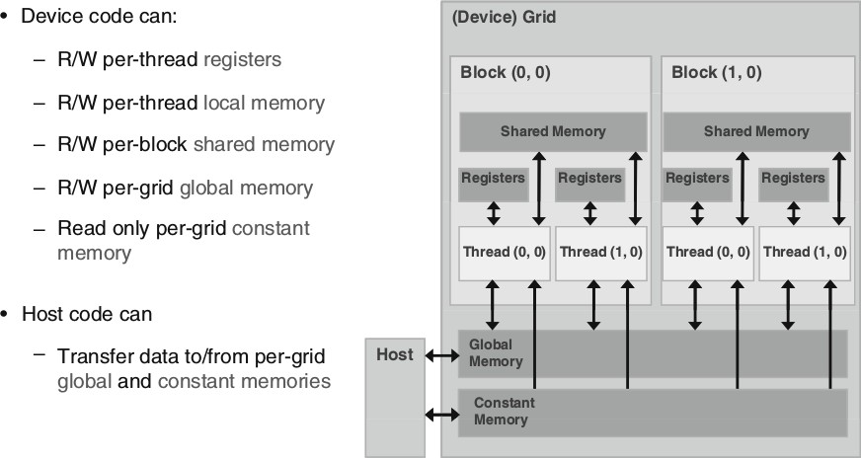

Slide 15

In CUDA, host and devices have separate memory spaces.
But in recent GPUs we have Unified Memory Access (UMA)
If GPU and CPU are on the same chip, then they share memory space → fusion

Slide 16
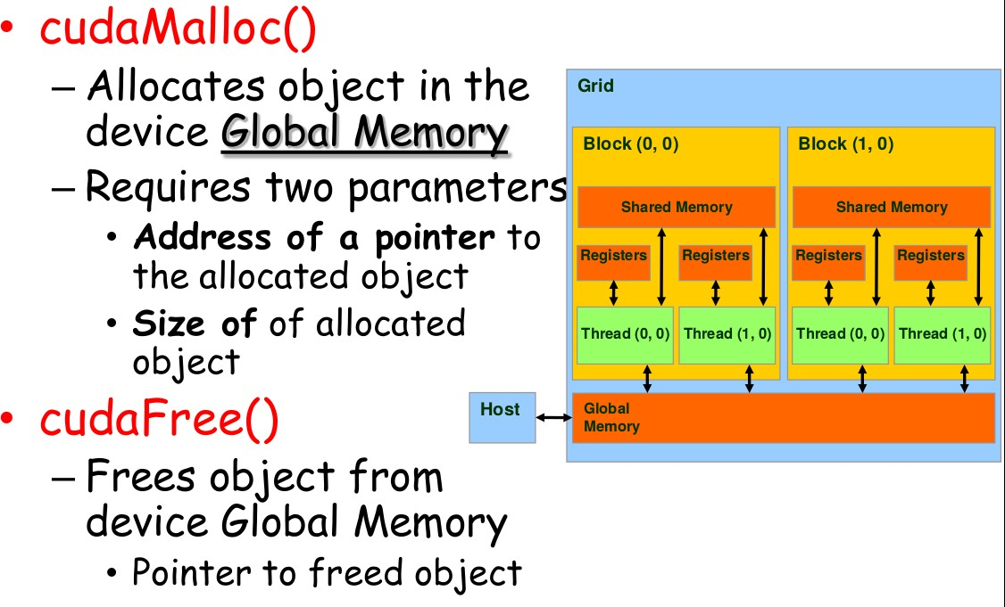

Slide 17
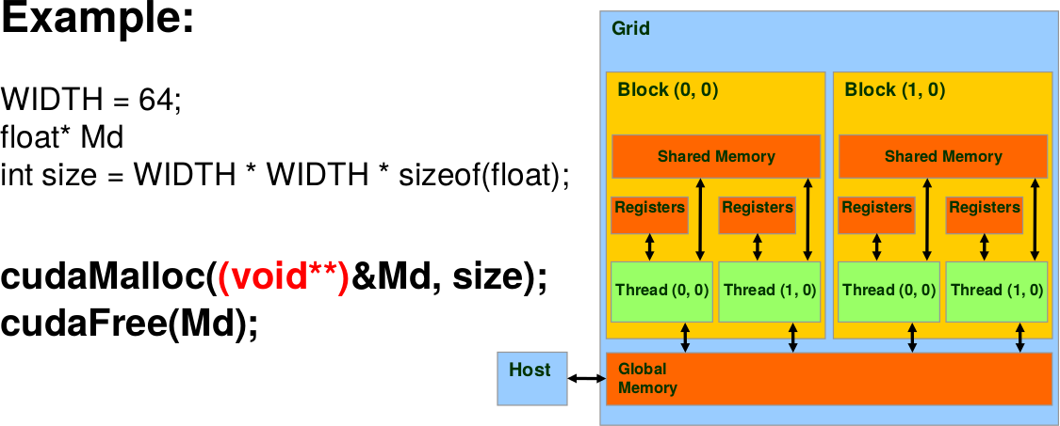

Slide 18
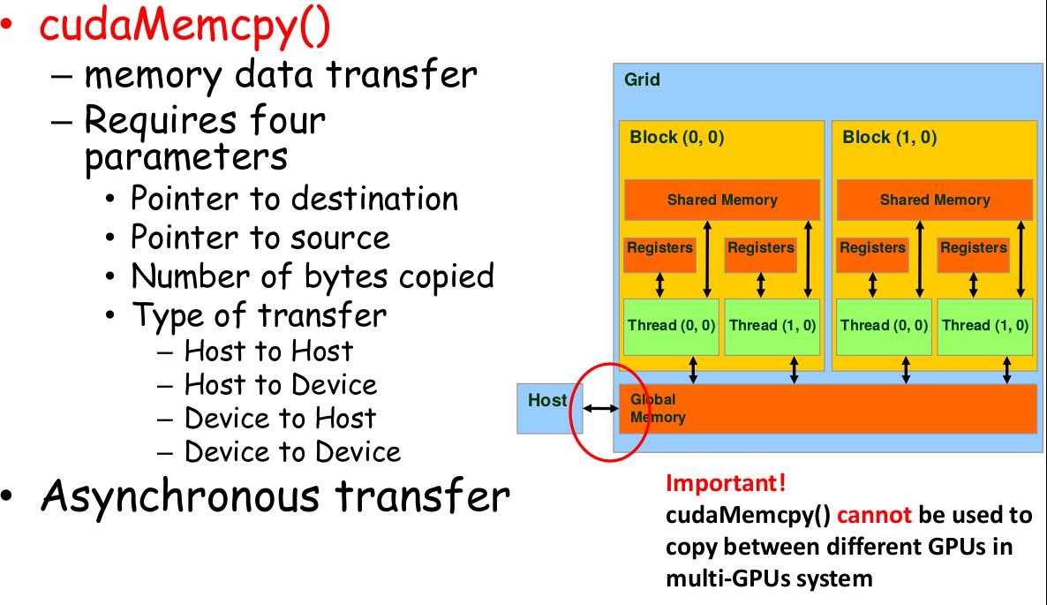

Slide 19
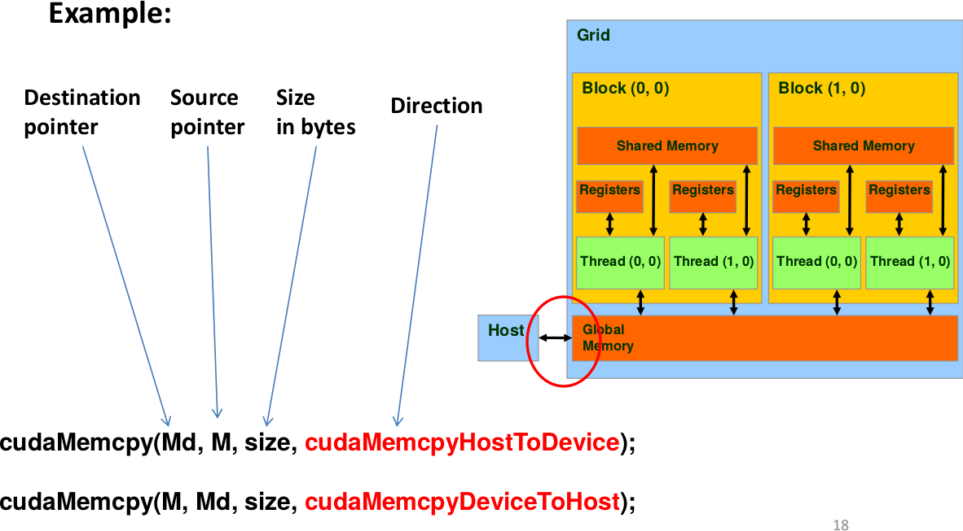

Slide 20
Almost all API calls return success or failure.
The type of the outcome is: cudError_t
Success → cudaSuccess
Translate the error code to an error message: char * cudaGetErrorString (cudaError_t error)

Slide 21
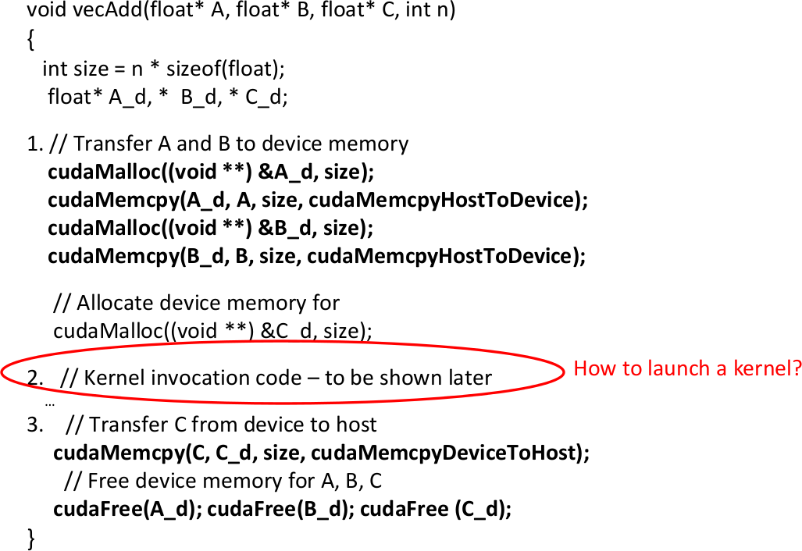

Slide 22
int vecAdd(float* A, float* B, float* C, int n)
{
// A_d, B_d, C_d allocations and copies omitted
// Run ceil(n/256) blocks of 256 threads each
vecAddKernel<<<ceil(n/256),256>>>(A_d, B_d, C_d, n);
}
// Each thread performs one pair-wise addition
global
void vecAddkernel(float* A_d, float* B_d, float* C_d, int n)
{
int i = threadIdx.x + blockDim.x * blockIdx.x; if(i<n) C_d[i] = A_d[i] + B_d[i];
}

Slide 23

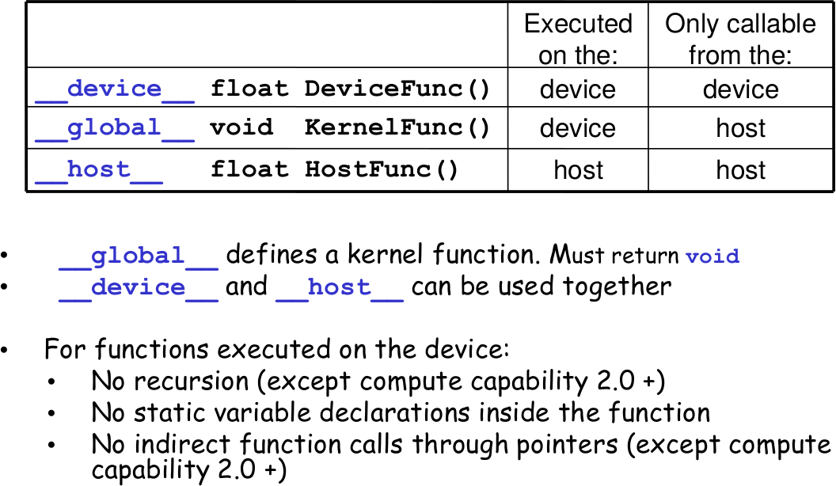

Slide 24
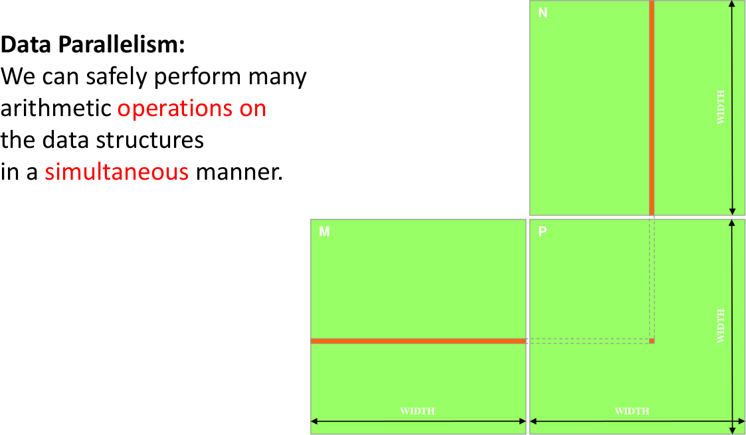

Slide 25
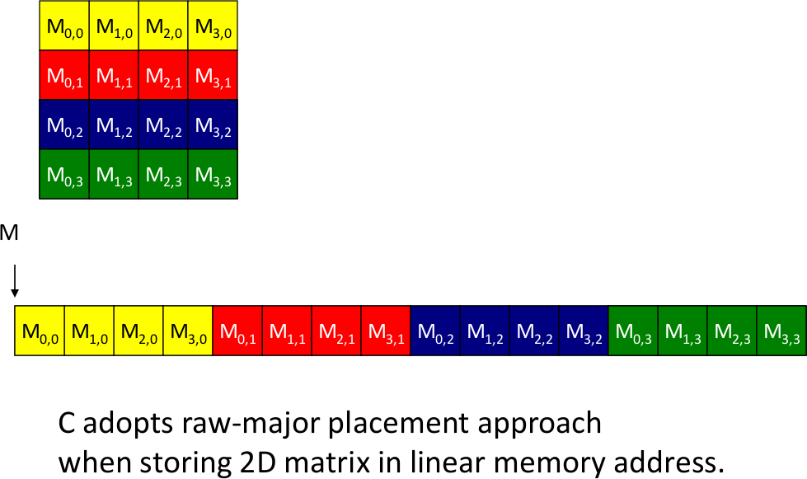

Slide 26
int main(void){
// 1: Allocate and initialize the matrices M, N and P
// I/O to read the input matrices M and N
…
// 2: Perform Matrix Multiplication MatrixMultOnHost(M, N, P, Width)
…
// 3: I/O to write the output matrix P
// Free matrices M, N, P
…
return 0;
}

Slide 27



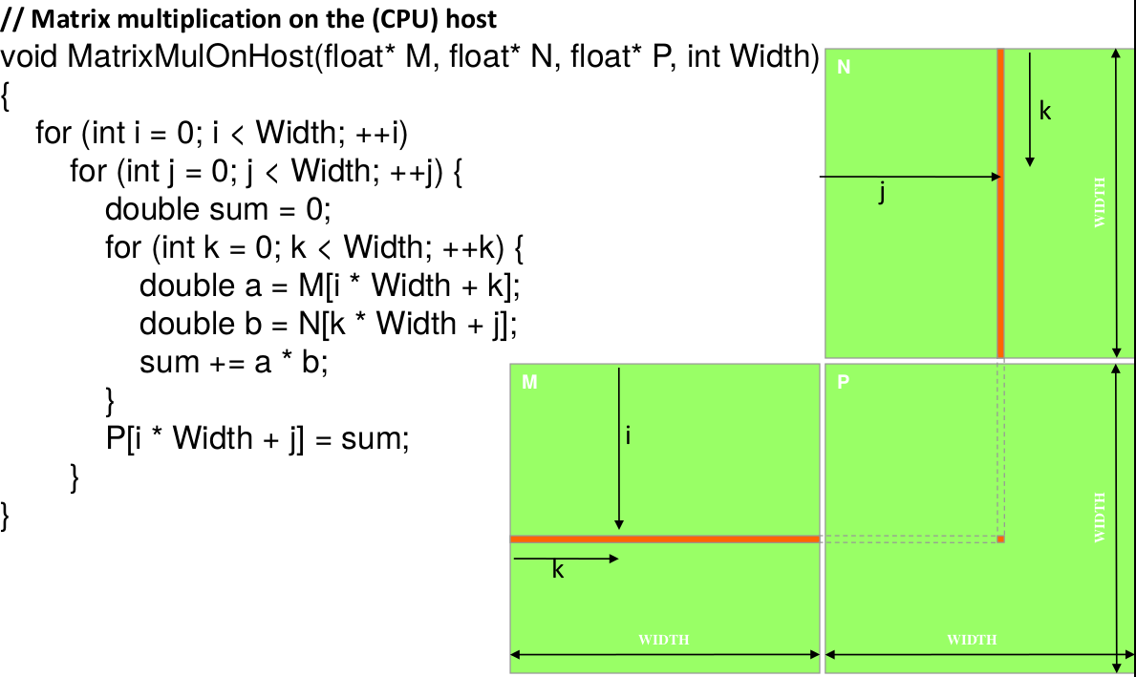

Slide 28
void MatrixMultiplication (float *M, float *N, float *P, int Width) { int size = Width * Width * sizeof(float);
float *Md, Nd, Pd;
// 1: Transfer M and N to device memory
cudaMalloc((void**), &Md, size);
cudaMemcpy(Md, M, size, cudaMemcpyHostToDevice);
cudaMalloc((void**), &Nd, size);
cudaMemcpy(Nd, N, size, cudaMemcpyHostToDevice);
// Allocate P on the device cudaMalloc((void**), &Pd, size);
// 2: Kernel invocation code -- to be shown later
// 3: Transfer P from device to host
cudaMemcpy(P, Pd, size, cudaMemcpyDeviceToHost);
// Free device matrices
cudaFree(Md); cudaFree(Nd); cudaFree(Pd);
}

Slide 29
// Matrix multiplication kernel - thread specification
global void MatrixMulKernel(float *Md, float *Nd, float *Pd, int Width)
{
// 2D Thread ID
int tx = threadIdx.x; int ty = threadIdx.y;
//Pvalue stores the Pd element that is computed by the thread
float Pvalue = 0;
for(int k = 0; k < Width; ++k) {
float Mdelement = Md[ty * Width + k] float Ndelement = Nd[k * Width + tx]
Pvalue += Mdelement * Ndelement;
}
// Write the matrix to device memory & each thread writes one element
Pd[ty * Width + tx] = Pvalue;
}

Slide 30
// Setup the execution configuration
dim3 dimGrid(x, y, z);
dim3 dimBlock(x, y, z);
// Launch the device computation threads!
MatrixMulKernel<<<dimGrid, dimBlock>>>(Md, Nd, Pd, Width);
Important:
dimGrid and dimBlock are user defined
gridDim and blockDim are built-in predefined variables accessible in kernel functions

Slide 31


Maximum dimensions of a block
Maximum number of threads per block
Maximum dimensions of a grid
Maximum number of blocks per grid

Slide 32
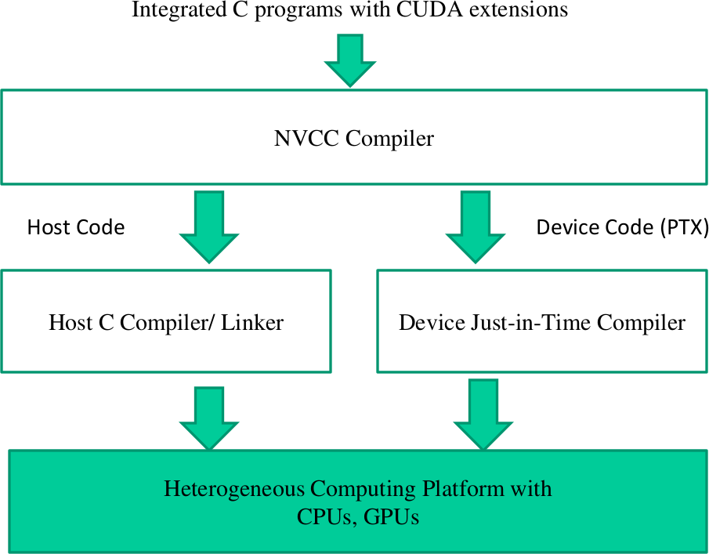

Slide 33

Data parallelism is the main source of scalability for parallel programs
Each CUDA source file can have a mixture of both host and device code.
What we learned today about CUDA:
KernelA<<< nBlk, nTid >>>(args)
cudaMalloc()
cudaFree()
cudaMemcpy()
gridDim and blockDim
threadIdx and blockIdx
dim3

