Slide 1
Corporate Finance
Cheat sheet

Slide 2
Different Types of Costs
Fixed costs: these costs do not vary with volume.
Ex. Monthly payments for plant, property, equipment
Variable & Semivariable costs: costs that vary with volume
Ex. Cost for materials used to produce a product; more materials are needed to make more units of production
Ex. Semivariable: cost for salaried employees who get commission on sales
Direct costs: costs that can be attributed to the production of a specific product
Ex. Cost for raw materials or labor hours to produce the product
Indirect costs (overhead): costs that cannot be attributed to the production of a specific product
Ex. Legal fees, SG&A, insurance
Ex. Manufacturing overhead. Costs incurred in the factory operations other than the costs of direct materials and direct labor. (depreciation or rent of factory/equipment, supervisory salaries, QC dept, utility cost for running the factory.

Slide 3
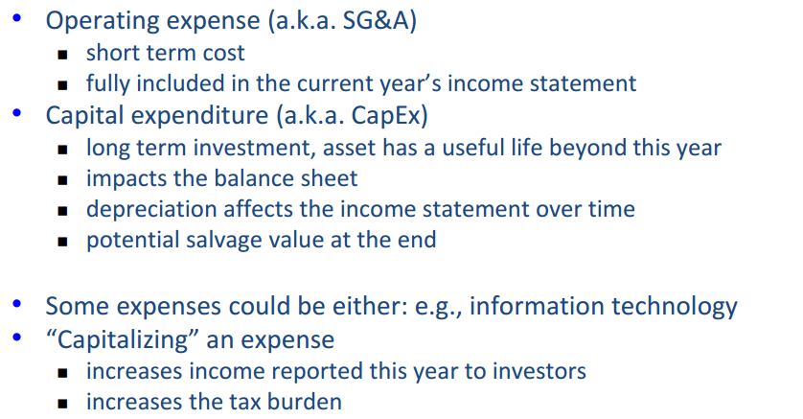
Different Types of expenses

Slide 4
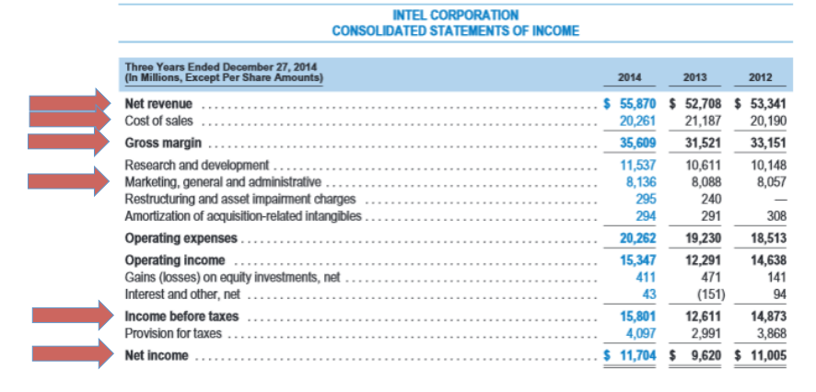
Income statement
Net Revenue – COGS = Gross Margin
Gross Margin – Operating expenses (Op Ex) = Operating Income
Op Ex – SG&A (Sales, General and administrative expenses) = EBITDA
EBITDA – (Depreciation and Amortization) = EBIT (Op Inc)
Op Inc – taxes and interest = Net Income
Op Ex includes Sales, General and Administrative expenses
Amortization accounts for the reduction in value of an intangible asset, e.g. goodwill

Slide 5
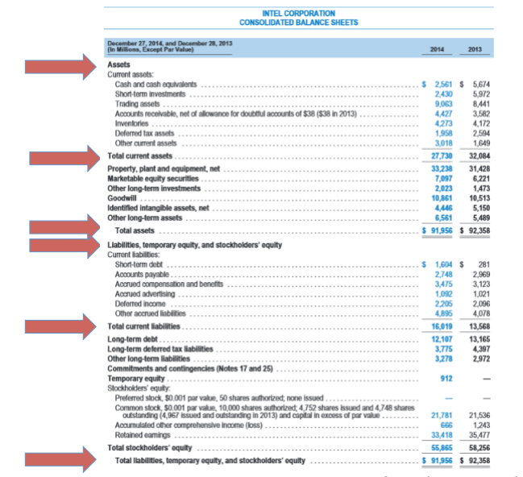
Balance Sheet
Current Assets examples: A/C receivable, Inventory, marketable securities, prepaid expenses
Long term assets: Plant, properties, other fixed assets, goodwill
Current liabilities: A/C payable, accrued expenses, other short term debt
Long term liabilities: long term debt like mortgage, bonds, etc
Equity: paid in capital and retained earnings.
The net income from the Income Statement is equal to the increase in Retained Earnings on the Balance Sheet
Assets = Liabilities + Equity

Slide 6
Working capital
Working capital = current Assets – current liabilities
Current ratio = Current Assets/Current liabilities
>1 and <2 is healthy. >2 implies too much inventory or excess cash
Acid Test = (Cash + Accounts Receivable + Short Term Investments) / Current Liabilities
More stringent.
Excludes inventory
Working capital turnover = Sales/Working capital
Higher number is better as it suggests that the company is generating more sales compared to the money used to fund the sales
Negative working capital is not always bad. It works for companies that are able to collect revenues before having to pay for materials. (i.e firm works with other entity’s money)

Slide 7
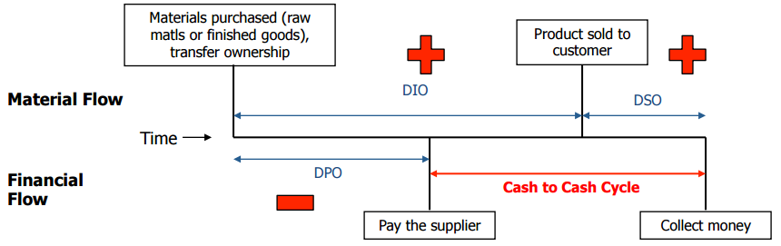
Cash conversion cycle (CCC)
CCC expresses the amount of time (in days) that a company uses to sell inventory, collect receivables and pay its accounts payable
CCC = DIO + DSO – DPO
DIO = Days of inventory outstanding. Measures how long to convert inventory into sales
DIO = (Average Inventory/COGS) x 365
DSO = Days of sales outstanding. Days required to collect payment on A/R.
DSO = (Average Acc Receivable/Total Sales) x 365
DPO = Days of payments outstanding. Days required to pay A/P.
DPO = (Average Acc Payable/COGS) x 365
Working capital = current Assets – current liabilities
WC = A/R + Inventory – A/P + Other
WC = CCC + Other

Slide 8
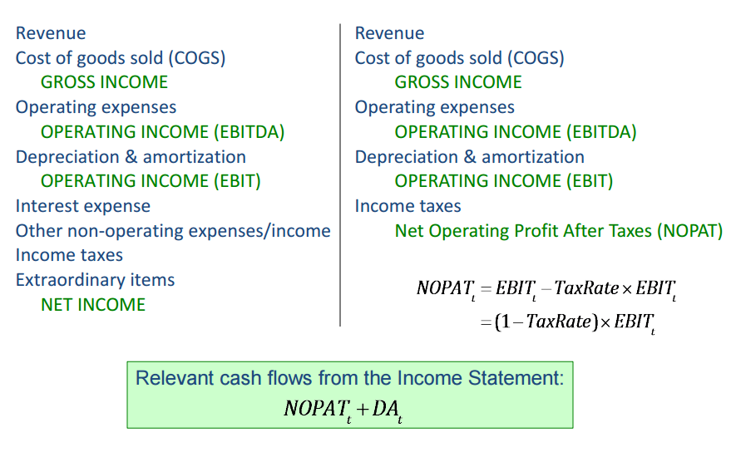
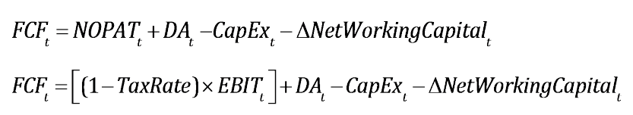
Cash flows
Cash flow = money received – money paid out
Cash flow is not
Accrual accounting transactions. (ex. Income registered when earned, before cash is received)
Accounting costs not related to cash movement (ex. Depreciation)
Nominal cash flows account for inflation. Real cash flows don’t.
Depreciation is not a relevant cash flow, but it impacts taxes which are relevant cash flows.
FCF = free cash flow
Relevant cash flow from Balance Sheet

Slide 9
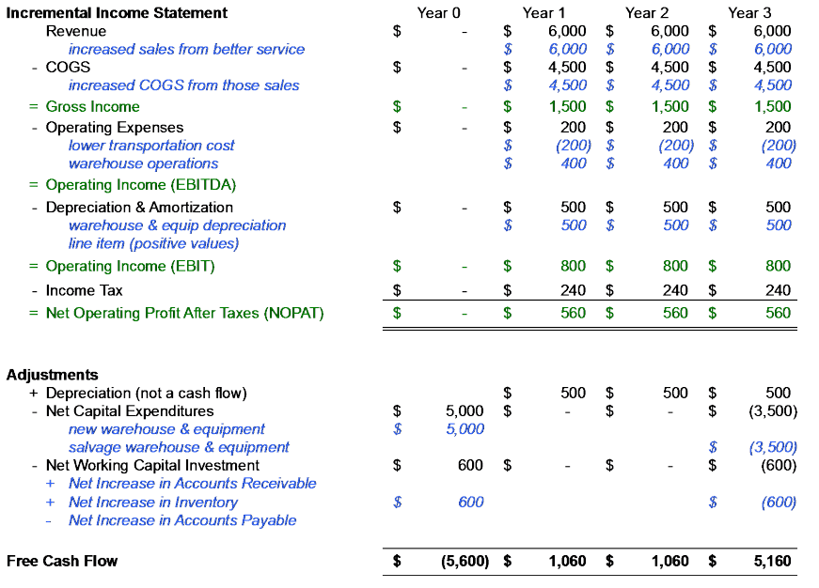
Sample FCF – from hypothetical project
Hypothetical project assumes cash flow from a project that involves construction of a new warehouse.

Slide 10
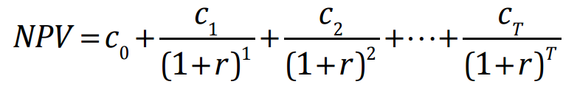
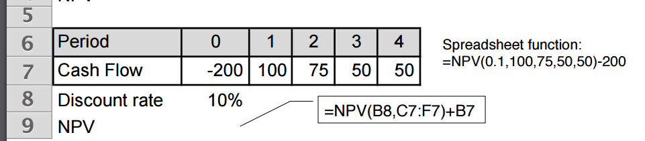
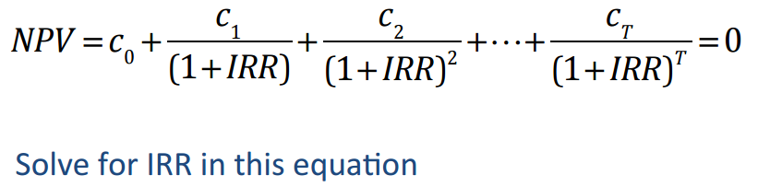
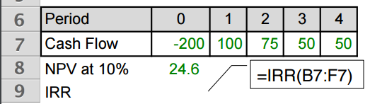
KPIs for investment decisions
Investment decisions can be made on the basis of:
Payback period: Time taken for the cumulative cash flows = Initial investment
Simple and provides rough measure of investment risk
Ignores timing of cash flow and periods after payback period
Return on asset (ROA): Net Income / Assets
Simple and linked to financial statements
Not based on cash flow
NPV: net present value … accounts for future cash flow in present terms.
In the figure r = discount rate*, C0 = cash flow in the first period (usually negative because it usually represents CAPEX), C1 = cash flow in second year, …..
Second figure shows how to do it in excel
Quantifies actual value created, uses cash flow and incorporates time value of money
Very dependent on selecting the correct discount rate
Internal Rate of Return (IRR): It is the discount rate at which NPV is 0
Uses cash flow, incorporates time value of money
Not dependent on discount rate selection
With some cash flows, you may get varying IRRs or none whatsoever.
Discount Rate*: Investor’s expected rate of return.
For example: S&P 500 CAGR at 6% can be used as benchmark

Slide 11
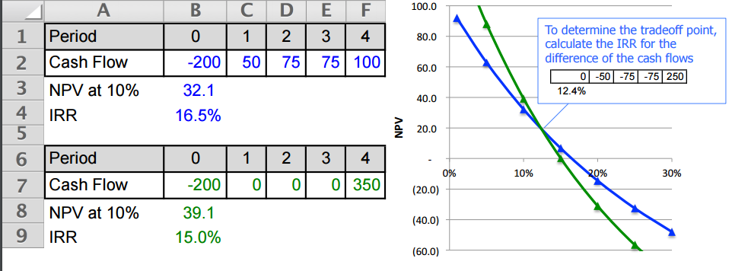
NPV v/s IRR
Discount Rate →

Slide 12


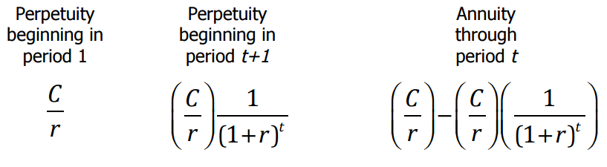
Terminal value, perpetuity and annuity
Terminal value: Present value of all cash flows that occur after project period “T”.
Perpetuity: estimated value of stable flows that continue indefinitely.
Annuity: estimated value of stable flows that continue for a definite period after “T”.
Example:
Commercial real estate is constructed for 3 Million dollars.
Depreciation period = 20 years.
Net Income for first 20 years = Rental incomes – opex – depreciation
After 20 years: stable cash flow = rental incomes – opex = C (stable cash flow)
Figure 1 shows Perpetuity calculation
Figure 2 shows annuity calculation
Annuity in spreadsheet: Use PV(discount rate, number of periods, stable cashflow)
Returns negative number.
Example: =PV(0.1,5,2700)*(-1) … use *(-1) to convert to positive number
Returns 10,235
Perpetuity in spreadsheet. Same example as above = C/r = 2700/0.1 = 27000
Perpetuity
Annuity
Calculating Annuity

Slide 13
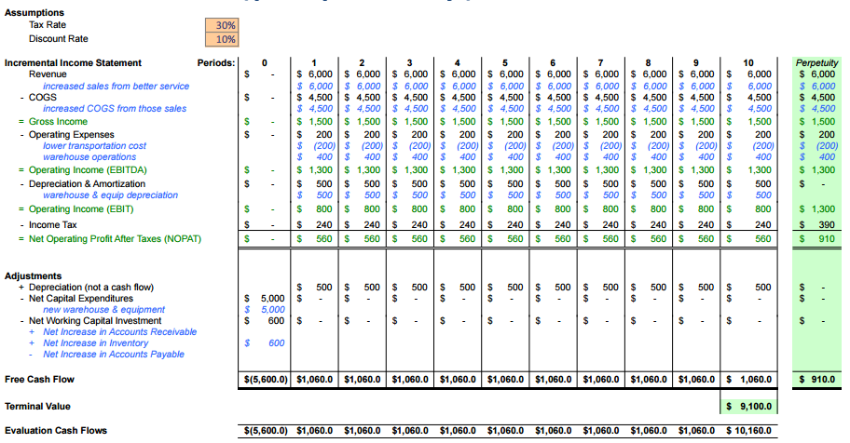
Sample perpetuity – from hypothetical project
Hypothetical project assumes cash flow from a project that involves construction of a new warehouse.

Slide 14
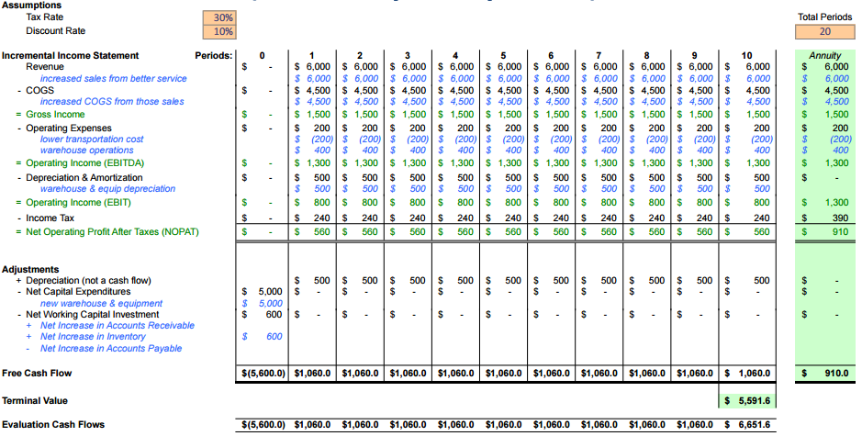
Sample annuity – from hypothetical project
Hypothetical project assumes cash flow from a project that involves construction of a new warehouse.

