Slide 1
HDInsight - introduction
HDInsight is a cloud implementation (on Microsoft Azure) of the rapidly expanding Apache Hadoop technology
It includes implementations of Apache Spark, HBase, Storm, Pig, Hive, Sqoop, Oozie, Ambari, and so on
HDInsight provides cluster configurations for Apache Hadoop, Spark, HBase, or Storm.
Hadoop (the "Query" workload): Provides reliable data storage with HDFS, and a simple MapReduce programming model to process and analyze data in parallel.
Apache Spark: A parallel processing framework that supports in-memory processing to boost the performance of big-data analysis applications, Spark works for SQL, streaming data, and machine learning.
HBase (the "NoSQL" workload): A NoSQL database built on Hadoop that provides random access and strong consistency for large amounts of unstructured and semi-structured data - potentially billions of rows times millions of columns. See Overview of HBase on HDInsight.
Apache Storm (the "Stream" workload): A distributed, real-time computation system for processing large streams of data fast. Storm is offered as a managed cluster in HDInsight. See Analyze real-time sensor data using Storm and Hadoop.

Slide 2

HBase - introduction
HBase
HDFS
Hbase is A low-latency, NoSQL database built on Hadoop
Stores data as Key Value pairs.
Modeled on Google’s BigTable
HBase stores data in StoreFiles on HDFS

Slide 3
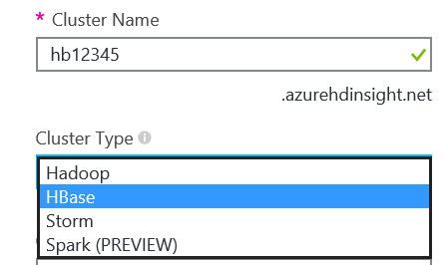
HBase – implementing on HDInsight
HDInsight supports an HBase cluster type
Choose Cluster Type in the Azure Portal
You can also specify ClusterType in PowerShell
Creates a Windows or Linux-based Hadoop cluster that includes HBase
Can be provisioned in a virtual network (useful if you want to connect your Hbase cluster in the cloud with on premise network)
FYI Only – YARN is the engine that runs and coordinates the jobs on HD Insight cluster
New-AzureHDInsightCluster -ClusterType HBase

Slide 4
HBase – Data Structure
Data is stored as key-value pairs
Table schema arranges values into column families
Column family schema is flexible
Columns are row-specific
readings
key | value
1 | {Sensor1, 2015-01-01, 125.9}
2 | {Sensor2, 2015-01-01, 152.3}
3 | {Sensor1, 2015-01-02, 87.3}
4 | {Sensor2, 2015-01-02, 151.8}
readings
key | sensor | reading
1 | Sensor1 | 2015-01-01 | 125.9
2 | Sensor2 | 2015-01-01 | 152.3
3 | Sensor1 | 2015-01-02 | 87.3
4 | Sensor2 | 2015-01-02 | 151.8
readings
key | sensor | reading
 | id | datetime | value
1 | Sensor1 | 2015-01-01 | 125.9
2 | Sensor2 | 2015-01-01 | 152.3
3 | Sensor1 | 2015-01-02 | 87.3
4 | Sensor2 | 2015-01-02 | 151.8
readings
key | sensor |  | reading
 | id | location | datetime | value
1 | Sensor1 |  | 2015-01-01 | 125.9
2 | Sensor2 |  | 2015-01-01 | 152.3
3 | Sensor1 |  | 2015-01-02 | 87.3
4 | Sensor2 |  | 2015-01-02 | 151.8
5 | Sensor1 | Building 1 | 2015-01-03 | 126.3

Slide 5
HBase – Data Structure
Cells in a table are versioned
Each versioned cell value is indicated by a timestamp
readings
key | sensor |  | reading
 | id | location | datetime | value
1 | Sensor1 |  | 2015-01-01 | 125.9
2 | Sensor2 |  | 2015-01-01 | 152.3
3 | Sensor1 |  | 2015-01-02 | 87.3
4 | Sensor2 |  | 2015-01-02 | 151.8
5 | Sensor1 | Building 1 | 2015-01-03 | 126.3
127.1
147152436 | 126.3
147152442 | 127.1

Slide 6
How Do You Work with an HBase Table? CRUD on HBase

Slide 7
readings
key | sensor | reading
create 'readings', 'sensor', 'reading‘
Create “readings” table with 2 column placeholders called sensor and reading
Notes:
To create a table, use the create statement, specifying the table name followed by the column groups you want to define.
See http://wiki.apache.org/hadoop/Hbase/Shell for a full list of Hbase shell commands.

Slide 8
put 'readings', '2', 'reading:value', '157.6'
put 'readings', '2', 'reading:value', '152.3'
put 'readings', '2', 'reading:datetime', '2015-01-01'
put 'readings', '2', 'sensor:id', '2'
put 'readings', '1', 'reading:value', '125.9'
put 'readings', '1', 'sensor:id', 'Sensor1'
put 'readings', '1', 'reading:datetime', '2015-01-01'
put 'readings', '2', 'sensor:location', 'Building 2'
readings
key | sensor | reading
 | id | datetime | value
1 | Sensor1 | 2015-01-01 | 125.9
2 | Sensor2 | 2015-01-01
readings
key | sensor | reading
 | id | datetime | value
1 | Sensor1 | 2015-01-01 | 125.9
2 | Sensor2
readings
key | sensor |  | reading
 | id | location | datetime | value
1 | Sensor1 |  | 2015-01-01 | 125.9
2 | Sensor2 | Building 2 | 2015-01-01 | 157.6
readings
key | sensor | reading
 | id | datetime | value
1 | Sensor1 | 2015-01-01 | 125.9
readings
key | sensor | reading
readings
key | sensor | reading
 | id
1 | Sensor1
readings
key | sensor | reading
 | id | datetime
1 | Sensor1 | 2015-01-01
readings
key | sensor | reading
 | id | datetime | value
1 | Sensor1 | 2015-01-01 | 125.9
2 | Sensor2 | 2015-01-01 | 152.3
readings
key | sensor |  | reading
 | id | location | datetime | value
1 | Sensor1 |  | 2015-01-01 | 125.9
2 | Sensor2 | Building 2 | 2015-01-01 | 152.3
Notes:
Use put to insert a value into a cell. If the cell doesn’t already exist, it is created; otherwise a new timestamped version of the data is added to the cell.

Slide 9
get 'readings', '2'
readings
key | sensor |  | reading
 | id | location | datetime | value
1 | Sensor1 |  | 2015-01-01 | 125.9
2 | Sensor2 | Building 2 | 2015-01-01 | 157.6
COLUMN | CELL
sensor:id | timestamp=142361, value=Sensor2
sensor:location | timestamp=142366, value=Building 2
reading:datetime | timestamp=142363, value=2015-01-01
reading:value | timestamp=142381, value=157.6
Notes:
Use get to retrieve cells for the row. By default, the most recent timestamped versions of each cell is returned.

Slide 10
get 'readings', '2', {COLUMN => [reading:value]}
readings
key | sensor |  | reading
 | id | location | datetime | value
1 | Sensor1 |  | 2015-01-01 | 125.9
2 | Sensor2 | Building 2 | 2015-01-01 | 157.6
COLUMN | CELL
reading:value | timestamp=142379, value=152.3
Notes:
You can specify one or more COLUMN values to retrieve only those columns.

Slide 11
get 'readings', '2', {TIMERANGE => [0,142380]}
readings
key | sensor |  | reading
 | id | location | datetime | value
1 | Sensor1 |  | 2015-01-01 | 125.9
2 | Sensor2 | Building 2 | 2015-01-01 | 157.6
COLUMN | CELL
sensor:id | timestamp=142361, value=Sensor2
sensor:location | timestamp=142366, value=Building 2
reading:datetime | timestamp=142363, value=2015-01-01
reading:value | timestamp=142379, value=152.3
Notes:
Use TIMERANGE to get a timestamped version of the data.

Slide 12
scan 'readings'
readings
key | sensor |  | reading
 | id | location | datetime | value
1 | Sensor1 |  | 2015-01-01 | 125.9
2 | Sensor2 | Building 2 | 2015-01-01 | 157.6
readings
key | sensor |  | reading
 | id | location | datetime | value
1 | Sensor1 |  | 2015-01-01 | 125.9
2 | Sensor2 | Building 2 | 2015-01-01 | 157.6
3 | Sensor1 | Building 1 | 2015-01-02 | 87.3
4 | Sensor2 | Building 2 | 2015-01-02 | 151.8
5 | Sensor1 | Building 1 | 2015-01-03 | 126.3
6 | …
ROW | COLUMN+CELL
1 | column=sensor:id, timestamp=142356, value=Sensor1
1 | column=reading:datetime, timestamp=142357, value=2015-01-01
1 | column=reading:value, timestamp=142359, value=125.9
2 | column=sensor:id, timestamp=142361, value=Sensor2
2 | column=sensor:location, timestamp=142366, value=Building 2
2 | column=reading:datetime, timestamp=142363, value=2015-01-01
2 | column=reading:value, timestamp=142381, value=157.6
Notes:
Use scan to return multiple rows. By default, the latest timestamped version of each cell is returned.

Slide 13
scan 'readings', {LIMIT => 1}
readings
key | sensor |  | reading
 | id | location | datetime | value
1 | Sensor1 |  | 2015-01-01 | 125.9
2 | Sensor2 | Building 2 | 2015-01-01 | 157.6
3 | Sensor1 | Building 1 | 2015-01-02 | 87.3
4 | Sensor2 | Building 2 | 2015-01-02 | 151.8
5 | Sensor1 | Building 1 | 2015-01-03 | 126.3
6 | …
ROW | COLUMN+CELL
1 | column=sensor:id, timestamp=142356, value=Sensor1
1 | column=reading:datetime, timestamp=142357, value=2015-01-01
1 | column=reading:value, timestamp=142359, value=125.9
Notes:
You can use LIMIT to scan the first N rows.

Slide 14
scan 'readings', {STARTROW=>'2', STOPROW=>'3'}
readings
key | sensor |  | reading
 | id | location | datetime | value
1 | Sensor1 |  | 2015-01-01 | 125.9
2 | Sensor2 | Building 2 | 2015-01-01 | 157.6
3 | Sensor1 | Building 1 | 2015-01-02 | 87.3
4 | Sensor2 | Building 2 | 2015-01-02 | 151.8
5 | Sensor1 | Building 1 | 2015-01-03 | 126.3
6 | …
ROW | COLUMN+CELL
2 | column=sensor:id, timestamp=142361, value=Sensor2
2 | column=sensor:location, timestamp=142366, value=Building 2
2 | column=reading:datetime, timestamp=142363, value=2015-01-01
2 | column=reading:value, timestamp=142375, value=157.6
3 | column=sensor:id, timestamp=142371, value=Sensor1
3 | column=sensor:location, timestamp=142372, value=Building 1
3 | column=reading:datetime, timestamp=142373, value=2015-01-02
3 | column=reading:value, timestamp=142375, value=87.3
Notes:
You can use STARTROW and ENDROW to scan a range of rows

Slide 15
delete 'readings', '2', 'sensor:location'
readings
key | sensor |  | reading
 | id | location | datetime | value
1 | Sensor1 |  | 2015-01-01 | 125.9
2 | Sensor2 | Building 2 | 2015-01-01 | 157.6
3 | Sensor1 | Building 1 | 2015-01-02 | 87.3
4 | Sensor2 | Building 2 | 2015-01-02 | 151.8
5 | Sensor1 | Building 1 | 2015-01-03 | 126.3
6 | …
readings
key | sensor |  | reading
 | id | location | datetime | value
1 | Sensor1 |  | 2015-01-01 | 125.9
2 | Sensor2 |  | 2015-01-01 | 157.6
3 | Sensor1 | Building 1 | 2015-01-02 | 87.3
4 | Sensor2 | Building 2 | 2015-01-02 | 151.8
5 | Sensor1 | Building 1 | 2015-01-03 | 126.3
6 | …
Notes:
Use delete to insert a “delete” into a cell – this overrides any previous timestamped value.

Slide 16
deleteall 'readings', '4'
readings
key | sensor |  | reading
 | id | location | datetime | value
1 | Sensor1 |  | 2015-01-01 | 125.9
2 | Sensor2 |  | 2015-01-01 | 157.6
3 | Sensor1 | Building 1 | 2015-01-02 | 87.3
4 | Sensor2 | Building 2 | 2015-01-02 | 151.8
5 | Sensor1 | Building 1 | 2015-01-03 | 126.3
6 | …
readings
key | sensor |  | reading
 | id | location | datetime | value
1 | Sensor1 |  | 2015-01-01 | 125.9
2 | Sensor2 |  | 2015-01-01 | 157.6
3 | Sensor1 | Building 1 | 2015-01-02 | 87.3
5 | Sensor1 | Building 1 | 2015-01-03 | 126.3
6 | …
Notes:
Use deleteall to delete all cells in a specified row.

Slide 17
drop 'readings'
disable 'readings'
readings
key | sensor |  | reading
 | id | location | datetime | value
1 | Sensor1 |  | 2015-01-01 | 125.9
2 | Sensor2 |  | 2015-01-01 | 157.6
3 | Sensor1 | Building 1 | 2015-01-02 | 87.3
5 | Sensor1 | Building 1 | 2015-01-03 | 126.3
6 | …
readings
key | sensor |  | reading
 | id | location | datetime | value
1 | Sensor1 |  | 2015-01-01 | 125.9
2 | Sensor2 |  | 2015-01-01 | 157.6
3 | Sensor1 | Building 1 | 2015-01-02 | 87.3
5 | Sensor1 | Building 1 | 2015-01-03 | 126.3
6 | …
Notes:
First disable the table:
disable 'readings'
and then you can drop it:
drop ‘readings'

Slide 18
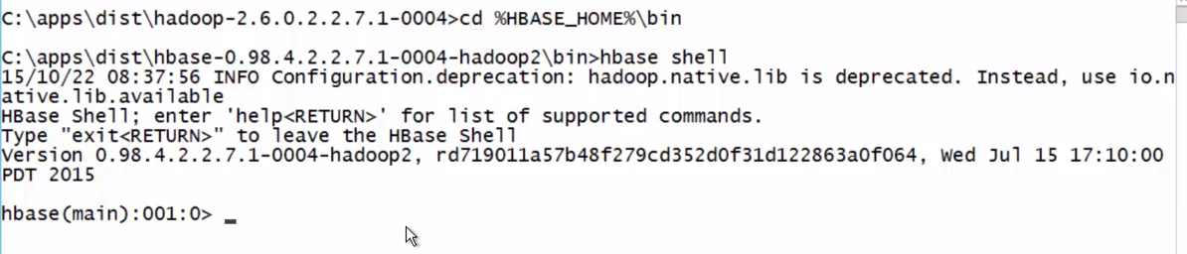
HBase – on HDInsight
Remote into the Hbase cluster from HDInsight dashboard
cd %HBASE_HOME%\bin …. is the short cut to the folder where the Hbase shell lives
“hbase shell” …. starts the hbsase shell
For list of linux commands go to https://help.ubuntu.com/community/UsingTheTerminal

Slide 19
HBase – Bulk load Data
Upload data to HDFS
in Azure Storage
Import into a StoreFile
Load The StoreFile to an HBase table
HBase
HDFS
ImportTSV
LoadIncrementalHFiles

Slide 20
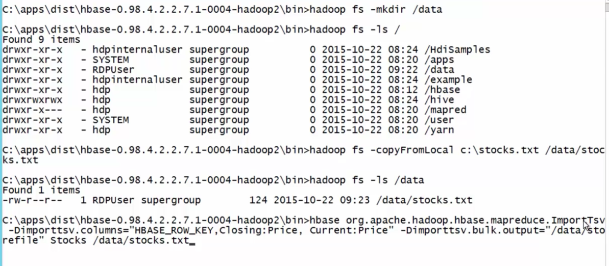
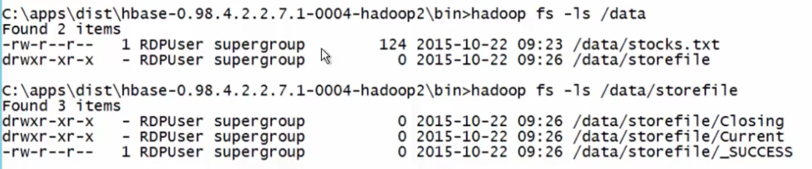
HBase – Bulk load data
Step 0: Using Technology like MoveIT, one can transfer the file to local file system
Step 1 Move file into HDFS file system
Make directory in the Hadoop cluster … hadoop fs – mkdir /data
hadoop fs – ls …. To list all files in the Hadoop cluster
Step 2: copy file from local file system … hadoop fs –copyFromLocal c:\filename.csv /data/filename.csv
Another way … hadoop fs -put filename.csv /user/hadoop/dir1/filename.csv
ls /data …. To review all files in the data folder
To load a lot of data using Map Reduce (from files from dir1 to dir3)
hadoop distcp /user/hadoop/dir1/ /user/hadoop/dir3/
Step 3: convert the file into the right format for Hbase (2nd bullet is for csv)
hbase org.apache.hadoop.hbase.mapreduce.ImportTsv -Dimporttsv.columns=”HBASE_ROW_KEY,colFamily1:column1,colFamily2:column1″ -Dimporttsv.bulk.output=”/example/data/storeDataFileOutput” t1 /example/data/data.tsv
hbase org.apache.hadoop.hbase.mapreduce.ImportTsv -Dimporttsv.columns=”HBASE_ROW_KEY,colFamily1:column1,colFamily2:column1″ -Dimporttsv.separator=”,” -Dimporttsv.bulk.output=”/example/data/storeDataFileOutput” t1 /example/data/data.tsv
You can verify using ls /data … look for storefile
Step 4: Import the data from storefile into the table that will be used for Hbase querying
hbase org.apache.hadoop.hbase.mapreduce.LoadIncrementalHFiles /data/storefile new_table
Step 5: Confirm that new_table is available by staring hbase shell and using scan ‘new_table', {STARTROW=>'2', STOPROW=>'3'}

Slide 21
Using HIVE to query Hbase
HIVE
SELECT…
HBase
CREATE EXTERNAL TABLE hivetable
(key STRING, col1 STRING, col2 STRING)
STORED BY 'org.apache.hadoop.hive.hbase.HBaseStoragehandler'
WITH SERDEPROPERTIES
('hbase.columns.mapping' = ':key,cf:col1, cf:col2')
TBLPROPERTIES('hbase.table.name' = 'hbtable')

Slide 22
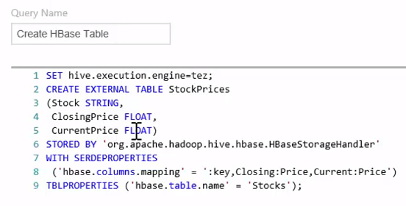
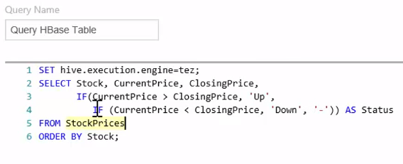
Using HIVE to query Hbase
Set up a query name (so that you can track the job on HDInsight dashboard)
Set hive execution to Tez for optimization. Tez can be used to process data, that earlier took multiple MR jobs, now in a single Tez job.
Create Hive table called “StockPrices”
Rows 3 – 5 establish the columns and column attributes (Float, string, etc) [http://www.tutorialspoint.com/hive/hive_data_types.htm]
The “STORED BY” clause points to HBASE (i.e. we are building this HIVE table on top of a HBASE table)
With SERDEPROPERTIES maps HIVE table columns to HBASE table columns
TBLPROPERTIES points to the underlying HBASE table
Now you can run queries on top of the HIVE table. (don’t forget to set up the query name)
Just remember, you cannot use HIVE to update the underlying Hbase tables. Its good for reading data, and using SQL like syntax to query underlying Hbase tables.

Slide 23
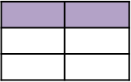
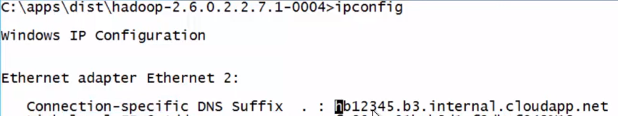

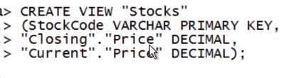

Using PHOENIX to query Hbase
Apache Phoenix
Relational database engine built on HBase
Included in Azure HDInsight
Can be used to create Hbase tables or map to an existing Hbase table using read-write TABLE or a read-only VIEW
JDBC Interface
Clients connect using JDBC
SQLLine client included in HDInsight
>SELECT
JDBC
Apache Phoenix
HBase
Notes:
See https://phoenix.apache.org/

Slide 24
STORM

Slide 25

01100101
01100101
01100101
01100101
01100101
01100101
01100101
01100101
01100101
What is Stream → A unbounded sequence of event data
Stream processing is continuous
Aggregation is based on temporal windows

Slide 26
Introducing Storm
What is Storm? An event processor for data streams
Defines a streaming topology that consists of:
Spouts: Consume data sources and emit streams that contain tuples
Bolts: Operate on tuples in streams. (operation examples: aggregate, stores the data, splits the data, etc)
Storm topologies run continuously on streams of data
Real-time monitoring
Event aggregation and logging
HDInsight supports an Storm cluster type
Choose Cluster Type in the Azure Portal
OR … Specify ClusterType in PowerShell
Creates a Windows or Linux-based Hadoop cluster that includes Storm
Can be provisioned in a virtual network
Spout
Bolt

Slide 27
Storm topology
Spouts emit tuples in streams
Spouts can emit multiple streams
Bolts process tuples
Bolts can also emit tuples
There can be multiple spouts and bolts in a topology
Bolts can process multiple streams
Spout
Bolt
Bolt
Bolt
Spout
Bolt
Notes:
http://storm.apache.org/documentation/Concepts.html

Slide 28

Create a Storm topology
Implement Spout and Bolt classes
Native language of Storm is Java
Microsoft SCP.NET package enables development in C#
Use a TopologyBuilder class to connect the components
Build and package the code, and submit the topology to a Storm cluster
TopologyBuilder tb = new TopologyBuilder();
tb.setSpout ("spout", myspout,…);
tb.setBolt("bolt", mybolt…).shuffleGrouping("spout");
public class myspout
{
...
}
public class mybolt
{
...
}
Notes:
http://storm.apache.org/documentation.html
https://github.com/hdinsight/hdinsight-storm-examples/blob/master/SCPNet-GettingStarted.md

Slide 29
SPARK

Slide 30

What is SPARK?
A fast, general purpose computation engine that supports in-memory operations
A unified stack for interactive, streaming, and predictive analysis
Can run in Hadoop clusters
Why is SPARK faster than MR?
One of the main limitations of MapReduce is that it persists the full dataset to HDFS after running each job. This is very expensive, because it incurs both three times (for replication) the size of the dataset in disk I/O and a similar amount of network I/O. Spark takes a more holistic view of a pipeline of operations. When the output of an operation needs to be fed into another operation, Spark passes the data directly without writing to persistent storage.
The main innovation of Spark was to introduce an in-memory caching abstraction. This makes Spark ideal for workloads where multiple operations access the same input data. Users can OPTIONALLY instruct Spark to cache input data sets in memory, so they don't need to be read from disk for each operation.
What about Spark jobs that would boil down to a single MapReduce job? In many cases also these run faster on Spark than on MapReduce. The primary advantage Spark has here is that it can launch tasks much faster. MapReduce starts a new JVM for each task, which can take seconds with loading JARs, JITing, parsing configuration XML, etc. Spark keeps an executor JVM running on each node, so launching a task is simply a matter of making an RPC to it and passing a Runnable to a thread pool, which takes in the single digits of milliseconds
A misconception: a common misconception probably worth mentioning is that Spark somehow runs entirely in memory while MapReduce does not. This is simply not the case. Spark's shuffle implementation works very similarly to MapReduce's: each record is serialized and written out to disk on the map side and then fetched and deserialized on the reduce side

Slide 31
SPARK Architecture
The core abstraction for data in Spark is the resilient distributed dataset (RDD)
An RDD represents a collection of items that can be distributed across compute nodes
Distributed processing architecture consists of:
A driver program
One or more worker nodes
The driver program uses a spark context to connect to the cluster…
…and uses worker nodes to perform operations on RDDs
Tasks
Executor
Worker Node
Spark Context
Driver Program
Tasks
Executor
Worker Node

Slide 32
SPARK Context and RDD
To create a Spark Context:
Create a configuration for your cluster and application
Use the configuration to create a context
(Spark shells have one pre-created)
To create an RDD
Load from a source
Text file, JSON, XML, etc.
Parallelize a collection (if for example you already have list in python)
sc.textFile delimiter is a new line (as FYI)
For json go to https://databricks.com/blog/2015/02/02/an-introduction-to-json-support-in-spark-sql.html
Cluster URL
cfg = SparkConf().setMaster("local").setAppName("App")
sc = SparkContext(conf = cfg)
Your application name
Path to file
(default text delimiter is newline)
txtRDD = sc.textFile("/data/tweets.txt")
lstRDD = sc.parallelize(["A", "B", "C"])
List

Slide 33
SPARK Operations
RDD operations include:
Transformations
Create a new RDD by transforming an existing one
Actions
Return results to the driver program or an output file
Spark uses Lazy Evaluation
No execution occurs until an action
RDDs are recomputed with each action
Use persist action to retain in memory
Persist is used when RDD may be used in other computations, especially if it requires significant com
Inline function
msTwts = txtRDD.filter(lambda t: "#ms" in t)
msTwts.count()
msTwts.persist()

Slide 34
Common Transformations:
txt = sc.parallelize(["the owl and the pussycat",
"went to sea"])
filter: Creates a filtered RDD
flatMap: Applies a function to each element that returns multiple elements into a new RDD
map: Applies a function to each element that returns an element in a new RDD
reduceByKey: Aggregates values for each key in a key-value pair RDD
As FYI … flatmap will return multiple items for each item in source, whereas map will return 1 item for each item.
{["the owl and the pussycat"], ["went to sea"]}
owlTxt = txt.filter(lambda t: "owl" in t)
{["the owl and the pussycat"]}
words = owlTxt.flatMap(lambda t: t.split(" "))
{["the"], ["owl"], ["and"], ["the"], ["pussycat"]}
kv = words.map(lambda key: (key, 1))
{["the",1], ["owl",1], ["and",1], ["the",1], ["pussycat",1]}
counts = kv.reduceByKey(lambda a, b: a + b)
{["the",2], ["owl",1], ["and",1], ["pussycat",1]}

Slide 35
Common Actions:
nums = sc.parallelize([1, 2, 3, 4])
reduce: Aggregates the elements of an RDD using a function that takes two arguments
count: Returns the number of elements in the RDD
first: Returns the first element in the RDD
collect: Returns the RDD as an array to the driver program
saveAsTextFile: Saves the RDD as a text file in the specified path
For more info: http://spark.apache.org/docs/1.3.1/programming-guide.html
To run a standalone application:
Use the spark-submit script
{[1], [2], [3], [4]}
nums.reduce(lambda x, y: x + y)
9
nums.count()
4
nums.first()
1
nums.collect()
spark-submit c:\myscript.py
[1, 2, 3, 4]
nums.saveAsTextFile("/results")
/results/part-00000

Slide 36
SPARK SQL
Spark SQL provides a query interface for structured data
DataFrames are used to abstract RDDs and define a schema
There are two API entry points:
HiveContext (use if you want to query existing HIVE tables on the Hadoop cluster)
SQLContext (light weight and to be used when you want to query your own dataframe)
Client applications can connect to Spark SQL using JDBC
JDBC
HiveContext
SQLContext
SELECT * FROM …
DataFrame
Col1 | Col2 | Col3
ABCDEF | 1234567 | 891011
 | RDD
ABCDEF | 1234567 | 891011
… | … | …

Slide 37
Infer the schema of an RDD by using Reflection
Create a row and then create your dataframe by “inferring” the schema
Specify the schema programmatically
More formal. Define fields using StructField(“field name”, fieldType(), False) … false here means it wont allow NULL values
Then define schema using StructType
And then create your dataframe using createDataFrame
# Python
rows = txtRDD.map(lambda c: Row(name=c[0], email=c[1]))
contacts = sqlContext.inferSchema(rows)
# Python
fields = [StructField("name", StringType(), False), StructField("email", StringType(), False)]
schma = StructType(fields)
contacts = sqlContext.createDataFrame(txtRDD, schma)

Slide 38
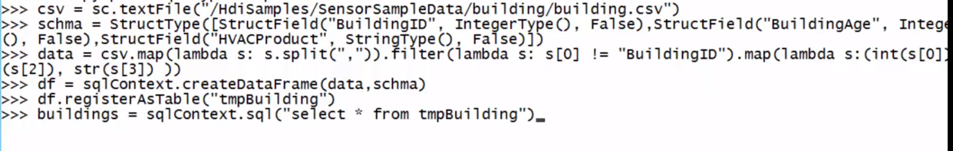
SPARK SQL Screenshots
Start pyspark
Import all SQL types
Create a CSV RDD from textFile
Create a schema for the dataFrame
Create another RDD from CSV called “data” with the relevant columns
Create the dataframe ‘df’ with the data and schema
Register the dataframe as a table called “tmpBuilding” so that you can run queries against the table
If required you can persist the table in HiveMetaStore.
For additional information:
http://spark.apache.org/docs/latest/sql-programming-guide.html
https://databricks-training.s3.amazonaws.com/data-exploration-using-spark-sql.html

