Slide 1

Band theory-Electron in a periodic potential
Course: Solid state physics
Referred books:
Solid state physics (Ashcroft & Mermin) Chapters 1-3, 8
Introduction to solid state physics (Charles Kittel) Chapters 6 & 7
Additional reading:
Group Theory – Application to the Physics of Condensed Matter (M.S. Dresselhaus, G. Dresselhaus and A. Jorio.)
Chapters 9, 10 and 13.
Why there are metal and insulators among solids?
Answer lies in the quantum mechanical behavior of electron
in a crystalline solid.

Slide 2
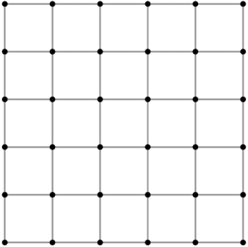
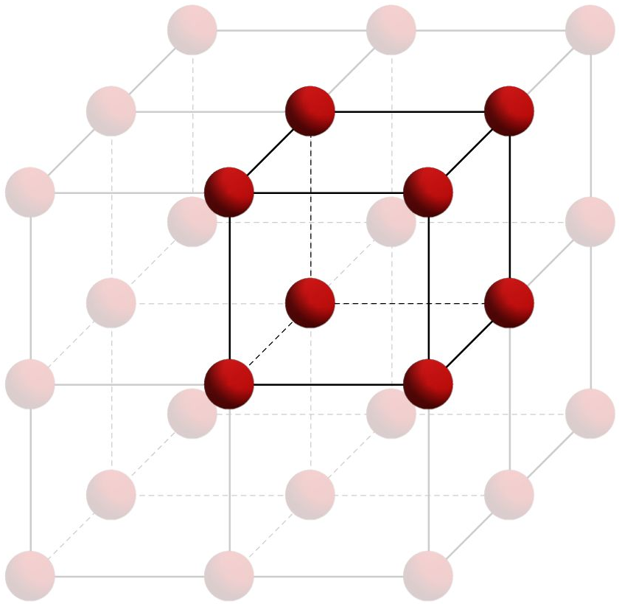
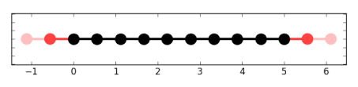
Electron in a periodic potential
A perfect crystal: regular periodic arrangement of ions
Examples:
Recap:
Bravais lattice :
lattice with points represented by position
vectors R of the form,
R = n₁a₁ + n₂a₂ +n₃a₃
where a_{i} are the primitive vectors which generate the lattice and n_{i} are all integer values.
1D chain
2D square
3D cubic
Electron in a crystal electron in a potential U(r) with periodicity of underlying
Bravais lattice i.e. U(r + R) = U(r)

Slide 3
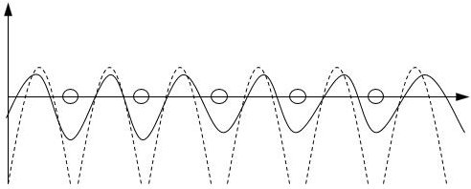


Electron in a periodic potential
Example of 1D chain:
A typical crystalline periodic potential:
U(r)
Ions
r
Recap:
de Broglie wavelength $λ=\frac{2π}{k}$ appears in the Sommerfeld free electron model.
Sommerfeld model: quantum mechanical extension of Drude’s classical electron gas model
Quantum Fermi-Dirac distribution of electronic velocity distribution rather than classical Maxwell-Boltzmann distribution of Drude Model.
U(r) must satisfy U(r) = U(r + R) if the crystal is perfectly periodic, independent of its detailed form.
We need to examine electronic motion in this perfectly periodic potential within quantum mechanical framework.
Why quantum mechanics needed for this problem?
Because scale of periodicity of U (~ Å) is size of a typical de Broglie wavelength.

Slide 4
Electron in a periodic potential
A typical crystalline periodic potential:
U(r)
Ions
r
Recap:
Full Hamiltonian of a periodic system $=H^{e−z}+H^{e−e}$
One-electron
Many-electron term
Treating electrons independently, above terms can be replaced by an effective one-electron potential U(r).

Slide 5





Electron in a periodic potential
We need to solve Schrodinger equation for a single electron with
U(r) = U(r + R),
Remark:
U(r) = 0 in this equation will lead to Schrodinger eq. for free electrons which is the Sommerfeld model.
$Hψ=\left[−\frac{ℏ2}{2m}∇2+U\left(r\right)\right]ψ=Eψ$
The independent single electrons obeying above equation are called Bloch electrons.
Recap:
As a direct consequence of periodic U, the eigenstates states $ψ$ of above Hamiltonian can have the form,
position vectors R are of lattice points in a Bravais lattice with,
R = n₁a₁ + n₂a₂ +n₃a₃
k is wave vector similar to the one appeared in Sommerfeld’s free electron gas model.
$$ψ_{nk}\left(r\right)= e^{ik⋅r}u_{nk}(r)$$
Bloch function
Plane waves
$$u_{nk}\left(r+\text{R}\right)= u_{nk}\left(r\right)$$
Remark:
From above,
Straightforward to see [H, T_{R}] = 0 where T_{R} is any translation operator defined on the Bravais lattice.
Show this.
$$ψ_{nk}\left(r+R\right)= e^{ik⋅R}ψ(r)$$
Alternative form of Bloch function

Slide 6




Electron in a periodic potential
$$ψ_{nk}\left(r\right)= e^{ik⋅r}u_{nk}(r)$$
Are the Bloch functions eigenstates of momentum operator $p=−iℏ∇$?
Answer: No. But why?
Recap:
Recall that for free electron case [U(r) = 0],
$$Hψ\left(r\right)=−\frac{ℏ^{2}}{2m}∇^{2}ψ\left(r\right)=Eψ(r)$$
Solution of the Schrodinger equation is given by,
$$ψ_{k}\left(r\right)=\frac{1}{\sqrt{V}}e^{ik⋅r}$$
with energy $E\left(k\right)=\frac{ℏ^{2}k^{2}}{2m}$
is also the eigenstate of momentum operator $p$.
U(r)
r
H is not completely translationally invariant becaue of the presence of non-contant potential U(r).
Hence, eigenstates of H cannot be simultaneous eigenstates of momentum operator $p$.

Slide 7




Electron in a periodic potential
$ψ$ which obeys Born-von Karman Boundary condition
Remark:
$$ψ\left(r+N_{i}a_{i}\right)=ψ\left(r\right) i=1,2,3$$
Can be expanded in the set of all plane wave satisfying the above condition.
i.e. $ψ\left(r\right)=\sum_{q}{c_{q}e^{iq⋅r}}$
(1)
Periodic potential U(r) can also be expand as,
Recap:
U(r) = $\sum_{k}{U_{k}e^{iK⋅r}}$
(2)
where K are the vectors of the recoprocal lattice.
Putting (1) and (2) in the Schrodinger eq. below,
$Hψ=\left[−\frac{ℏ2}{2m}∇2+U\left(r\right)\right]ψ=Eψ$

Slide 8



Electron in a periodic potential
We obtain set of Schrodinger eq in momentum space as,
Remark:
$$\left(\frac{ℏ^{2}}{2m}{\left(k−K\right)}^{2}\right)c_{k−K}+\sum_{K′}{U_{K′−K}}c_{k−K′}=Ec_{k−K}$$
Crystal momentum $k$ (in 1st BZ) can be view as a quantum number originated from the translational symmetry of the periodic potential.
Note: For fixed k, one will have many solutions to the above equation.
Hence, another index n is needed to label these solutions.
Recap:
Recall the form of Bloch function
$$ψ_{nk}\left(r\right)= e^{ik⋅r}u_{nk}(r)$$
Substituting it into the Schrodinger equation, for a fixed k, we have

Slide 9





Electron in a periodic potential
Substituting it into the Schrodinger equation, for a fixed k, we have the eigenvalue problem as,
Recall:
$$ψ_{nk}\left(r\right)= e^{ik⋅r}u_{nk}(r)$$
$$H_{k}unk\left(r\right)=\left(\frac{ℏ^{2}}{2m}{\left(−i∇+k\right)}^{2}+U\left(r\right)\right)unk\left(r\right)=E_{nk}unk\left(r\right)$$
Remark:
How do we solve this eigenvalue problem?
with boundary condition $u_{nk}\left(r+\text{R}\right)= u_{nk}\left(r\right)$
Things to note:
For two k values differ only by reciprocal lattice vector, eigenfunctions and eigenvalues must be identical.
Energy levels represented by eigenvalues $E_{nk}$is periodic function of k and vary continuously as k varies.
Energy levels of an electron in a periodic potential:
family of continuous functions $E_{nk},$ each with periodicity of reciprocal lattice.

Slide 10
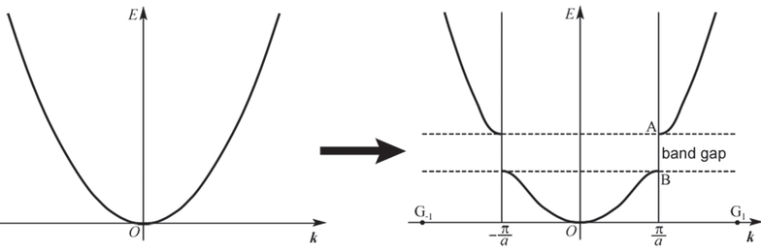
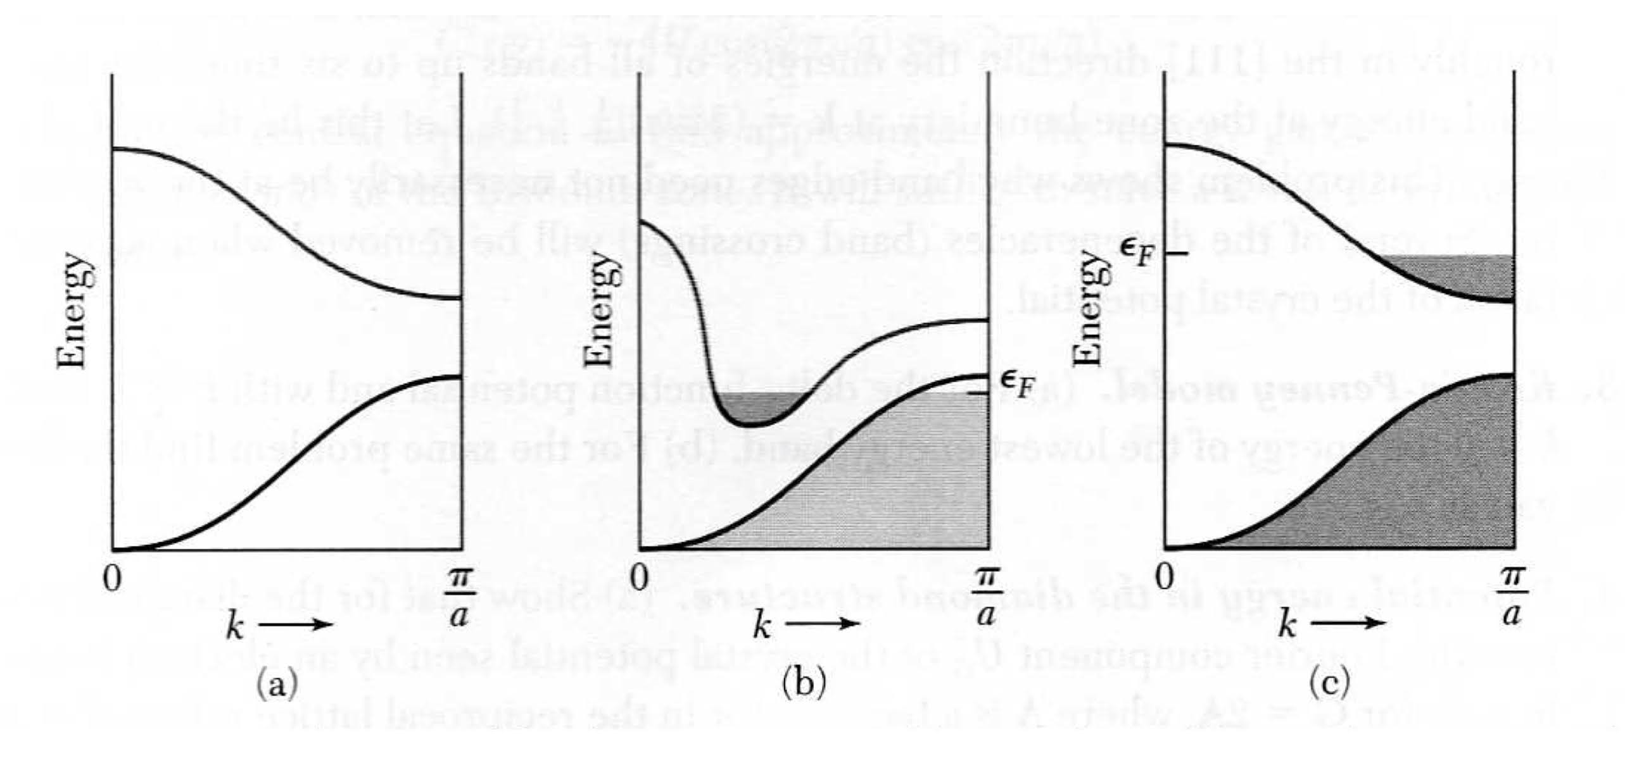

Energy levels of an electron in a periodic potential:
family of continuous functions $E_{nk},$ each with periodicity of reciprocal lattice.
Free electron gas, U(r) = 0
Electron in a periodic potential U(r)
$$E\left(k\right)=\frac{ℏ^{2}k^{2}}{2m}$$
Metal
Metal or insulator depends on the filling of energy levels
Pictorially:
Metal
Insulator

