Slide 1
LendingClub
EDA Case Study

Slide 2
Objectives
Build risk profile to enable lending business
Develop recommendations on ability to repay loan, which will lead to loan approval, which in turn improve business to company.
Identify key risks leading to loan default
Identify strong drivers (variables) for loan default.

Slide 3
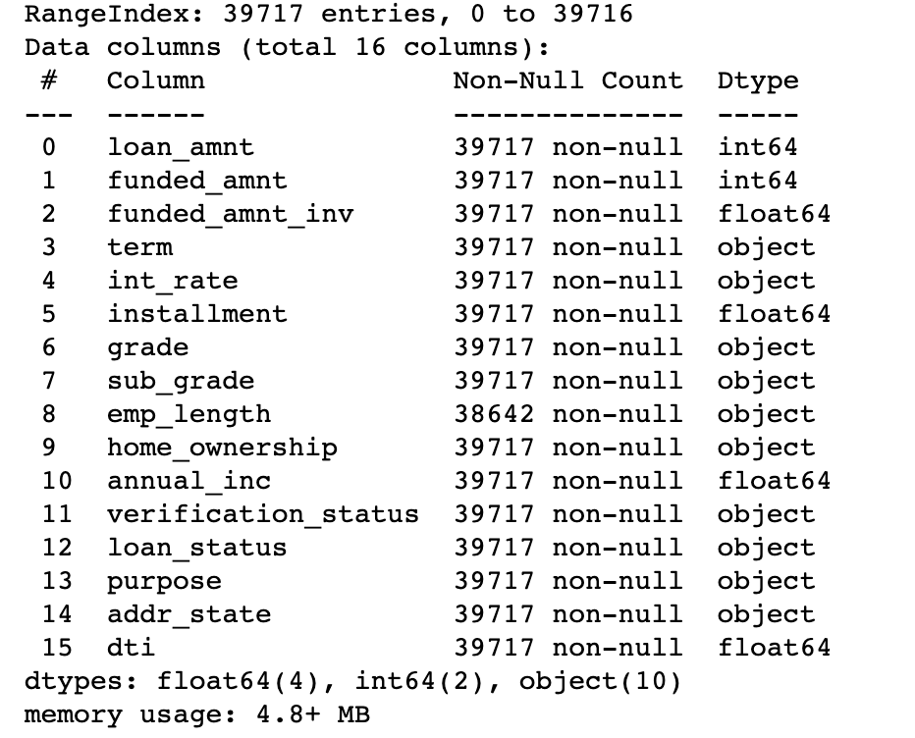
Available Dataset
Dataset contains information about past loan applicants.
Columns with demographic and customer specific details have been removed from analysis as they do not help in predicting the business.
Columns with more than 90% missing values
There are about 56 columns with more than 90% values missing.
Rows that has more than 25% data missing has been removed.
Fields with mixed data type has been converted to usable format (ex. Term field is a string, moved to integer).
Columns that do not drive any impact has been removed.
16 columns have been identified and taken for analysis

Slide 4
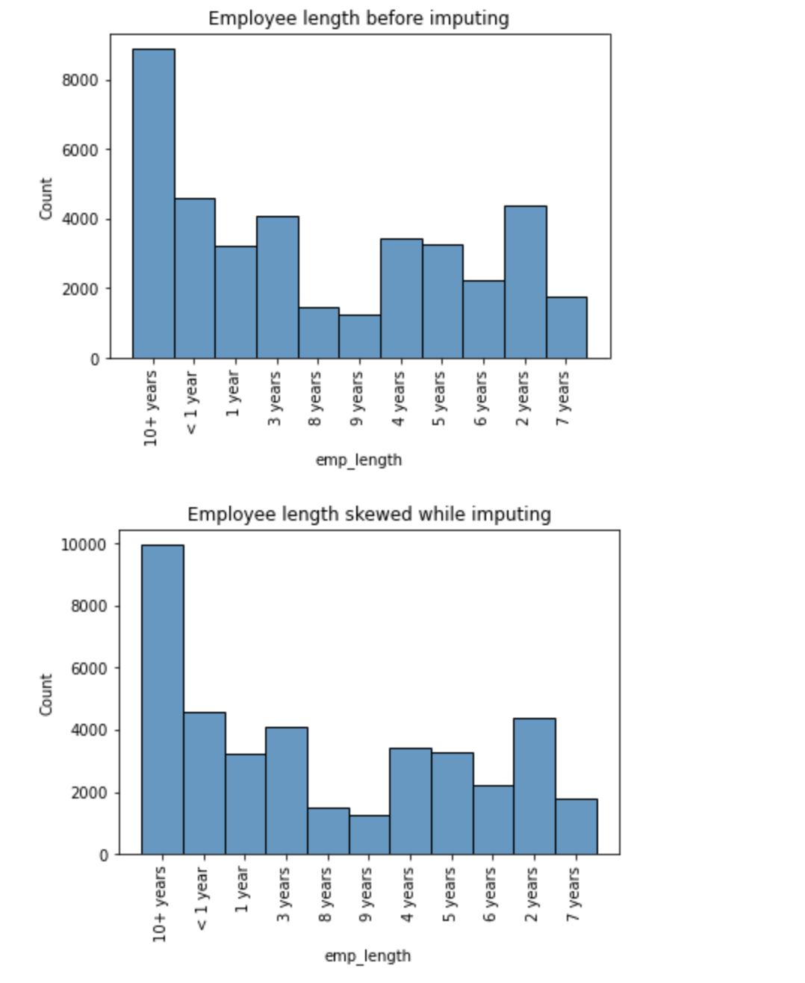
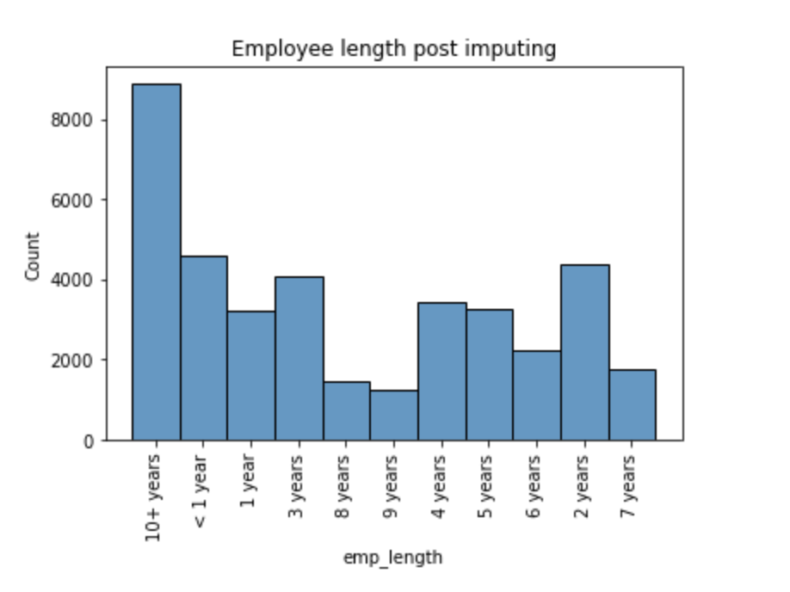
Variables
Null values imputation
emp_length variable need to be imputed as it had 1000+ null data.
Using mode function, data was left skewed.
Hence removed the null values.

Slide 5
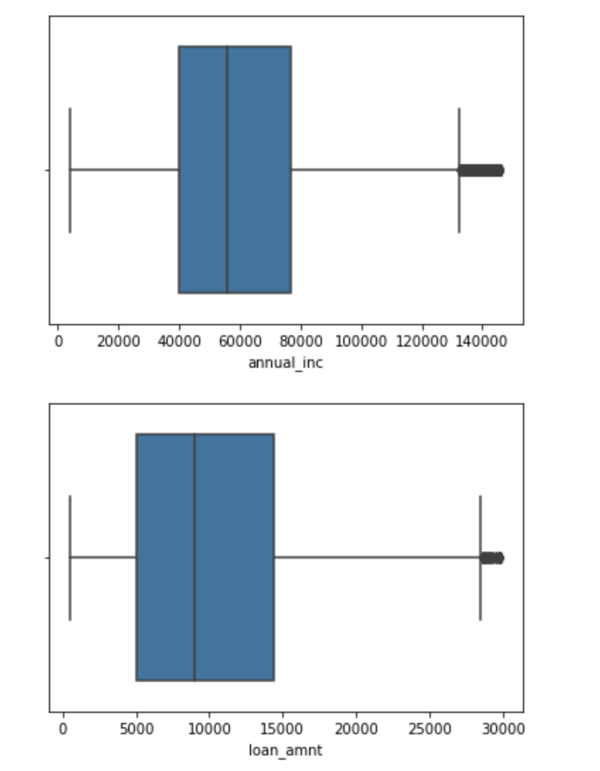
Target Variables
loan_default_status variable has been identified to classify target as fully paid or defaulted
Current employees are not added for analysis as we do not have information regarding they have defaulted any payment.
Outlier Treatment
annual inc & loan_amnt variabled are treated for outliers using IRQ. Hence data used for analysis represents the entire customer database.

Slide 6
Driver Variables
grade
purpose
emp_length
home_ownership
addr_state
annual_inc
funded_amnt
are identified to have business impact on determining if a borrower tends to pay fully or default.

Slide 7
Conclusions
Risk profile recommendations based on loan data set research

Slide 8
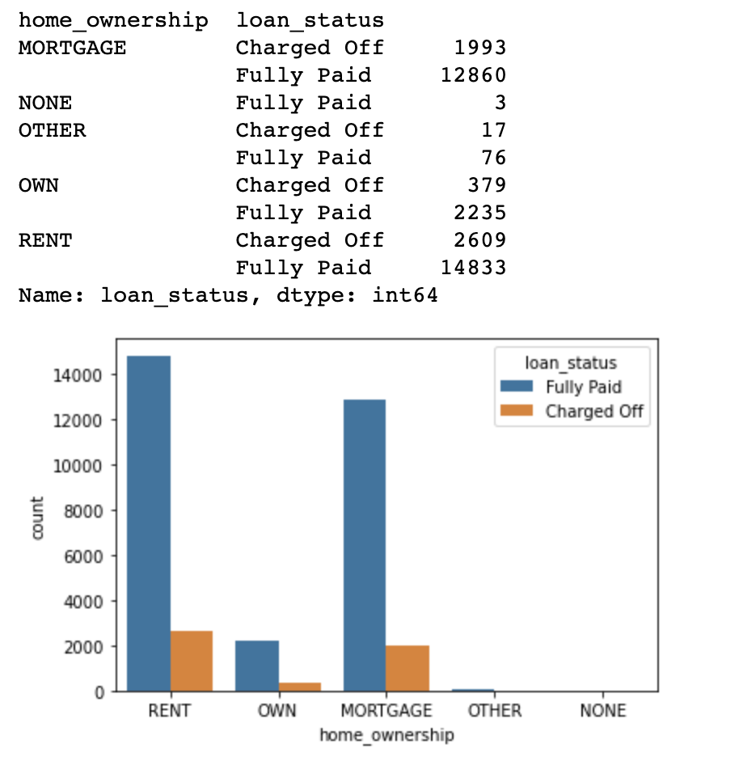
Risk Profile based on Home Ownership
An applicant is more likely to default loan re-payment, when type of residence is Rented or Mortgaged when compared to Owned.

Slide 9
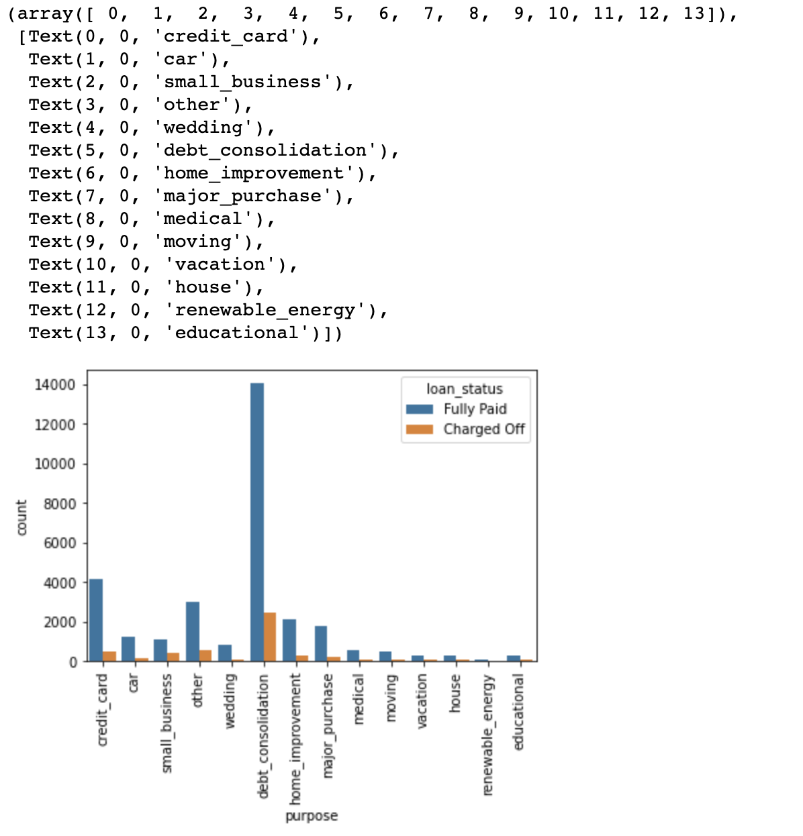
Risk Profile based on loan purpose
Risk Profile based on Loan purpose
An applicant is more likely to default loan re-payment, when purpose of loan is for debt consolidation as opposed to any other purpose.

Slide 10
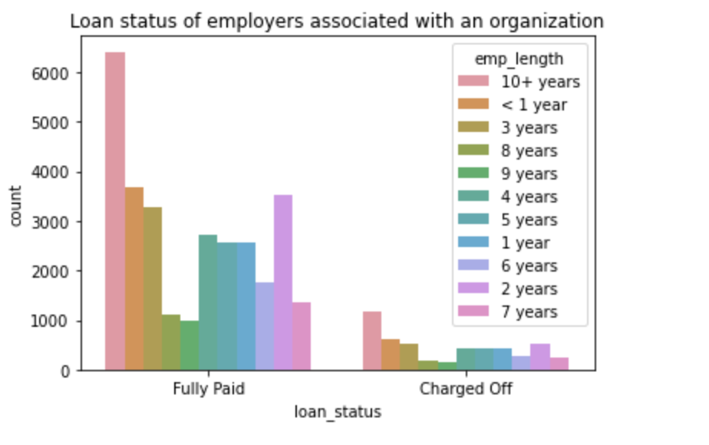
Risk Profile based on Employment Length
Risk Profile based on Employment Length
Applicant's that has worked at an employer for longer term, i.e., 10+ years tend to re-pay better.

Slide 11
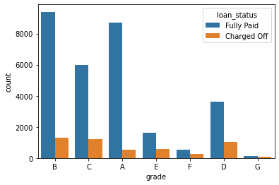
Risk profile based on applicaton grade
Risk Profile based on Applicant's grade
Applicants belonging to E,F,G grades are more likely to default on loan re-payment.

Slide 12
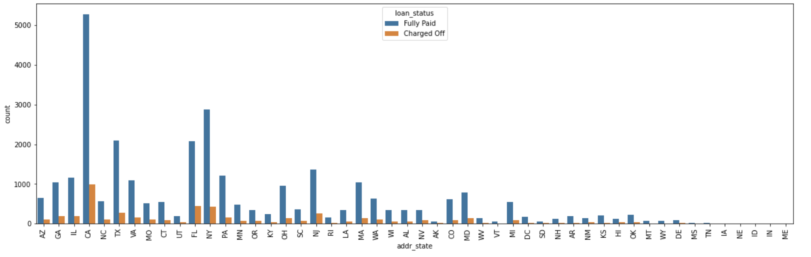
Risk Profile based on Home Ownership
Applicants from state of California has higher changes of a loan default than most other states.

Slide 13
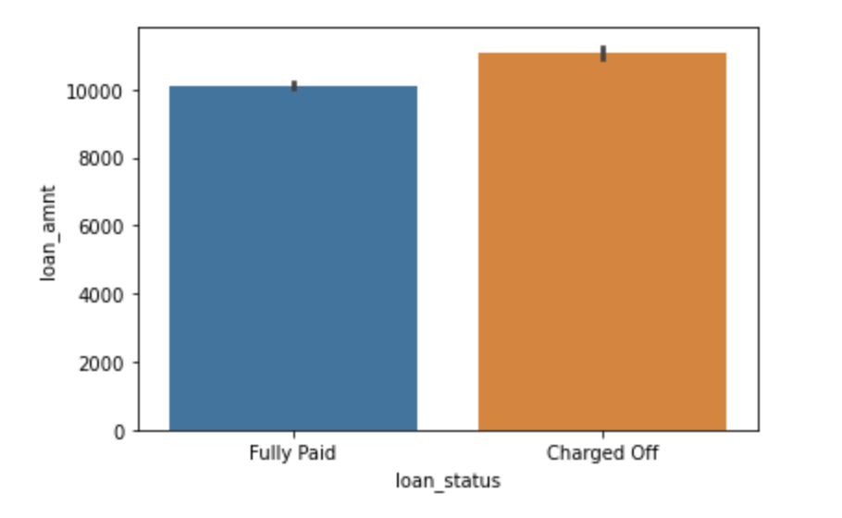
Risk Profile based on loan amount
Applicants requesting for higher loan amount tends to default more.
Lesser the loan amount, lesser chances of defaulting

Slide 14
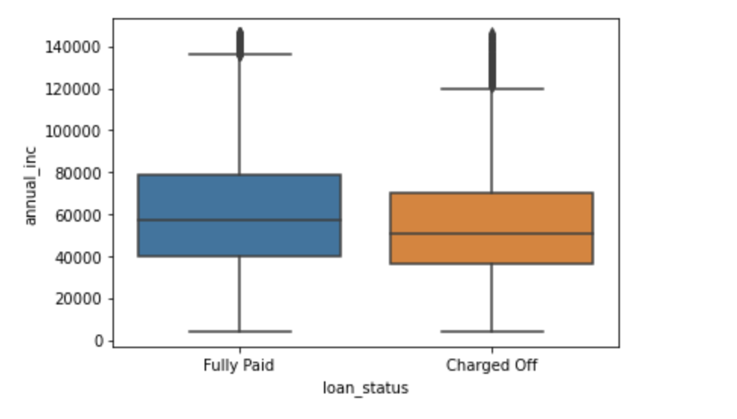
Risk Profile based on annual income
Applicants having lesser annual income more likely to default.

Slide 15
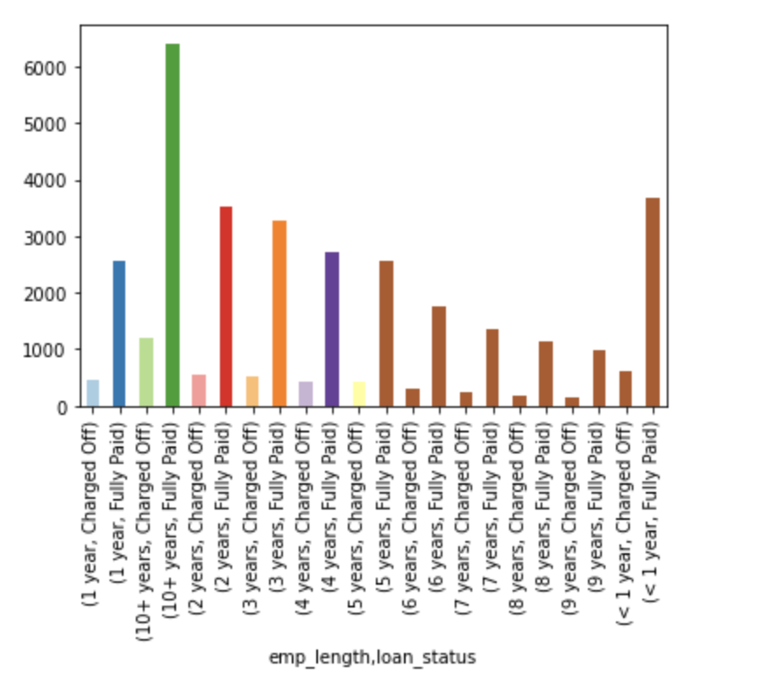
Risk Profile based on funded amount vs emp _length
Applicants having lesser annual income more likely to default.

Slide 16
Thank you!
Univariate and bivariate analysis of variables in the ipynb files

