Slide 1
Photography
How photography begans ?

Slide 2
Photography
Camera Obscura
  How it works ?
  Diaphragm
Black and White film
  Reaction to light
  Photographic processing

Slide 3
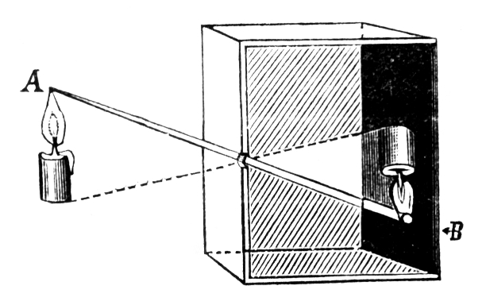
Photography
Camera Obscura > How it works
An object reflect his
light in every directions
This light passes
through the hole

Slide 4


Slide 5
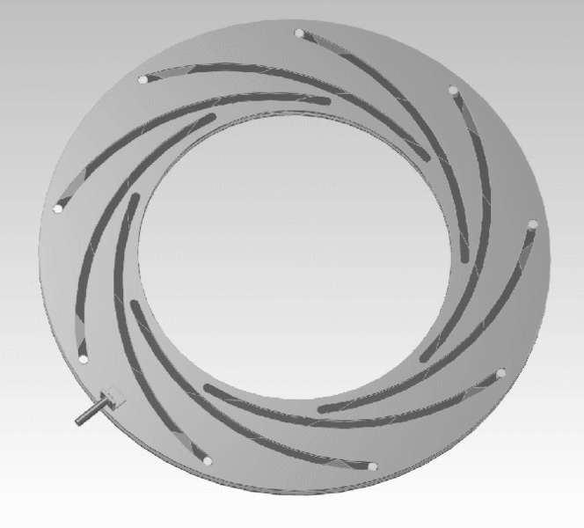
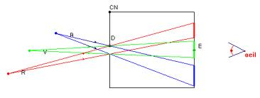
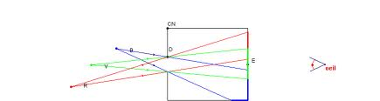
Photography
Camera obscura > Diaphragm
The diaphragm changes
the hole size
The hole size affects
the sharpness and the
brightness

Slide 6

Photography
Black and white film > Reaction to light
A film is a piece of plastic
where there is a lot of
particles of silver salts which
react to light
This particles are activated
when there is light

Slide 7
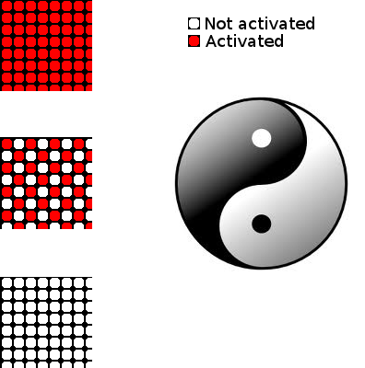
Photography

Slide 8
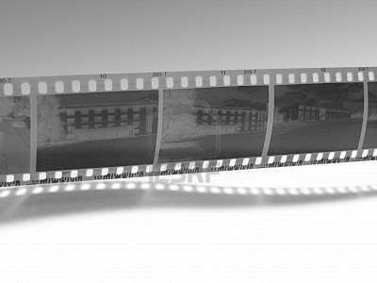
Photography
Black and white film > Photographic processing
The stop-bath which blacken
the activated particles
The fixer remove all the
particle not activated

Slide 9
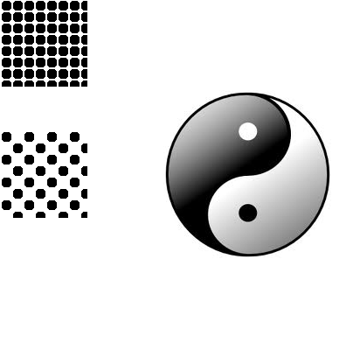
Photography

Slide 10
Photography
Photography begans with the camera obscura and the light which passes through a hole.
Then, this light was fixed in black and white thanks to silver salts.

