Slide 1
Etude du Système d’Information
Rapport de mission n°3

Slide 2
Sommaire
1.
Continental Corporation
1.1
Situation en 2010
1.2
Sites Continental
2.
Mon Service
2.1
5 grandes Divisions
3.
Travail accompli
3.1
Besoin
3.2
Environnement de développement
3.3
ReportGenerator
3.4
AchileSwitchTool

Slide 3
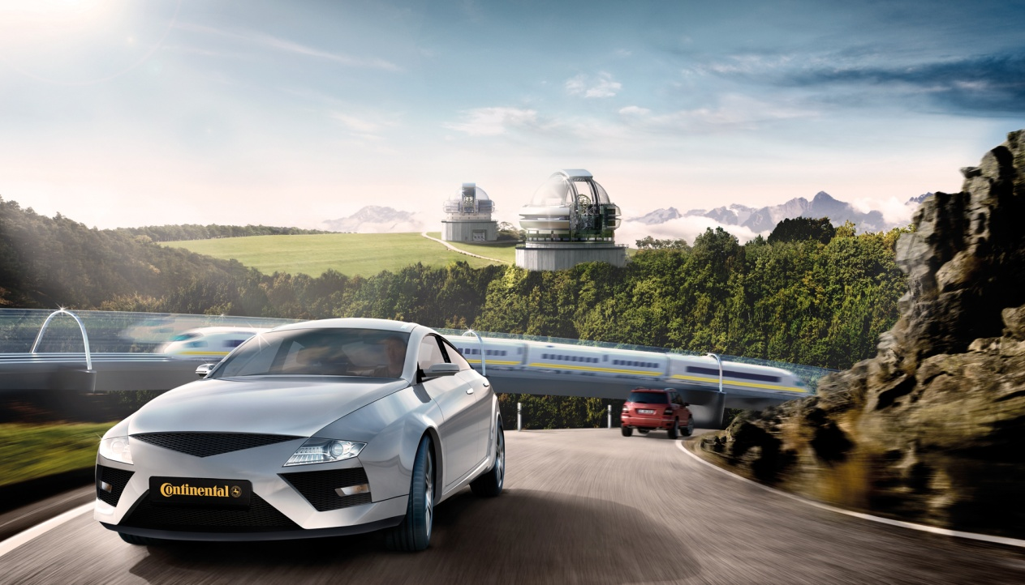

1. Continental Corporation

Slide 4

Continental Corporation 1.1 - Situation en 2010
Vente par divisions
Vente de pneus
Depuis 1871 avec son siège à Hanovre, Allemagne
Ventes pour 26.0 Milliards d’euros
148,228 employés dans le monde
193 sites dans 37 pays
Leader du marché dans plusieurs domaines
Un des 5 meilleurs équipementiers automobiles
Interior
ContiTech
Chassis & Safety
Powertrain
Status: December 31, 2010

Slide 5
Continental Corporation 1.2 - Sites Continental
Europe
Autriche
Belgique
Finlande France
Allemagne* Grèce
Italie Portugal
Espagne
Suède
Suisse
Royaume Uni
République tchèque
Hongrie
Roumanie
Russie
Serbie
Slovaquie
Turquie
North America
Canada
Mexique
USA
Asia
Chine
Inde
Japon
Malaisie
Philippines
Singapour
Corée du sud
Sri Lanka
Thaïlande
South America
Brésil
Chilie
Ecuateur
Africa
Afrique du sud
Tunisie
Australia
*Siege à Hanovre
Status: January 1, 2011

Slide 6
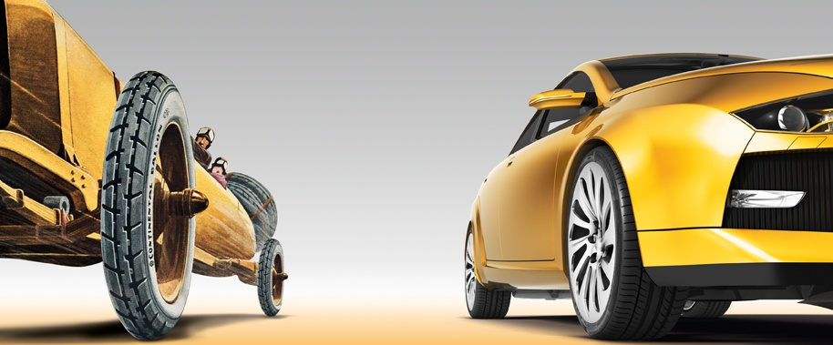
2. Mon service
140 Years Continental
1871 – 2011

Slide 7

Mon service 2.1 - 5 grandes Divisions
Chassis & Safety
Powertrain
Interior
Tires
ContiTech
Electronic Brake Systems
Engine Systems
Instrumentation & Driver HMI
PLT,
Original Equipment
Air Spring Systems
Hydraulic Brake Systems
Transmission
Infotainment & Connectivity
PLT, Repl. Business, EMEA
Benecke-Kaliko Group
Sensorics
Hybrid Electric Vehicle
Body & Security
PLT, Repl. Business, The Americas
Conveyor Belt Group
Passive Safety & Advanced Driver Assistance Systems (PSAD)
Sensors & Actuators
Comm. Vehicles & Aftermarket
PLT, Repl. Business, Asia Pacific
Elastomer Coatings
Fuel Supply
Commercial Vehicle Tires
Fluid Technology
Chassis Components
Two Wheel Tires
Power Transmission Group
Vibration Control
Other Operations
PLT – Passenger and Light Truck Tires
Status: August 1, 2011

Slide 8
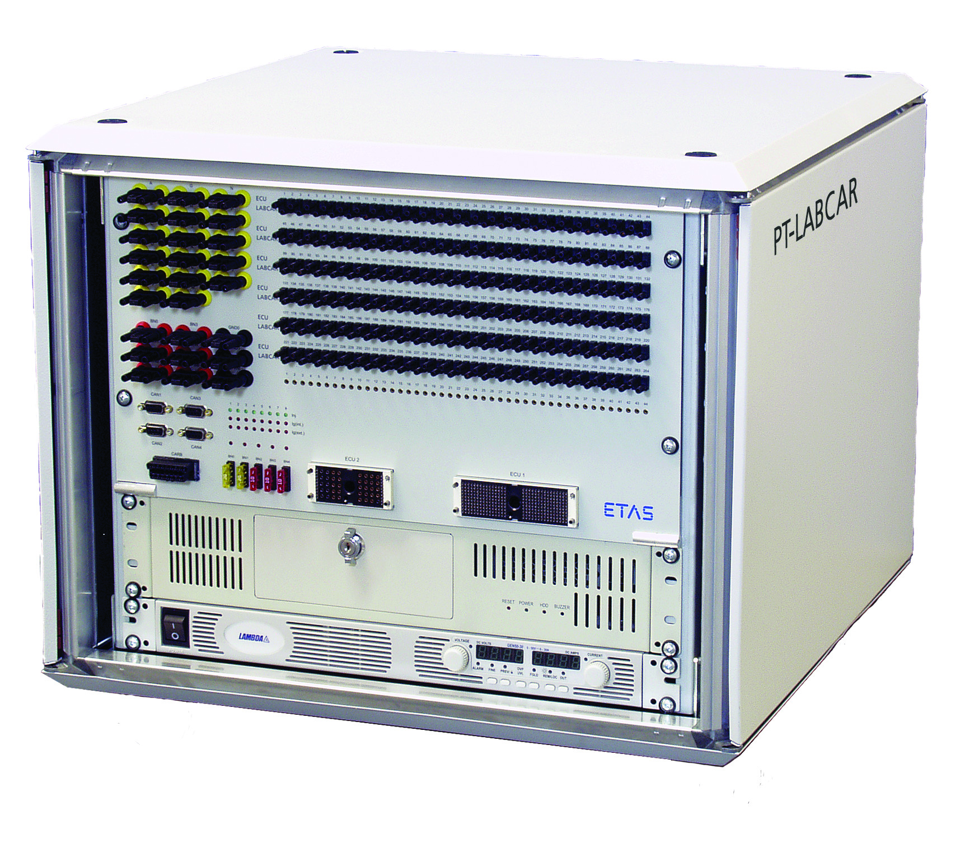
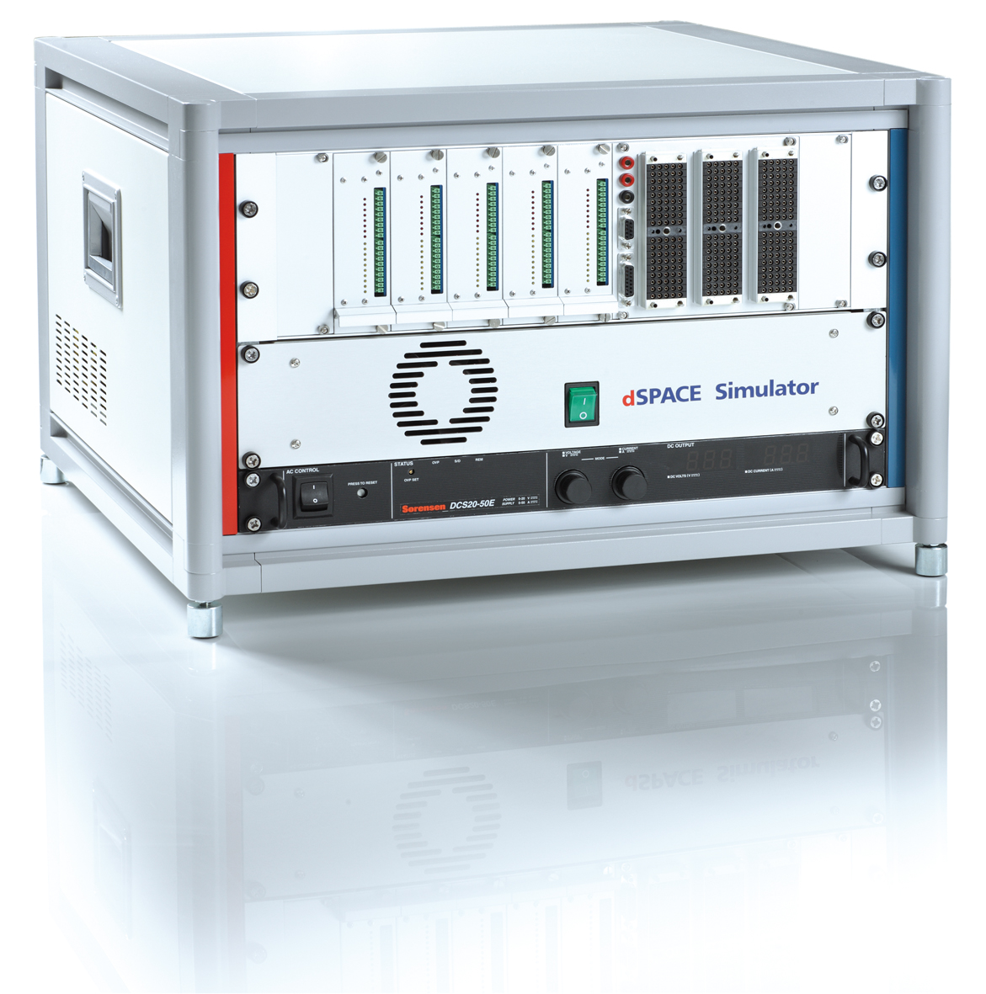

Slide 9
3. Le Rôle du Système d’Information

Slide 10
4. SI CONTINENTAL

Slide 11
4.1 Architecture réseau

Slide 12
4.2 Architecture logicielle

Slide 13

Travail accompli 3.1 Besoin
Animated Slide
Wiki :
Sharepoint :
Lotus Note :
Notes:
We make individual mobility safer, more comfortable, and more sustainable
Thanks to our core competencies, products and services, we, together with our customers, improve the safety, comfort and fun of driving. With our products, technologies and processes we significantly contribute to sustainable individual mobility.
Performance is our passion
Delivering trend-setting innovations, high performance products, quality without compromise and outstanding services to our customers is what motivates us in all our business areas. Combining technological, ecological, economic and personal aspects of performance makes the difference at Continental.
Creating value is our driving force
With our products and services we create value for our business partners and shareholders as well as for our employees and society in general. Profitable growth and consistent cost management in all business areas are the basis for our success.

Slide 14
Travail accompli 3.1 Besoin
Animated Slide
IMES :
LIMAS :
PVCS :
Notes:
We make individual mobility safer, more comfortable, and more sustainable
Thanks to our core competencies, products and services, we, together with our customers, improve the safety, comfort and fun of driving. With our products, technologies and processes we significantly contribute to sustainable individual mobility.
Performance is our passion
Delivering trend-setting innovations, high performance products, quality without compromise and outstanding services to our customers is what motivates us in all our business areas. Combining technological, ecological, economic and personal aspects of performance makes the difference at Continental.
Creating value is our driving force
With our products and services we create value for our business partners and shareholders as well as for our employees and society in general. Profitable growth and consistent cost management in all business areas are the basis for our success.

Slide 15
Travail accompli 3.2 Environnement de développement
Pourquoi MATLAB
Utilisation de modèles Simulink
Contraintes
Base de Donnée XML
Travail sur de l’existant
Besoin des personnes qui valident les bancs de test
Génération automatique du rapport de test
Sélection simplifié des tests
Sauvegardes des tests sélectionnés

Slide 16
Travail accompli 3.1 Besoin
Animated Slide
Changement de version ACHILE (AchileSwitchTool)
Notes:
We make individual mobility safer, more comfortable, and more sustainable
Thanks to our core competencies, products and services, we, together with our customers, improve the safety, comfort and fun of driving. With our products, technologies and processes we significantly contribute to sustainable individual mobility.
Performance is our passion
Delivering trend-setting innovations, high performance products, quality without compromise and outstanding services to our customers is what motivates us in all our business areas. Combining technological, ecological, economic and personal aspects of performance makes the difference at Continental.
Creating value is our driving force
With our products and services we create value for our business partners and shareholders as well as for our employees and society in general. Profitable growth and consistent cost management in all business areas are the basis for our success.

Slide 17
Merci pour votre attention!

