Slide 1
GRUPO BIMBO DEMAND PREDICTION
Tanya Malhotra (malhotra.t@husky.neu.edu)
Paritosh Arora (arora.par@husky.neu.edu)

Slide 2
Business Goal
Currently, the bakery’s demand is anticipated by the workers based on their personal experience. This needs to be changed by predicting the demand based on historical sales data in order to be more accurate.
While doing so, Grupo Bimbo intends to reduce the amount spent on refunds to store owners with surplus product unfit for sale.
Technical Goal
Set up platform to analyze and process the big dataset
Apply predictive analysis on provided dataset and evaluate the resultant model

Slide 3
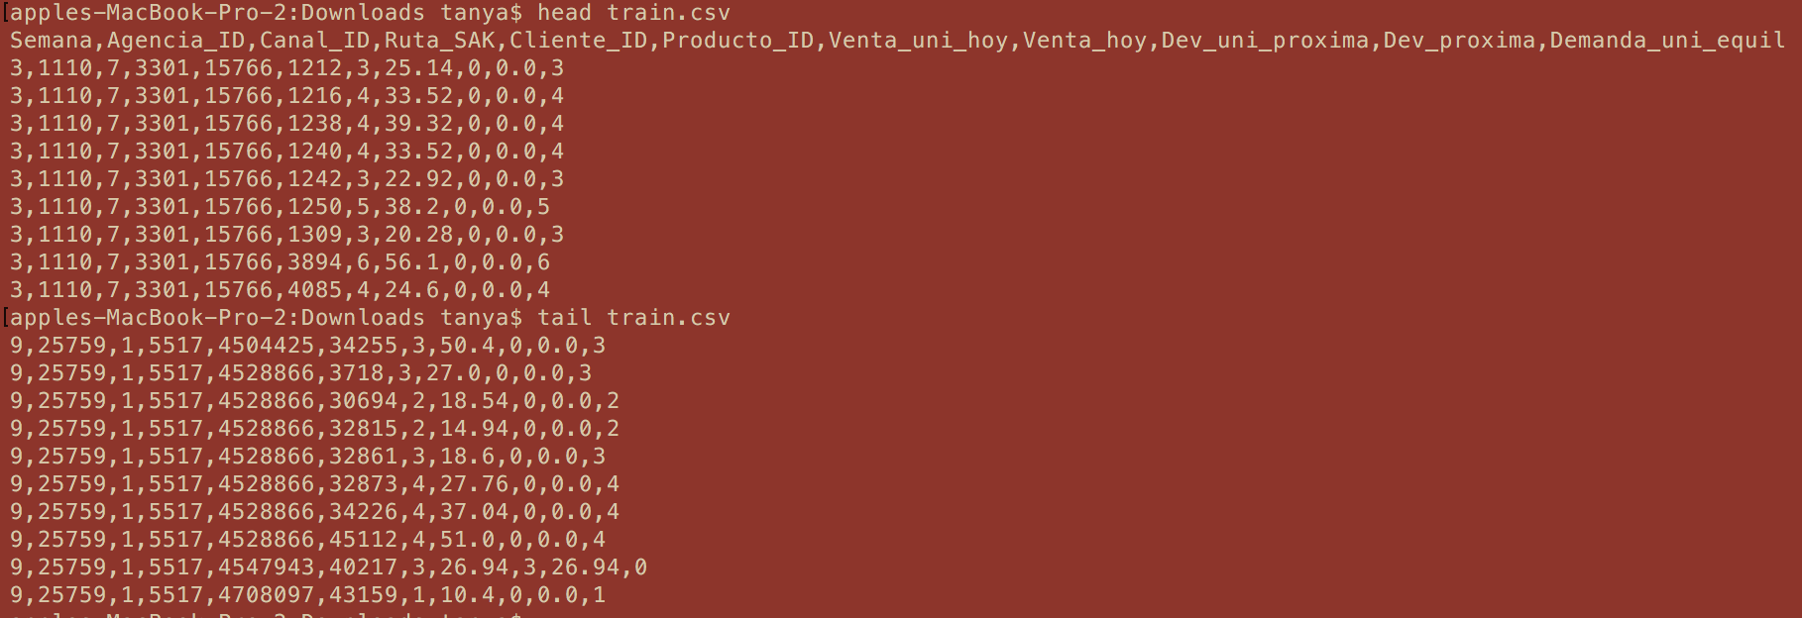

Data source
The data is sourced from one of the current Kaggle competitions:
https://www.kaggle.com/c/grupo-bimbo-inventory-demand/data

Slide 4
Approach
Parse & Transform Training Data
Train Regression Model
Predict Demand Value
Evaluate Model

Slide 5
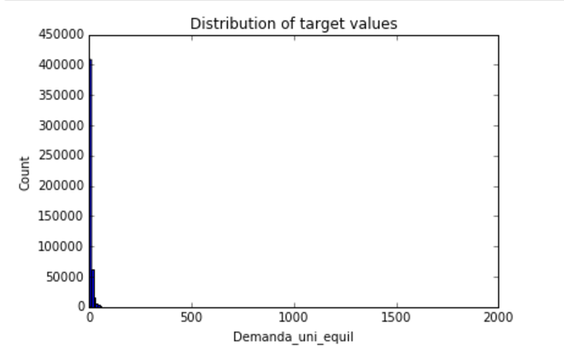
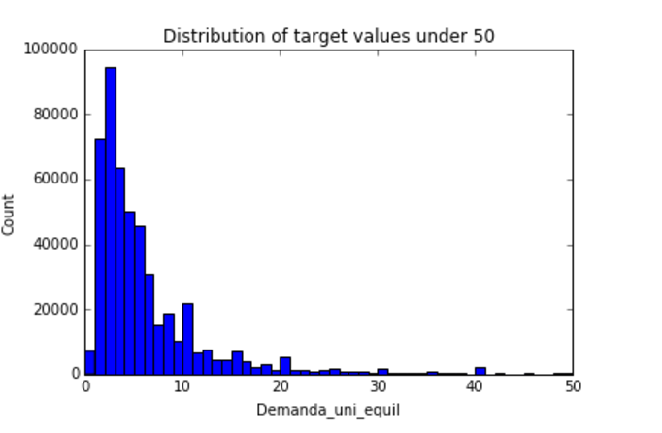
Analyzing The Data
Big dataset : 74 million records
No missing values
Non-uniform demand distribution
Very few but big outliers
Random samples not good enough

Slide 6
Solution
Part1 - Cloud computing:
Cluster set up on AWS
1 Master node & 8 Slave nodes
8GB memory running on Amazon Linux
Parallel Processing using Spark
HDFS

Slide 7
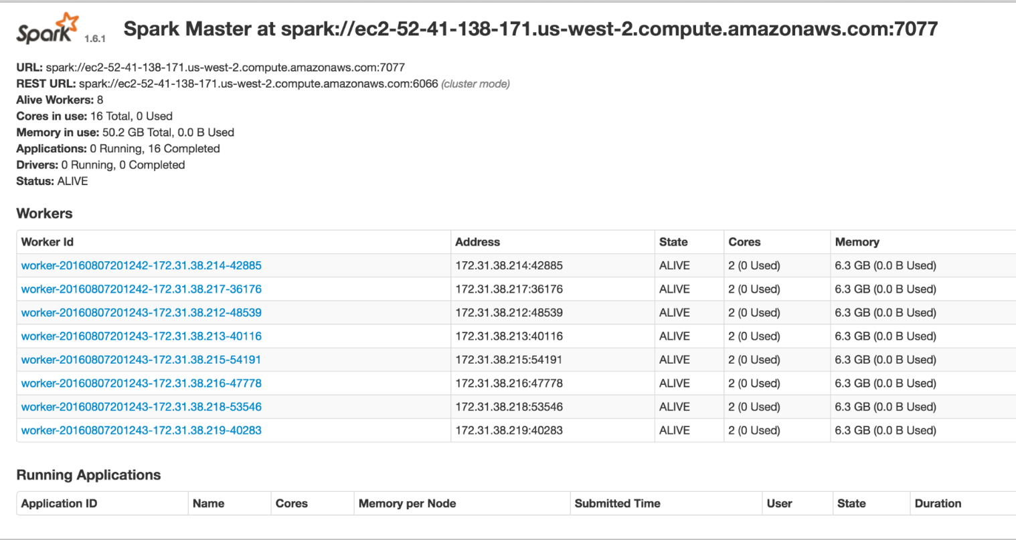
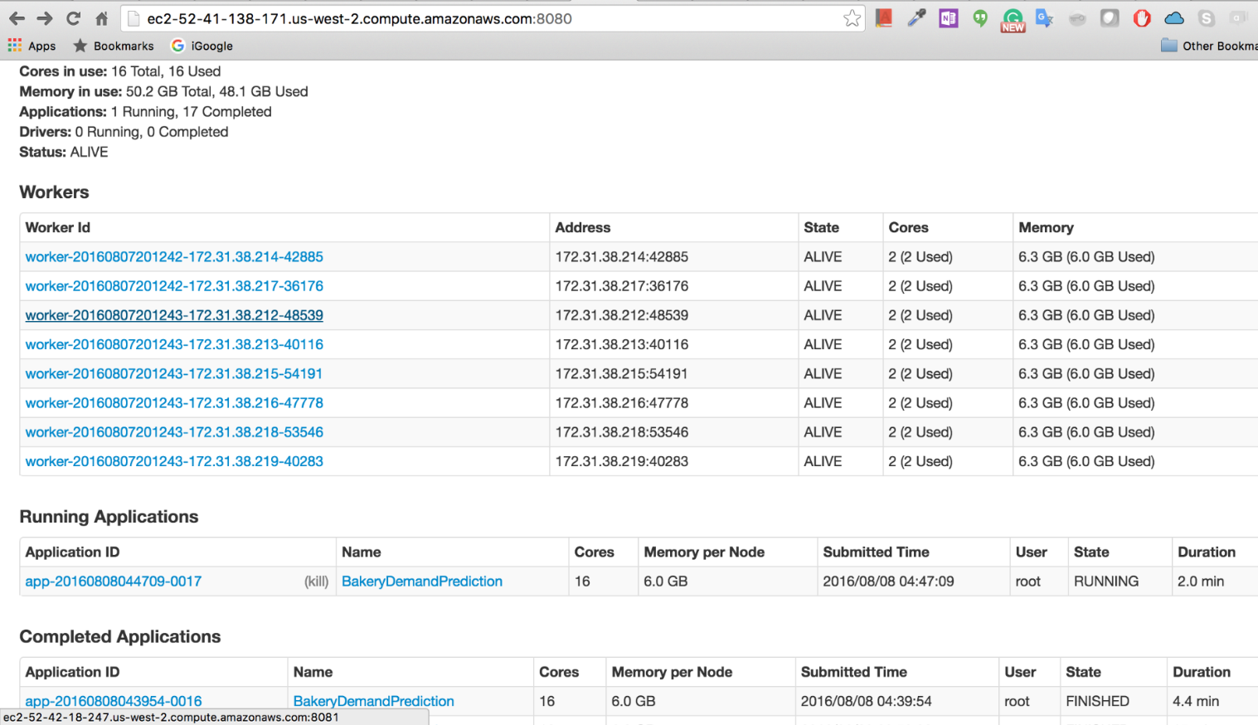
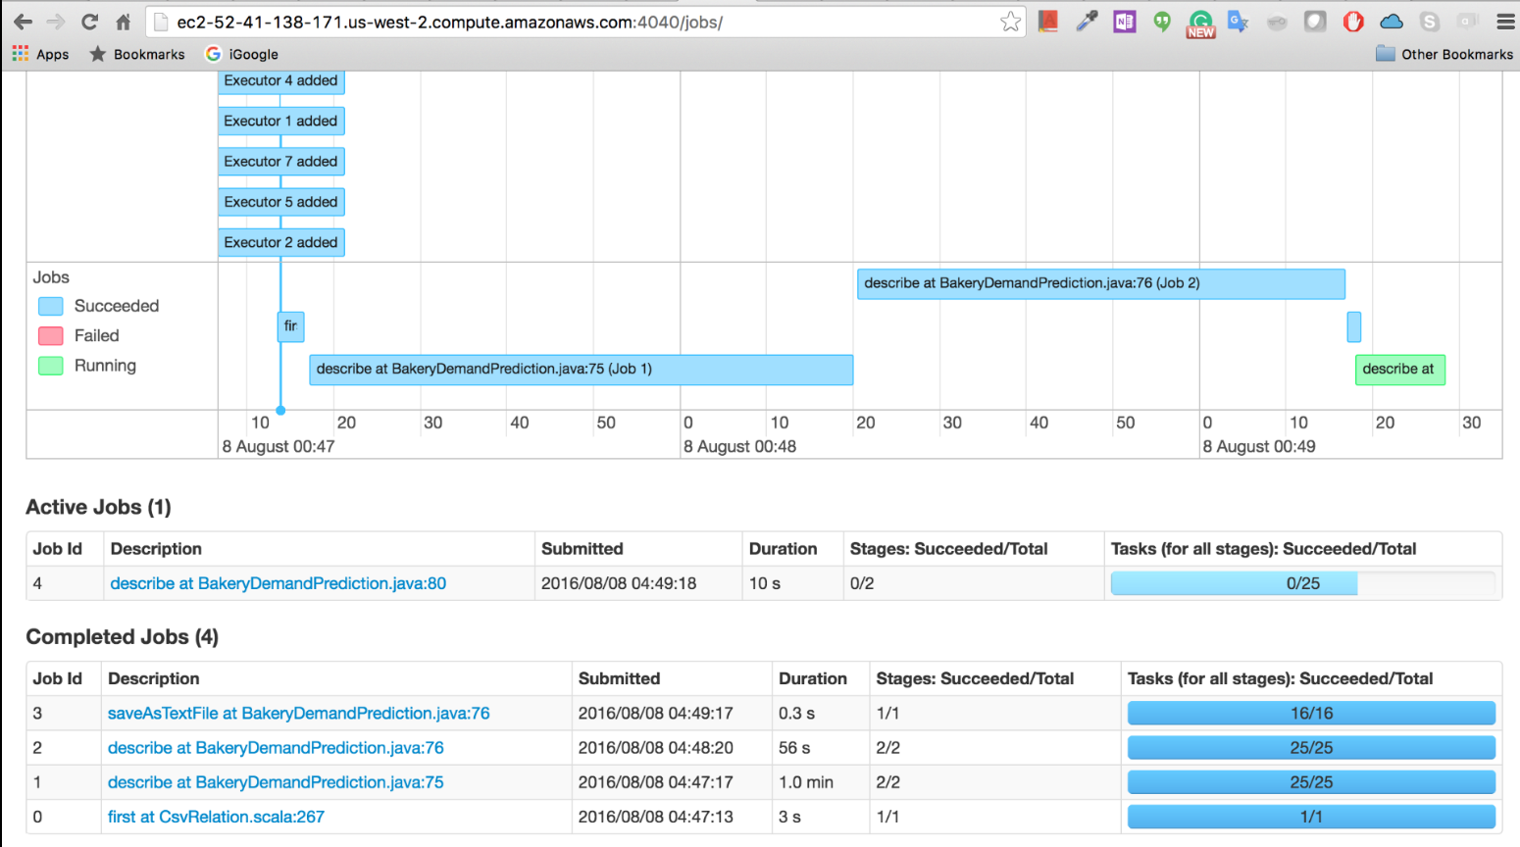
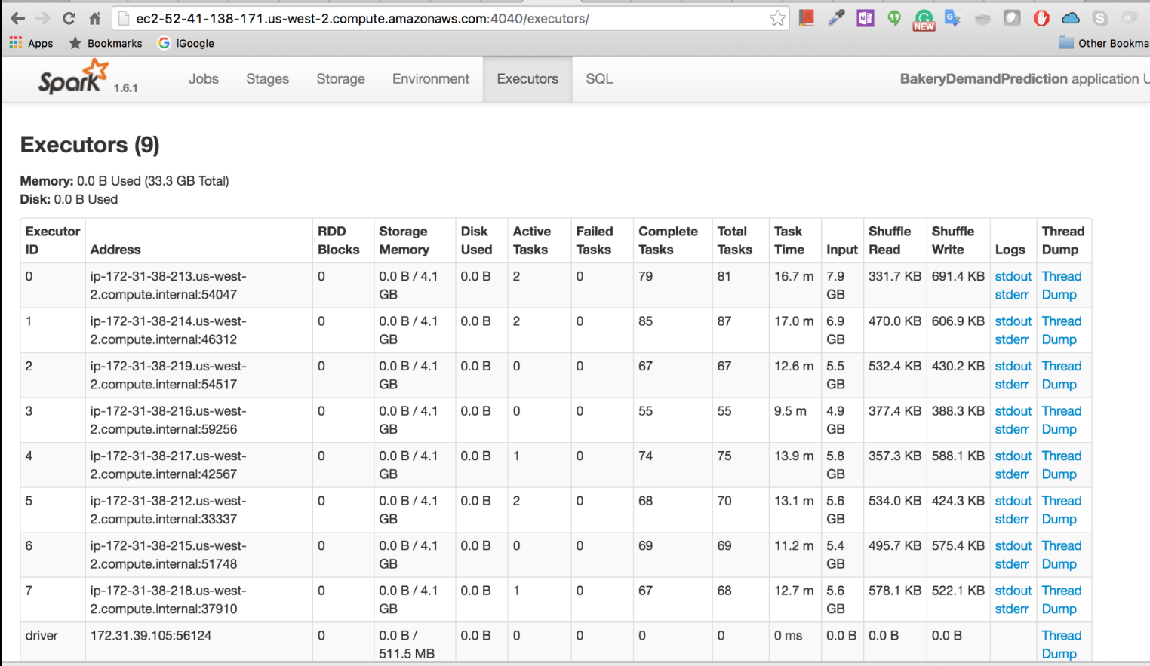

Slide 8
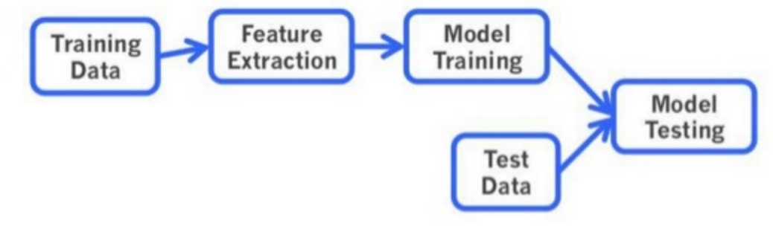
Solution
Part 2 - Machine learning
Spark ML Pipeline – Vector indexer and GBT regression
Evaluation – Root Mean Square Log Error
Source Code
https://bitbucket.org/arora_par/demandprediction

Slide 9
Up and Running
Compile Code
mvn clean compile package
Copy jar to master node
scp -i bigdatakey.pem /Users/tanya/workspace/bakery/target/bakery-0.0.1-SNAPSHOT.jar root@ec2-52-41-138-171.us-west-2.compute.amazonaws.com:~/
Move data to HDFS
scp -i bigdatakey.pem train.csv.zip root@ec2-52-41-138-171.us-west-2.compute.amazonaws.com:~/
ephemeral-storage/bin/hadoop dfs -mkdir input
ephemeral-storage/bin/hadoop dfs -put /root/train.csv.zip input
Execute
spark/bin/spark-submit --class edu.neu.bigdata.course.BakeryDemandPrediction --master spark://ec2-52-41-138-171.us-west-2.compute.amazonaws.com:7077 --packages com.databricks:spark-csv_2.11:1.4.0 bakery-0.0.1-SNAPSHOT.jar

Slide 10
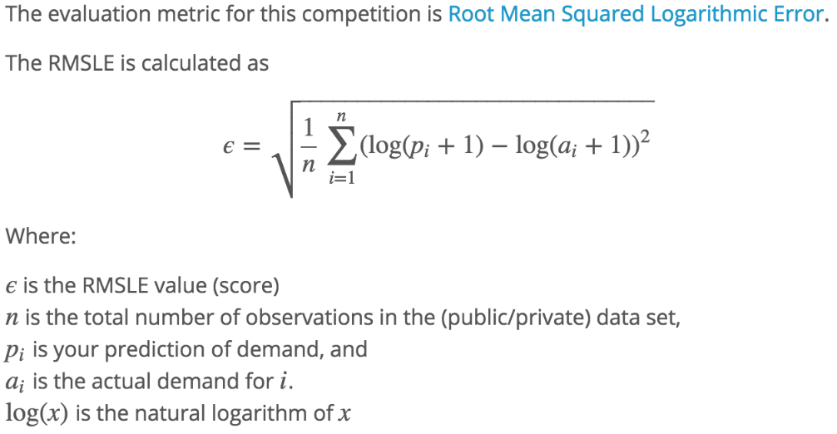
Evaluate Results
Formula for evaluation:
Final Result: 0.310235374584404

Slide 11
Challenges
Size of the dataset – Too big to run on standalone system
Cluster setup – Access issues for command line tools
JDK compatibility issue – 8 vs 7 on localhost and cluster
Spark compatibility issues – 2.0.0 vs 1.6.2

Slide 12
Thank you!

