Slide 1

Image Steganography
School of Computer Science and Engineering
Department of Computer Science and Engineering
Submitted By:
Anirudh Arora
23FE10CSE00637
Supervised By:
Dr. Neha Janu

Slide 2
Outline
Introduction
Literature Review
Problem Statement
Proposed Solution
Objectives

Slide 3
Introduction
Steganography
The art of hiding secret information within an ordinary file, like an image, to conceal the very existence of a message.
Covert Communication
Allows for the secure transmission of sensitive data for national security, journalism, or corporate intelligence without attracting suspicion
Unlike encryption, which scrambles a message, steganography hides it in plain sight.
Digital Watermarking
Enables creators to embed invisible signatures in their work to prove ownership and protect intellectual property.
The Rise of Deep Learning
Modern steganography uses AI (deep learning) to automate the hiding process.
AI models can achieve better imperceptibility and robustness than traditional methods.

Slide 4
Literature Review
Traditional Approach: Convolutional Neural Networks (CNNs)
Most early deep learning steganography models were built using CNNs.
Limitation:
CNNs process images using small, localized filters. This gives them a limited "field of view" (receptive field).
Consequence:
They struggle to understand the global context of an image and often fail to properly reconstruct complex textures (like feathers or water), which are the best places to hide data. This leads to visible artifacts and lower imperceptibility.

Slide 5
Literature Review
A Major Leap Forward: The Vision Transformer (ViT)
The base paper, "TransStego," introduced a Vision Transformer (ViT) to solve the CNN problem.
How it Works
ViT treats an image as a sequence of patches and uses a "self-attention" mechanism to compare every patch with every other patch simultaneously.
Advantage:
This provides a true global understanding of the image, allowing the model to identify the most suitable and complex regions for embedding data, significantly improving imperceptibility over CNNs.

Slide 6
Problem Statement
While the Vision Transformer (ViT) in the "TransStego" framework offers superior global context, its quadratic computational complexity (O(N2)) makes it extremely inefficient and impractical for the high-resolution images common in real-world applications.

Slide 7
Objectives
To analyze the architectural and computational bottlenecks of the ViT-based "TransStego" framework.
To propose and implement a more efficient architecture by replacing the Vision Transformer with a Swin Transformer.
To evaluate the proposed model's performance against the original, focusing on improvements in imperceptibility, robustness, and computational efficiency.
To demonstrate the new model's capability to perform steganography on high-resolution images, a task that was previously infeasible.
To integrate an adversarial training framework with mask-guided embedding to enhance perceptual invisibility and resistance to steganalysis.

Slide 8
Proposed Methodology
Step 1:
Input Preparation – Take the cover image and secret binary message as input. Convert the message into a tensor and concatenate it with the image tensor to form the combined input representation.
Step 2:
Hierarchical Feature Extraction – Pass the combined tensor through the Swin Transformer backbone. Perform self-attention within local windows and apply shifted windows across stages to enable cross-region interaction. Generate multi-scale hierarchical feature maps.
Step 3:
Mask-Guided Adaptive Embedding – Generate a spatial importance mask to guide embedding. Allocate higher payload capacity to textured regions and reduce embedding strength in smooth regions to improve imperceptibility.
Step 4:
Residual Stego Generation – Predict a residual perturbation map and add it to the original cover image to produce the final high-quality stego image.
Step 5:
Adversarial Robust Training – Train the model with a discriminator to enforce image realism. Apply random occlusions, rotations, cropping, and noise during training to improve robustness. Pass attacked stego images through the decoder for secret recovery and optimize a joint loss function consisting of Pixel Loss (MSE), Perceptual Loss (LPIPS), Adversarial Loss, and Message Reconstruction Loss.

Slide 9
Proposed Methodology
Feature | Vision Transformer (ViT) | Swin Transformer (Proposed)
Attention | Global (all patches at once) | Local (within shifted windows)
Complexity | Quadratic (O(N2)) | Linear (O(N))
Structure | Monolithic, single-scale | Hierarchical, multi-scale
Efficiency | Impractical for high-res images | Highly efficient and scalable
The Key Takeaway: The shift from quadratic to linear complexity is a game-changer. It makes high-resolution steganography computationally feasible, unlocking higher data capacity and even better imperceptibility.

Slide 10
Results :
Improved Imperceptibility:
  Swin's superior ability to model multi-scale textures will lead to smarter data placement, resulting in stego images that are perceptually closer to the original.
  We expect better scores on all metrics, especially LPIPS, which measures human-perceived similarity.
Enhanced Robustness
  The model's hierarchical structure provides inherent resilience to attacks like cropping and rotation, leading to higher message extraction accuracy under duress.
High-Resolution Capability
  The primary outcome is a model that can efficiently process large images enabling higher-capacity steganography that was previously impractical.

Slide 11
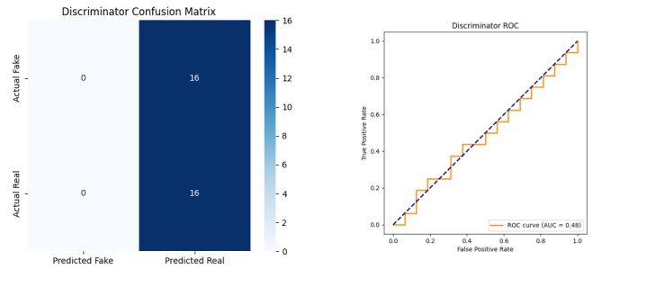
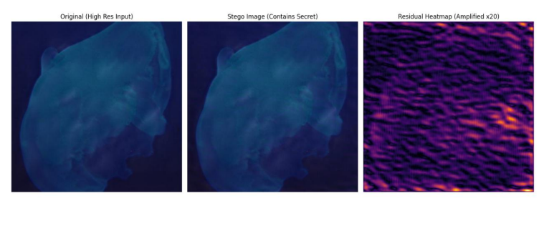
Results :

Slide 12
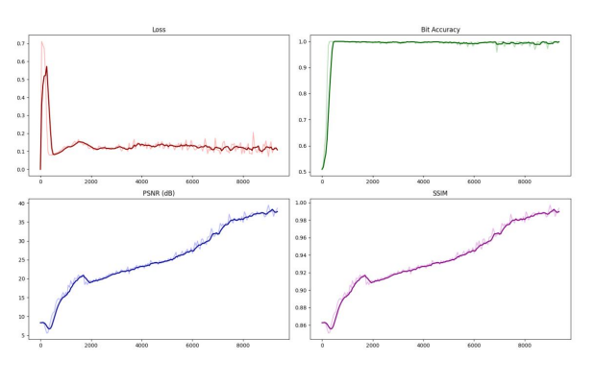
Results :

Slide 13
References
Xiao, C., Peng, S., Zhang, L., Wang, J., Ding, D., & Zhang, J. (2025). A transformer-based adversarial network framework for steganography. Expert Systems With Applications, 269, 126391.
Liu, Z., Lin, Y., Cao, Y., Hu, H., Wei, Y., Zhang, Z., Lin, S., & Guo, B. (2021). Swin Transformer: Hierarchical Vision Transformer using Shifted Windows. arXiv preprint arXiv:2103.14030.
Dosovitskiy, A., Beyer, L., Kolesnikov, A., Weissenborn, D., Zhai, X., Unterthiner, T., Dehghani, M., Minderer, M., Heigold, G., Gelly, S., Uszkoreit, J., & Houlsby, N. (2020). An image is worth 16x16 words: Transformers for image recognition at scale. arXiv preprint arXiv:2010.11929.
Vaswani, A., Shazeer, N., Parmar, N., Uszkoreit, J., Jones, L., Gomez, A. N., Kaiser, L., & Polosukhin, I. (2017). Attention is all you need. Advances in Neural Information Processing Systems, 30.

Slide 14
Thank You

