Slide 1
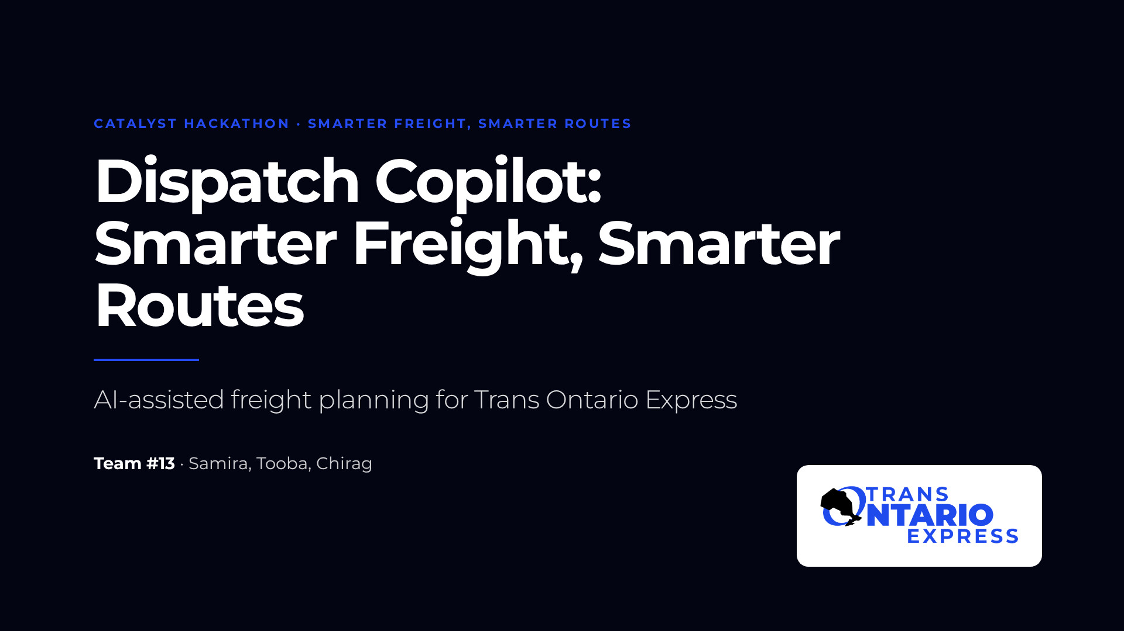
Notes:
Welcome to Dispatch Copilot, Team #13's answer to the Catalyst Hackathon challenge "Smarter Freight, Smarter Routes". We built an AI-assisted planning web app for Trans Ontario Express. This deck is written to stand on its own, so every slide explains one idea. We are Samira, Tooba and Chirag.

Slide 2
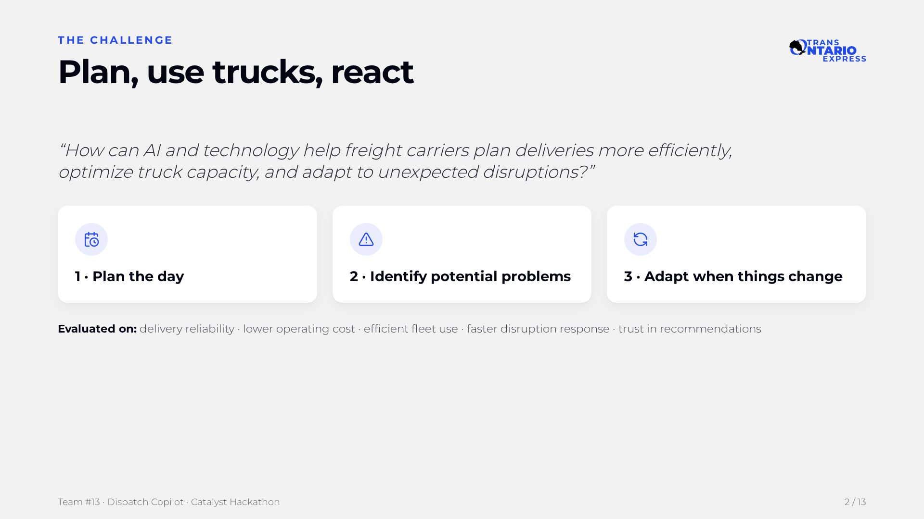
Notes:
Trans Ontario Express asked how AI and technology can help carriers plan deliveries, use trucks better and react to disruptions. They set three tasks: plan the day, identify problems, and adapt when things change. They will judge us on reliability, cost, fleet use, response speed and trust. Every part of our solution maps back to one of these.

Slide 3
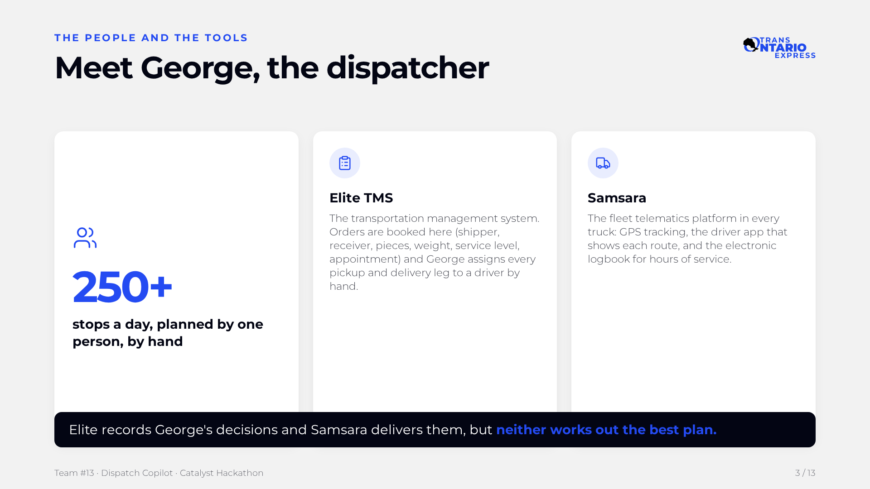
Notes:
George is the dispatcher, and he plans more than 250 stops a day by hand. He books and assigns work in Elite TMS, the order system. Samsara, the telematics platform in every truck, sends his routes to drivers and logs their hours. Both systems record and deliver George's decisions, but neither one works out the best plan. That gap is where Dispatch Copilot sits.

Slide 4
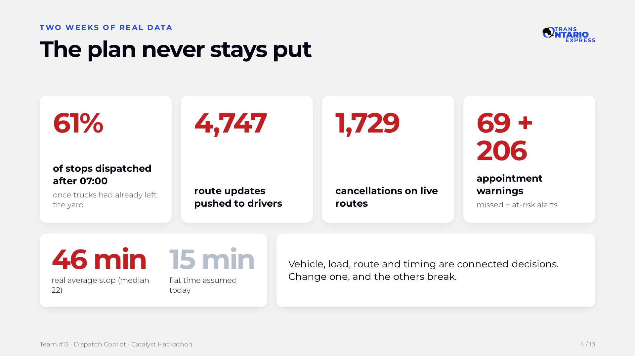
Notes:
Two weeks of real data show a plan that never stays put. Most stops are dispatched after the trucks have already left, and drivers get thousands of route updates. Appointments are regularly at risk. And real stop times are about three times what the current set-up assumes, so every plan starts out optimistic. These decisions are all connected: vehicle, load, route and timing.

Slide 5
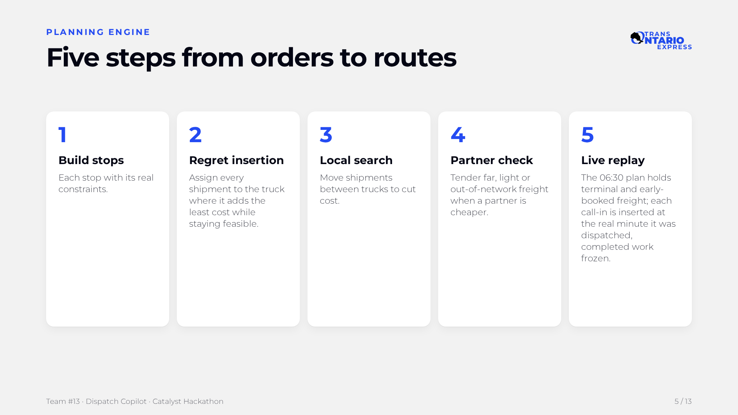
Notes:
The engine works in five steps. First it builds every stop with its real constraints. Regret-based insertion then places each shipment where it adds the least cost while staying legal, starting with the hardest ones. Local search moves shipments between trucks to cut cost further, and a partner check tenders freight when a partner carrier is cheaper. Finally, live replay inserts each call-in pickup at the real minute George dispatched it, with completed work frozen.

Slide 6
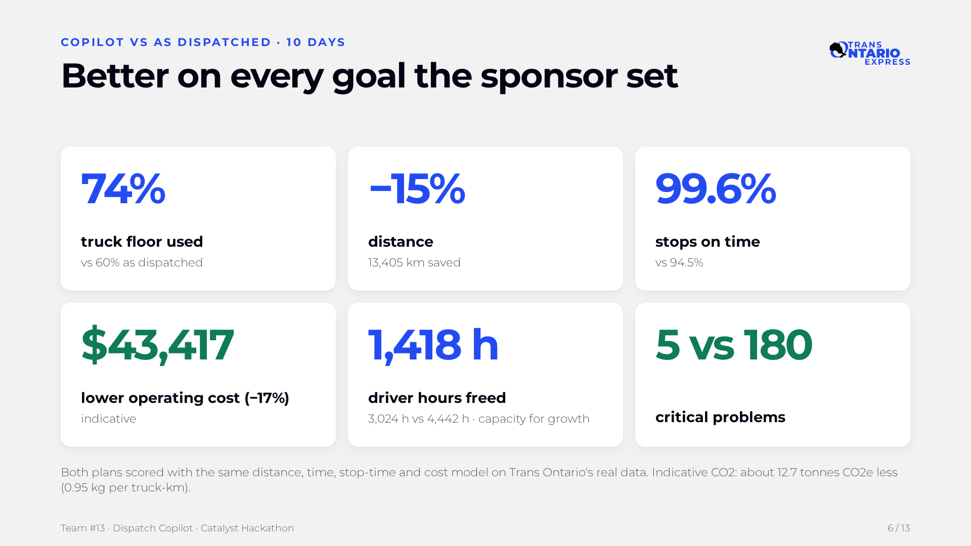
Notes:
Over ten days, the copilot fills more truck floor, drives 15 percent fewer kilometres and puts 99.6 percent of stops on time. Operating cost is about 43 thousand dollars lower, which is 17 percent. It frees 1,418 driver hours, which is capacity for growth, call-ins and less overtime. Critical problems drop from 180 to 5. Costs are indicative, and both plans use the same model.

Slide 7
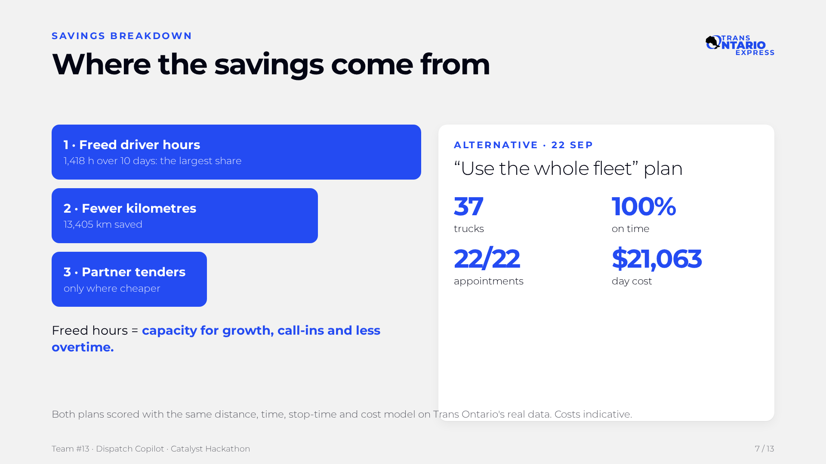
Notes:
Most of the saving comes from freed driver hours, 1,418 hours over ten days. Next comes fewer kilometres, and last, partner tenders used only where they are cheaper. We see those hours as capacity for growth, call-ins and less overtime. If Trans Ontario prefers to keep every truck busy, the 'Use the whole fleet' plan runs 37 trucks with 100 percent on time and all 22 appointments met for 21,063 dollars on 22 September.

Slide 8
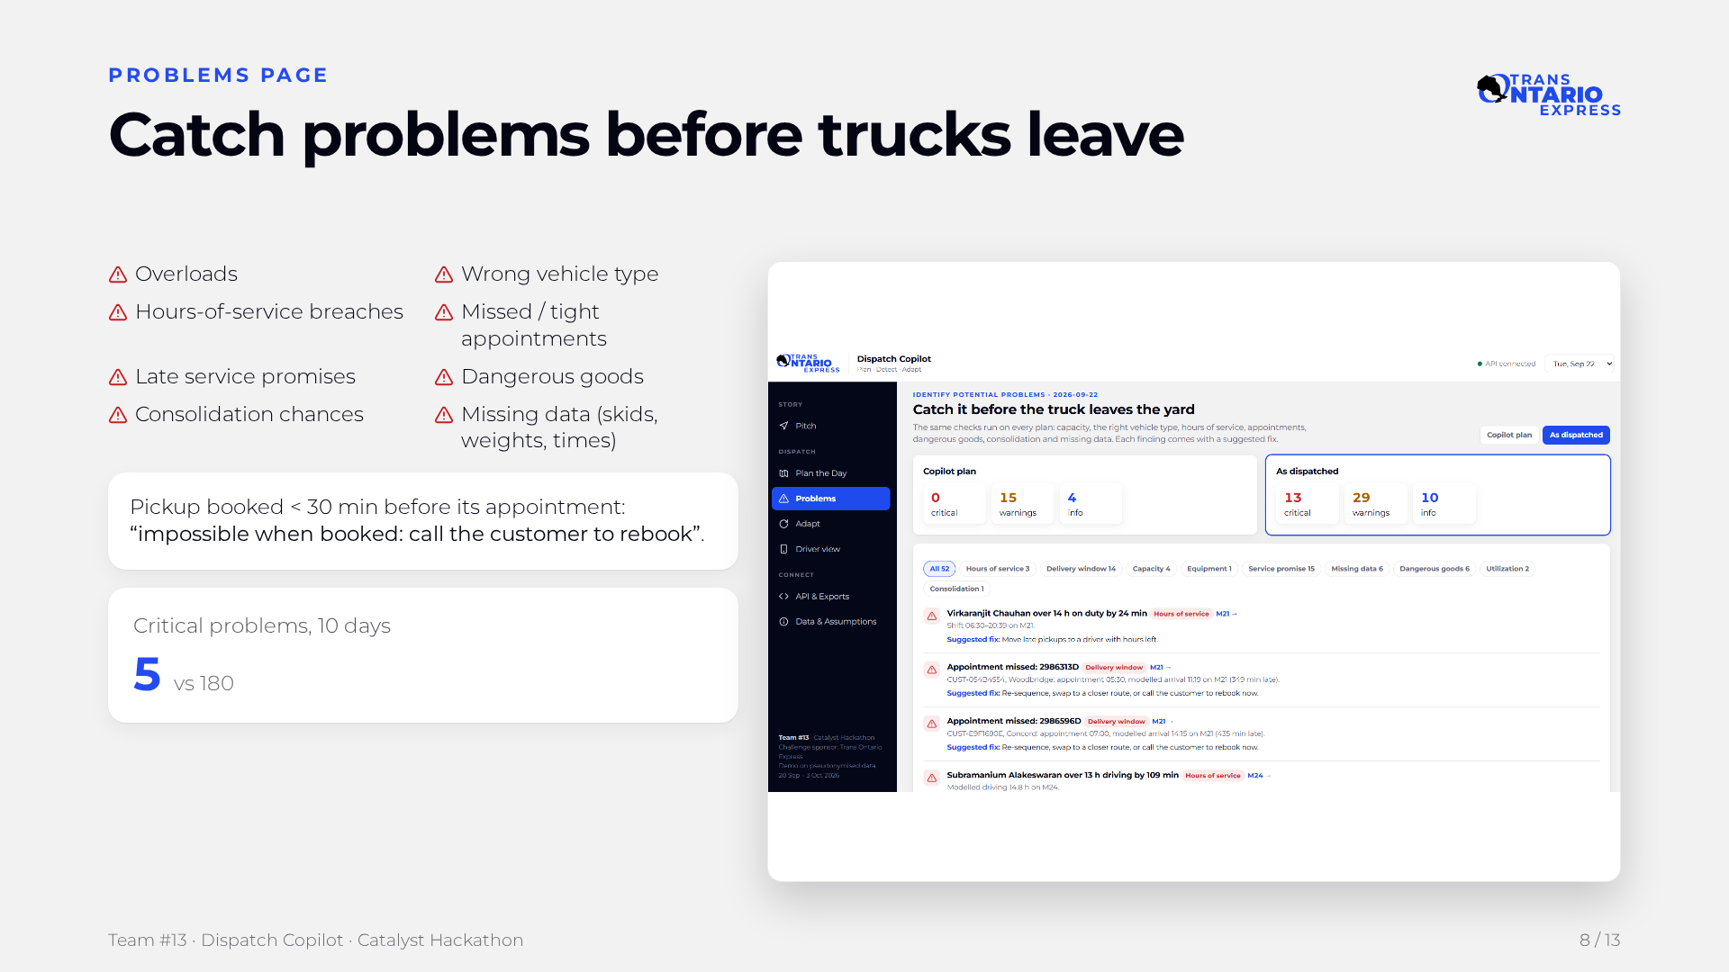
Notes:
The Problems page runs the same checks on every plan, including today's manual one. It looks for overloads, wrong vehicles, hours breaches, tight or missed appointments, late service promises, dangerous goods and missing data. A pickup booked less than 30 minutes before its appointment is flagged as impossible when booked, so George can call the customer to rebook. Over ten days, critical problems fall from 180 to 5.

Slide 9
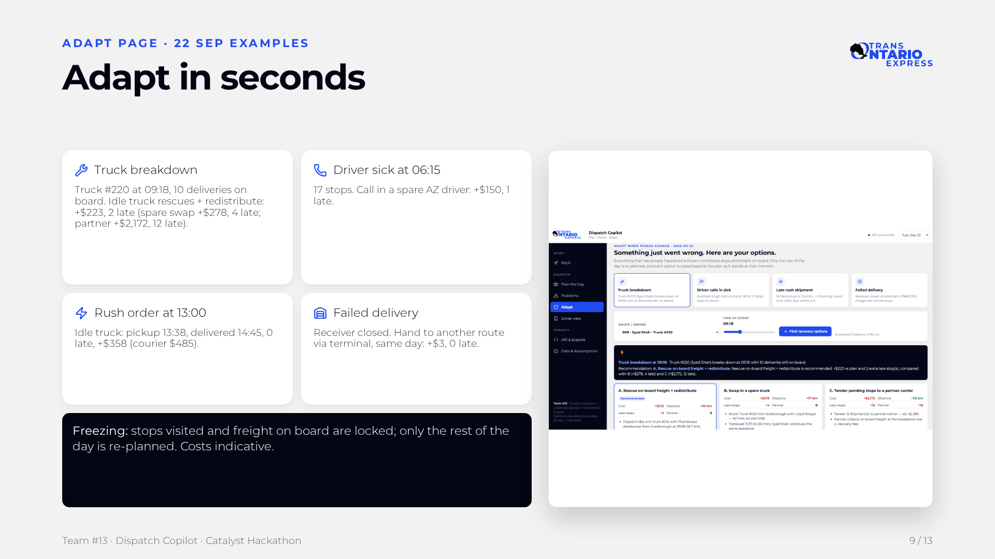
Notes:
When something goes wrong, the copilot freezes everything already done, like stops visited and freight on board, and re-plans only the rest of the day. Each option shows the change in cost, distance, late stops and partner use. For the truck #220 breakdown, an idle truck rescuing the freight beats a spare-truck swap or a partner carrier. The other examples show sick calls, rush orders and failed deliveries handled for a few hundred dollars or less.

Slide 10
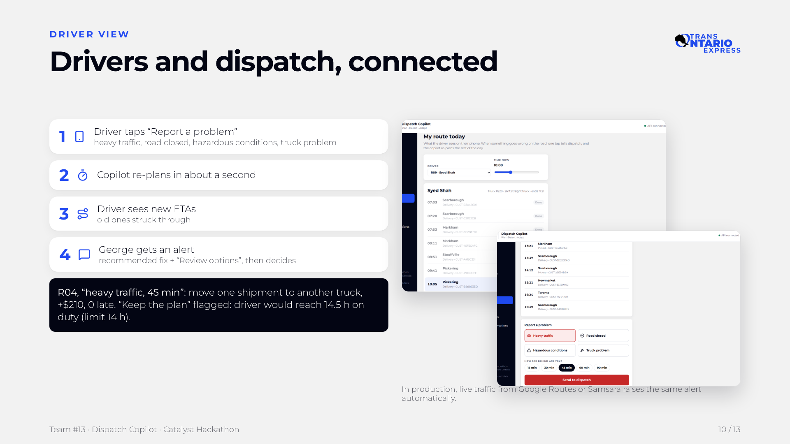
Notes:
Drivers are the first to know when something goes wrong, so we gave them one tap to tell dispatch. When the R04 driver reports 45 minutes of heavy traffic, the copilot re-plans in about a second, the driver sees new ETAs, and George gets an alert with the recommended fix. The copilot recommends moving one shipment to another truck for 210 dollars and zero late stops. It also flags that keeping the plan would push the driver to 14.5 hours on duty, past the 14-hour legal limit.

Slide 11
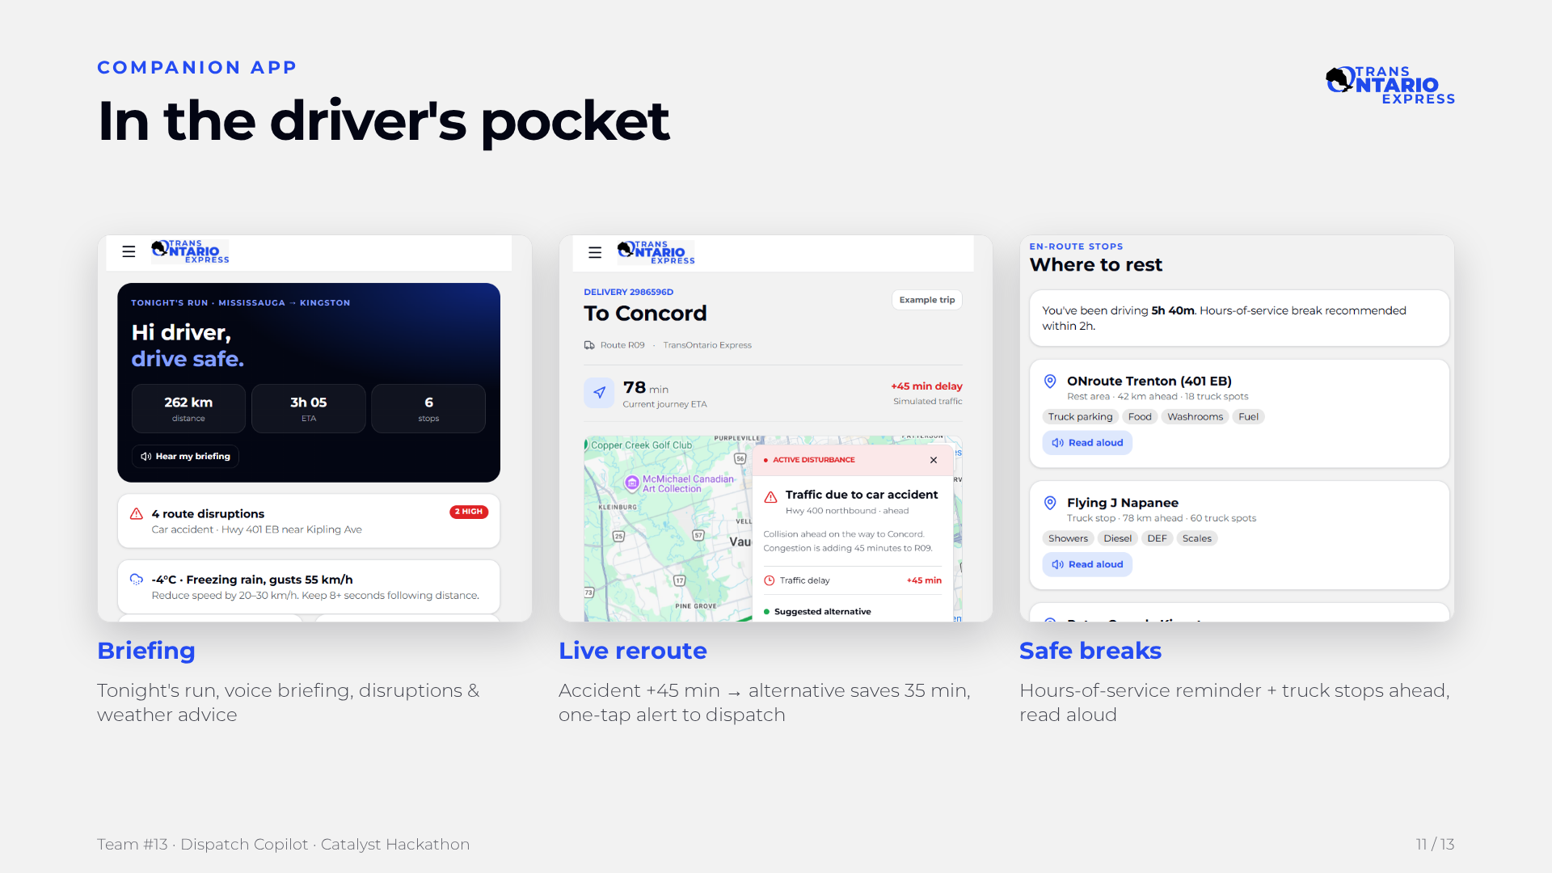
Notes:
The companion app is the driver's side of Dispatch Copilot. Home shows tonight's run, Mississauga to Kingston: 262 km, 3 hours 5 minutes, 6 stops, with a spoken briefing, live disruptions and weather advice such as reducing speed in freezing rain. On the route screen, when a car accident on Highway 400 adds 45 minutes, the driver sees a suggested alternative via Weston and Rutherford Road that saves 35 minutes, and can send a disturbance alert to dispatch. The stops screen tracks hours of service, recommends a break, and lists truck-friendly rest stops ahead with parking spots and amenities, each readable aloud so the driver keeps eyes on the road.

Slide 12
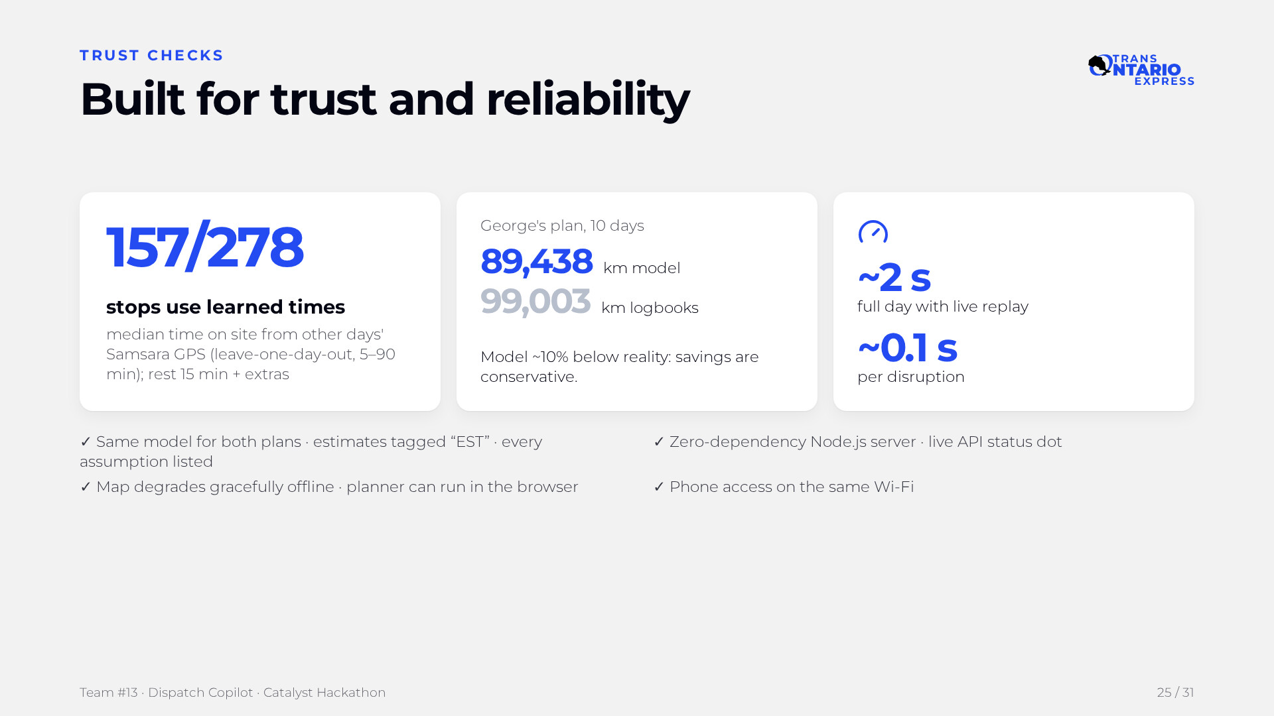
Notes:
We know a dispatcher will only trust numbers he can check. Stop times are learned from real GPS history, and our distances are checked against the trucks' own logbooks: our model is about 10 percent below reality, so our savings are conservative. Both plans use the same model, estimates are tagged EST, and every assumption is listed in the app. The system is also fast and robust: about 2 seconds for a full day and 0.1 seconds for a disruption.

Slide 13
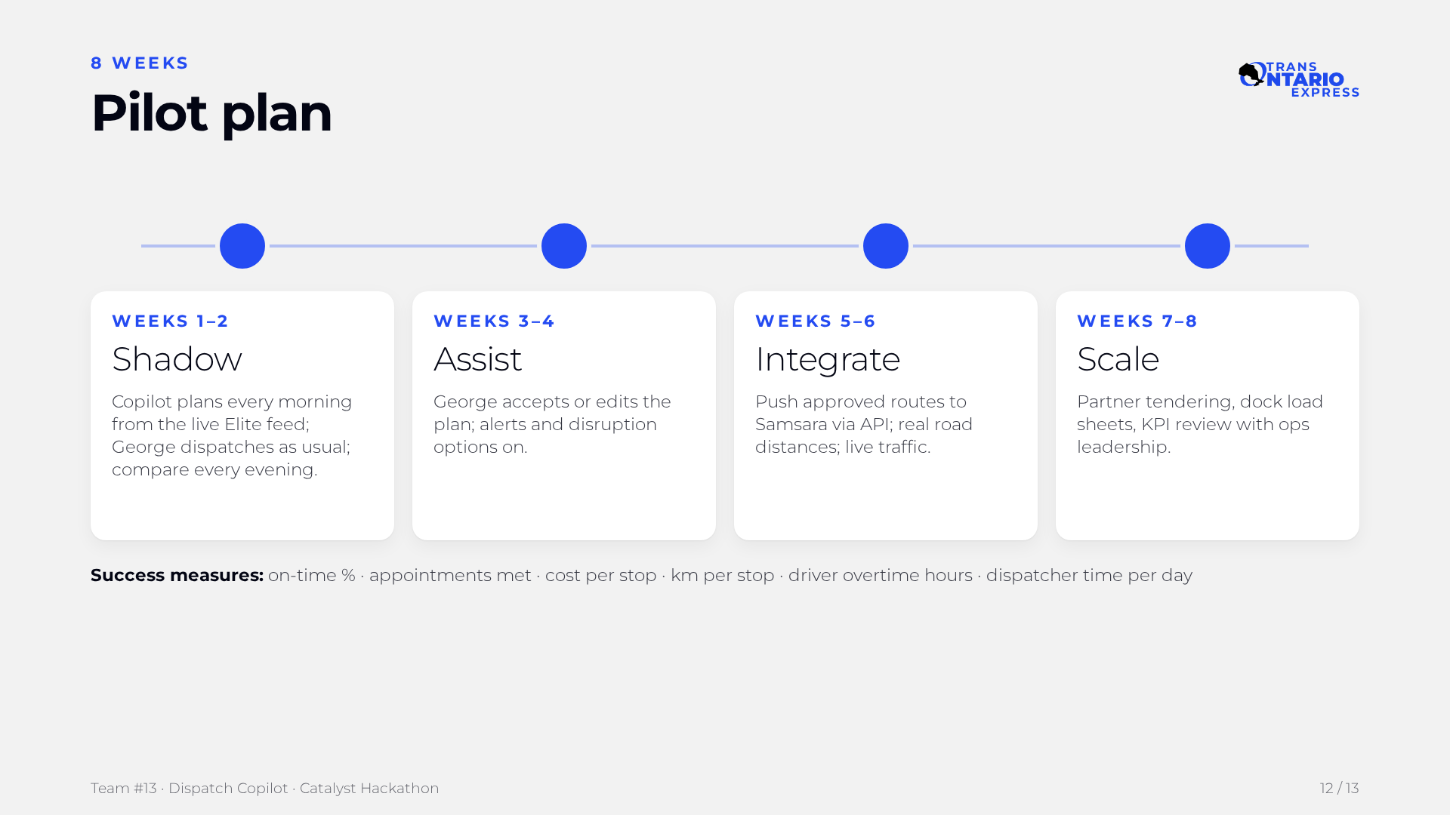
Notes:
We propose an eight-week pilot that builds trust step by step. In weeks one and two the copilot shadows George and we compare every evening. In weeks three and four George starts accepting or editing its plans, then we integrate with Samsara and real road data, and finally we scale to partners and the dock. Success is measured on on-time rate, appointments, cost and kilometres per stop, overtime and dispatcher time.

Slide 14
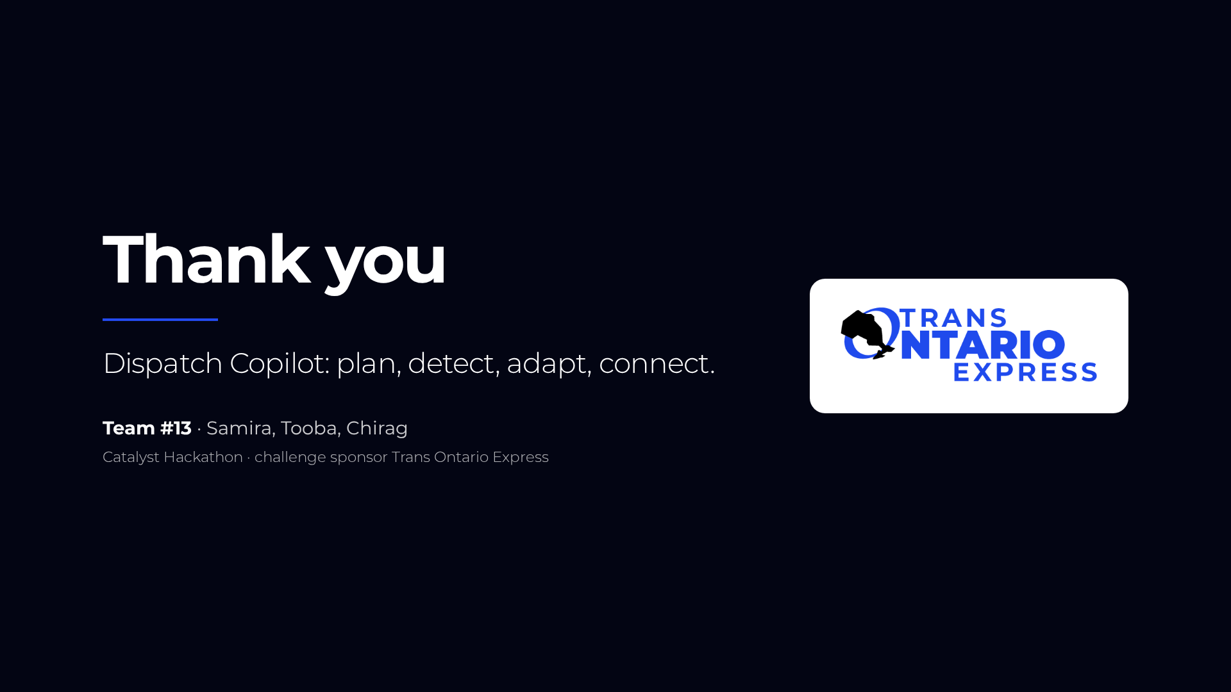
Notes:
Thank you for reading. Dispatch Copilot plans the day, detects problems early, adapts in seconds and connects drivers with dispatch, all tested on Trans Ontario's real data. We are Team #13: Samira, Tooba and Chirag. We would love to run the pilot with Trans Ontario Express.

