Slide 1
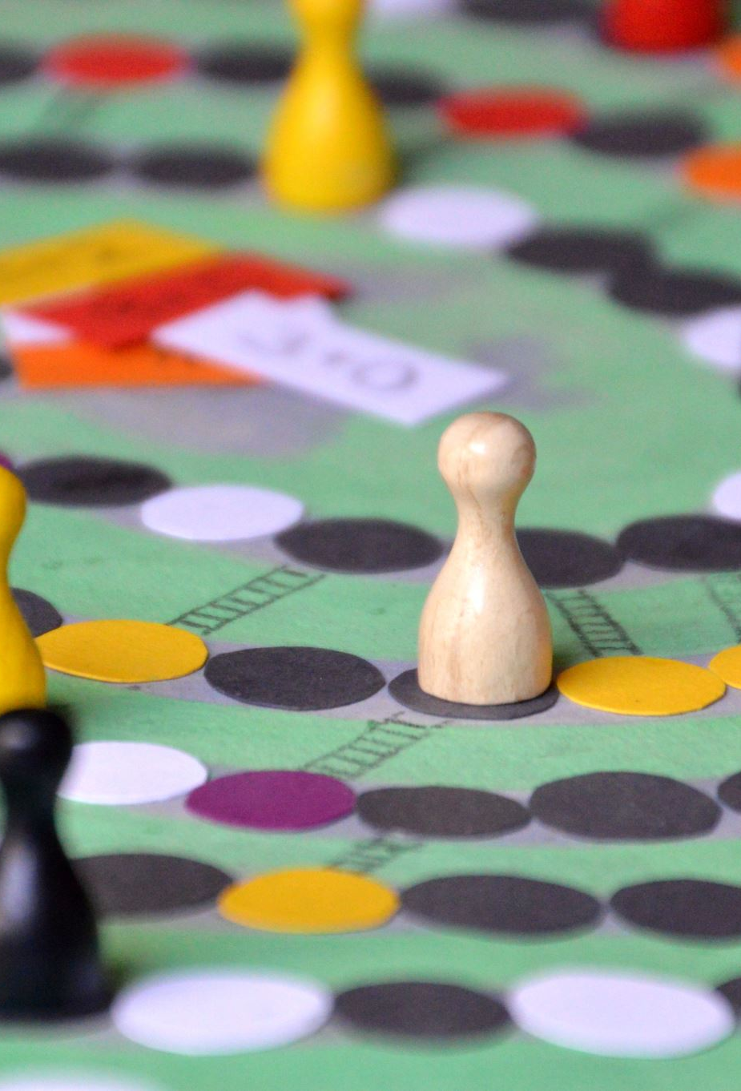
Board Game Checkers
Team: Brute Force

Slide 2
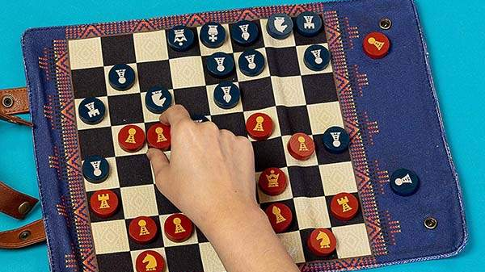
Introduction
Checkers is a group of strategy board games.
Diagonal moves of uniform game pieces.
Jumping over opponent pieces.
Two main types of checkers played:
8x8 and 10x10
This Photo by Unknown Author is licensed under CC BY-SA-NC

Slide 3
Game Requirements
Click and drag
Piece animation.
Moves database undo/redo (moves that have been played by players)
Players can communicate.

