Slide 1
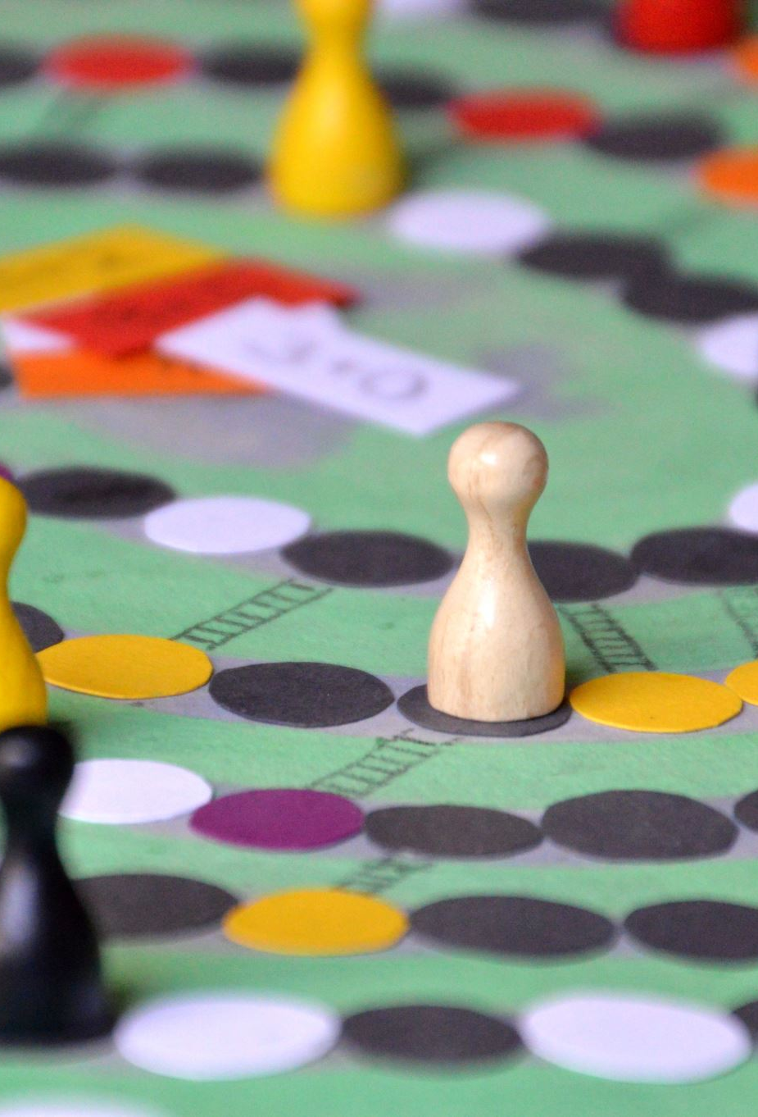
Board Game Checkers
Team: Brute Force

Slide 2
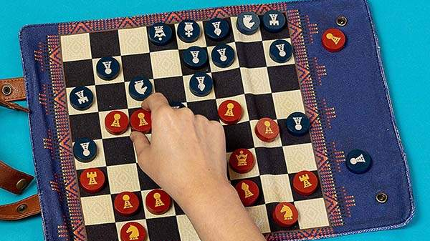
Introduction
Checkers is a group of strategy board games.
Diagonal moves of uniform game pieces.
Jumping over opponent pieces.
Two main types of checkers played:
8x8 and 10x10
This Photo by Unknown Author is licensed under CC BY-SA-NC

Slide 3
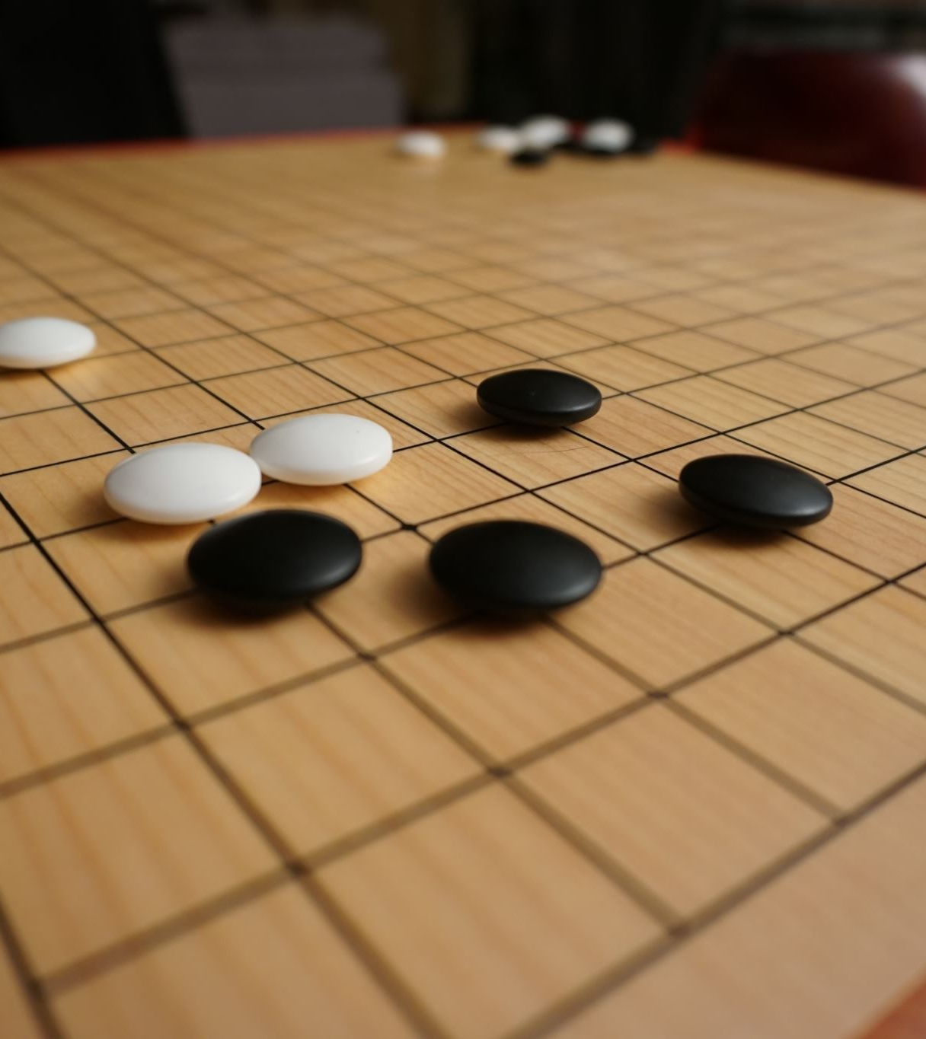
SCOPE
The Scope of this project is to create an online multiplayer checkers game where the player can also communicate with each other and get token rewards when they win.

Slide 4
Game Requirements
Click and drag
Piece animation.
Moves database undo/redo (moves that have been played by players)
Players can communicate.

Slide 5
Features
Two players will play on screen.
The state of the game can be saved, and the game can be continued.
Both versions of the game will be playable on the main screen.
Players will be able to click and point the pieces.
Players will be able to change the theme of the app.
Players will be able to play live over a local network.

Slide 6
Software requirements
Python Programming language.
Pycharm/VS Code for IDE.
Firebase for backend.
Pygame for UI.

Slide 7

Thank You

