Slide 1

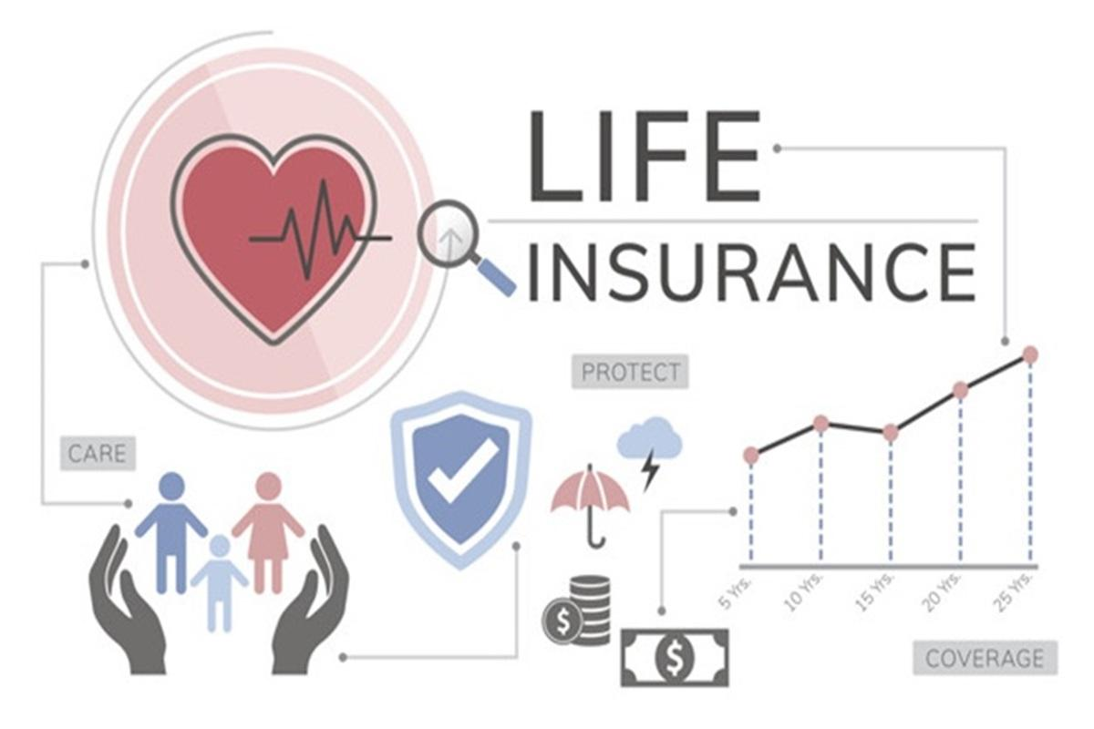

Risk Classification for Insurance
by Akshay Arora

Slide 2
Introduction
Insurance has become necessity these days as lot of uncertain health problems.
Insurance is a means of protection from financial loss. It can cover your loss caused either by accident or other unpredicted factors.
Insurance is one of the essentials which an individual should have for the more contented future of his family in his absence.
Customers can avail different insurance plan as per their age group.

Slide 3
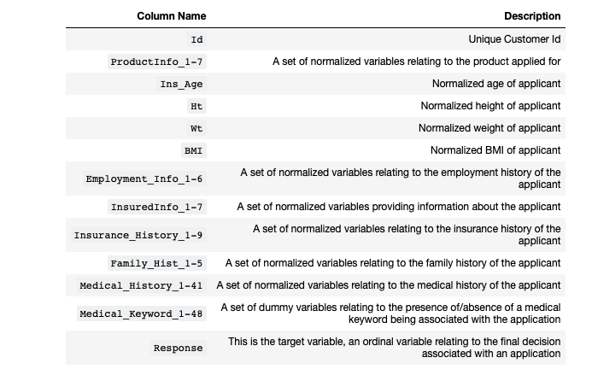
Data Description
The data set consist of 59381 observations from 128 columns. Above is table showing names of all columns and their description.

Slide 4
Problem Statement
We are building a Predictive Machine Learning Model to predict the risk factor for a firm while giving life insurance to the new and existing customers based upon their medical history, family history and various other factors.

Slide 5
Problem Solving Methodology
We will have a closer look of Insurance data to resolve data ambiguities by using different Python Packages like Pandas, matplotlib etc. and doing below :
Finding Patterns in Data
Checking Assumptions
Handling missing Values if any
Build Prediction Machine Learning Model

Slide 6
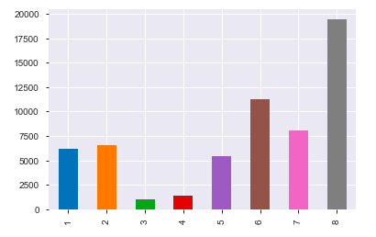
Response Variable(1-8) Present in Dataset
We are seeing in response variable, class 8 has max values and class 3 has least values.

Slide 7
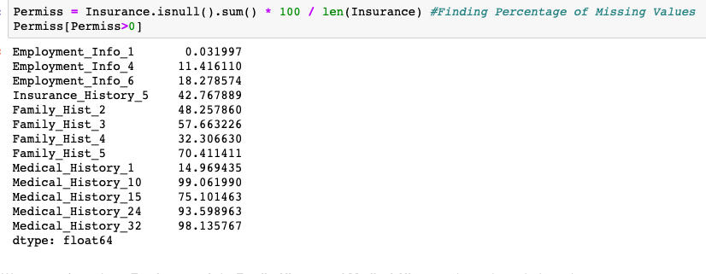
Handling missing Values
1> We have dropped columns having more than 70% missing values.
2> Replaced values with mean in other columns.

Slide 8
Predictive Models
We will be using below three classification techniques to evaluate the model :
Logistic Regression
Decision Tree
Random Forest

Slide 9
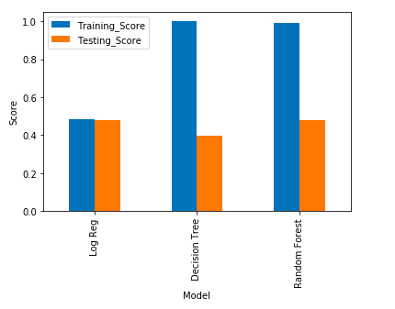
Applying Models With Default Parameters
Above Graphs Show:
1 > Log Regression is giving around 50% accuracy.
2 > We are seeing over fitting in case of Decision Tree and Random Forest.

Slide 10
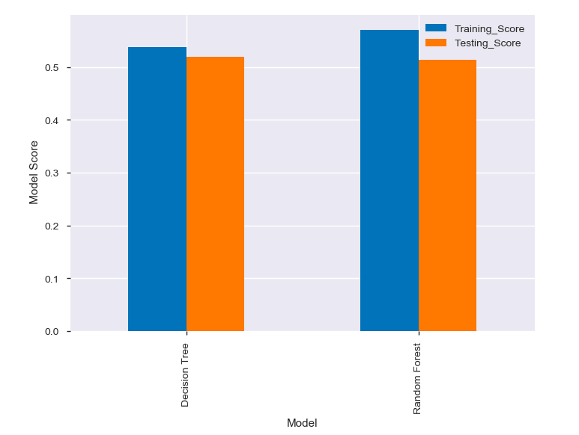
Applying Model with Grid Search
After applying grid search over fitting has been removed.

Slide 11
Conclusion
This notebook helps us understanding the risk classification of customers while giving insurance using predictive Machine Learning Algorithms.
We have used below three ML algorithms for prediction:
Logistic Regression
Decision Tree
Random Forest
We used above algorithm with default parameters and have seen over fitting in case of Decision Tree and Random Forest.
We have used again Decision tree and Random Forest using hyper parameters and have seen both are giving around same accuracy.
As Response Variable is __imbalanced__, we may need to use some resampling techniques and use some other models to increase the accuracy/precision/recall.

Slide 12
Thank you!!

