Slide 1
Behavior Parameterization

Slide 2
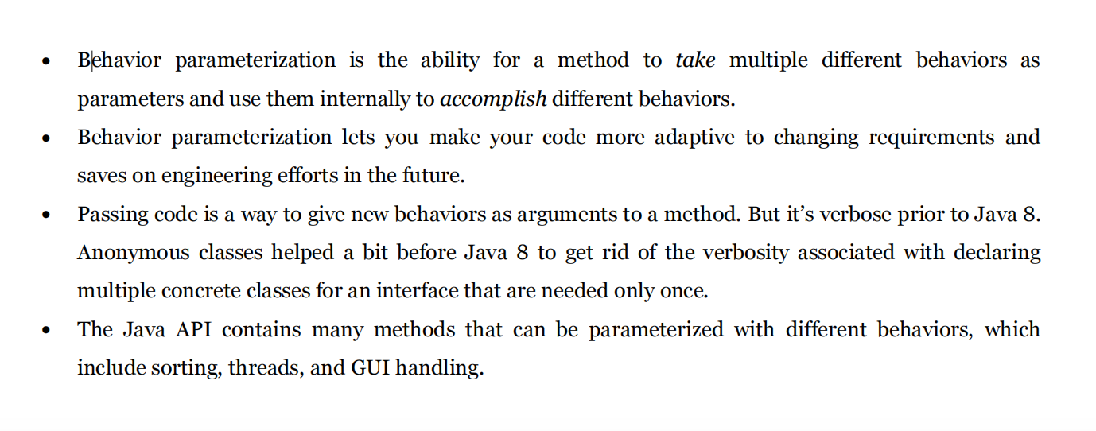
SUMMARY

Slide 3
Evolution of a problem and requirement

Slide 4
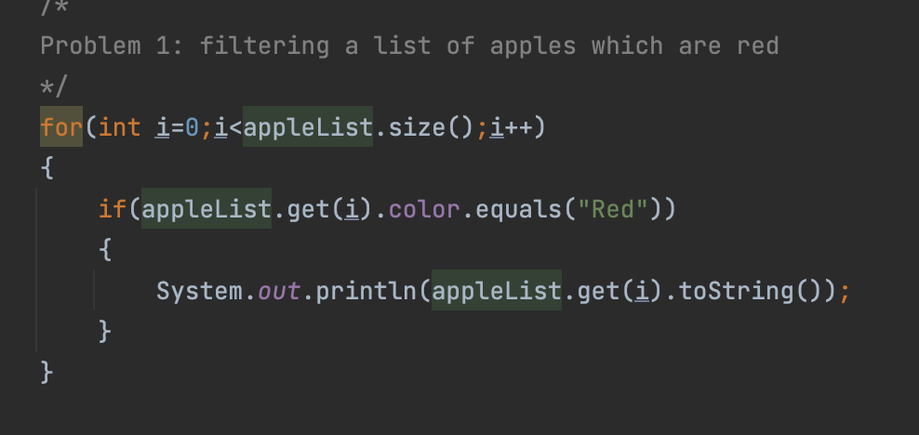
First Requiement
Prob: The farmer wants to filter all red apples . What should be the code??
Solution: We will iterate over all elements and get red apples

Slide 5
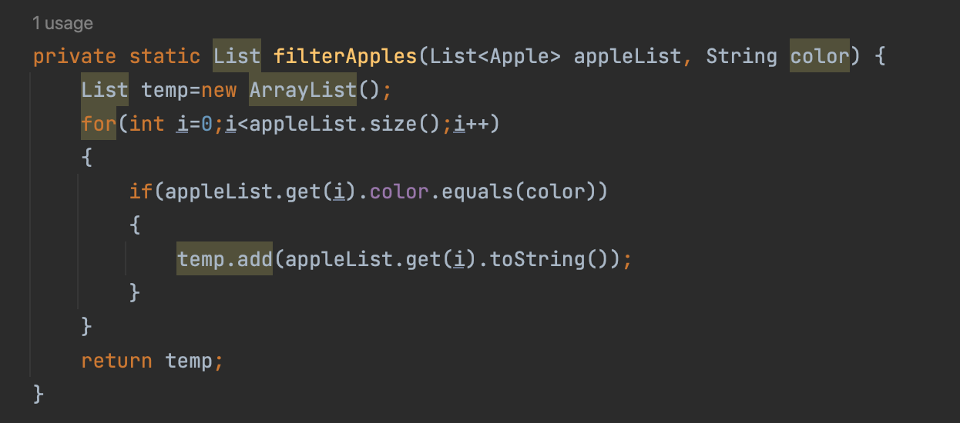
Second requirement
Problem: Now farmer wants to filter red as well as green apples
Solution: Instead of rewriting same code in problem 1 for red apples, we can evolve our method by adding a parameter color

Slide 6
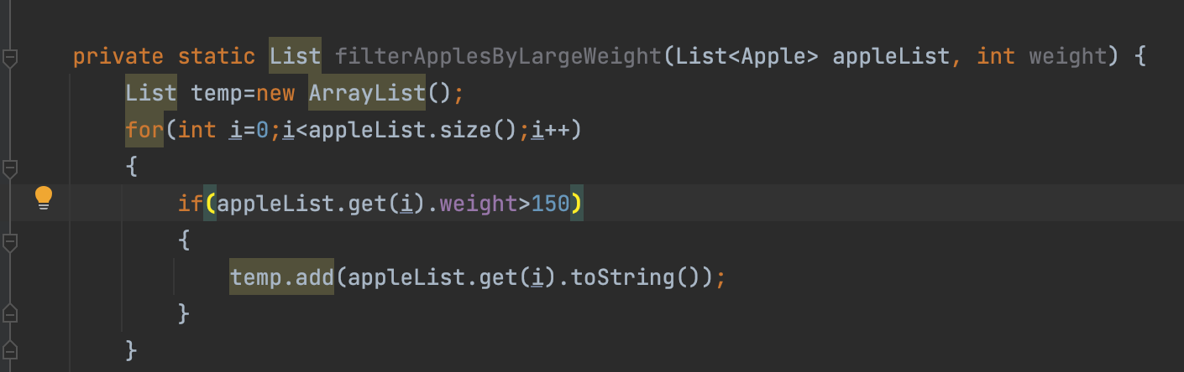
But, what happens if farmer now wants to filter by weight?
Then we need to rewrite the same logic for weight
Notice we need to duplicate same traversal code again and again

Slide 7
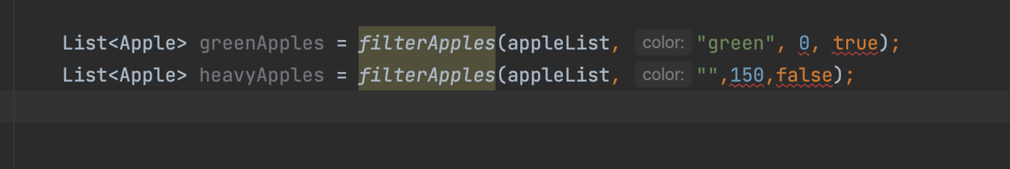
Third requirement(add as many parameter as you can)
Now, lets suppose farmer wants to filter by both weight and color.So we need to pass these 2 as parameters to the method
What should happen in future if farmer wants additional criteria to filter??
We will keep on adding new parameteres.
Notice how ugly client code looks.?
this solution doesn’t cope well with changing requirements.

Slide 8
Fourth Requirement(filtering by behavioral parameter) or passing behaviour as parameter
In previous example, we usually filtered elements from collection. These filters returned a boolean values.
We call this a predicate (that is, a function that returns a boolean)
Therefore going one step back, lets define a predicate that returns a boolean value.
This predicate can be used generally for both size and color.
see next slide.....

Slide 9
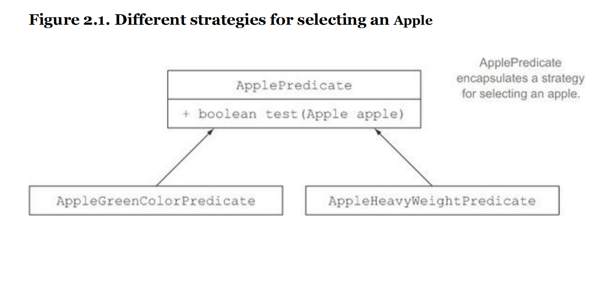
What you just did is related to the strategy design pattern which lets you define a family of algorithms, encapsulateeach algorithm (called a strategy), and select an algorithm at run-time. In this case the family of algorithms is ApplePredicate and the different strategies are AppleHeavyWeightPredicate and AppleGreenColorPredicate

Slide 10
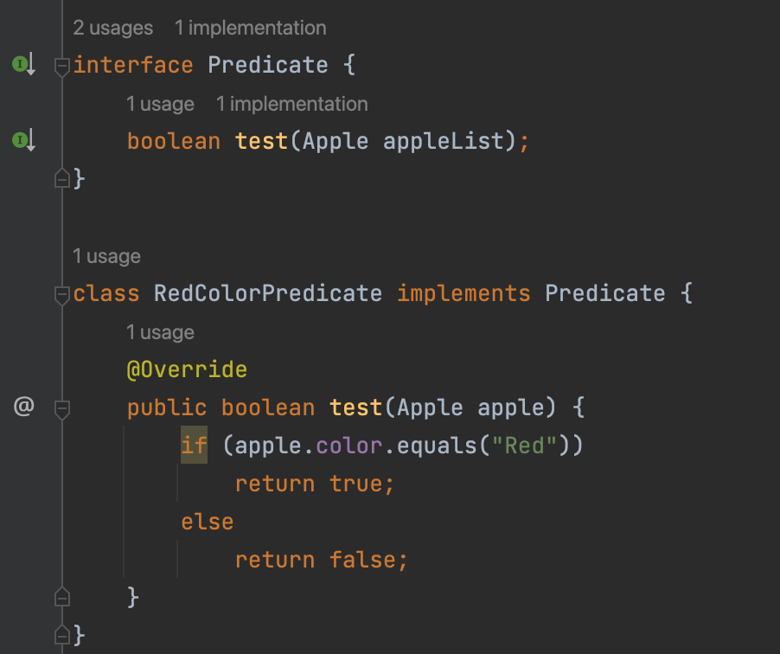
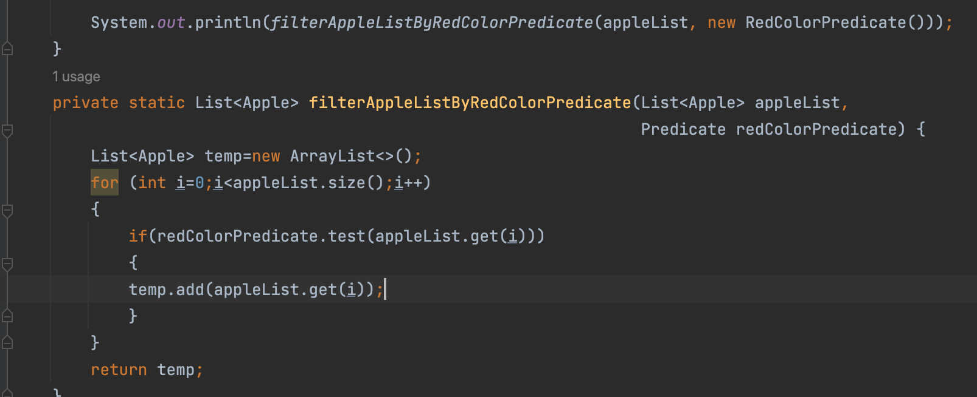
Client code

Slide 11
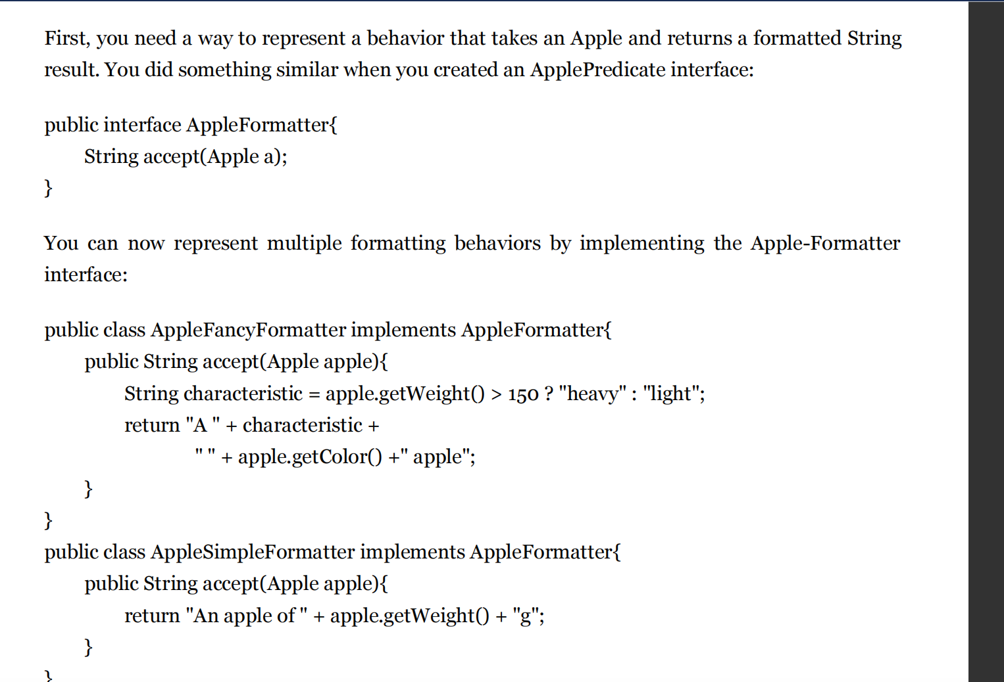
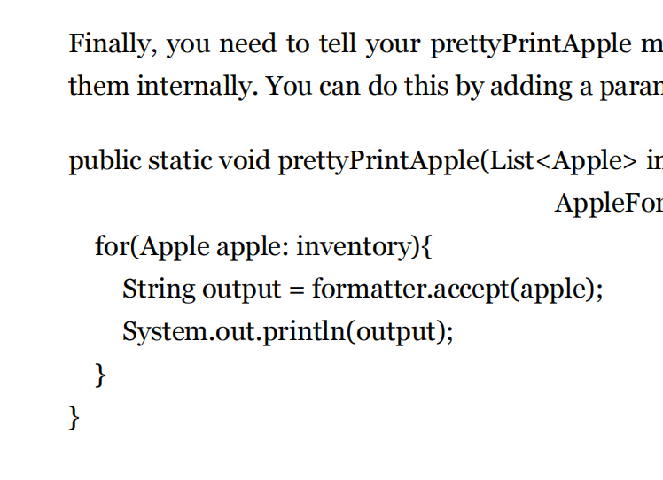
Another example of behavior parameterization with just display, and return of String values

Slide 12
Fifth requirement(Tackling verbose)
Previous method of writing multiple classes for each separate implementation of filter/accept methods looks verbose
Hence we use anonymous class to mitigate the rewriting of a new class

Slide 13
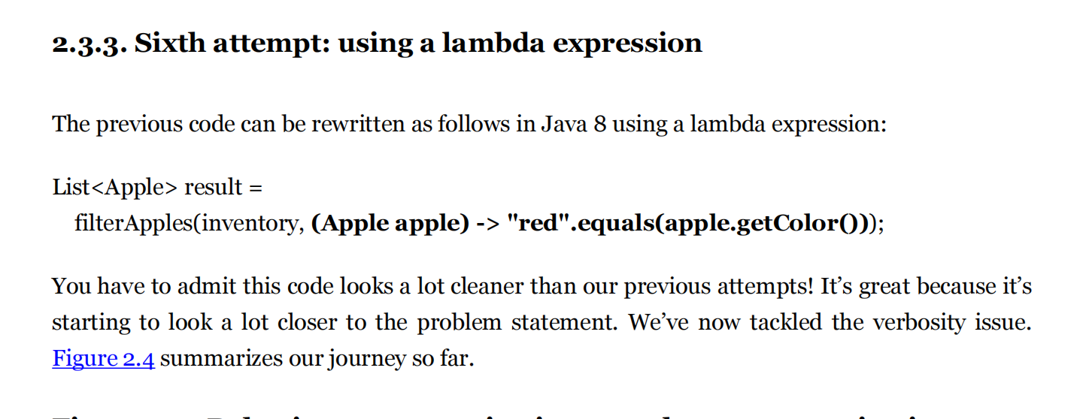
Sixth Requirement(using lambda’s)

Slide 14
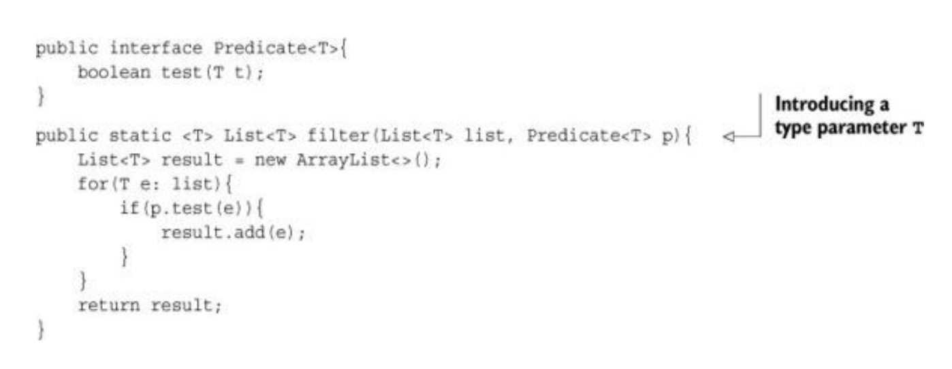
Seventh Requirement(Abstracting over a generic type T instead of a apple class in Lambda)

Slide 15
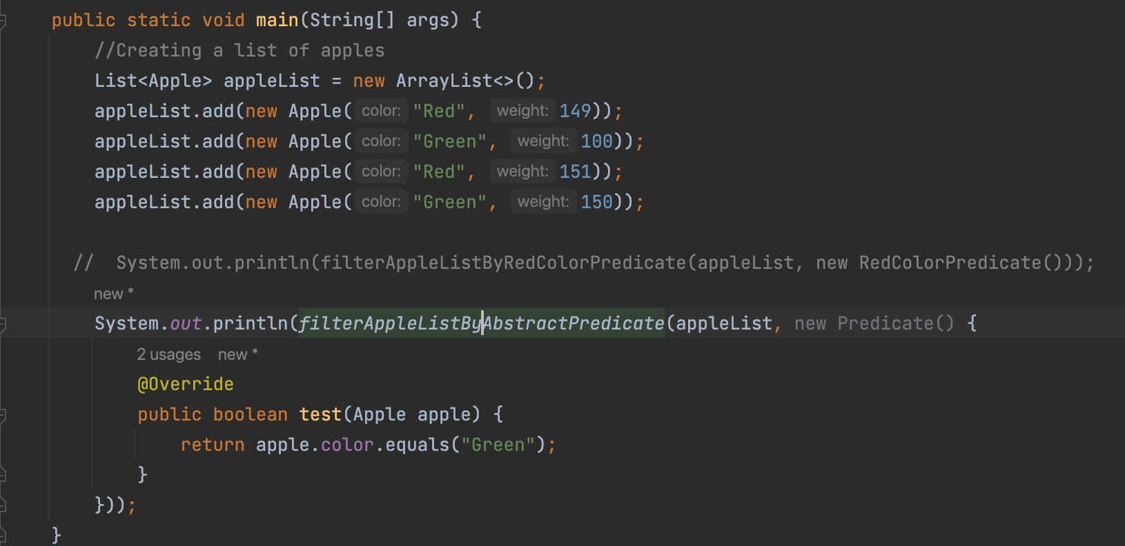
abstraction

