Slide 1
Express js

Slide 2
Why express.js
Express js is a framework that is going to make use of nodejs easier
Helps to organize and structure our code better
In the site https://2019.stateofjs.com/back-end/ , it is shown to be most preferable javascript library used in backend
Next.js is a competor now and it is used currently

Slide 3
How to install express.js
Create a new project and initialize it
/Users/I563584/PersonalProjects/WebDevelopment/Nodejs/MyExpressServer
Create file as server.js
Type npm init and follow the instructions to create a new package
Go to express js website and follow instructions
https://expressjs.com/en/starter/installing.html

Slide 4
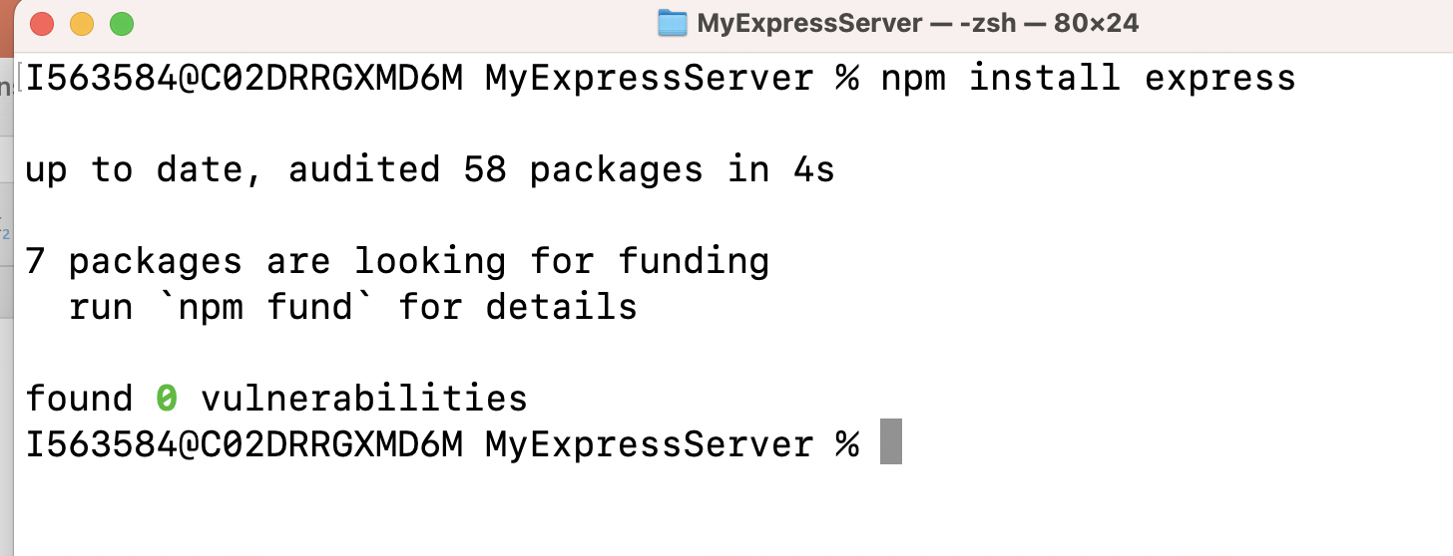
How to install express.js
npm install express –save. ( save has been removed now , because its not used after nodejs v5)
Currently I am using a much newer version
node -v
v18.12.1

Slide 5
How to install express.js
Check express.js is installed
{
"name": "myexpressserver",
"version": "1.0.0",
"description": "FirstServer",
"main": "server.js",
"scripts": {
"test": "echo \"Error: no test specified\" && exit 1",
"start": "node server.js"
},
"author": "Nishant",
"license": "ISC",
"dependencies": {
"express": "^4.18.2"
}
}

Slide 6
Using Express
Follow the link https://expressjs.com/en/starter/hello-world.html
Server.js
const express = require('express')
const app = express()
const port = 3000
app.get('/', (req, res) => {
res.send('Hello World!')
})
app.listen(port, () => {
console.log(`Example app listening on port ${port}`)
})

Slide 7
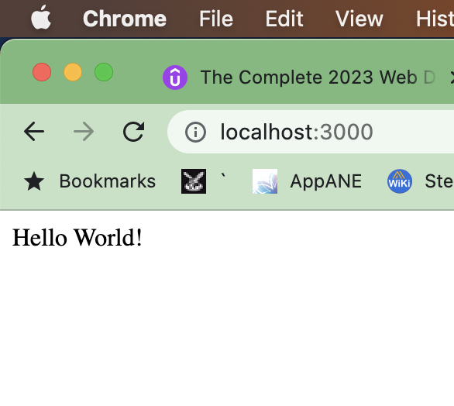
Starting the server
node server.js
It will start the server on port 3000

Slide 8
NodeMon
This tool is used to auto re-start the server after we make changes to any file in server.js file
To install this tool use below command
sudo npm install -g nodemon (can be installed anywhere)
In case you receive any error , go to error folder manually and give all permission to file/folder which is causing the issue
If by chance the port is already in use, use below command to kill a process in mac
First, you would want to know which process is using port 3000
sudo lsof -i :3000 ( this will list all PID listening on this port, once you have the PID you can terminate it with the following☺
kill -9 {PID}

Slide 9
NodeMon
How to use Nodemon
Use below command
nodemon server.js

Slide 10
Enable Server to receive a post data
app.post('/bmicalculator',(req,res) => {
var weight=parseFloat(req.body.weight);//
var height=parseFloat(req.body.height);
var bmi=weight/(height*height);
res.send("Your bmi is "+bmi);
});
The above code wont work as we don’t have a way to parse through body data

Slide 11
Body Parser
A Body Parser is used to make use of the data that comes with client request
1st step is to install body parser
Npm install body-parser
const bodyparser = require('body-parser’)
app.use(bodyparser.urlencoded({extended:true}));// we will parse data from form
extended:true is for using nested block
Usage
var weight=parseFloat(req.body.weight);//

