Slide 1
Node js

Slide 2
Why nodejs
It uses Javascript which everybody knows
It is Superfast and Scalable .
Used by Companies like Ebay,uber,twitter,Netflix. Even Atom desktop app is based of Node js
What is nodejs
Node js is a backend language that is used to interact with System.
Unlike javascript , which only has access to browser, node js has access to system. SO we can do lot of stuffs like create a web application backend, or create a desktop application

Slide 3
Installation of Node js
Download it from website https://nodejs.org/en/
Confirm it
node --version

Slide 4
Testing node.js
Create a file index.js
Console.log(“Hello World”)
In cmd , type node index.js
Output:- Hello World

Slide 5
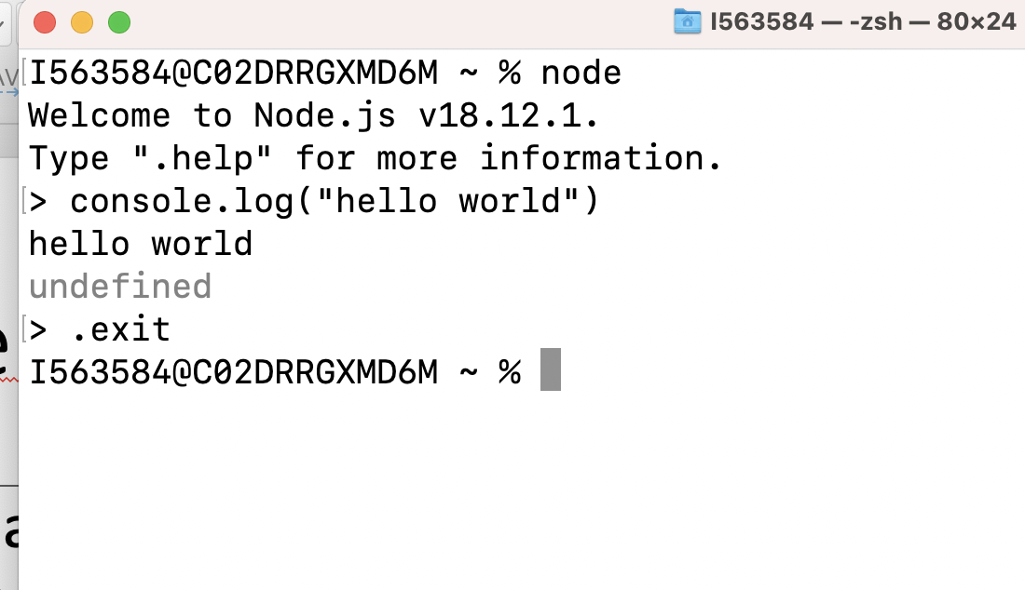
Repl(Read, Evaluate, Print, Loop)
It’s a tool provided by node where we can directly write code line by line and execute same
To open the tool , type node
To exit from tool, either
Write .exit
Or ctrl+z 2 times

Slide 6
How to use native Node modules
Node.js comes with prebuild modules. We can use them as follows
const fs= require("fs");
fs.copyFileSync("file1.txt","file2.txt");
The above commands will copy file1 to file2.

Slide 7
NPN Manager(Node package Manager)
In previous session we saw how to use inbuilt packages.
Here we will talk about how to create your own package and how to import external packages

Slide 8
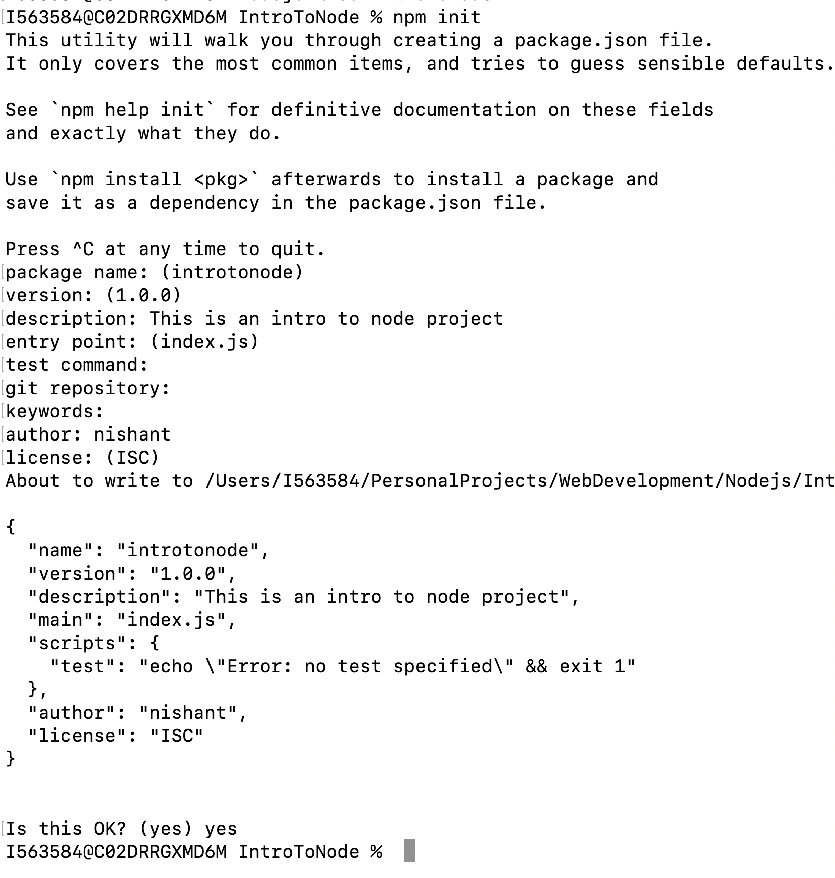
To initialize your own package
Type
Npm init
This will ask for basic details
Once package is created then we will see a properties file generated
Called package.json
{
"name": "introtonode",
"version": "1.0.0",
"description": "This is an intro to node project",
"main": "index.js",
"scripts": {
"test": "echo \"Error: no test specified\" && exit 1"
},
"author": "nishant",
"license": "ISC"
}

Slide 9
To import external package
There is a website https://www.npmjs.com/package/superheroes
Follow the instruction to download this package
npm install superheroes
As you can see below, the dependency gets added to package.json
{
"name": "introtonode",
"version": "1.0.0",
"description": "This is an intro to node project",
"main": "index1.js",
"scripts": {
"test": "echo \"Error: no test specified\" && exit 1"
},
"author": "nishant",
"license": "ISC",
"dependencies": {
"superheroes": "^3.0.0"
}
}

Slide 10
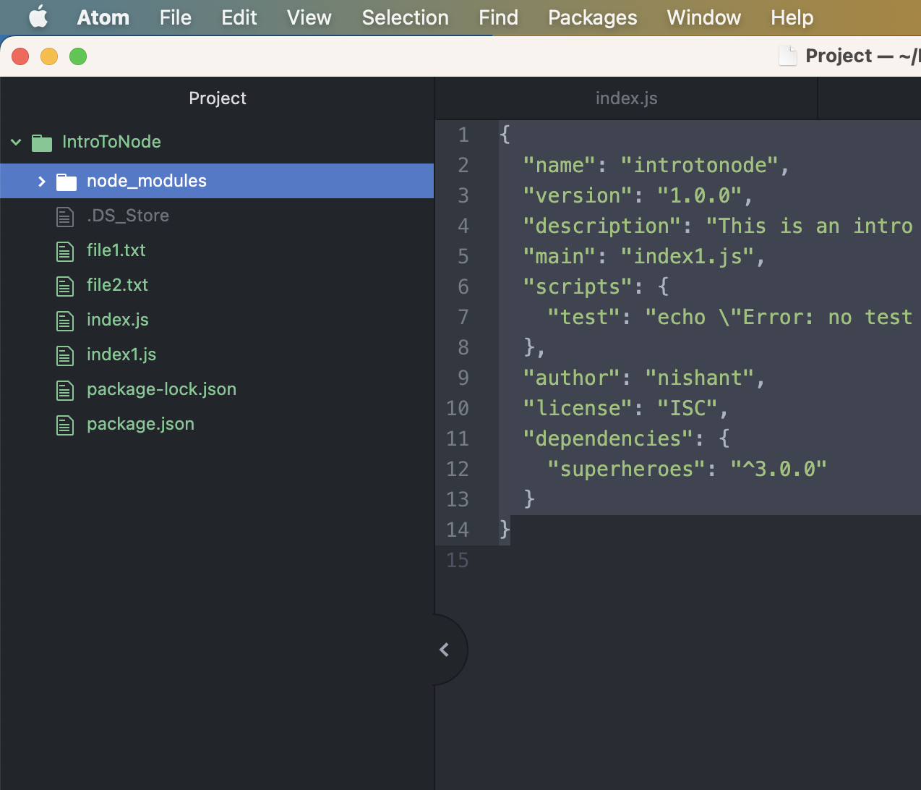
Node modules folder
All dependencies gets pulled into this folder

