Slide 1
ShadowForge – AI-Powered API Cloning & Mock Server Platform
(Course Code: 25CS022)
Presented By:
Riya Rana (2411981467)
Riyanshi (2411981468)
Rohani (2411981469)

Slide 2
Index
Introduction
Project Description
System Architecture & Design
Database Design
Data Flow Diagrams (DFD)
Features Implemented
Screenshots
Challenges Faced
Pending Tasks
Conclusion

Slide 3
Introduction
ShadowForge is an AI-powered platform that automatically clones REST APIs and creates intelligent mock servers for faster, safer, and more efficient software development.
AI-powered platform for automatic REST API cloning.
Generates realistic mock APIs within seconds.
Analyzes API structure without manual configuration.
Enables safe testing without using live APIs.
Allows frontend and backend teams to work in parallel.
Provides API versioning, analytics, and request logging.
Secure, scalable, and developer-friendly architecture.
Reduces development time, cost, and dependency on third-party APIs.

Slide 4
Project Description
ShadowForge is an innovative platform that simplifies API development and testing by automatically cloning existing REST APIs and generating intelligent mock servers. It enables developers to create realistic API responses without relying on live or third-party services, allowing frontend, backend, and QA teams to work simultaneously.
The platform analyzes API structures, generates dynamic mock data, simulates various response scenarios (such as delays and errors), and provides features like API versioning, request logging, and performance analytics. By reducing dependency on production APIs, ShadowForge accelerates development, improves testing accuracy, and enhances collaboration across software development teams.

Slide 5
Key Features
Key Features:
AI-powered REST API cloning
Automatic mock API generation
Dynamic response simulation
API analytics & request logging
Error and latency simulation
API version management
Secure user authentication
Scalable MERN-based architecture

Slide 6
System Architecture and
Design
1. User Authentication
Secure user registration and login using JWT.
Role-based access to projects and APIs.
2. API Scanner
Accepts an API endpoint.
Analyzes request methods, headers, parameters, and JSON responses.
Detects API schema automatically.
3. Mock API Generator
Generates realistic mock APIs from detected schemas.
Supports dynamic fake data generation.

Slide 7
System Design And
Architecture
4. Response Simulation
Simulates success responses, delays, authentication failures, and server errors.
Helps developers test multiple scenarios.
5. API Version Management
Maintains different API versions.
Supports comparison and rollback.
6. Analytics & Logging
Tracks API requests and response times.
Displays usage statistics and performance reports.
7. Database Management
Stores users, API schemas, mock responses, logs, and version history in MongoDB.

Slide 8
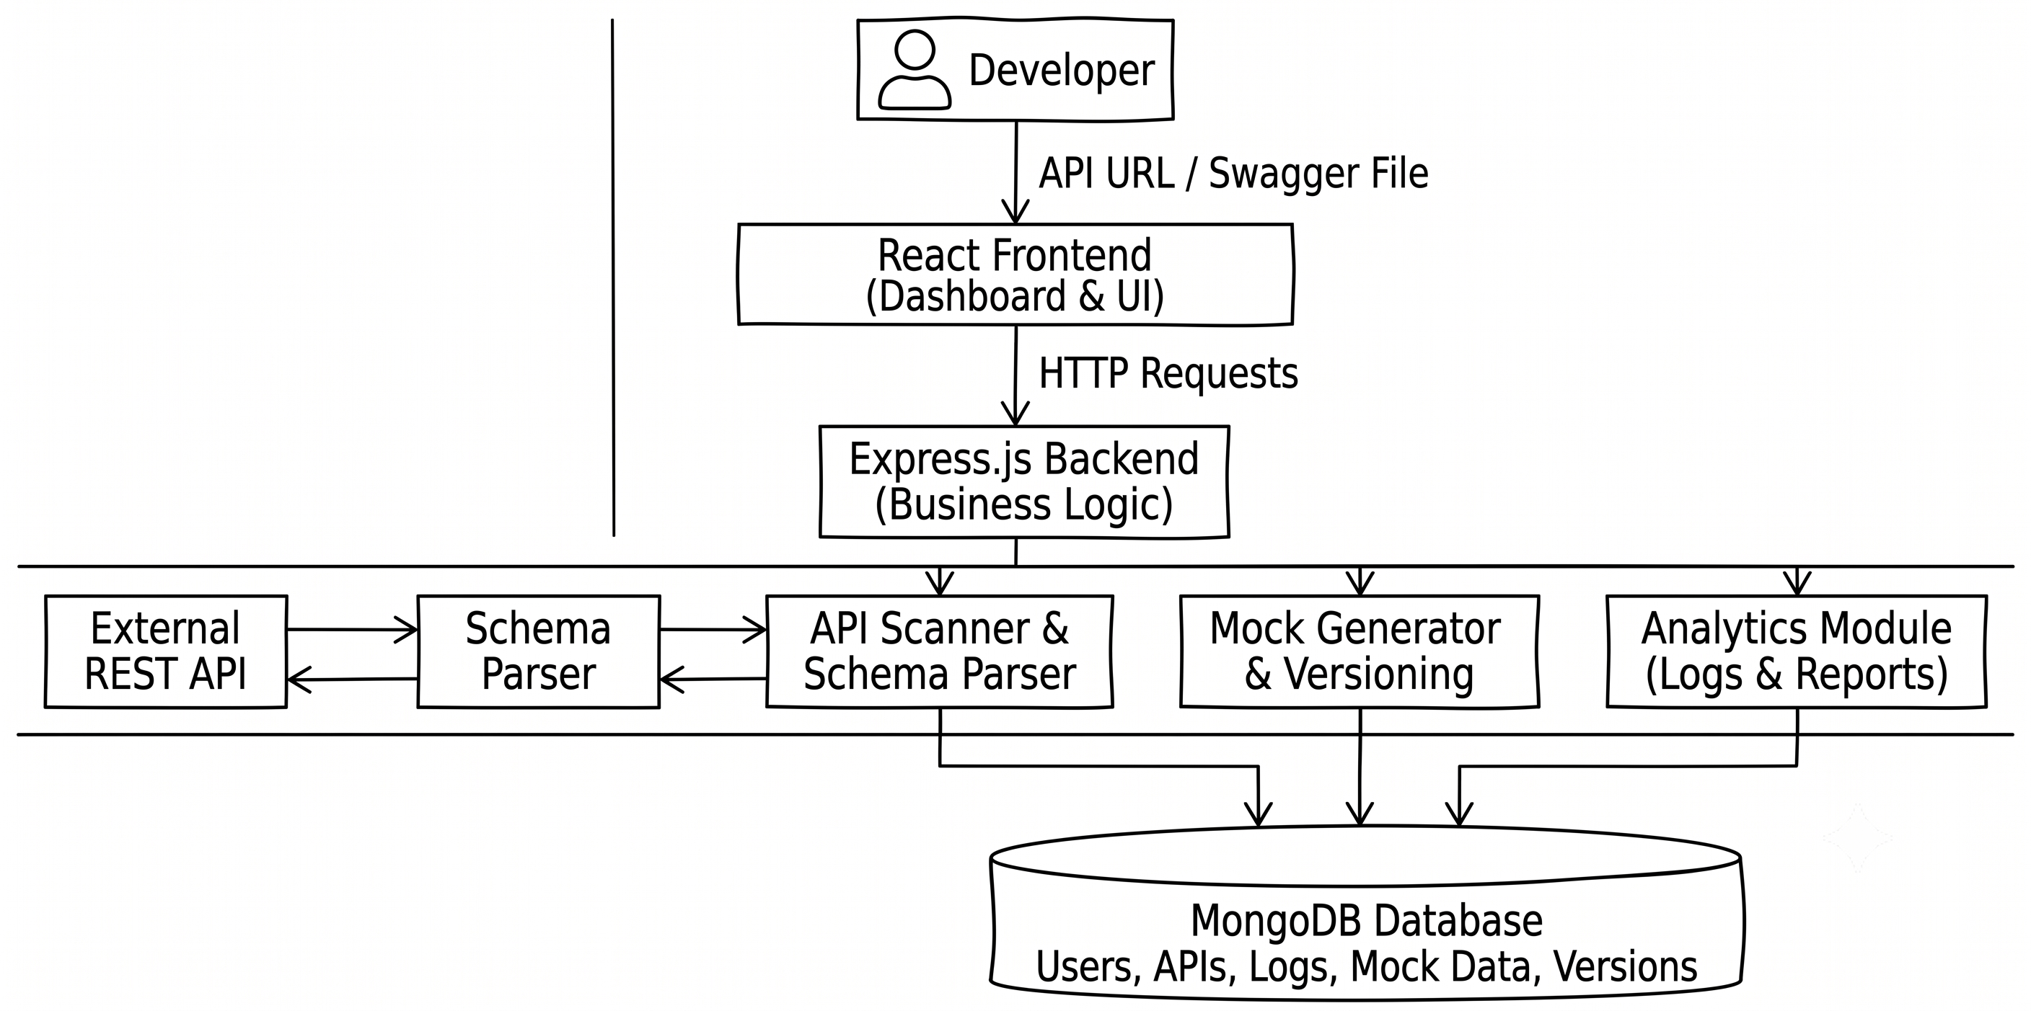
System Design And
Architecture

Slide 9
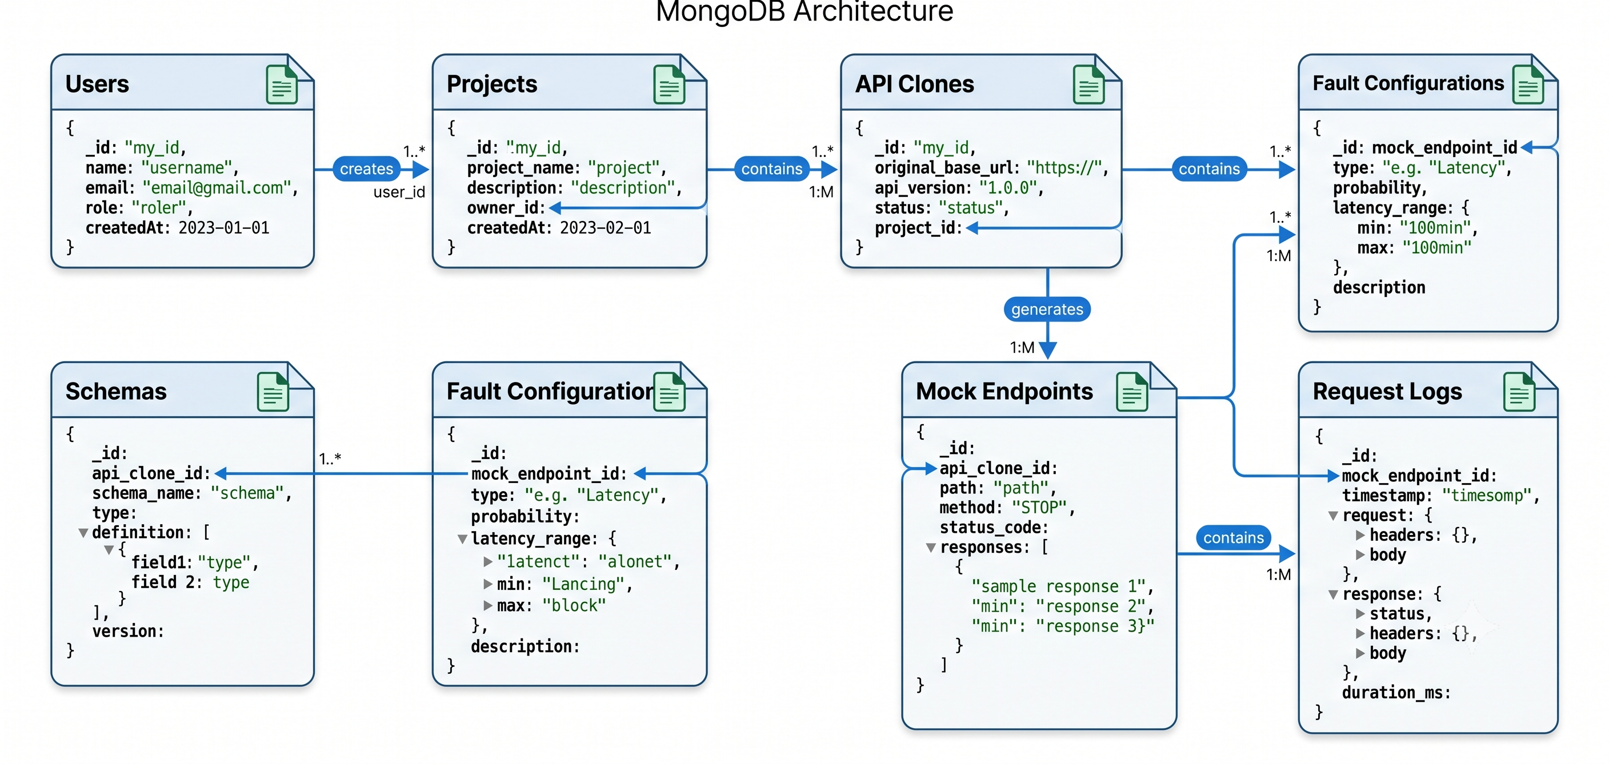
Database Design
ShadowForge uses MongoDB, a NoSQL document-oriented database, to store dynamic API schemas, mock responses, user information, and request logs.
.

Slide 10
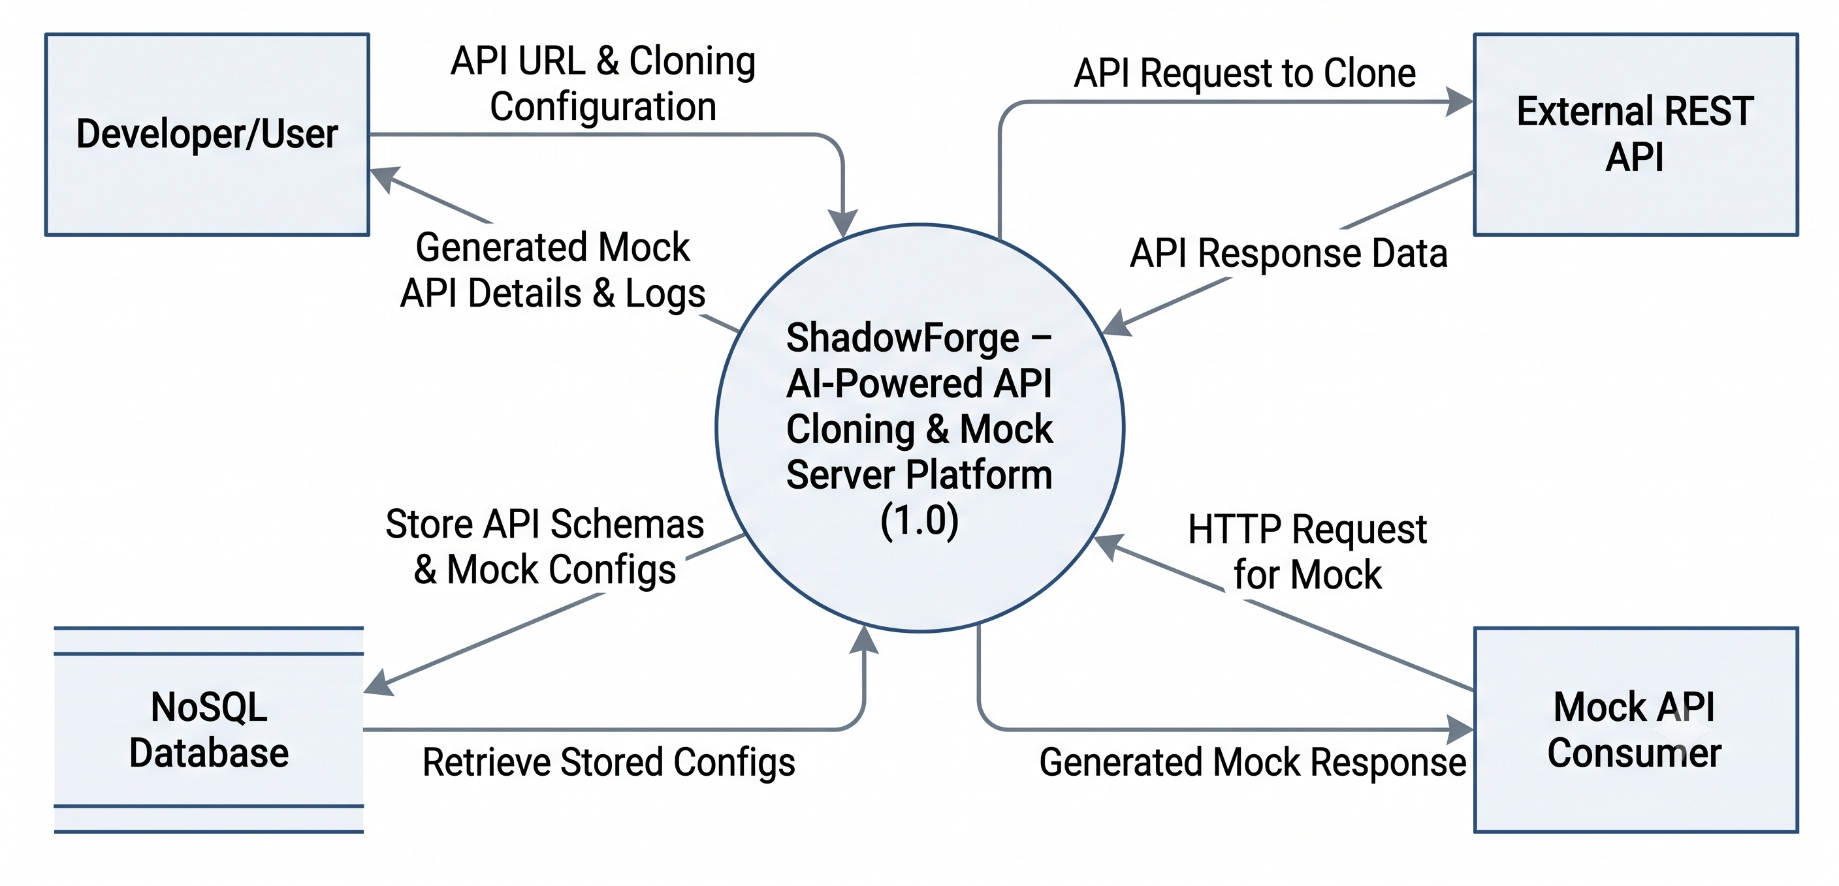
Dataflow Diagrams
Level-0 DFD

Slide 11
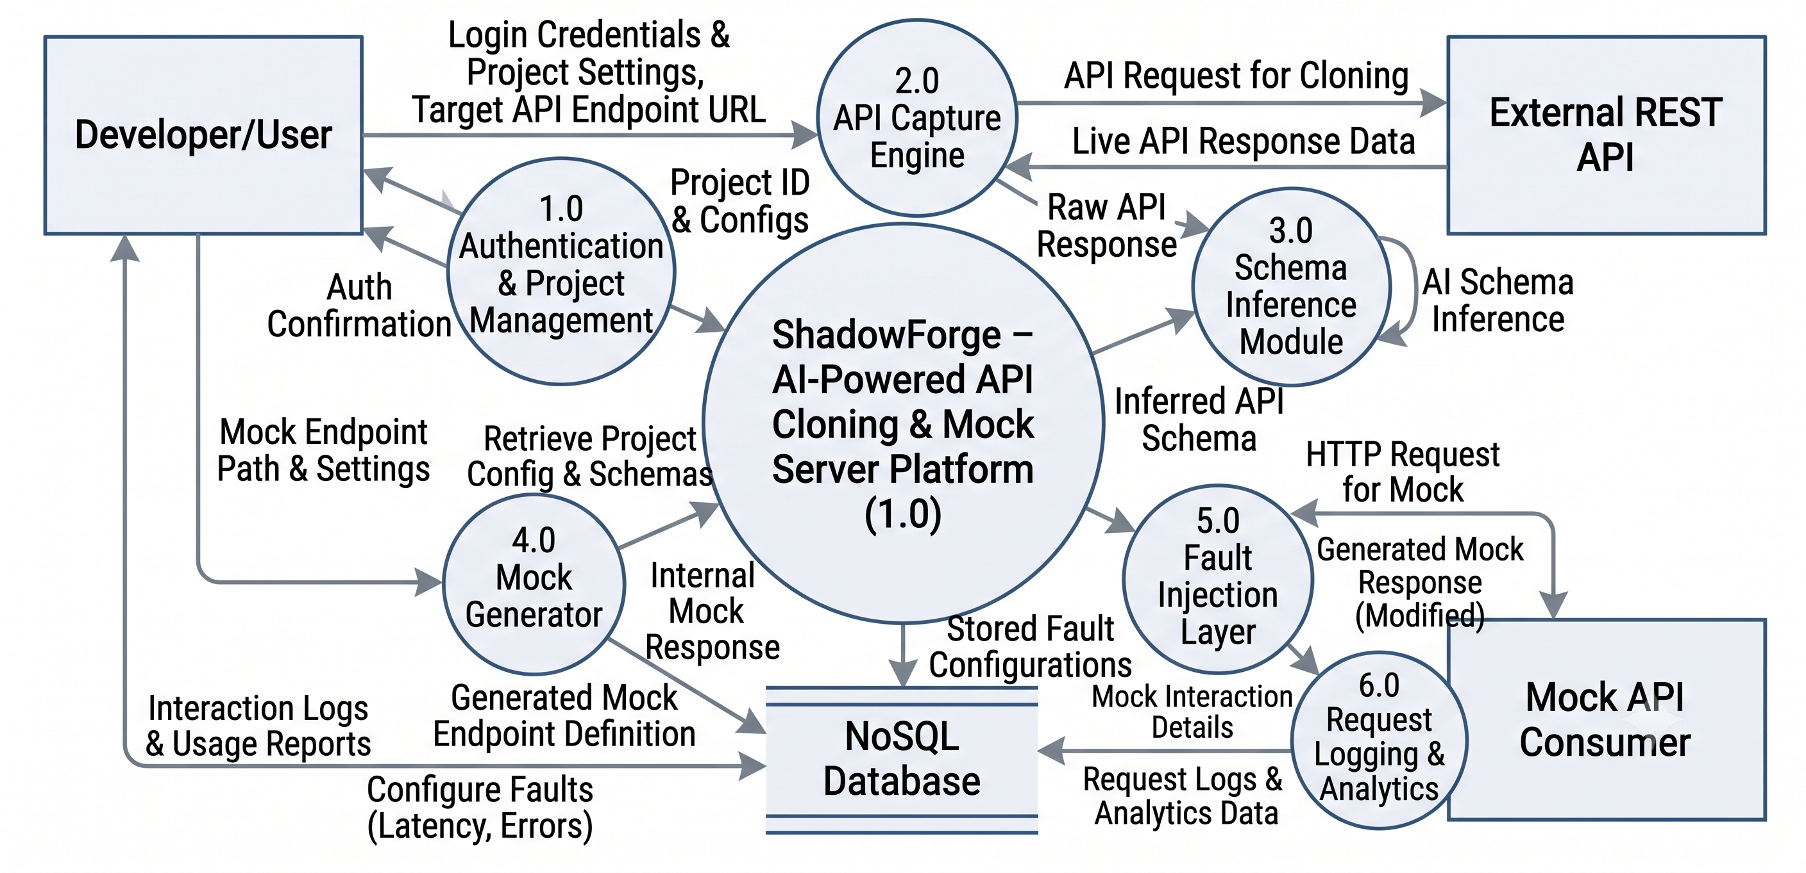
Dataflow Diagrams
Level-1 DFD

Slide 12
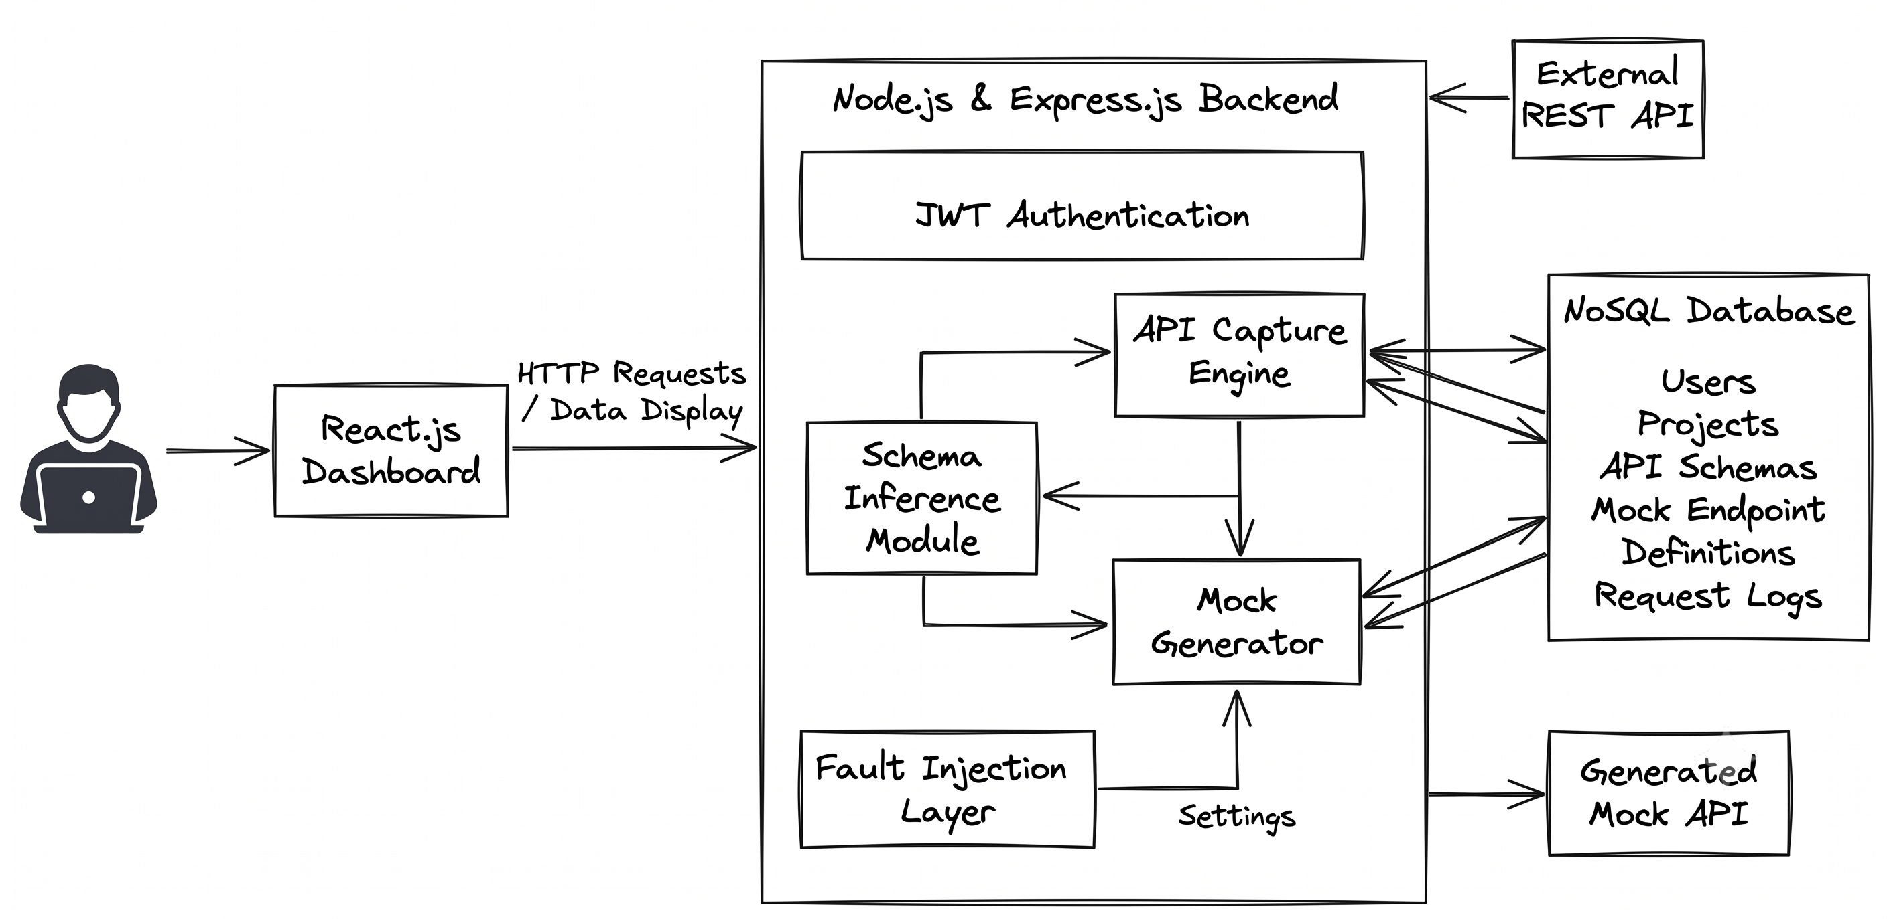
Dataflow Diagram
Use-Case Diagram

Slide 13
Features Implemented
ShadowForge provides secure authentication, intelligent API cloning, dynamic mock API generation, response simulation, version management, analytics, and scalable API testing—all within a single MERN-based platform.
Secure User Authentication (JWT-based Login & Registration)
Automatic REST API Cloning
AI-Based API Schema Detection
Dynamic Mock API Generation
API Response & Error Simulation
API Version Management
Request Logging & Analytics Dashboard
MongoDB Data Storage
Fast API Testing Environment
User-Friendly Dashboard
API Search & Management

Slide 14
Conclusion
ShadowForge is an AI-powered API cloning and mock server platform that simplifies API development and testing by automatically analyzing REST APIs and generating realistic mock endpoints. It reduces dependency on live APIs, enables frontend and backend teams to work in parallel, and improves development speed through intelligent automation. Built using the MERN stack, the platform provides a secure, scalable, and user-friendly environment with features such as authentication, API version management, request logging, analytics, and response simulation.
The project demonstrates how automation can enhance software development by improving collaboration, reducing testing time, and increasing overall productivity. With its flexible architecture and efficient database design, ShadowForge serves as a reliable solution for modern API development and testing. In the future, the platform can be further enhanced by integrating AI-powered response generation, GraphQL support, cloud deployment, and real-time team collaboration, making it a more comprehensive and powerful development platform.

Slide 15
Thank You

