Slide 1

DATATHON
Saransh Arora
Samarth Modi
Pradeep Prabhakar

Slide 2

Seattle Crime Dataset
Dataset: https://data.seattle.gov/Public-Safety/Call-Data/33kz-ixgy | View the Dataset Schema Here
Task Category: Data Visualization, Data Analysis, and Machine Learning Modelling
This data represents crime reported to the Seattle Police Department (SPD). Each row contains the record of a unique event where at least one criminal offense was reported by a member of the community or detected by an officer in the field.
These data contain offenses and offense categorization coded to simulate the standard reported to the FBI under the National Incident-Based Reporting System (NIBRS) and used to generate a Uniform Crime Report (UCR) summary statistics.

Slide 3
Questions to be answered
What formula would you use for a metric to rank the safety of each neighborhood for a student, a family with a young child below the age of 15, and an elderly person? What would be the ranking result when this formula is used for each category of people?
To what extent and accuracy can we predict the level of change in crime for a neighborhood?
What unique statistics and patterns were you able to identify in Seattle’s crime?

Slide 4
About the data
The Seattle crimes dataset that we used has 523k tuples and 11 features. For the sake of simplicity, we worked only on crimes reported in year 2017 and 2018. This gave us roughly 100k rows.
The dataset provided the following features:
Incident occurrence date and time
Incident reporting date and time
Crime description
Neighborhood of crime occurrence

Slide 5
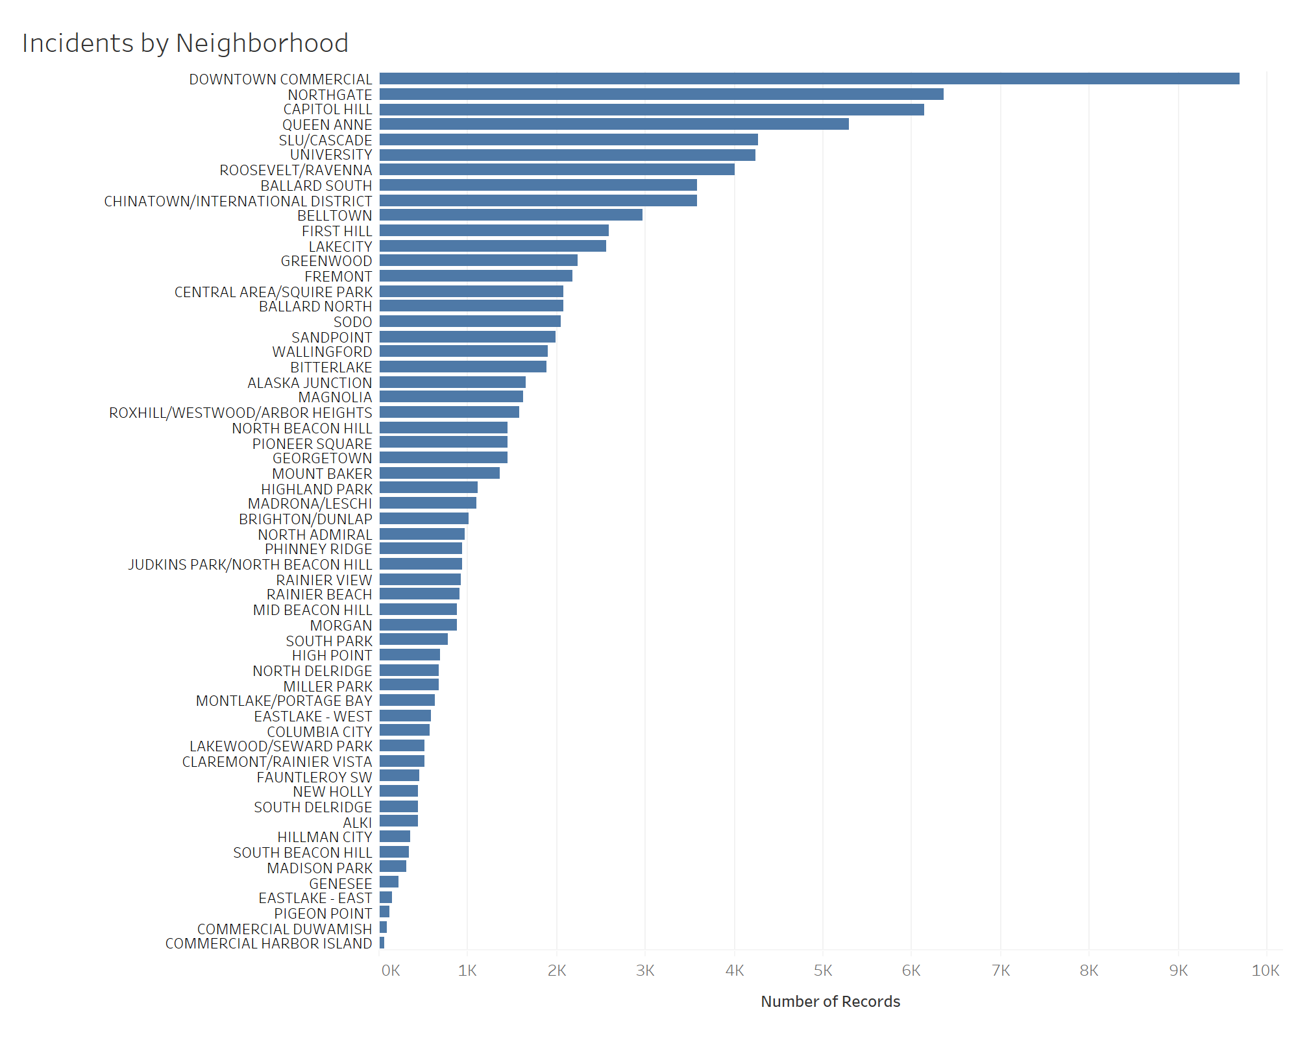
Number of Incidents per Neighborhood

Slide 6
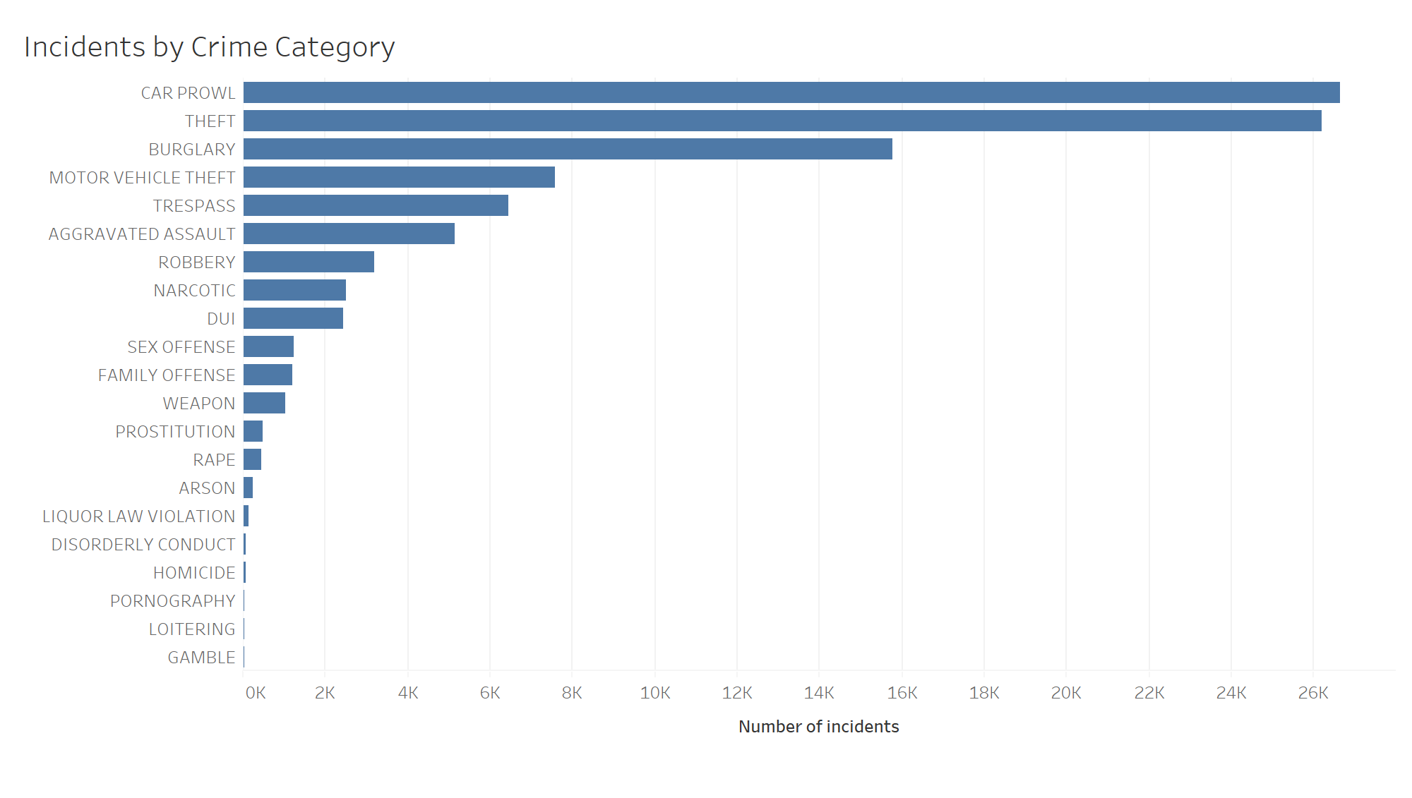
Number of Incidents by Crime Category

Slide 7
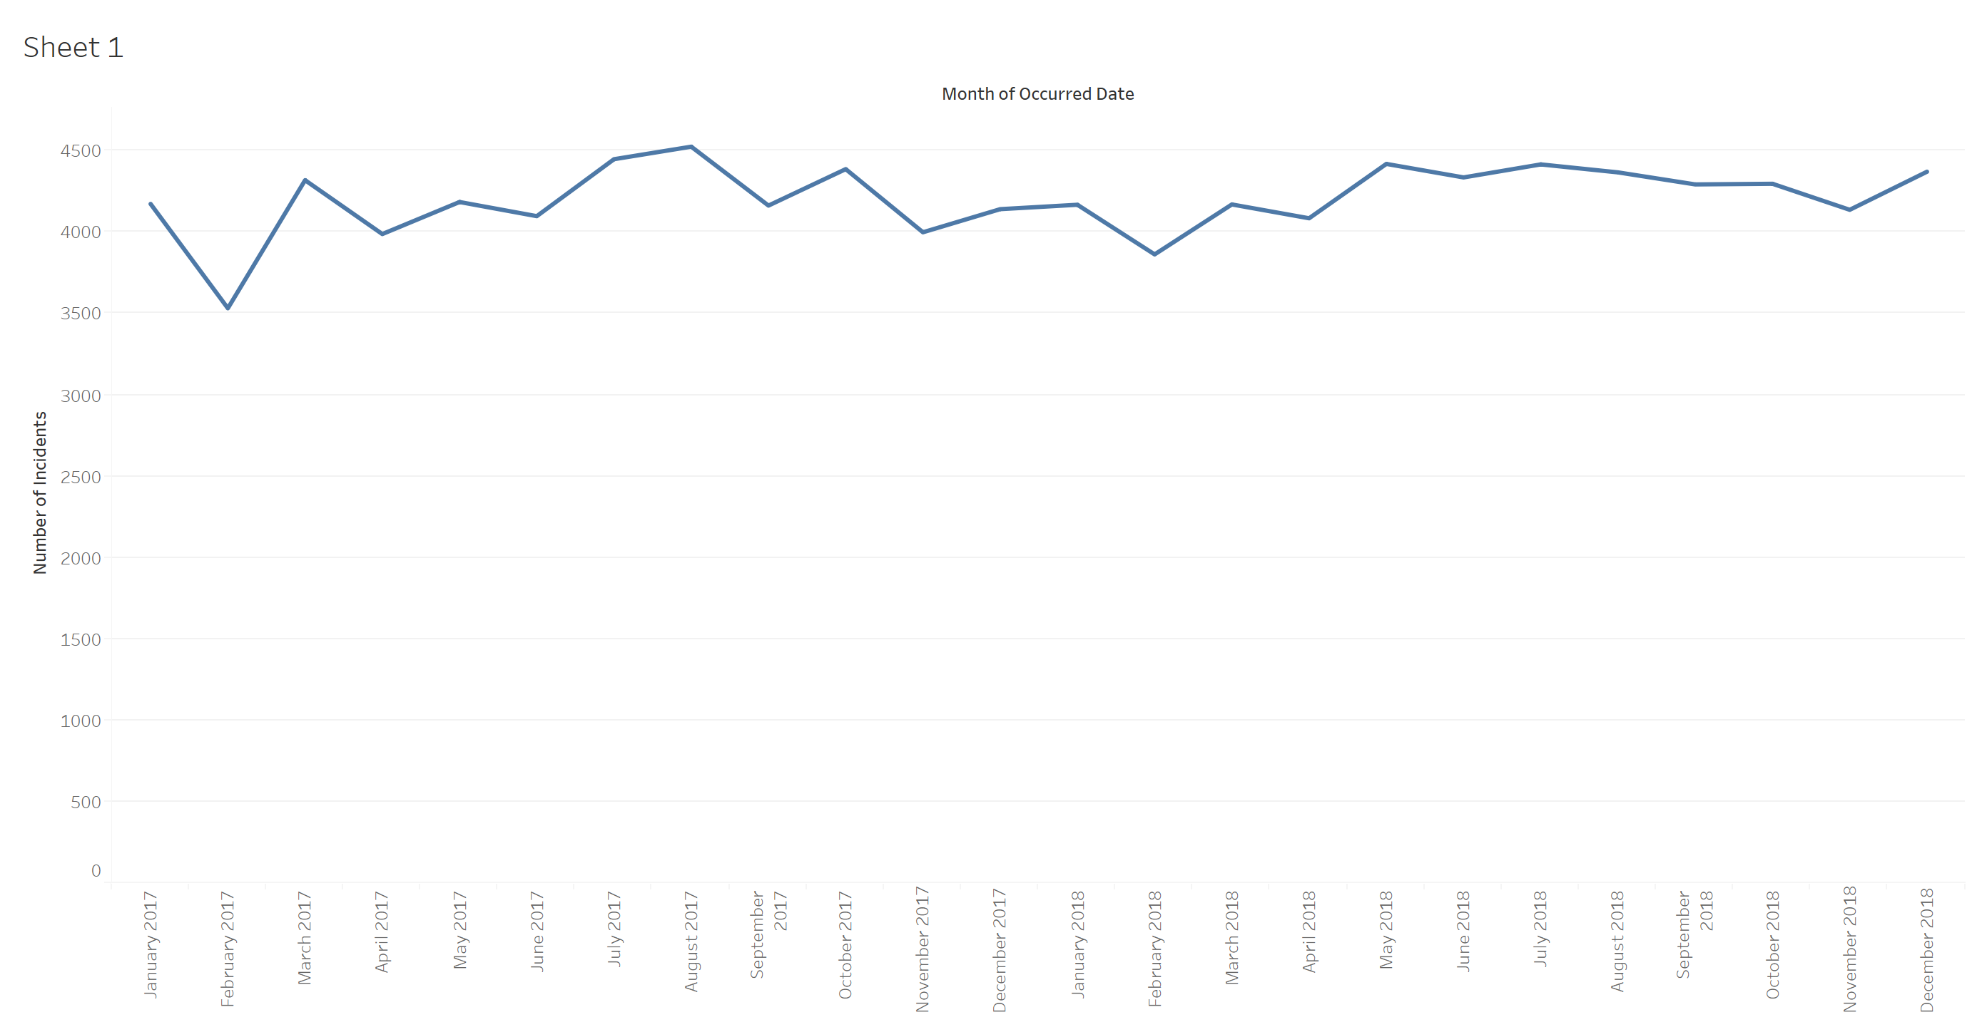
Number of Incidents vs Month of Incident

Slide 8
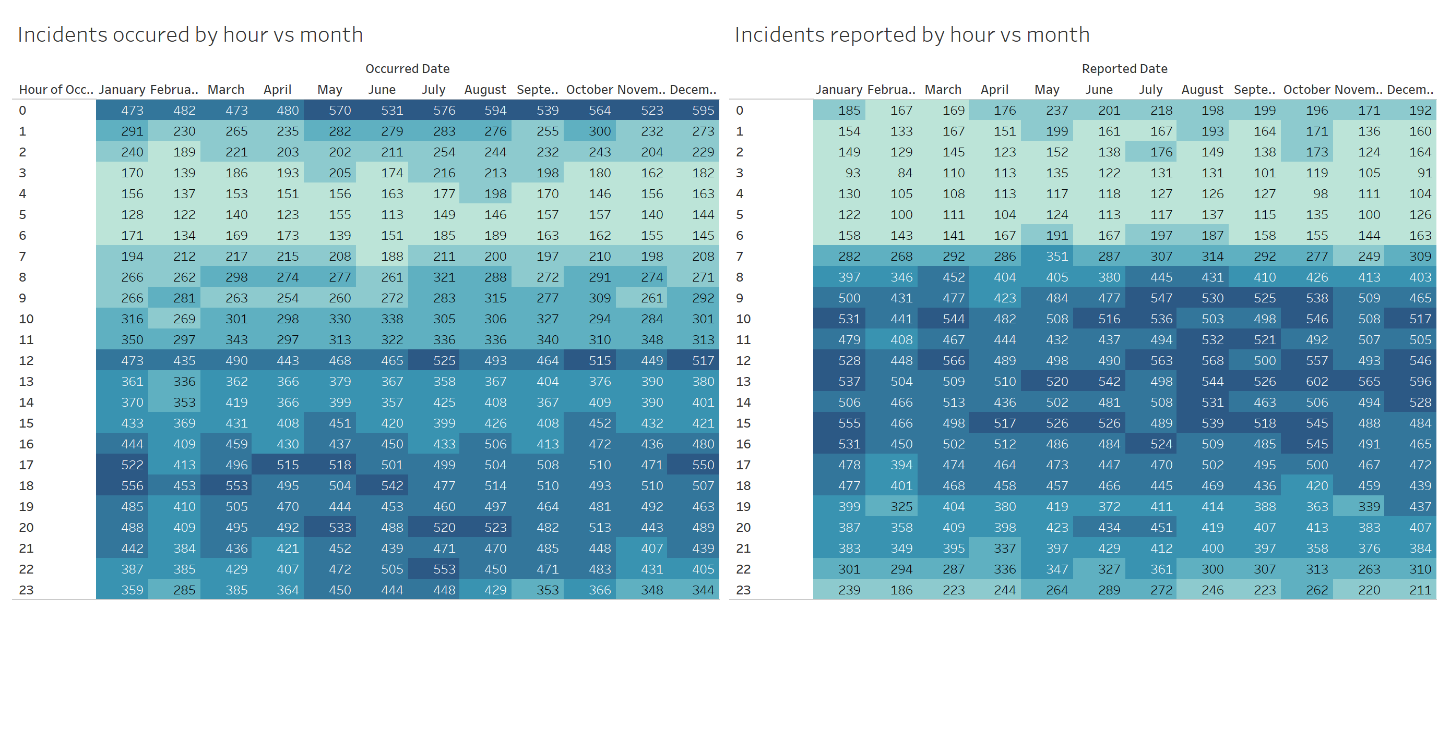
Number of Incidents occurred by hour vs month

Slide 9
Calculating how unsafe a neighborhood is for a particular group
Given the data we have, we calculate how unsafe a neighborhood is for a particular group. We roughly need answers to the following questions:
What crimes are commited in each neighborhood?
Who was (or can be) affected by the committed crime?
How frequently is crime commited in each neighborhood?
Based on the above information we tried to derive a metric to assess how unsafe a neighborhood is. We calculated a value in range [0,1] with 0 being extremely safe and 1 being extremely unsafe. This can be plotted as a heatmap, which could lucidly give a view of which area should be avoided by what group?

Slide 10
Methodology
Prepared a matrix of Group affected vs Type of crime. Each cell represents whether the group is affected by the type of crime or not (A logical matrix)
[3 x 131].
2. Prepared a matrix of Type of Crime vs Neighborhood. Each cell contains the ratio of number of incidents of that particular crime in that neighborhood to the total number of crimes committed in that neighborhood. [131 x 58]
Calculated a matrix of Group vs Neighbor by performing matrix multiplication of the above two matrices. [3 x 58]
Calculated frequency of crime in each neighborhood, by taking a ratio of number of days of a year when a crime was committed and total number of days in a year (365). [1x58]
Finally, performed element wise multiplication for each group. Thus we finally calculated a [3x58] matrix.

