Slide 1
C
CATAWBA COLLEGE
DATA MINING · FINAL PROJECT
Online Shoppers
PROJECT TITLE
STUDENT NAME
DATE
Online Shoppers Purchasing Intention
Alan Rosales
04/29/2026
CIS 3902

Slide 2


CATAWBA COLLEGE
01 · PROBLEM
Problem Statement & Objective
Frame the problem, clarify the target, justify the work
01
Motivation
Understanding which site visitors will convert to buyers is critical for e-commerce survival. Accurate prediction enables targeted marketing, better UX decisions, and revenue growth.
Introduction
E-commerce businesses need to identify which visitors are likely to make a purchase. This model predicts online purchase intent to help retailers, digital marketing agencies, and analytics firms improve conversion rates and profitability.
02
Prediction Target
Binary classification: predicting the Revenue variable (True/False) — whether a website session results in a purchase.
03
Impact
E-commerce retailers can use predictions to personalize offers in real time. Digital marketing agencies benefit from smarter budget allocation. Analytics firms can offer richer customer journey insights.
Data Mining · Final Project
1 / 10

Slide 3




CATAWBA COLLEGE
02 · DATASET
Dataset & Domain Context
Where the data comes from and why it fits the problem
AT A GLANCE
Source & Citation
UCI ML Repository — Online Shoppers Purchasing Intention Dataset. Sakar, C.O. et al. (2019). Also available on Kaggle (henrysue/online-shoppers-intention). Open access.
#
12,330
Number of observations
Size & Structure
#
18
12,330 sessions, 18 features (10 numeric, 7 categorical + 1 boolean target). Key features include page duration metrics, bounce rates, special day proximity, visitor type, and month.
Columns in df.info()
—
Target Type
Domain Relevance
Classification - Binary
Directly captures real e-commerce session behavior — ideal for purchase intent classification. Limitation: heavily imbalanced (~84.5% non-purchase sessions), requiring careful evaluation with F1/Kappa metrics.
Data Mining · Final Project
2 / 10

Slide 4

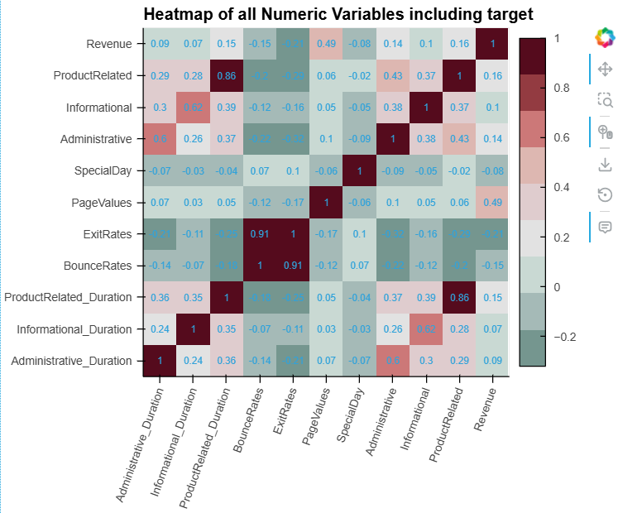

CATAWBA COLLEGE
03 · EXPLORATION
Data Exploration & Key Insights
What the data reveals before any modeling happens
WHAT TO COVER
Summary statistics
12,330 sessions; 84.5% non-purchase (False), 15.5% purchase (True). Numeric features include Administrative, Informational, and ProductRelated page counts and durations. No missing values found.
Visuals
AutoViz generated distributions and correlation heatmaps. ProductRelated_Duration and BounceRates showed strong visual separation between classes.
[ Insert AutoViz output or histogram/heatmap screenshot here ]
Histogram · Correlation heatmap · Scatter · etc.
Notable trends & outliers
High class imbalance (85/15 split). ProductRelated_Duration, ExitRates, and PageValues were the most discriminating features. Weekend and Region showed low variance across classes.
Data Mining · Final Project
3 / 10

Slide 5


CATAWBA COLLEGE
04 · PREPARATION
Data Cleaning & Feature Engineering
From raw dataframe to model-ready matrix
01
Handle Missing Data
02
Encoding & Discretization
03
New Feature Creation
No missing values were found in this dataset. The Pipeline includes a SimpleImputer(strategy=“median”) for numerics and SimpleImputer(strategy=“most_frequent”) for categoricals as a safeguard.
VisitorType was one-hot encoded using pd.get_dummies(drop_first=True). Month was handled by the Pipeline’s OneHotEncoder. No scaling was applied (Random Forest is scale-invariant).
No new features created. Five columns were dropped: OperatingSystems, Browser, TrafficType, Weekend, and Region because they were judged as low-signal for predicting purchase intent.
COMMON TOOLS
COMMON TOOLS
get_dummies
LabelEncoder
pd.cut
ratio
datetime
interaction
Data Mining · Final Project
4 / 10

Slide 6

CATAWBA COLLEGE
05 · METHOD
Model Selection & Method
The algorithm, the reasoning, the tooling
ALGORITHM
Why This Choice?
Random Forest
More stable due to averages of trees · handles mixed feature types · captures non-linear relationships · gives feature importance · does not need standardization
FAMILY
Supervised · Ensemble · Tree-based
Tools & Libraries
ALTERNATIVES CONSIDERED
Logistic Regression · XGBoost · SVM
PyCaret
scikit-learn
pandas
matplotlib
SHAP
Data Mining · Final Project
5 / 10

Slide 7

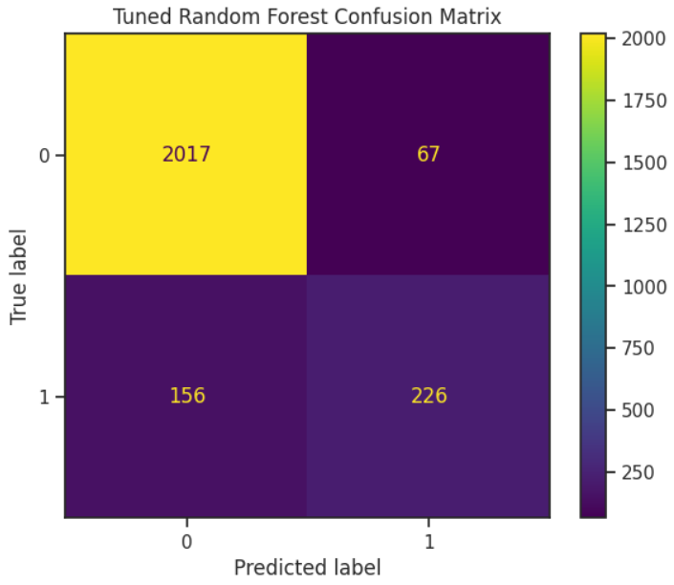
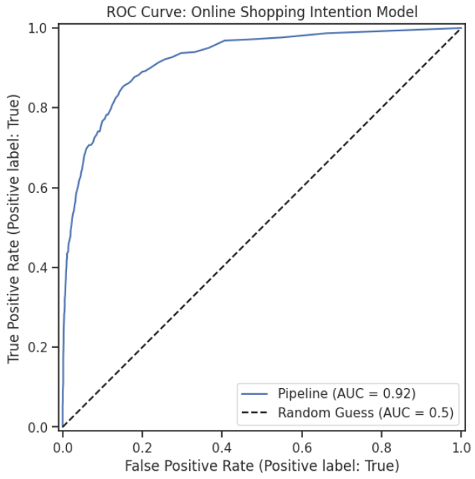
CATAWBA COLLEGE
06 · EVALUATION
Model Evaluation & Tuning
How well it works — and how you made it better
0.91
0.9223
ACCURACY
AUC
Overall correctness
Ranking quality
0.77
0.56
PRECISION
RECALL
Of predicted positives
Of actual positives
HYPERPARAMETER TUNING: GridSearchCV (5-fold CV, f1_weighted). Grid: n_estimators=[100,200], max_depth=[None,5,10], min_samples_split=[2,5], min_samples_leaf=[1,2]
Data Mining · Final Project
6 / 10

Slide 8

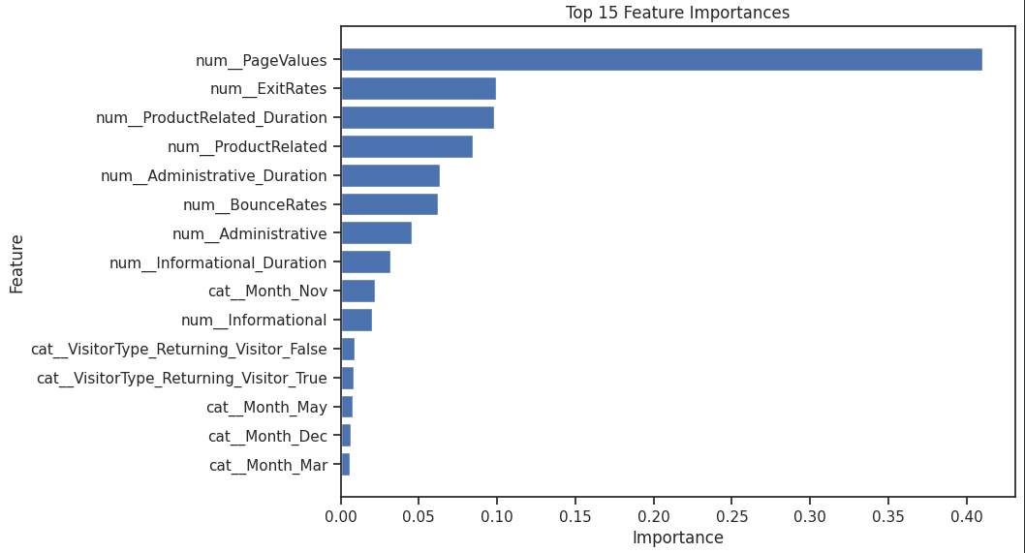

CATAWBA COLLEGE
07 · INTERPRETATION
Feature Importance & Interpretation
Which features drive the predictions, and what it means
TOP FEATURES
1
PageValues
2
ExitRates
[ Insert top 15 feature importance bar chart from notebook ]
3
ProductRelated_Duration
4
BounceRates
INTERPRETATION
Month (November)
PageValues is the strongest predictor. Pages with high monetary value strongly influence purchase intent. High ExitRates and BounceRates show users who leave quickly are less likely to buy. ProductRelated_Duration confirms that time spent on product pages correlates with conversion. November being significant aligns with Black Friday/Cyber Monday shopping behavior. These results match business intuition well.
5
Data Mining · Final Project
7 / 10

Slide 9


CATAWBA COLLEGE
08 · REFLECTION
Limitations & Next Steps
What’s imperfect, what’s next
LIMITATIONS
ETHICS & BIAS
ROADMAP
Model Limitations
Data Issues & Bias
Future Work
Class imbalance (~85% non-purchase) makes the minority class harder to predict — recall for buyers is lower than precision, meaning that the model is “playing it safe” and letting 44% of potential sales pass. It also means that the model is making fewer false alarms
Dataset lacks demographic info, limiting fairness analysis. Behavioral data (bounce rates, page durations) can be manipulated by bots, introducing noise. Data is from a single retailer and may not generalize across industries.
Add features – Time/page ratios
Session depth
Survey users to see what shoppers look for while making shopping decisions
Update with newer data
Data Mining · Final Project
8 / 10

Slide 10


CATAWBA COLLEGE
09 · REFERENCES
References & Acknowledgments
Include use of AI
DATA SOURCES
GITHUB REPOSITORY
[ QR CODE ]
Sakar, C.O. et al. (2019). Neural Computing and Applications. UCI ML Repository. https://archive.ics.uci.edu/ml/datasets/Online+Shoppers+Purchasing+Intention+Dataset
Scan to view code, data & notebooks
Kaggle dataset mirror: https://www.kaggle.com/datasets/henrysue/online-shoppers-intention
github.com/arosales23/CIS-3902-AI-ML-ARA-OnlinePurchasingIntent
scikit-learn documentation. RandomForestClassifier, GridSearchCV, Pipeline. https://scikit-learn.org
Issues · Pull Requests welcome
TOOLS & LIBRARIES
Python
PyCaret
scikit-learn
pandas
THANK YOU
matplotlib
AutoViz
Claude
Questions welcome.
Thanks to the course instructor for the project template, dataset provided by UCI ML Repository, AutoViz library used for exploratory analysis.
Data Mining · Final Project
10 / 10
Data Mining · Final Project
10 / 10

