Slide 1
Automated Dog Breed Identification
from Shelter Photos
Using deep learning to support more consistent breed labeling in animal shelters
Data Science Career Track — Capstone 3

Slide 2
Breed Labels Are Guessed, Not Verified
25%
Shelters assign breed labels visually at intake — known to be unreliable, especially for “bully”-type mixes
Inaccurate labels drive real consequences: adoption outcomes, breed-restricted housing/insurance, and skewed bite-report demographics
Goal: a trained image classifier as a consistent, evidence-informed second opinion — not a replacement for staff judgment
of shelter staff visual breed calls
matched DNA-verified breed
(Voith et al., 2009)
2

Slide 3
Success Criteria, Stakeholders & Constraints
Success Criteria
Stakeholders
Constraints
≥70% top-1 accuracy
≥90% top-5 accuracy
(Stanford Dogs test set)
Shelter operations manager (client)
Behaviorist / animal control officer (consult)
The dogs — ultimate beneficiaries
Staged vs. real-photo domain shift
No DNA-verified ground truth
Politically sensitive to automate fully
3

Slide 4
A Multi-Class Image Classification Problem
Target: breed label — 115 classes
Stanford Dogs
PetFinder.my
Austin Animal Center
Training + test set
Real-world validation
Real-world context (no images)
20,486 images
1,604 matched photos
outcomes data
4

Slide 5
Data Wrangling: Raw Files to Model-Ready Data
Corrupt / unreadable file detection and exact-duplicate removal (MD5 hash)
Non-RGB images normalized; bounding-box crop applied where Stanford Dogs annotations exist
All images resized to 224×224 and normalized to match the pretrained model's expected input
Aspect-ratio outliers dropped; brightness outliers flagged for awareness
Class imbalance checked before splitting — informed the stratified train/val/test split
5

Slide 6
Two Breed Vocabularies, One Matching Pipeline
Stanford Dogs uses decade-old ImageNet naming; PetFinder uses everyday breed names
“Boston Bull” = “Boston Terrier”
3-layer pipeline: exact match → known-synonym lookup → token-subset matching (e.g. “Maltese” → “Maltese Dog”)
Most unmatched rows are “Mixed Breed” listings — expected, not a data error
6

Slide 7
EDA: Class Balance Shapes the Metrics
Stanford Dogs is close to balanced (143–463/breed) → plain top-1/top-5 accuracy is trustworthy here
PetFinder's matched subset skews heavily toward a few common breeds (Labrador Retriever, Shih-Tzu)
→ macro-F1 used for PetFinder evaluation so common breeds can't hide poor performance on rare ones
7

Slide 8
EDA: Two Very Different Kinds of Dog Photos
Stanford Dogs
PetFinder.my
Training data
Real-world validation
Staged, posed photos
Clean backgrounds
Consistent lighting
Real shelter/rescue photos
Cluttered, variable backgrounds
Inconsistent lighting & angles
8

Slide 9
EDA: Real Shelter Stakes from Austin Animal Center
17.4%
17.4% of Austin Animal Center's dog outcomes are labeled some variant of “Pit Bull”
This one label touches a huge share of real shelter dogs — the stakes of breed labeling are not hypothetical
Austin's data has no photos, so it's used here for real-world framing, not as training data
of all dog outcomes
9

Slide 10
Modeling: Isolating What Fine-Tuning Buys You
MobileNetV2 (ImageNet-pretrained, Hugging Face Model Hub) via transfer learning
A
→
B
→
C
Frozen backbone
Last 3 blocks unfrozen
Fully unfrozen
Only classifier head trained
Partial backbone adaptation
Entire network fine-tuned
Same checkpoint, same data, same epochs — the only variable is how much of the backbone can adapt
10

Slide 11
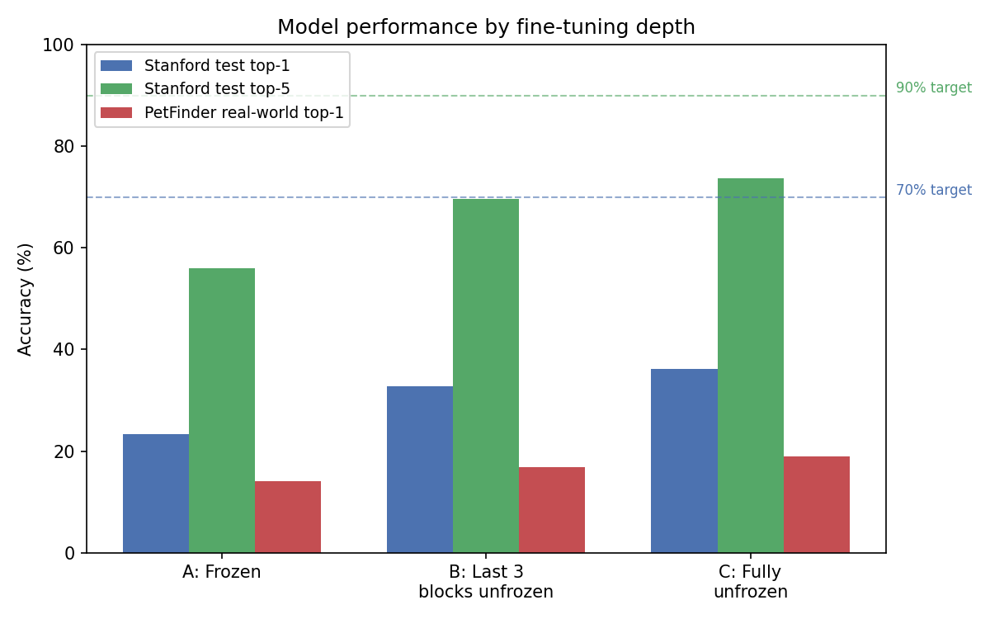
More Fine-Tuning Freedom, Better Performance — Every Time
11

Slide 12
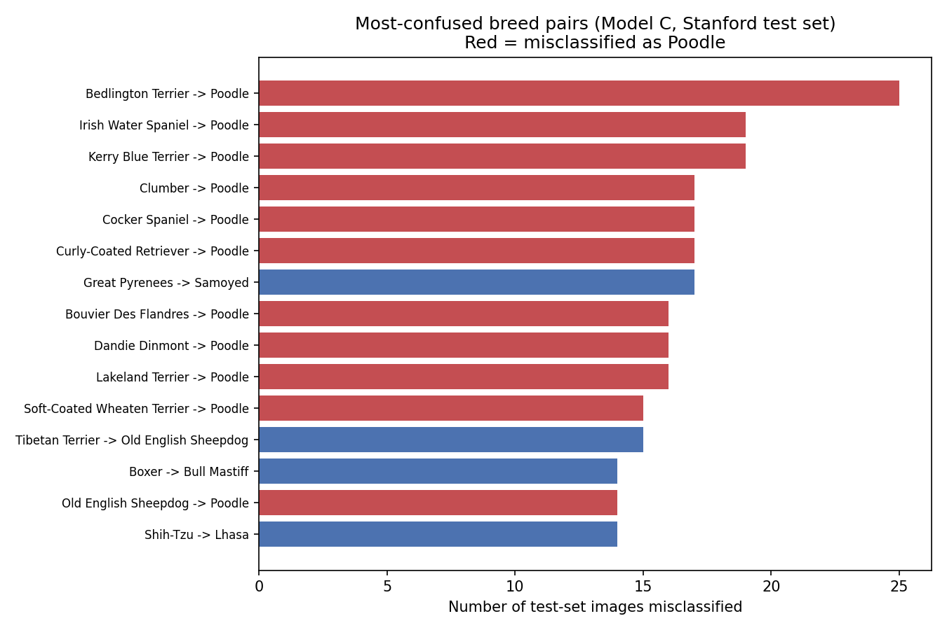
Key Finding: The Model Learned “Curly Coat = Poodle”
11 of the top 15 misclassifications funnel into “Poodle” — all curly/wavy-coated breeds
12

Slide 13
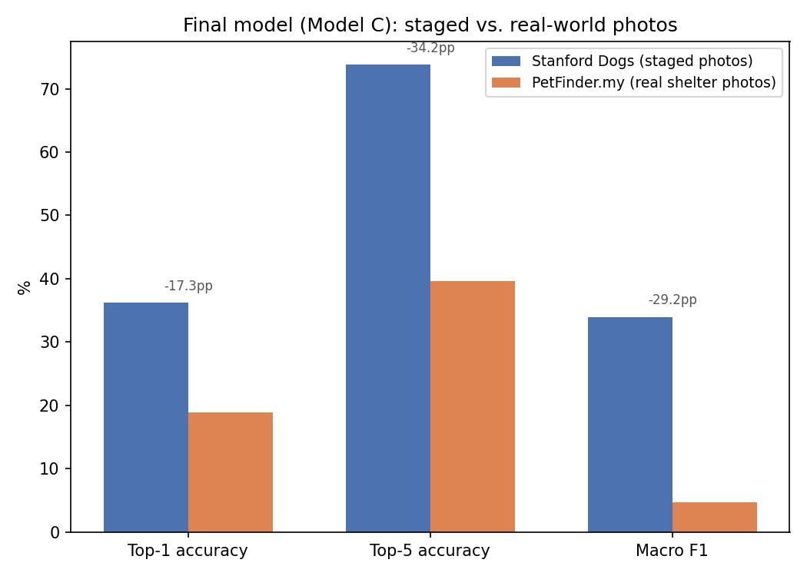
Key Finding: A Real-World Generalization Gap
Macro-F1 drops 86% (staged → real) — far steeper than the 48% drop in top-1 accuracy: strong on common breeds, weak on rare ones
13

Slide 14
Recommendations for a Shelter Client
1
Use as a second-opinion flag
Not a replacement — flag listings where the model and staff disagree for a second look
2
Prioritize more training first
Every added fine-tuning depth improved results with no plateau — more epochs is the fastest path forward
3
Trust top-5, not top-1, for now
At 73.8% top-5, the correct breed is usually in the shortlist even when it isn't the top guess
14

Slide 15
Limitations & Future Work
Only 3 training epochs on CPU hardware — no plateau seen yet, so more epochs is the clearest next step
Coat-texture shortcut (Poodle bias) suggests targeted data augmentation could help the model learn finer distinguishing features
Class-weighted loss or oversampling of rare breeds could directly address the real-world macro-F1 gap
No DNA-verified ground truth exists for any breed label used — results describe agreement with human labels, not biological accuracy
15

Slide 16
Thank You
Questions & Discussion

