Slide 1
Kiva Online Crowdfunding
Kelly Boukouvala
Anna Roumpelaki
Eleni Tsanoula

Slide 2
Contents
Dataset Description
Challenges
Visualization
Conclusions

Slide 3
Crowdfunding
Crowdfunding is the practice of funding a project or venture by raising many small amounts of money from a large number of people, typically via the Internet.
If the amount for a loan is not fully raised, the payment is not made, and the money is returned to the funders.
Kiva: over $1b is reported.

Slide 4
Dataset Description
Given tables:
Kiva_loans: includes measures
Kiva_mpi_region_locations
Loan_theme_ids
Loan_theme_by_region
Created tables:
Fact: loan_mvmt
Dimension: Kiva_loans, date, country, partner, mpi_region, loan_theme
Bridge: loan_x_loan_theme, loan_themes_x_region
Notes:
Kiva_loans: amount, lenders, borrowers, dates, sector, activity, country
MPI_locations: country, ISO, longitude, latitude, MPI

Slide 5
Challenges
Missing Data: e.g. partners, countries, dates.
Aggregated fact table -> had to be reconstructed.
Difficulty in finding an easy to work with dataset.
Lack of familiarity with MSSQL and PowerBI.
Lack of time ☺

Slide 6
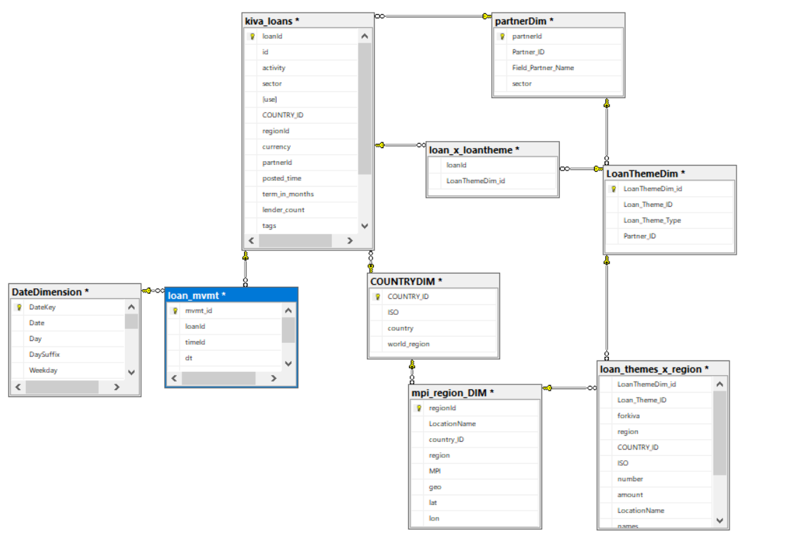
Final Schema

Slide 7
Visualization
4 basic families of visualisations:
Maps
Loan distribution
Amount distribution
Loan themes

Slide 8
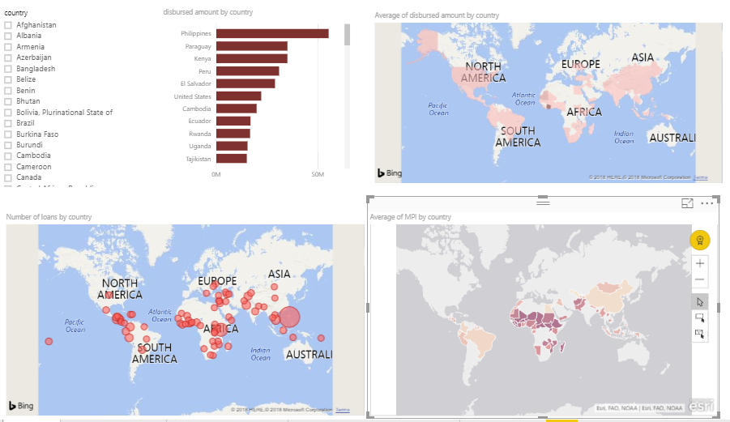
Maps

Slide 9
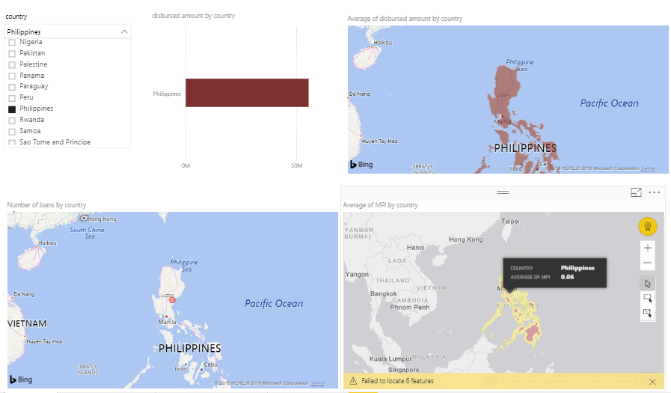
Maps: Philippines

Slide 10
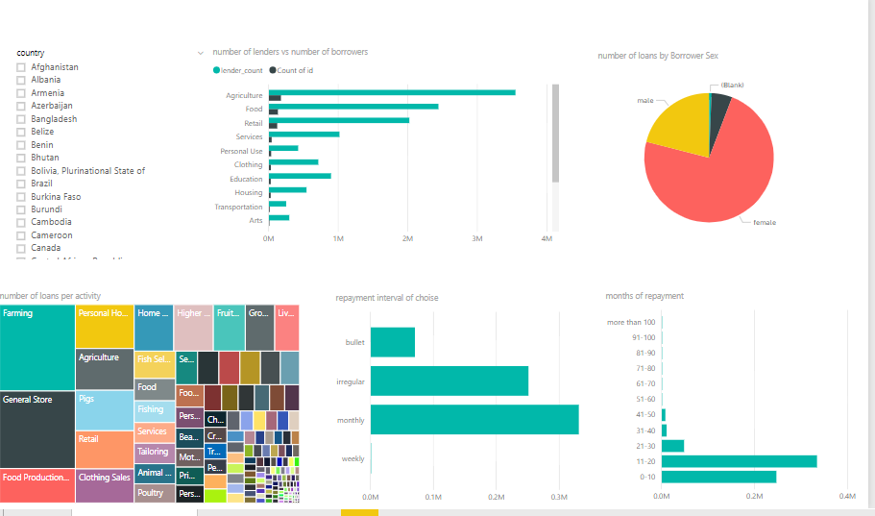
Loan distribution

Slide 11
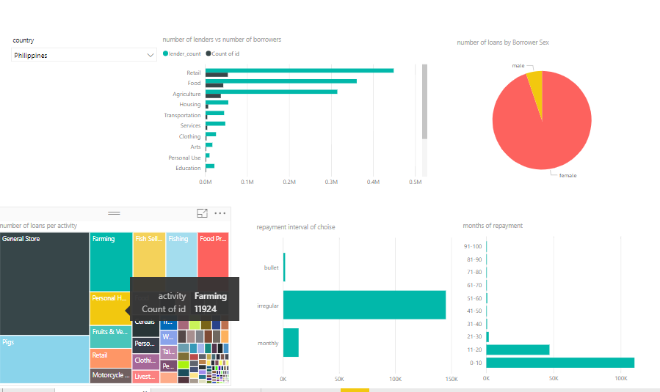
Loan distribution: Philippines

Slide 12
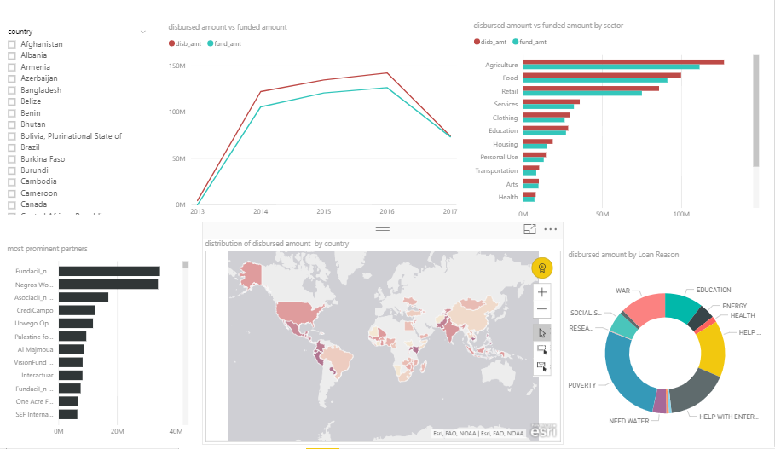
Amount distribution

Slide 13
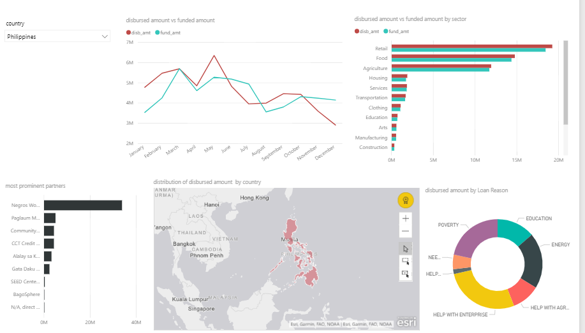
Amount distribution: Philippines

Slide 14
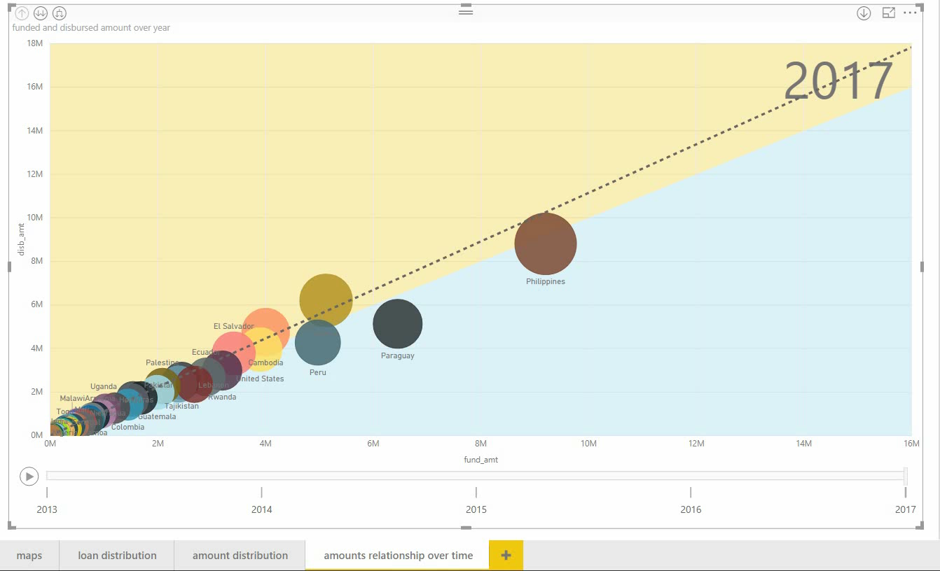
Amount relationships over time:

Slide 15
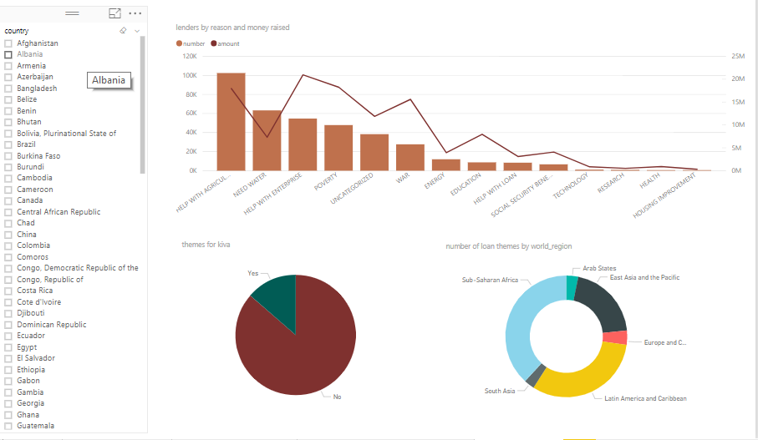
Loan themes

Slide 16
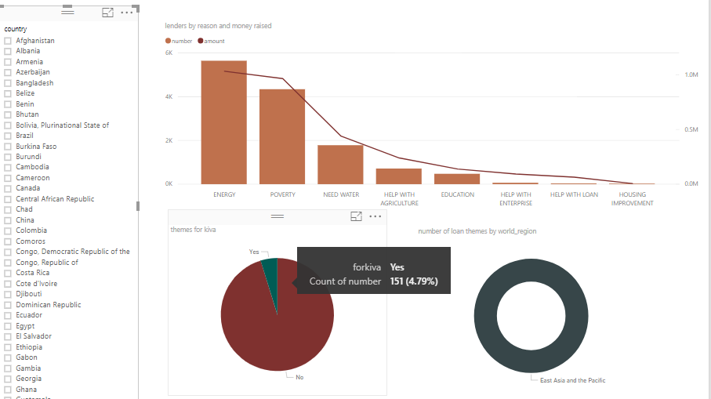
Loan themes: Philippines

Slide 17
Conclusions
Most loans were provided in the agriculture sector, followed by food.
Top loan activities: Farming & General Stores
Most loans were given in the Philippines. Next country is Kenya.
Approximately 80% of borrowers are female, and 20% are male.
Most loans have been funded.
Most loan applications were due to poverty.
Most loans are repaid monthly, and mainly within 11-20 months.
Loan funding was more popular between 2014-2016 and peaked on (November 2016).

Slide 18
Conclusions cont.
Gathered amount is not proportional to number of lenders.
Only 13% of loan themes were made especially for kiva.
Sub-Saharan Africa gathered more types of loan themes than other world regions.

Slide 19
Questions?

