Slide 1

Rous Coffee
Management System
(RCMS)
HW6 Final Project Presentation
Requirement recap • Models • Prototype • Deployment
Systems Analysis and Design S26
Notes:
Introduce the project as the Rous Coffee Management System, or RCMS. Explain that this presentation summarizes the requirements, main models, prototype walkthrough, deployment plan, and expected value of the system.

Slide 2
10-minute presentation roadmap
02
A clear path from business problem to prototype demo and value
1
System overview
2
Requirements
3
Models
Company, challenge, and opportunity
Functional and non-functional needs
Context diagram, DFD-0, and ERD
4
Prototype
5
Deployment
6
ROI & future
Core forms and walkthrough demo
Rollout, training, and support
Benefits and next improvements
RCMS Final Project Presentation
Notes:
Preview the order of the presentation. Mention that the goal is to show not only what the system does, but why it is needed and how it can be deployed for daily store operations.

Slide 3

System overview: company challenge and opportunity
03
RCMS supports a small coffee business that needs faster daily operations and better visibility
Current pain points
✍
Manual tracking
Orders, stock levels, and schedules are difficult to keep updated.
👁
Limited visibility
The owner cannot quickly see sales, inventory, or performance trends.
⏱
Operational delays
Employees and managers spend extra time checking information manually.
Opportunity: build one organized system for orders, inventory, schedules, employees, and reports.
RCMS Final Project Presentation
Notes:
Explain the business problem in simple terms. The coffee shop needs one place to manage orders, inventory, schedules, employees, and reports. RCMS turns separate manual tasks into a connected workflow.

Slide 4
System needs: users and key functions
04
The system is designed around the work of employees, the store manager, and the owner
☕
🗂
📈
Employees / Baristas
Store Manager
Owner
Take and update orders
View menu and product availability
Check assigned schedule
Manage inventory and products
Create employee schedules
Review daily operations
Request business reports
View sales and performance
Make strategic decisions
RCMS connects user actions to a shared database so information stays consistent across the store.
RCMS Final Project Presentation
Notes:
Describe the three major user groups. Employees focus on orders and schedule viewing. The store manager handles inventory and scheduling. The owner uses reports for decisions.

Slide 5
System requirements and core functions
05
Functional requirements define what RCMS must allow users to do
Manage Orders
Manage Inventory
Create orders, add items, calculate totals, update order status, and store order history.
Add products, update stock levels, track prices, and flag low-stock items.
Manage Schedule
Generate Reports
Create shifts, assign employees, and allow staff to view work schedules.
Produce sales, inventory, employee, and performance reports for the owner.
Additional requirement: role-based access for employees, managers, and the owner.
RCMS Final Project Presentation
Notes:
Walk through the core functional requirements. RCMS must handle orders, inventory, scheduling, and reports. These are the major sections of the prototype and the main screens in the system.

Slide 6
Non-functional requirements and special system features
06
These requirements describe the quality, security, and usability of the solution
Usability
Simple forms, clear labels, minimal training for daily users.
Reliability
Consistent data entry, validation rules, and regular backups.
Security
Login screen, user roles, and restricted owner reports.
Performance
Fast form loading and quick report generation for daily use.
Special features
Low-stock alerts
Daily operations dashboard
Role-based reports
Clean navigation menu
RCMS Final Project Presentation
Notes:
Explain that non-functional requirements make the system practical. The system should be easy to use, reliable, secure, and fast enough for store operations. Highlight the special features such as alerts and dashboards.

Slide 7
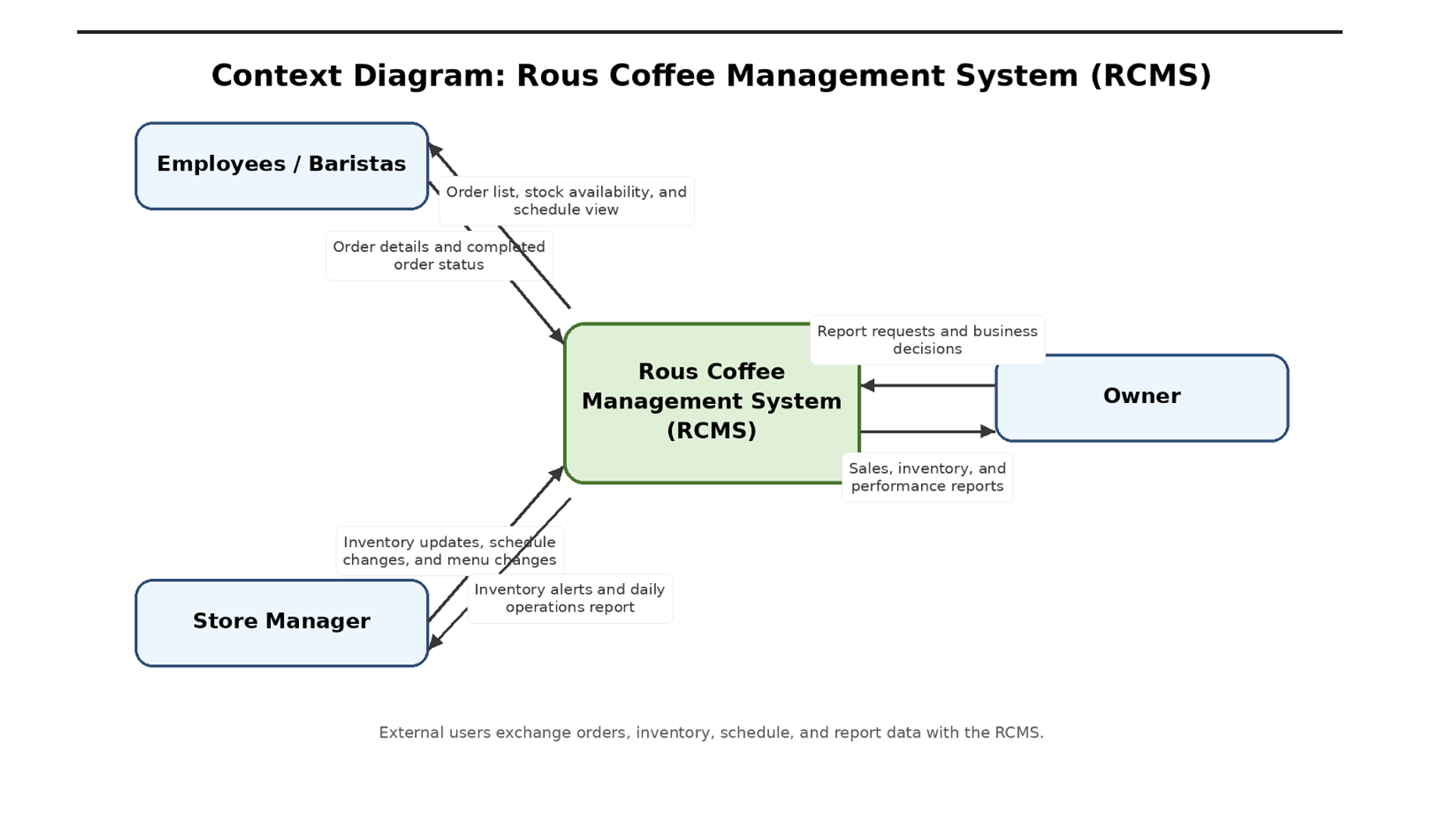
Context diagram: RCMS boundary and external users
07
The context model shows how employees, managers, and owners exchange information with RCMS
Key takeaways
• RCMS is the central system boundary.
• Employees send order details and receive order/status information.
• Managers update inventory, schedules, and menu changes.
• Owners request reports and receive business results.
RCMS Final Project Presentation
Notes:
Use this slide to describe the overall system boundary. The diagram shows who interacts with RCMS and what information moves between the users and the system.

Slide 8
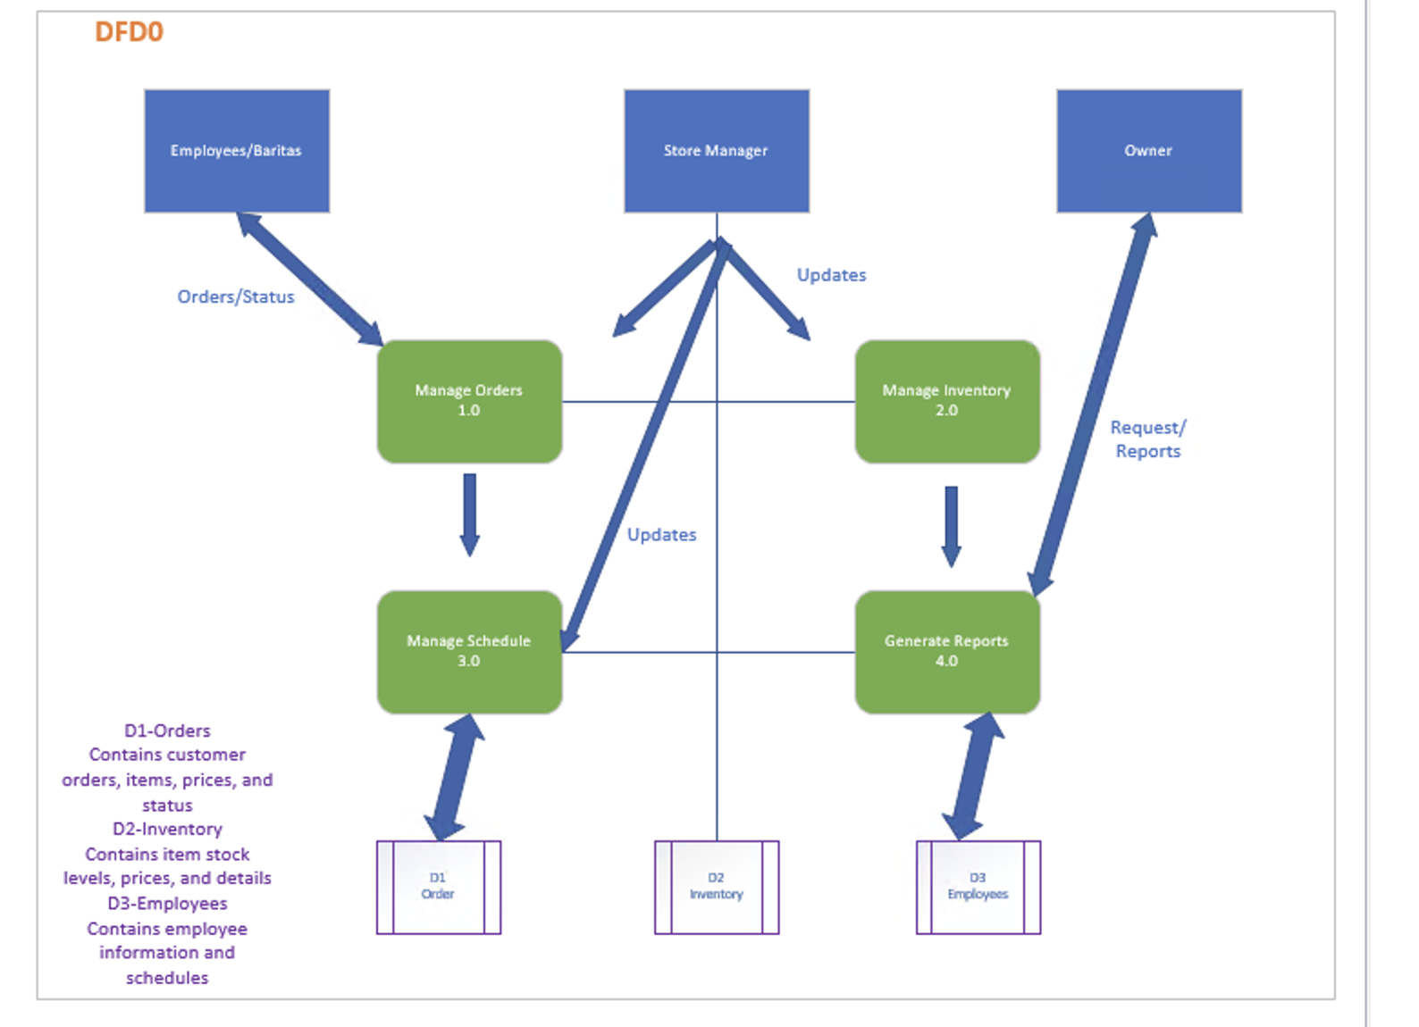
DFD-0: major processes and data stores
08
The level-zero data flow diagram breaks RCMS into its main processes
Processes
• 1.0 Manage Orders
• 2.0 Manage Inventory
• 3.0 Manage Schedule
• 4.0 Generate Reports
Data stores
• D1 Orders
• D2 Inventory
• D3 Employees
RCMS Final Project Presentation
Notes:
Explain how DFD-0 converts the context diagram into internal processes. The system processes orders, inventory, schedules, and reports while using three main data stores.

Slide 9
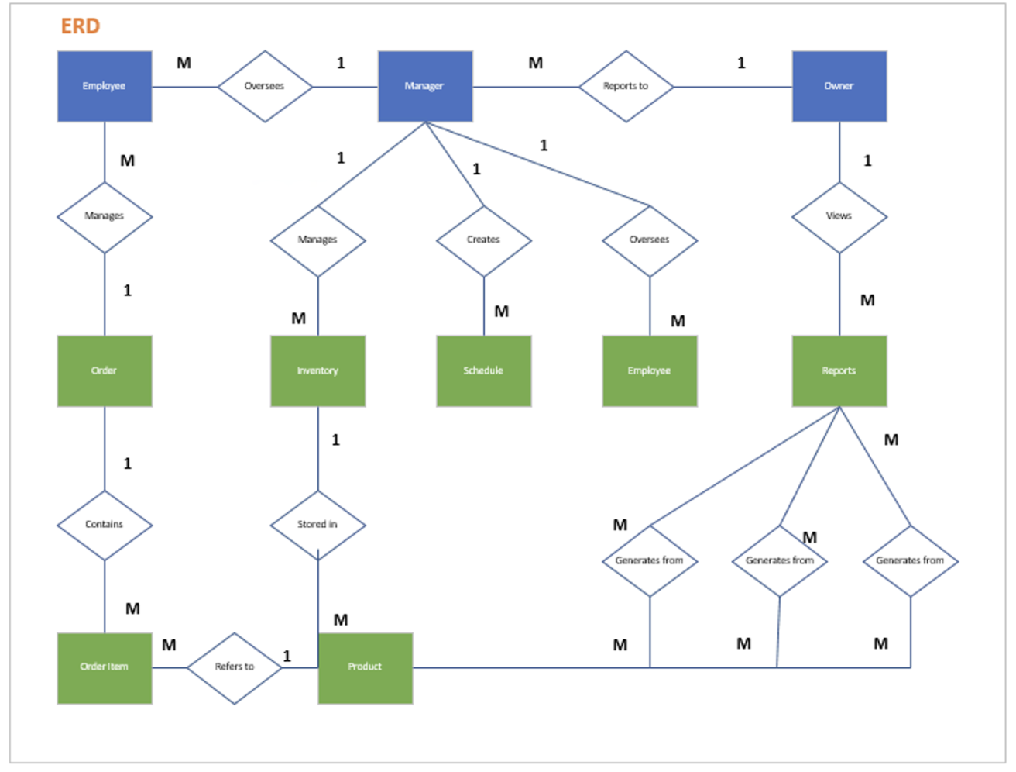
ERD: data relationships supporting the prototype
09
The ERD shows the main entities and how records connect in the database
Core entities
• Employee / Manager / Owner
• Order and Order Item
• Product and Inventory
• Schedule and Reports
Relationship logic
• One order can contain many order items.
• Products are stored in inventory.
• Reports are generated from operational records.
RCMS Final Project Presentation
Notes:
Walk through the ERD at a high level. Emphasize that the database supports the system forms by linking orders to items, products to inventory, schedules to employees, and reports to business records.

Slide 10
Prototype demo: navigation and order workflow
10
The prototype includes at least four functional forms and a simple user flow
Login
Dashboard
Order Form
Dashboard Form
Order Entry Form
Order Items Subform
Today's orders
24
Order ID
Auto number
Product
Cappuccino
Low stock
4 items
Employee
Barista name
Price
$3.20
Next shift
2:00 PM
Menu item
Latte
Qty
1
Reports
Owner view
Quantity
2
Subtotal
$3.20
Status
Completed
Payment
Cash/Card
Buttons: Orders • Inventory • Schedule • Reports
Save order and update status
Supports order totals
Demo steps: log in → open dashboard → create order → add items → save status
RCMS Final Project Presentation
Notes:
During the demo, start with the login and dashboard. Then move into the order workflow: create a new order, add order items, calculate the total, and update the order status.

Slide 11
Prototype demo: inventory, schedule, and reports
11
The prototype forms support daily management and owner decision-making
Inventory Form
Schedule Form
Report Form
Product ID
Auto number
Employee
A. Barista
Report type
Daily sales
Product name
Espresso beans
Date
Monday
Date range
This week
Category
Ingredient
Shift start
8:00 AM
Inventory
Low-stock list
Stock level
12
Shift end
2:00 PM
Employees
Hours worked
Reorder point
15
Role
Barista
Output
Preview/PDF
Price
$14.00
Status
Assigned
Owner view
Enabled
Low-stock alert appears when stock is below reorder point
Manager creates and updates shifts
Owner can view sales, inventory, and performance
Together, these forms show the minimum working prototype: Orders, Inventory, Schedule, and Reports.
RCMS Final Project Presentation
Notes:
Next, show the other required forms. Inventory helps track product quantities and low-stock alerts. The schedule form manages employee shifts. The report form creates the information the owner needs.

Slide 12
Deployment plan: moving RCMS into daily use
12
A phased rollout reduces risk and helps users adopt the new system
1
2
3
4
Final test
Data setup
Pilot + training
Go-live support
Verify forms, validation rules, reports, and sample data.
Enter products, employees, starting inventory, and user roles.
Run the system with the manager and selected employees first.
Switch to RCMS, monitor issues, and back up the database daily.
Deployment environment
• Microsoft Access prototype with related tables, forms, queries, and reports.
• Shared database location with scheduled backups.
• Short user guide for order, inventory, schedule, and report tasks.
RCMS Final Project Presentation
Notes:
Explain the rollout plan. The system should be tested with sample data, then loaded with real product and employee data. A small pilot helps identify problems before full use.

Slide 13
ROI and future prospects
RCMS improves daily control now and creates a foundation for future growth.
Time saved
Future improvements
Less manual checking of orders, inventory, and schedules.
• Online ordering and customer loyalty module
• Mobile schedule viewing for employees
• Inventory forecasting based on sales patterns
• Multi-store support if Rous Coffee expands
Fewer errors
Validation and connected data reduce duplicate or missing records.
Better decisions
Owner reports turn daily data into business insight.
Notes:
Close with the value of the system. RCMS saves time, reduces errors, and improves decision-making. Future enhancements could include online ordering, loyalty features, mobile schedule viewing, forecasting, and multi-store support.

