Slide 1


Software Requirements Analysis ITSE311 -- S2023
University of Tripoli
Faculty of Information Technology
Department of Software Engineering
INTRODUCTION TO REQUIREMENTS ENGINEERING

Slide 2
What Is Requirements Engineering?
Requirements engineering is the branch of software engineering concerned with the real-world goals for, functions of, and constraints on software systems. It is also concerned with the relationship of these factors to precise specifications of software behavior, and to their evolution over time and across software families.

Slide 3
Motivation
There are four kinds of problems that arise when one fails to do adequate requirements analysis:
Top-down design is impossible;
Testing is impossible;
The user is frozen out;
Management is not in control.
Poor Management

Slide 4
What Are Requirements?
Requirements can range from high-level, abstract statements to formal (mathematically rigorous) specifications.
Why?
Stakeholders have needs at different levels, hence, depend on different abstraction representations.
Stakeholders also have varying abilities to make and read these representations (for example a business customer versus a design engineer), leading to diverse quality in the requirements.

Slide 5
Requirements Versus Goals
Goals are high-level objectives of a business, organization, or system, but a requirement specifies how a goal should be accomplished by a proposed system.
Treat a goal as a requirement is to invite TROUBLE because
Achievement of the goal will be difficult to prove.
Goals evolve as stakeholders change their minds and refine and operationalize goals into behavioral requirements.

Slide 6
Requirements Level Classification
To deal with the diversity in requirements types, they should be organize into three levels of abstraction:
User requirements
System requirements
Software design specifications

Slide 7
User Requirements
They are abstract statements written in natural language with accompanying informal diagrams.
They specify what services (user functionality) the system is expected to provide and any constraints.
In many situations user stories can play the role of user requirements.

Slide 8
System Requirements
They are detailed descriptions of the services and constraints.
They are sometimes referred to as functional specification or technical annex.
These requirements are derived from analysis of the user requirements.
They act as a contract between client and contractor, so they should be structured and precise.
Use cases can play the role of system requirements in many situations.

Slide 9
Software Design Specifications
They emerge from the analysis and design documentation used as the basis for implementation by developers.
The software requirements specification document (SRS) is the “contractual” document that we generally refer to when we speak of a “software” or “system” requirements specification.

Slide 10
Example - Airline Baggage Handling System
A user requirement
The system shall be able to process 20 bags per minute.
System requirements
Each bag processed shall trigger a baggage event.
The system shall be able to handle 20 baggage events per minute.
System specifications
1.2 The system shall be able to process 20 baggage events per minute in operational mode.
1.2.1 If more than 20 baggage events occur in a one-minute interval, then the system shall …
1.2.2 [more exception handling]…

Slide 11
Requirements Specifications Types
Functional requirements
Nonfunctional requirements (NFRs)
Domain requirement

Slide 12
Functional Requirements
They describe the services the system should provide and how the system will react to its inputs.
They need to explicitly state certain behaviors that the system should not do.
They can be high level and general (in which case they are user requirements in the sense that was explained previously) or they can be detailed, expressing inputs, outputs, exceptions, and so on (in which case they are the system requirements described before).
There are many forms of representation for functional requirements, from natural language, visual models, and the more rigorous formal methods.

Slide 13
Functional Requirements - Example
1.1The system shall handle up to 20 bags per minute.
1.4 When the system is in idle mode, the conveyor belt shall not move.
1.8 If the main power fails, the system shall shut down in an orderly fashion within 5 seconds.
1.41 If the conveyor belt motor fails, the system shall shut down the input feed mechanism within 3 seconds.

Slide 14
Nonfunctional Requirements
Nonfunctional requirements (NFRs) are imposed by the environment in which the system is to operate.
These kinds of environments include timing constraints, quality properties, programming languages to be used, and so on.
Many of these NFRs are beyond the control of the requirements engineer and customer.
All of the nonfunctional requirements need to be tracked by the requirements engineer, typically, using an appropriate software tool.

Slide 15
Nonfunctional Requirements
Some NFRs are difficult to define precisely, making them difficult to verify.
It is easy to confuse goals with NFRs. Remember a goal is a general intention of a stakeholder,
for example:
The system should be easy to use by experienced operators
whereas a verifiable NFR is a statement using some objective measure: Experienced operators shall be able to use the following 18 system features after two hours of hands-on instructor-led training with an error rate of no greater than 0.5%.

Slide 16
Nonfunctional Requirements - Example
Product requirements
Efficiency
Performance (e.g., number of bags per minute)
Space (e.g., physical size of system, amount of memory, power consumption)
Reliability (e.g., Mean time before failure or Mean time before first failure)
Portability (e.g., can it be used with other hardware?)
Usability (amount of training required)

Slide 17
Nonfunctional Requirements - Example
Organizational requirements
Delivery (e.g., date of delivery, date when fully operational, training sessions, updates)
Implementation (e.g., full capability in first roll-out or phased capability)
Standards (if there are industry standards for baggage handling systems)
External requirements
Interoperability (e.g., with other equipment, communications standards)
Ethical (e.g., security clearance for REs, professional certification)
Legislative
Privacy
Safety

Slide 18
Domain Requirements
Domain requirements are derived from the application domain.
These types of requirements may consist of:
New functional requirements
Constraints on existing functional requirements
They may specify how particular computations must be performed.
Notes:
متطلبات المجال هي المتطلبات التي تميز فئة معينة أو مجال معين من المشاريع، وتندرج الوظائف الأساسية التي يجب أن يعرضها نظام مجال معين بالضرورة ضمن هذه الفئة. على سبيل المثال، في البرمجيات الأكاديمية التي تحتفظ بسجلات لمدرسة أو كلية، فإن وظيفة القدرة على الوصول إلى قائمة أعضاء هيئة التدريس وقائمة الطلاب في كل صف هي أحد متطلبات المجال، لذلك يتم تحديد هذه المتطلبات من نموذج المجال هذا وليست خاصة بالمستخدم.

Slide 19
Domain Requirements - Example
There are industry standards (we wouldn’t want the new system to under-perform versus other airlines’ systems).
There are constraints imposed by existing hardware available (e.g., conveyor systems).
And there may be constraints on performance mandated by collective bargaining agreements with the baggage handlers union.

Slide 20
Requirements Engineering Activities
The requirements engineer is responsible for a number of activities. These include:
Requirements Elicitation
Requirements Analysis
Requirements Representation/Modeling
Requirements Verification And Validation
Requirements Management

Slide 21
Requirements Elicitation
It involves uncovering what the customer needs and wants, while some requirements will be obvious, many requirements will need to be discovered from the customer through well-defined approaches.
Requirements engineering also involves discovering who the stakeholders.
Elicitation also involves determining the nonfunctional requirements, which are often overlooked.

Slide 22
Requirements Analysis
Requirements analysis involves techniques to deal with a number of problems with requirements in their “raw” form, that is, after they have been collected from the customers. Problems with raw requirements include:
They don’t always make sense.
They often contradict one another (and not always obviously so).
They may be inconsistent.
They may be incomplete.
They may be vague or just wrong.
They may interact and are dependent on each other.

Slide 23
Requirements Representation and Modeling
It involves converting the requirements processed raw requirements into some model (usual natural language, math, and visualizations), proper representations facilitate communication of requirements and conversion into a system architecture and design.
Various techniques are used for requirements representation including:
Informal (e.g., natural language, sketches, and diagrams)
Formal
Semiformal.

Slide 24
Requirements Validation
Requirements validation is the process of determining if the specification is a correct representation of the customers’ needs.
Validation answers the question “Am I building the right product?”
Requirements validation involves various semi-formal and formal methods, text-based tools, visualizations, inspections, and so on

Slide 25
Requirements Management
One of the most overlooked aspects of requirements engineering.
Requirements management involves managing the realities of changing requirements over time.

Slide 26
The Requirements Engineer Skills مهارات مهندس المتطلبات
What skills should a requirements engineer have?
the requirements engineer should:
be organized منظم
has experience throughout the (software) engineering lifecycle
لديه خبرة طوال دورة حياة هندسة البرمجيات
has the maturity to know when to be general and when to be specific
لديه النضج لمعرفة متى يكون عاما أو محددا
be able to stand up to the customer when necessary
يكون قادر على الوقوف في وجه العميل عند الضرورة
be a good manage له ادارة جيدة
Be a good listener, fair, a good negotiator, multidisciplinary
مستمع جيد، عادل، مفاوض، ومتعدد التخصصات
understand the problem domain فهم مجال المشكلة

Slide 27
The Requirements Engineer Skills (cont’d)
Be thinking: requirements engineers are structured and logical
مفكرا: مهندسو المتطلبات منظمون ومنطقيون
Be sensing: focus on information gathered and do not try to interpret it
مستشعرا: ركز على المعلومات التي تم جمعها ولا تحاول تفسيرها
Be judging: seek closure rather than leaving things open
حَكَمًا: ابحث عن الإغلاق بدلا من ترك الأمور مفتوحة

Slide 28
Requirements Engineering Paradigms نماذج هندسة المتطلبات
Another way to understand the nature of requirements engineering is to look at various models for the role of the requirements engineer:
طريقة أخرى لفهم طبيعة هندسة المتطلبات هي بالنظر إلى نماذج مختلفة لدور مهندس المتطلبات:
requirements engineer as software systems engineer
requirements engineer as subject matter expert
requirements engineer as architect
requirements engineer as business process expert
the ignorant requirements engineer

Slide 29
Requirements Engineer as Software Systems Engineer مهندس المتطلبات كمهندس أنظمة البرمجيات
It is likely that many requirements engineers are probably former software systems designers or developers.
من المحتمل أن يكون العديد من مهندسي المتطلبات من مصممي أو مطوري أنظمة البرمجيات السابقين.
The positive point, the requirements engineer can influence downstream development of models (e.g., the software design).
لنقطة الإيجابية ، يمكن لمهندس المتطلبات التأثير على تطوير النماذج النهائية (على سبيل المثال ، تصميم البرنامج).
The danger in this case is that the requirements engineer may begin to create a design when he should be developing requirements specifications.
الخطر في هذه الحالة هو أن مهندس المتطلبات قد يبدأ في إنشاء تصميم عندما يجب أن يقوم بتطوير مواصفات المتطلبات.

Slide 30
Requirements Engineer as Subject Matter Expert مهندس المتطلبات كخبير في الموضوع
In many cases the customer is looking to the requirements engineer to be a subject matter expert (SME) for expertise either in helping to understand the problem domain or in understanding the customers’ own wants and desires.
في كثير من الحالات، يتطلع العميل إلى مهندس المتطلبات ليكون SME للحصول على الخبرة إما في المساعدة على فهم مجال المشكلة أو في فهم رغبات العملاء ورغباتهم الخاصة.
Sometimes the requirements engineer isn’t an SME—they are an expert in requirements engineering. In those cases where the requirements engineer is not an SME, consider joining forces with an SME.
في بعض الأحيان لا يكون مهندس المتطلبات من الشركات الصغيرة والمتوسطة - فهو خبير في هندسة المتطلبات. في الحالات التي لا يكون فيها مهندس المتطلبات خبير بالموضوع ، فكر في توحيد الجهود مع خبراء.
SME : is a person who has a deep understanding of a particular subject, which can be anything1. They may have gained their knowledge through education, experience, or both

Slide 31
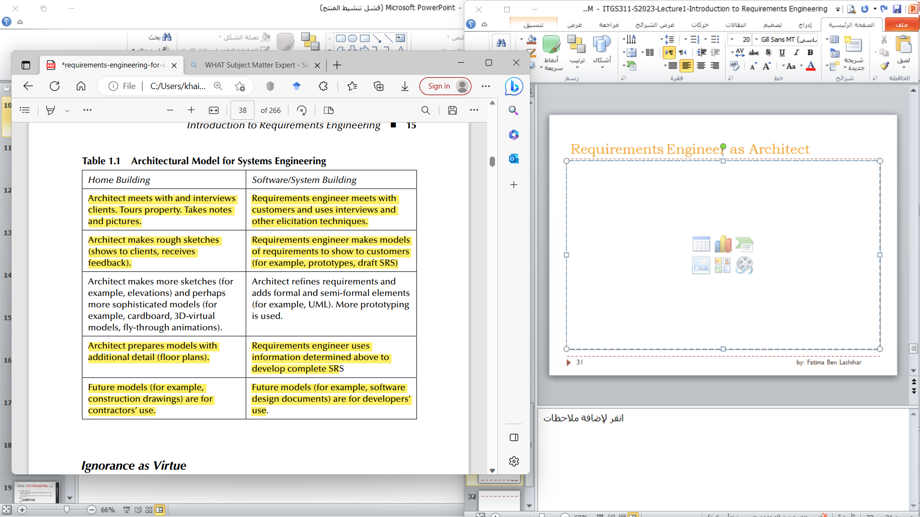
Requirements Engineer as Architect مهندس المتطلبات كمهندس معماري
المهندس المعماري يلتقي مع العملاء ويجرون مقابلات معهم. جولات عقارية. يدون الملاحظات والصور. | مهندس المتطلبات يجتمع مع العملاء ويستخدم المقابلات و تقنيات الاستنباط الأخرى
مهندس معماري يصنع الرسومات التقريبية (يعرضها للعملاء ، يتلقى الملاحظات). | مهندس المتطلبات يصنع النماذج من المتطلبات لإظهارها للعملاء (على سبيل المثال ، النماذج الأولية ، مسودة SRS ).

Slide 32
Requirements Engineer as Architect
مهندس معماري يعد النماذج مع تفاصيل إضافية (مخططات الطوابق) | يستخدم مهندس المتطلبات المعلومات المحددة أعلاه إلى تطوير SRS كاملة
النماذج المستقبلية (على سبيل المثال ، رسومات البناء) هي لاستخدام المقاولين. | النماذج المستقبلية (على سبيل المثال ، البرامج وثائق التصميم) هي لاستخدام المطورين.

Slide 33
Role of the Customer? دور العميل؟
Helping the requirements engineer understand what they need and want (elicitation and validation)
مساعدة مهندس المتطلبات على فهم ما يحتاجونه ويريدونه (الاستنباط والتحقق من الصحة)
Helping the requirements engineer understand what they don’t want (elicitation and validation)
مساعدة مهندس المتطلبات على فهم ما لا يريدونه (الاستنباط والتحقق من الصحة)
Providing domain knowledge when necessary and possible
توفير المعرفة بالمجال عند الضرورة والإمكان
Alerting the requirements engineer quickly and clearly when they discover that they or others have made mistakes
تنبيه مهندس المتطلبات بسرعة ووضوح عندما يكتشفون أنهم أو غيرهم قد ارتكبوا أخطاء

Slide 34
Role of the Customer? دور العميل؟
Alerting the requirements engineer quickly when they determine that changes are necessary (really necessary)
تنبيه مهندس المتطلبات بسرعة عندما يقرر أن التغييرات ضرورية (ضرورية حقا)
Controlling their urges to have more changes
السيطرة على رغباتهم في التغيير
Sticking to all agreements
الالتزام بجميع الاتفاقيات

Slide 35
Role of the Customer? دور العميل؟
In particular, the customer is responsible for answering the following four questions, with the requirements engineer’s help, of course:
على وجه الخصوص ، يكون العميل مسؤولا عن الإجابة على الأسئلة الأربعة التالية ، بمساعدة مهندس المتطلبات ، بالطبع:
Is the system that I want feasible?
هل النظام الذي أريده ممكن؟
If so, how much will it cost?
إذا كان الأمر كذلك ، كم سيكلف؟
How long will it take to build?
كم من الوقت سيستغرق البناء؟
What is the plan for building and delivering the system to me?
ما هي الخطة في بناء وتسليم النظام لي؟

Slide 36
Problems with Traditional Requirements Engineering مشاكل في هندسة المتطلبات التقليدية
Traditional requirements engineering approaches suffer from a number of problems, include:
تعاني مناهج هندسة المتطلبات التقليدية من عدد من المشاكل، منها:
Natural language problems (e.g., Ambiguity, imprecision)
مشاكل اللغة الطبيعية (مثل الغموض وعدم الدقة)
Domain understanding
فهم المجال
Dealing with complexity (especially temporal behavior)
التعامل مع التعقيد (خاصة السلوك الزمني)
Incompleteness (missing functionality)
عدم اكتمال (وظائف مفقودة)

Slide 37
Problems with Traditional Requirements Engineering مشاكل في هندسة المتطلبات التقليدية
Over-completeness
الإفراط في الاكتمال
Overextension
الإفراط في التمديد
Inconsistency
عدم تناسق
Incorrectness
خطأ

Slide 38
The End……

