Slide 1
Economics of Copyright and Piracy
Patrick Waelbroeck, ENST
waelbroe@enst.fr

Slide 2
Summary
Firms price discriminate in order to increase profits.
Price discrimination is not always possible: firms must have market power and be able to limit resale.
In third degree price discrimination, a profit maximizing firm should follow the inverse elasticity rule in each market.
Second-degree price discrimination: self-selection leads to inefficiently low quality/quantity for “low types”
Price discrimination can have ambiguous overall welfare implications. Quantity increases typically necessary for welfare gain.

Slide 3
Today
Last time: strategies assumed no piracy or perfect copyright protection
Today: with the internet, more difficult to prevent end-user copying of digital goods
Example: Peer-to-peer or file-sharing networks (Napster, Kazaa, Emule, BitTorrent, …)
End-user piracy ≠ for-profit or commercial piracy
Commercial piracy: should be limited; negative effect; no controversy
What are the economic implications of end-user piracy?

Slide 4
What is intellectual property?
Definition: Intellectual property is the tangible and intangible products of the human mind.
Physical property is either made or purchased.
Intellectual property is the results of one’s ideas.
Art, music, books, poetry, Software, blueprint
Value comes from both the physical medium (ink, paper, vinyl, aluminum, etc) and the work needed to produce the content.
Price reflects both the medium and the content.
Examples of IP: patent, copyright

Slide 5
Basic problem of innovation
Incentive problem within the relationship between one principal (society) and one agent (potential innovator) in order to produce a public good (knowledge, music, writings, films, …).
Induce innovation if social expected value exceeds social expected cost. If so, create sufficient incentives for the innovator so that private expected compensation exceeds private expected costs.
IP must be particularly protected when
  creation process is costly (either financially or in terms of opportunity costs);
  research is risky (the probability of innovation is low).

Slide 6
Economic rationale of IP rights
Non-excludability means no sales, and no sales might mean no production → risk of underproduction
Law awards exclusive right to control the production and the sales of their goods.
Generates an underutilization problem:
  Monopoly: price > marginal cost (= zero) → consumers who are willing to pay more than zero but less than monopoly price don’t consume → inefficiency
IP laws strike a balance between the two conflicting problems: the exclusivity created by copyright or patents is limited in length and in breadth → second best solution

Slide 7
Basic trade-off
Incentives:
  Dynamic efficiency
  Infinitie protection
Use:
  Static efficiency
  No protection

Slide 8
Basic trade-off (cont.)
Modèle de différenciation verticale
copie // version qualité faible
U(s₂, p) = θs₂ - p
θ ∼ Uniforme [0,1] = goût pour la qualité
c = 0 = coût marginal de production
K(s) = coût de développement/qualité, croissante/convexe (ex: k s²/2)

Slide 9
Demand function
1
SC*
demand for original product
θ*
u(s,p) = 0
no purchase
0

Slide 10
Profits
Π₁(s,p) = d₁(s,p) p - K(s)
(p*,s*) = argmax{Π₁(s,p)} (p,s≥0)

Slide 11
Effect of piracy
Utilité de la copie
U(s₁, x) = θs₁ - x
s₁ < s₂
x = coût de la copie (=0)
// concurrence

Slide 12
Effect of piracy
1
Purchase original
u(s₁,p₁) = u(s₂,p₂)
SC**
θ*
Copies
u(s₁,p₁) = 0
θ**
outside option
0

Slide 13
Profits
Π₂(s,p) = d₂(s,p) p - K(s)
(p**,s**) = argmax{Π₂(s,p)} (p,s≥0)

Slide 14
Effect of piracy
Sous-utilisation
SC* < SC**
Sous-production/qualité
s** < s*
preuve: exercice!

Slide 15
Copyright
Copyright exists to give creators of ‘artistic’ works the ability to generate revenues.
The theory is that without copyright, competition in selling reproductions of a title would drive the price down to the marginal cost of producing a reproduction.
They are given monopoly protection, which increases their revenues, but raises price to consumers.
The exclusivity created by copyright or patents is limited in length and in breadth.
This increases the number of inventions, but decreases the use of each invention

Slide 16
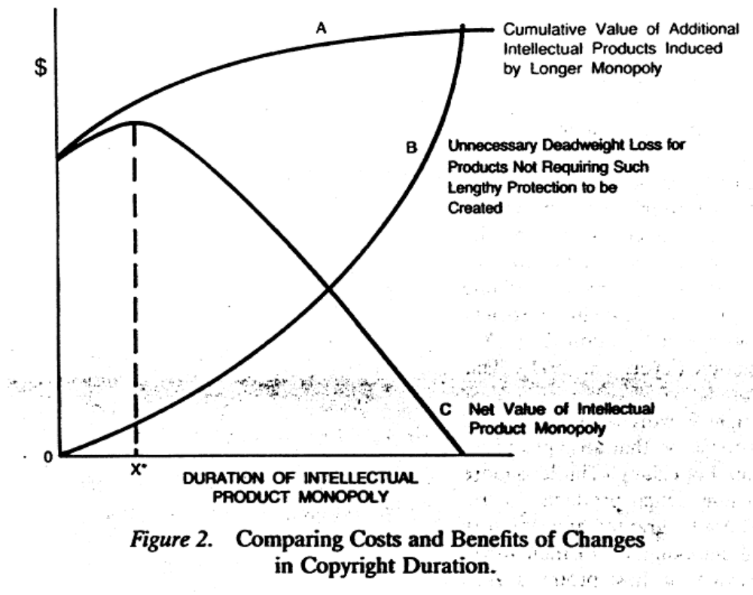
Copyright length

Slide 17
Actual copyright
Life of the author plus 70 years
‘Work for hire’, movies, games?, 95 years.
Is this too long?
Creative commons members say ‘yes.’
17 economists say ‘yes.’
Mark Twain says `no’
Complicated issue

Slide 18
Extension of Copyright law
1790 -Books, maps and charts
1802 -Prints
1831 -Music
1865 -Photographs
1870 -Drama, paintings, drawings and sculpture
1912 -Movies
1964, 1976 -Computer Programs
1971 -Records and tapes
1976 -Dance
1990 -Architecture
1998 -Digital Millenium copyright act

Slide 19
Limitations
– Non-profit musical performances
– Radio musical performance in restaurants and small businesses (1976)
– Works of utility (a chair)
– Expressions of fact (phone book)
– Ideas vs. expression of ideas
– Fair use
– Parody and commentary

Slide 20
Fair use
There is in the law an attempt to balance the interests of copyright holders and those of users.
Fair use is a defense to a claim of copyright infringement. It allows copying in instances when the copying appears not to be hurting the copyright owners revenues.
Betamax Case said home videotaping was fair use, and thus home videotaping was allowed.

Slide 21
Fair use: 4 factors
Amount of the copyright product that is copied.
Nature of the Copyright product (commercial versus academic or scholarly.
Nature of the use of the copied product
Impact on the revenues of the copyright holder.
Last factor is the most important.
The economic rationale for ‘fair use’ is that it increases the welfare of the consumer without seriously reducing the welfare of the producer and it saves on transaction costs of negotiating with copyright holder.

Slide 22
Fair use and internet file-sharing
Is internet file-sharing fair use?
Judges say no: prevented the development of legal market for digital music
More generally, what is the impact of file-sharing on firm profits?
Is it always bad?

Slide 23
Effect of end-user piracy on firms profits
Substitution: some customers do not purchase anymore (= competition)
Reduce profits
Reduce incentives to increase quality/variety
How to create value or appropriate revenues?
  Versioning
  Indirect appropriation
  Network externalities
  Informational externalities
  Technological protection (DRM)

Slide 24
How to create value?
Versioning
Indirect appropriation
Network externalities
Informational externalities
Technological protection (DRM)

Slide 25
Versioning
Free version = lower quality version
Some customers do not purchase anymore (= competition)
How to respond?
Introduce lower quality version at lower price
Competes with free (pirated) version
Example: student version of software

Slide 26
Spotify
Available in 13 countries (mostly Europe, incl. US)
2010: £63.16m, 2/3 from subscriptions
2.5m subscribers, 12.5m users
Free, 4.99 EUR unlimited, 9.99 EUR premium (income = 120 EUR > 2.5 CDs per year)

Slide 27
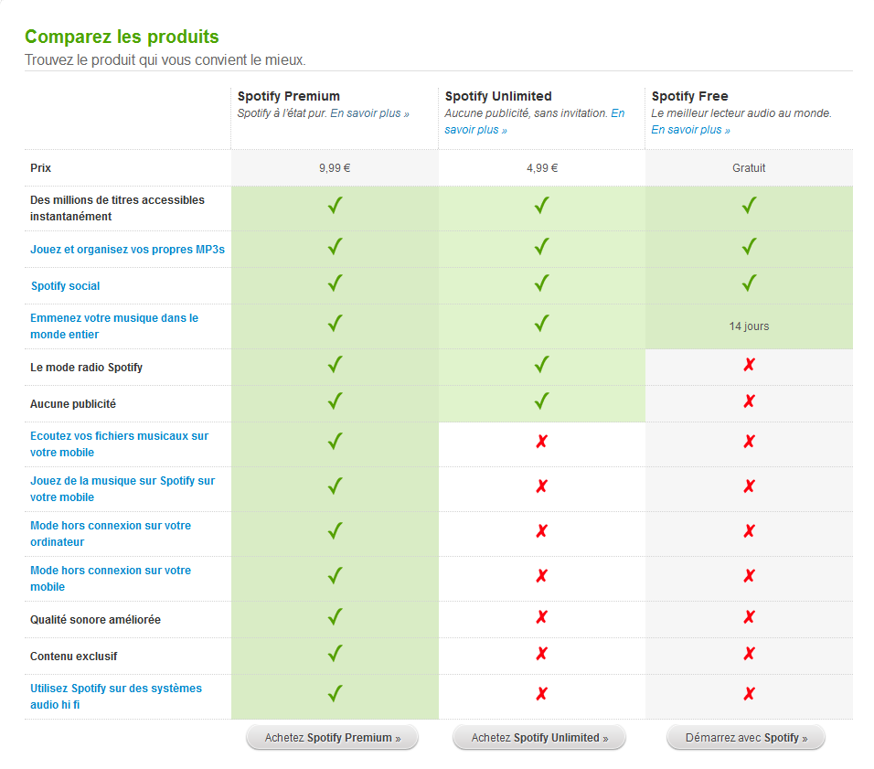
Spotify (cont.)

Slide 28
Deezer
Bundle with Orange in France, available in most European countries
1.4m subscribers in 2010
2.4m registered, 3.2m unregistered/month in 2011
15% conversion rate (out of 2.4m)

Slide 29
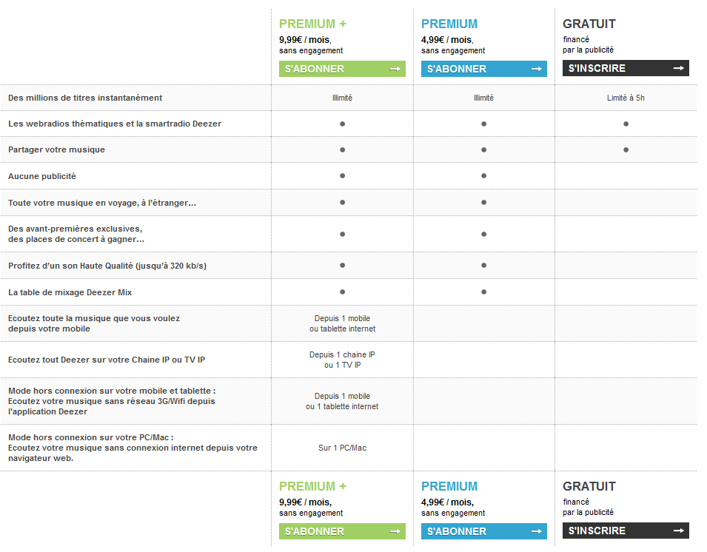
Deezer (cont.)

Slide 30
Model setup
Vertical differentiation with three choices
premium subscription at price p: U_{p} = θ − p
free version with restrictions 0 ≤ R ≤ 1: U_{f} = (1−R)θ
digital copy of lower quality 0 < α < 1: U_{c} = αθ
consumer taste θ is uniformly distributed on the segment [0, 1]
(later: general distribution function)
(later: fixed cost of copy)

Slide 31
Model setup (cont.)
The firm uses price and restrictions to maximize profits
Increasing price can increase profits, but some consumers switch to free version or copy
Increasing restrictions, increase demand for the premium version, but divert free users to piracy
a = ARPU from ads, exogenous

Slide 32
Demand functions
Two cases
1) few restrictions (R ≤ (1−α)): free > copy;
2) large set of restrictions (if R > (1−α)): copy > free
Main result: increasing copyright protection (smaller α), increases restrictions
Substitution between freemium and copyright protection

Slide 33





Interpretation (cont.)
1
1
0
0

Slide 34
Indirect appropriation
Possible to monitor number of copies
Example: photocopies
↑ Increase price of original product
Individual subscription <> libraries
Consequence: books → Academic journals
How to implement? Enforce monitoring of copies
Example: Business Software Alliance, site licences with internet activation

Slide 35
Indirect appropriation: examples
Increase price of complementary products
Examples:
  Concerts
  Ringtones
  Ipods
Taxed in many European countries:
  iPod
  Portable hard drives
  CD-R
  DVD+R/W

Slide 36
Network externalities
Strategy: use piracy to build a critical mass of users
Suppose two groups of consumers: low- and high-value
Without piracy: sell to high-value consumers
With piracy: more users → value increases → increase price and profit from high-value consumers

Slide 37
Network externalities (cont.)
Strategy: allow piracy to build a critical mass of users
Exemple: Microsoft in China
Early phase: Do not legally fight illegal copies
Later: lobby for reinforcement of intellectual property

Slide 38
Informational externalities
Music as an experience good
Consumers need information on new releases
Information-push : TV, radio, magasines
  Cost < record companies
Information-pull
Ex: free listening in record stores
Generalization: Internet, P2P networks
Cost < consumers
What if copies provide information? Competition effect vs. Matching effect of digital copies
Increase willingness to pay for music

Slide 39
Digital copies and information
What if copies provide information? Competition effect vs. Matching effect of digital copies
Increase willingness to pay for music
Suppose large number of albums and no information: pick album at random; sometimes enjoy, sometimes do not enjoy; on average, low value if only one album matches your taste
Suppose you can download as much as you want for small cost: you find out which album you like best; higher willingness to pay for albums

Slide 40
Digital Rights Management
= Digital Restrictions Management?
Give control to copyright owners not specified in copyright law
  Example: restrictions on transfers to computers and iPods
Can invade privacy
No second-hand market (Ebay case)
But: possibility to recommend products based on personal taste and targeted advertising
Can be flexible: allow some free listening a limited number of times

Slide 41
Example: Music copyright
In the US:
Audio Home Recording Act 1992
< Sony DAT, Philips DC: taxes are redistributed, technological protectionDRM (first copy authorized)
Digital Millenium Copyright Act 1998
Tamper with technological protection = crime
Ex: CSS/DVD, WMA/AAC

Slide 42
Online copyright enforcement
3 strike (Hadopi) law in France
« Effectiveness »?
  Natural rights view (property)
  Utilitarian approach (increased sales, distribution, creation, quality)
Two views can be contradictory: producer vs. consumer surplus
Hadopi law: both views
<> EU copyright enforcement directive: commercial scale.

Slide 43
Around the world
R. Giblin, « Evaluating Graduated Response », Columbia J. of Law & the Arts, 2014
In law
  France, New Zealand, Taiwan, South Korea, UK
  Not always operational
Private arrangements between right holders and ISPs
  Ireland
  US

Slide 44
Graduated response
Danaher, Smith, Telang, Chen, « The Effect of the Graduated Response Anti-Piracy Laws on Music Sales: Evidence from an Event Study in France», J. Ind. Eco., 2013
  Difference in difference: +25% on iTunes sales
  Controversial: digital sales driven by iPhones penetration in France?

Slide 45
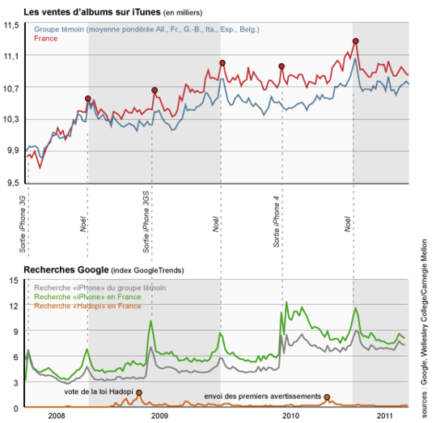
Graduated response
Le Monde, Hadopi, source de la croissance d’Itunes ?, 24/1/2012

Slide 46
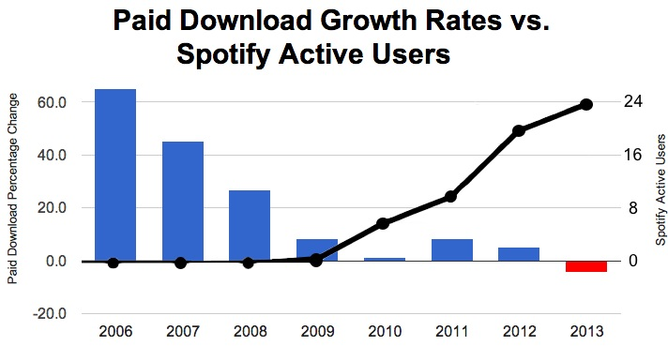
Graduated response
Adermon, Liang, « Piracy, and Music Sales: The Effects of an Anti-Piracy Law », J. Econ. Behavior Org., 2014
  Same methodology
  Limited effect in time (6 months)
  Effect of Spotify?

Slide 47
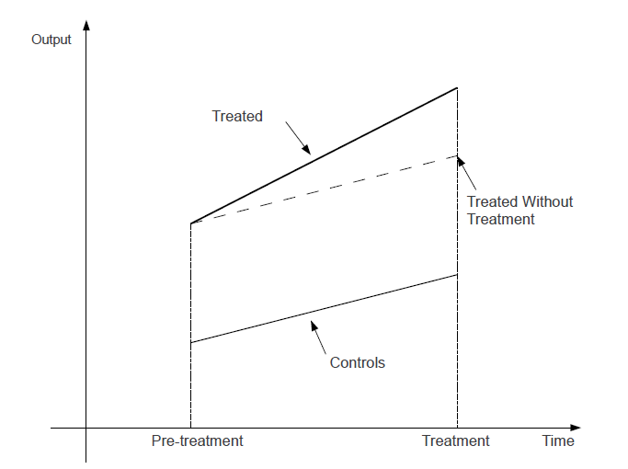
Common trend/parallel path assumption

Slide 48
Graduated response
Farbahbakhsh, Cuevas, Rejaie, Kryczka, Gonzalez, Crespi, « Investigating the Reaction of BitTorrent Content Publishers to Antipiracy Actions”, IEEE P2P Computing, 2013
  Reduced the number of casual publishers
  But the number of active publishers remained stable and they considerably increased their publishing rate.

Slide 49
MegaUpload
Danaher, Smith, « Gone in 60s: The Impact of Megaupload Shutdown on Movie Sales », Int. J. Industrial Org., 2014
  +6.5%-8.5% digital sales for 2 movie studios
  Megaupload penetration rate?
  Static measure
  Firm level sales data, but country level analysis.
Peukert, Claussen, Kretschmer, « Piracy and Movie Revenue: Evidence from Megaupload », 2013
  No effect on Box office revenues
  Negative effects on middle of the distribution (sampling); Positive effect for some blockbusters.

Slide 50
MegaUpload
Farahbakhsh, Cuevas, Rejaie, Kryczka, Gonzalez, Crespi, « Investigating the Reaction of BitTorrent Content Publishers to Antipiracy Actions”, IEEE P2P Computing, 2013
  Increase the number of the Pirate Bay publishers, but no impact on overall publishing rate, because major BT publishers reduced their publishing rate

Slide 51
The 3 strike law in France

Slide 52
History
Sept. 2009, Hadopi-2: a judicial authority has the power to suspend or terminate Internet access
2010: Hadopi is operational, max. fine of EUR 1500
July 2013, Hadopi-3: removes Internet termination
End of July 2013: 2004847 first notices, 201288 second notices, 710 investigations
Discussion of transfer to CSA (French Audiovisual Board)

Slide 53
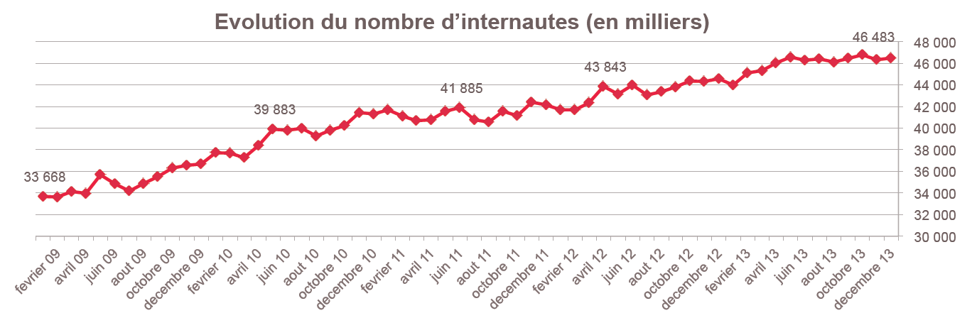
Internet penetration
Source: L’audience des sites internet dédiés à la contrefaçon audiovisuelle en France, ALPA, TMG, Mediametrie, CNC, 2014

Slide 54
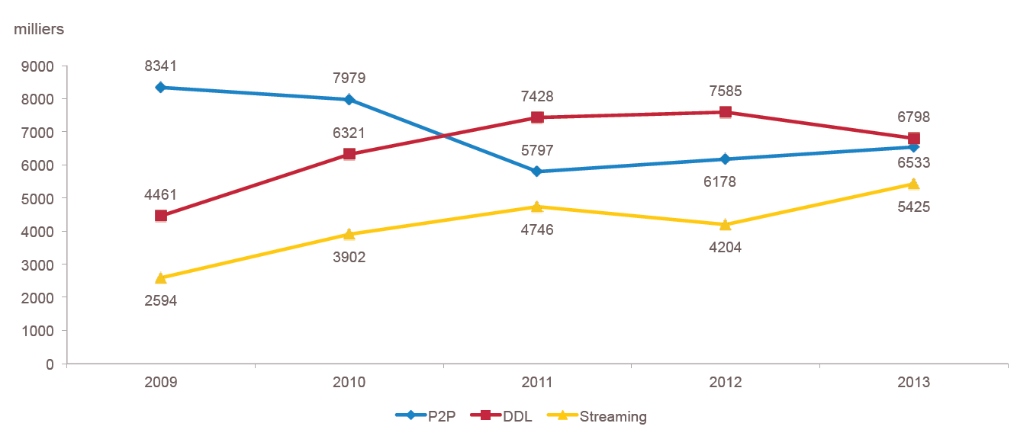
UVs by protocol

Slide 55
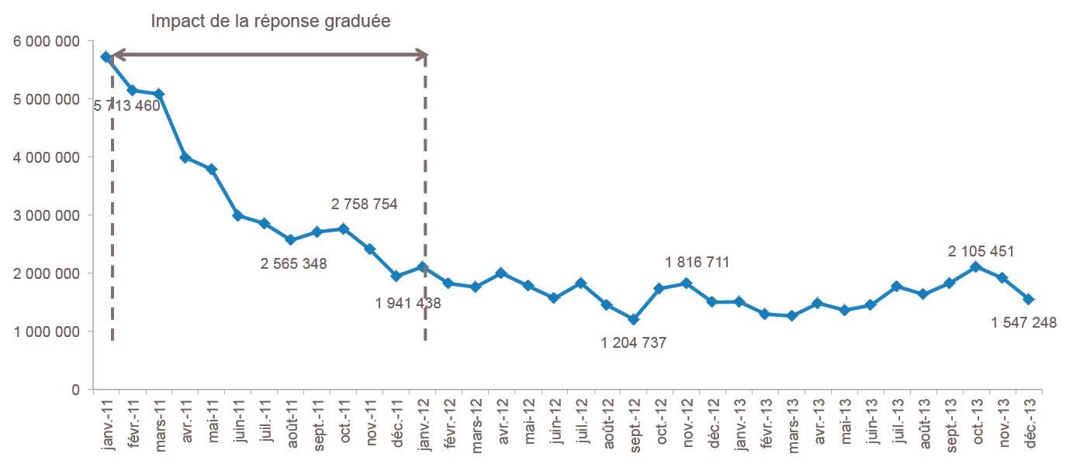
Number of publishers, Top 10 movies on P2P networks

Slide 56
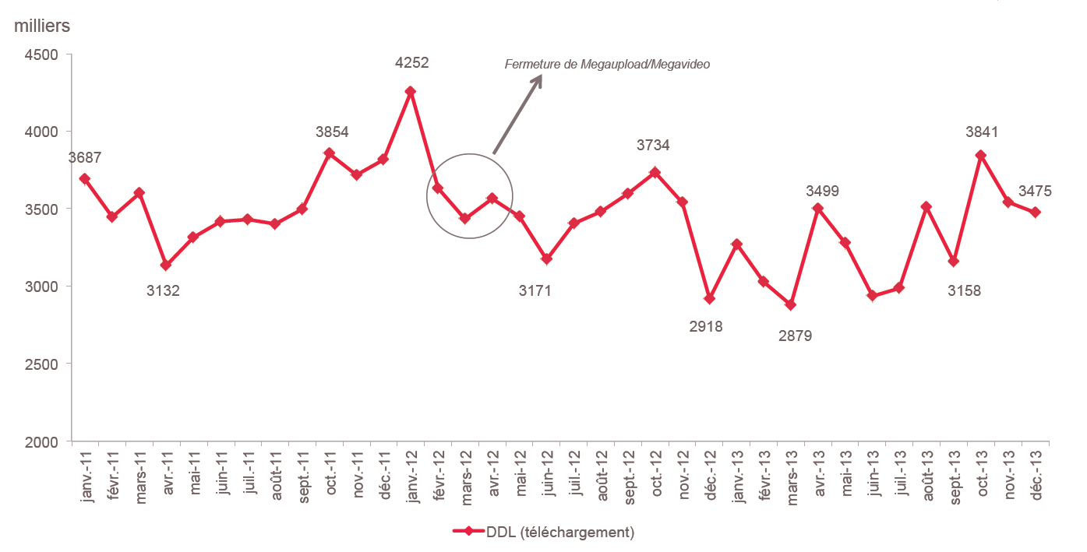
Number of individuals having accessed DDL sites at least once

Slide 57
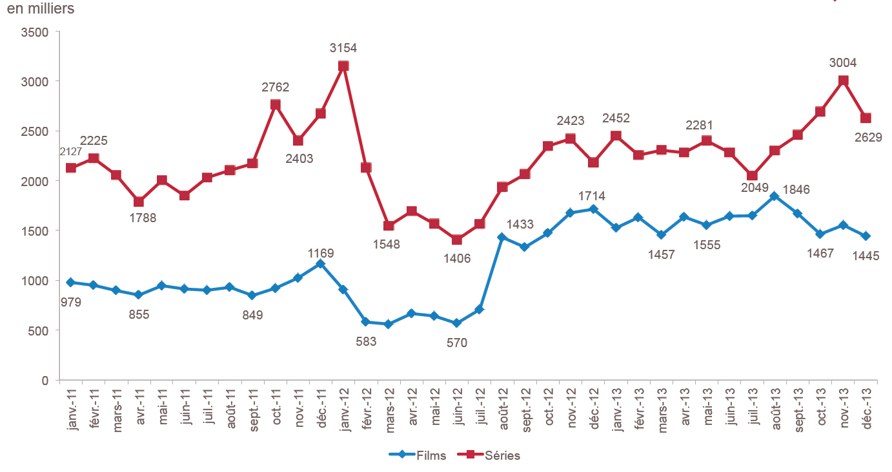
Number of individuals having streamed illegal content

Slide 58
Research question
100/10/1
Question: Due to the effectiveness of the graduated response? Or to the nature of the stochastic process?
Use a stochastic model that replicates the actual process of sending first/second/third letters.

