Slide 1

Enjeux économiques des données personnelles
Partie 1
Patrick Waelbroeck
patrick.waelbroeck@telecom-paristech.fr

Slide 2
Focus
Informational externalities
Example: online reviews on Amazon.com

Slide 3
Externality
Individual action creates an effect on others that is not directly captured by a market mechanism
Example: post on review of a product online (amazon.com for instance)
Informational externalities
The review benefits all potential consumers
Other example: the value of a software increases with the number of users (Word, Windows, etc.)
Other example: the value of online dating site increases with the number of users of the opposite sex
Network externalities

Slide 4
Four paradoxes
Paradox 1: Price dispersion
Paradox 2: Music is free, but Apple strives
Paradox 3: Used goods are ‘lemons’ but Ebay is alive and well
Paradox 4: Internet makes entry easier (more competition), but online markets dominated by large firms

Slide 5
Infrastructure
"The layers principle"
Content; IP rights enforcement
Logical = "machinery" of the internet; acrtions againts P2P networks, Digital Rights Management
Physical = computers, wireless devices, ...;
End-to-end principle = "dumb" network vs. packet discrimination; net neutrality

Slide 6
Digital/information goods
Define a digital good as anything that can be distributed in purely digital form
Text: books, periodicals
Images: photos, movies, illustrations
Sound: music
Structured data: directories, GIS
Not services!
Sometimes called information goods

Slide 7
Production of information goods
Producing first copy is generally sunk cost
Not recoverable if production halted
In contrast, for a building or equipment can recover some costs by selling
If additional copies are cheap for anyone to produce then hard to recover cost
Physical copies provide barrier (e.g., printing) Relatively expensive, especially mass copying
Degradation of copies provides barrier

Slide 8
Production of information goods
Information goods have little or no marginal cost
This is the cost of making additional copies.
Cost of media, or storage and transmission.
If marginal cost is low, it’s better to have many consumers.
Absorb high fixed costs.
This is called increasing returns to scale
The more you sell, the greater your profit per item.
Provides an advantage to large producers

Slide 9
Low marginal cost
Classical economic theory predicts that items in a
competitive market will be sold at marginal cost.
What if marginal cost is zero?
No incentive for sellers.
Obviously, this is not the way things work.
In real-world markets, copyright gives sellers a limited monopoly.
Cartel structures (e.g. music industry) also keep prices artificially high.

Slide 10
Public good
Definition: Goods that do not get used up when consumed. In other words, one person’s consumption of a good doesn’t reduce anyone else’s potential consumption of the same good.
Examples: Ideas, television broadcasts, national defense.
Obviously, these are not physical items that get used up. Instead they are usually ideas and artistic expressions.
They are at the core of the Information Age Economy, since information is a public good.

Slide 11
Non rivalry
Nonrivalry means that the amount one person consumes does not affect the amount available for others.
Rivalry allows for price competition among consumers.
If there are a limited number of luxury cars, Van Gogh paintings, stock shares, people will pay more for them.
This is called scarcity
If there is no limit to the number of goods available, no one will want to pay more than the lowest price.

Slide 12
Non excludability
Difficult to exclude people from using the good
This is a technical issue as it is always possible to exclude
Example: air

Slide 13
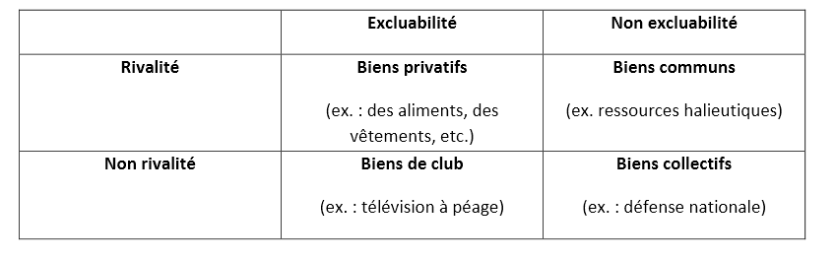
Confusion en français

Slide 14
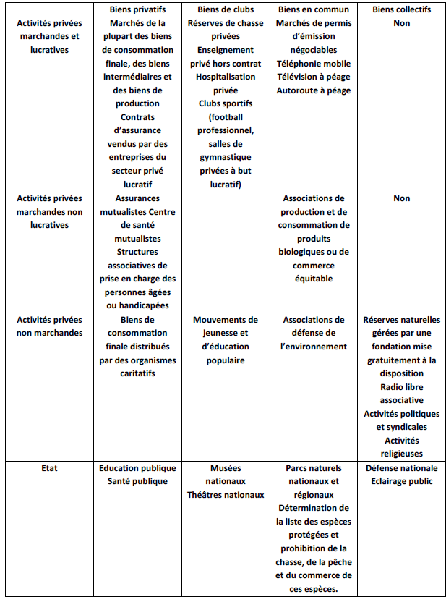
Gestion publique/privée

Slide 15
Les commons et leurs tragédies
Tragédie des communs
Tragédie des anti-communs
Autres solutions au problème du “free-rider” : Elinor Ostrom (prix nobel 2009)

Slide 16
Possible solution
Exclusive rights through (intellectua) property rights, leading to monopoly
Unfortunately, monopolies have undesirable side-effects
Corporations can exert undue influence over pricing and policy
Prices set above marginal cost.
This is nice for producers, but not economically
efficient.
There are people who would buy, if the good were available at a competitive price.
Problem with innovation: Arrow, Schumpeter

Slide 17
Consumer and producer surplus
Consumer surplus is the difference between the price paid and the higher price that consumers would have been willing to pay for the product.
Producer surplus is the difference between the payment received and the minimum payment that producers would have accepted.

Slide 18
Monopoly vs. competition
Monopoly versus competition
Smaller Quantity
Higher Price
Price discrimination.
The tradeoff associated with patents and copyright - deadweight loss in consumption versus possible new products.

Slide 19
Production of public goods
A firm cannot capture all social surplus
Plus: competition drives down the price to marginal cost; zero profit
Under-production of the public good
Need for copyright and IP protection
But under-consumption because monopoly power

Slide 20
Experience goods
Part of the law of supply and demand requires that consumers can accurately assess their choices.
Information goods are experience goods.
I don’t know how much I’ll like a CD until I hear it.
Compare this to a traditional good, like a car or a chair.
This means that consumers have a hard time determining how much they’re willing to pay.
Recommendations, try-before-purchase, reputation become very important.

Slide 21
Durable goods
Information goods are durable
Monopoly would like to price discriminate :
Charge a high price today and attract high-value consumers; then setting a low price tomorrow to sell to low-value consumers
Example: sales
Problem: buyers anticipate that and if they are patient, firm is forced to set a low price today
This is known as Coase’s conjecture
A monopoly faces competition from himself

Slide 22
Key characteristics of Internet
Universality of access
Any end user can gain access to the Internet, regardless of geographical location and time of the day.
Non-rivalry in consumption.
High speed information flows
Large quantities of data can be transmitted, retrieved and processed within a matter of seconds.

Slide 23
Privacy and price discrimination
Patrick Waelbroeck, ENST
waelbroe@enst.fr

Slide 24
Definition: Privacy
= ability to control the collection and use of personal information
Fundamental right in most countries
Security vs. individual rights of freedom

Slide 25
Privacy policies
Policies let consumers know about site’s privacy practices
Consumers can then decide whether or not practices are acceptable, when to opt-in or opt-out, and who to do business with
The presence of privacy policies increases consumer trust

Slide 26
Price discrimination
Charge different consumers different prices for same product
Examples
  Movies (adults, children, seniors)
  Movies: theatrical release, pay per view, dvd, cable, television
  Books: Hardcover and paperback
  Software: full versus ‘lite’ versions

Slide 27
Price variation vs. Price discrimination
Not all price differences are the result of price discrimination. Costs of dealing with different customers are not always the same.
Electricity generation has generally been less costly in the Northwest. Some customers are more prone to return purchases than others.

Slide 28
Example: Peak load pricing
At capacity, marginal costs include
  Costs of expanding capacity
  Value of unserved customers
For electricity, airlines, hotels, marginal costs fluctuate dramatically
Pricing should reflect likelihood of sellout or reaching capacity
Mobile telephone calls

Slide 29
Price discrimination: definition
Two varieties of a good are sold (by the same seller) to two buyers at different net prices
Net price = price after including cost related to product differentiation (delivery cost for instance)

Slide 30
Price discrimination
First degree (perfect): seller charges a different price for each good exactly equal to willingness to pay of buyer
Second degree (nonlinear, quantity discount): prices differ by amount of good purchased, not by consumer.
Third degree: different consumers charged different prices

Slide 31
Price discrimination law
Illegal if it gives some firm an advantage over other firms.
If individuals are consumers, is not illegal.
Price Discrimination is not likely to harm efficiency. Perfect Price discrimination is perfectly efficient.
Intention of this rule was to protect ‘mom-and-pop’ stores and grocers from department stores and supermarkets. It was intended to reduce competition.

Slide 32
Conditions for price discrimination
Market Power: If firm is price taker, cannot charge markup
  But: can have price discrimination in markets with free entry and competition
Firm must have some knowledge of consumer’s willingness to pay.
  Third degree: must know how the elasticity of demand differs across markets.
  Second degree: must have some knowledge about the different “types” of consumers that exist in the market place.
Prevent or limit resale

Slide 33
How to prevent resale?
Legal restrictions (computer software, educ. discount)
Services cannot be resold.
Warranties: the firm can void a warranty if the product is resold.
Adulteration: Make the product unfit for other potential uses (damaged goods)
Transactions costs/switching costs/lock-in: If markets are spatially separated or barriers imposed by tarrifs, taxes, resale is more expensive (ex: email address, mobile phone #)
Contractual remedies (iTunes/Ebay case)

Slide 34
Perfect Price discrimination
Find maximum price that every consumer is willing to pay and charge them that price.
Requires more information than any firm has, and the prevention of arbitrage.
Demand Curve becomes MR curve.
No Deadweight Loss but no consumers surplus
Theoretical ideal. Cannot be fully achieved.
But: Digital Rights Management (DRM)

Slide 35
Third-degree price discrimination
Different customers are charged different prices based on observed demographic characteristics (related to elasticity).
  Geographic markets
  Product use markets
  Customer types (senior citizen, students)

Slide 36
Price discrimination with two or more markets
If markets for a single product have different MRs, profits can be increased by shifting output from low MR markets to high MR markets.
Raise price in low MR market and lower price in high MR market.
High MR market is high elasticity market.
Need to Prevent Arbitrage.
Examples: Airlines with business travelers and vacationers. Coupons.

Slide 37
Price discrimination with two or more markets
Raise price in market with lower elasticity (lower responsiveness)
Lower price in market with higher elasticity.
Do this until MRs are equalized. But prices will not be equalized.
Inverse elasticity rule
Examples: Airlines with business travelers and vacationers

Slide 38
Second-degree price discrimination
Heterogeneous consumers.
  Ex: some consumers want 2 units and some consumer only want one unit.
  No observed characteristics that can be used to forecast willingness to pay for a given unit
  The consumer’s demand is private information
Heterogeneous tastes for different quantities
  Value first unit more than later units
  Each consumer has downward-sloping demand

Slide 39
Examples of second degree price discr.
Monopolist offers “menu of bundles” to choose from
Examples:
  Two part tariff: fixed fee plus fee for each additional unit
  Long-distance phone service
  Disneyland: admission fee and fee per ride
Alternative bundles
  Mobile phone service (100, 500, 1000 minutes)

Slide 40
Two-part tariff
The two-part tariff is another common example of non-linear pricing.
A two-part tariff consists of fixed fee and a per unit charge.
The fixed fee is the amount the consumer must pay for the right to purchase any amount of the good.
The per unit charge is the price the consumer pays for each unit of the good.

Slide 41
Two-part tariff strategy
If a monopolist is able to use a two-part tariff, she will set the per unit charge equal to the competitive equilibrium price and the fixed fee equal to the competitive consumer surplus.
  Remember that the competitive equilibrium was the solution that allowed the most total surplus.
By setting the per unit charge equal to the competitive price, the monopolist preserves the largest possible surplus and the capitalizes on it by setting the fixed fee equal to the surplus.

Slide 42
Bundling
Two or more products that are sold as a package.
CDs versus singles
Cable television bundles versus a la carte.
Subscription services versus pay per use –cable blanket versus long distance telephone or pay per view; Rhapsody versus iTunes.
Computers with software
Office suites versus individual components.

Slide 43
Bundling and tie-in
Bundling: firms sell two or more products combined
  Microsoft Office
  Internet Explorer and Windows
  Idea: charge more to consumers with a low value for one good but high value for the other
Tie-in sales: consumers that buy one product are required to make all future purchases of another product from the same firm.
  Xerox copiers and paper or service
  Printers and toner

Slide 44
When to bundle?
Mark: values "Baby one more time" at $3, "I will still love you" at $1
Sally: values "I will still love you" at $3, "Baby one more time" at $1
Individual pricing:
  Sell each song at $3 or $1
  At a price of $3 sell 1 to each, per person profits = $3
  At a price of $1 sell 2 to each, per person profits = $2
  Total profits: $3 + $3 = $6
Bundling
  Sell bundle at $4 to both: profits = $8

Slide 45
When to bundle?
Bundle products that are substitutes
  When consumers want one or the other
  When valuations are negatively correlated
Offer complements separately
Offer both if consumers are mixed

Slide 46
Issues with bundling
CDs versus singles- pricing versus cannibalism. iTunes versus prior models.
Cable television bundles versus a la carte; competition in content
Internet explorer vs. Netscape

Slide 47
Versioning
Sometimes (frequently) creating different grades of products might just better meet consumer demands.
Versioning is artificially creating different products (where the high end product would meet all needs) to achieve price discrimination.
+: market expansion
Problem: avoiding cannibalization of higher end product line.

Slide 48
Examples of versioning
Luxury versus regular automobile brands.
PC Junior.
‘lite’ versions of software with reduced functionality.
Putting identical chips in high and low powered calculators.
By delaying introduction
  Hardcover then later paperback books
  Film release, then video, then television

Slide 49
Examples of versioning: Quicken
Quicken Basic $34.95
Quicken 2001 Deluxe $59.95
Quicken Home & Business $79.95
  Payroll & invoicing
Quicken 2001 Suite $99.95
  Tax Software
Home & Business Suite $139.95
  Payroll & invoicing
  Tax software

Slide 50
How many versions?
Usually have at least three for software
  Low-priced: focus on price over functionality
    E.g., personal, essentials,
  Mid-priced: balance of two
  High-priced: for those who want all functions
    E.g., professional
Majority will avoid extremes
  With three choices nearly half generally buy mid-priced version

Slide 51
Résultat
Versioning augmente les profits
Expansion de marché > cannibalisation
Preuve: exercice

Slide 52
Free version
For physical goods, generally too expensive to give away for free
  Marginal cost is not low
For digital goods, marginal cost near zero
Build interest and market by giving away
  But need people to pay eventually
Free versions (or cheaper ones)
  Limited functionality
  Limited time period
  No support
  Personal or educational use only

Slide 53
Indirect network effects
or 2-sided network externality: is a demand economy of scale that crosses coupled heterogeneous markets.
Examples include:
  card-holders & merchants that accept the same credit card
  content consumers & creators (e.g. PDF, MP3 streaming, video)
  Online dating site
For coupled networks, expect to see an intermediary try to manage price pairs regardless of whether the intermediary is independent or managed by one side of the network.

Slide 54
Examples
Meetic: men/women
  Free for women
  Men pay two part tariffs
Google :
  3 versants : consommateurs, intermédiaire publicitaires, producteurs

Slide 55
Les marchés à plusieurs versants
Externalités croisées ou indirectes, intergroupes
Souvent : externalités directes négatives, intra-groupes
« Diviser pour conquérir »
La plateforme peut avoir intérêt à limiter la concurrence
De manière plus générale : « waterbed effect »
Eléments inhabituels de politique de la concurrence : 1 réseau > 2 réseaux, élasticité prix positive de la demande, prix en dessous du coût marginal

Slide 56
Intertemporal price discrimination
Firms producing a durable good would like to charge a higher price at product introduction and decrease price after
= price discrimination
Problem: Coase's conjecture
A durable good monopolist "competes with himself"

Slide 57
Avoiding Coase’s trap
Flow of new customers willing to pay relatively high prices.
Rent rather than sell the product.
Improve the product, increase old consumers’ demand. OR: fuel future demand by engaging in planned obsolescence (intergenerational incompatibility). 2 typical patterns:
  a user upgrades one component of her system, which degrades the performance of another component;
  other users upgrade their software, so that it is no longer compatible with the single user’s software.
Commit not to lower price/Reputation (de Beers)
Make good non-durable
Fads, fashion
Make capacity constraints so expanding output costly
Most favored customer clause or Best price
Buy back guarantee

Slide 58
Welfare effects of price discrimination
Ambiguous
First degree
  Consumer surplus + producer surplus under first degree price discrimination is the same as under perfect competition.
  First degree price discrimination is efficient.
  Inequitable.

Slide 59
Welfare effects of price discrimination
Second degree
  Can raise/lower welfare for certain groups.
  On an airplane, if all customers were charged the same price, last minute travelers might be made better off while travelers who book far in advance might be made worse off.
  Students/low value typically better off if they wouldn’t be served under monopoly
  Typically need increase in quantity for increase in welfare

Slide 60
Summary
Firms price discriminate in order to increase profits.
Price discrimination is not always possible: firms must have market power and be able to limit resale.
In third degree price discrimination, a profit maximizing firm should follow the inverse elasticity rule in each market.
Second-degree price discrimination: self-selection leads to inefficiently low quality/quantity for “low types”
Price discrimination can have ambiguous overall welfare implications. Quantity increases typically necessary for welfare gain.

Slide 61
Economie des réseaux
Patrick Waelbroeck, ENST
waelbroe@enst.fr

Slide 62



Introduction
Téléphonie: déploiement de la 3G en cours, anticipation de la 4G; Iphone, Googlephone
Diffusion de l’ADSL
Déploiement de la TNT
Industrie du jeu video
Concurrence dans les modèles de plateforme de téléchargement de musique
Concurrence entre téléchargement et streaming, modèles d’affaires non stabilisés
Guerre des standards sur les formats et les technologies

Slide 63
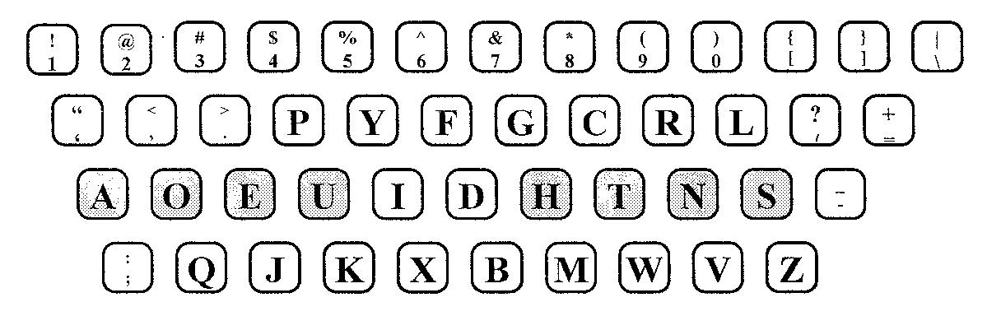
Les externalités de réseaux
Sont étroitement liées à la notion de standard et de compatibilité.
« path dependence », « lock -in », « qwerty » economics

Slide 64
Les externalités de réseaux
Composante traditionnelle indépendante des autres usagers
Composante liée au nombre d’interactions et la qualité du service en réseau
Directes et indirectes
<> externalité de marché

Slide 65
Limites des externalités
Effets de congestion
Différentes populations (ex : mobile/fixe)
Standard et formats (ex : PC/MAC)
Concurrence entre réseaux et switching costs (ex : différents sites de rencontres)

Slide 66
Analyse théorique
Problème fondamental des anticipations (Katz et Shapiro)
Dans l’approche classique avec anticipations rationnelles, il existe une multiplicité d’équilibres
… que l’on ne peut classer selon un critère de Pareto
Problème de coordination

Slide 67
La dynamique des réseaux
Rétroaction positive entre les externalités du côté demande et les économies d’échelles du côté de l’offre (positive feedback)
Conséquence : concentration de l’offre et importace de dépasser la masse critique (tipping point) > etre premier (lycos, altavista)
Exemples : échecs du mini-disc, betamax
Courbe de diffusion en S

Slide 68
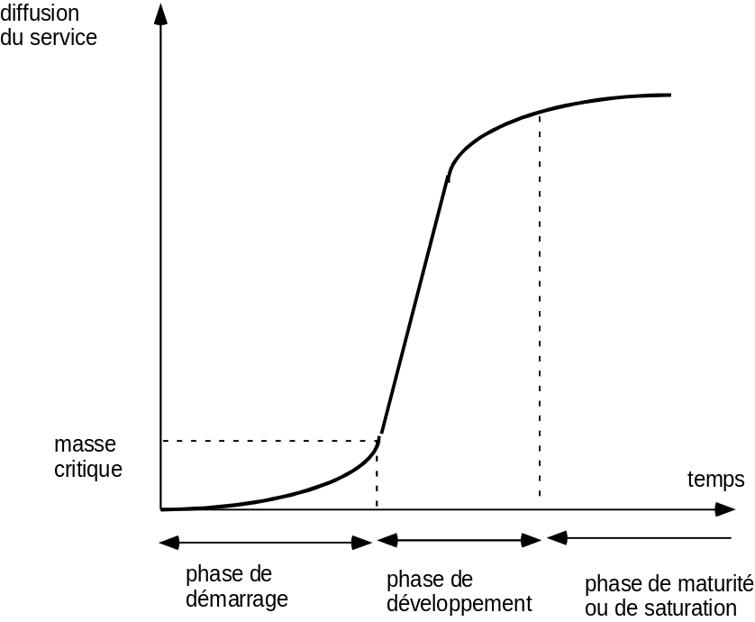
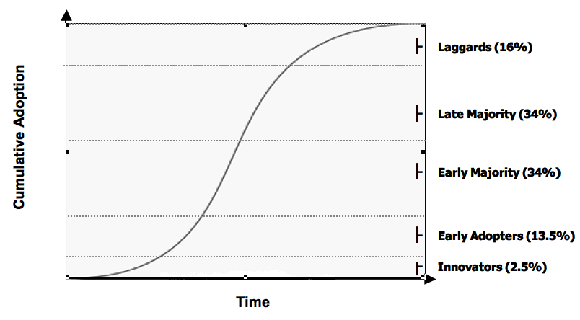
Dynamique des réseaux

Slide 69
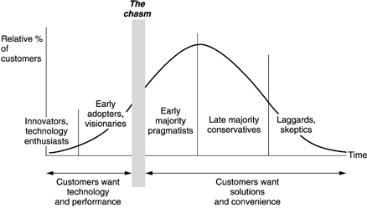
Dynamique des réseaux (suite)

Slide 70
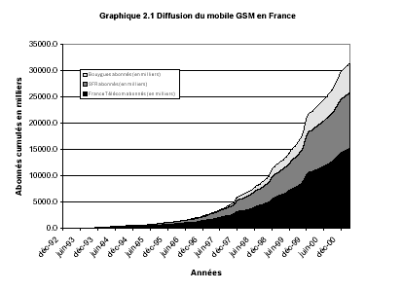
Dynamique des réseaux (suite)

Slide 71
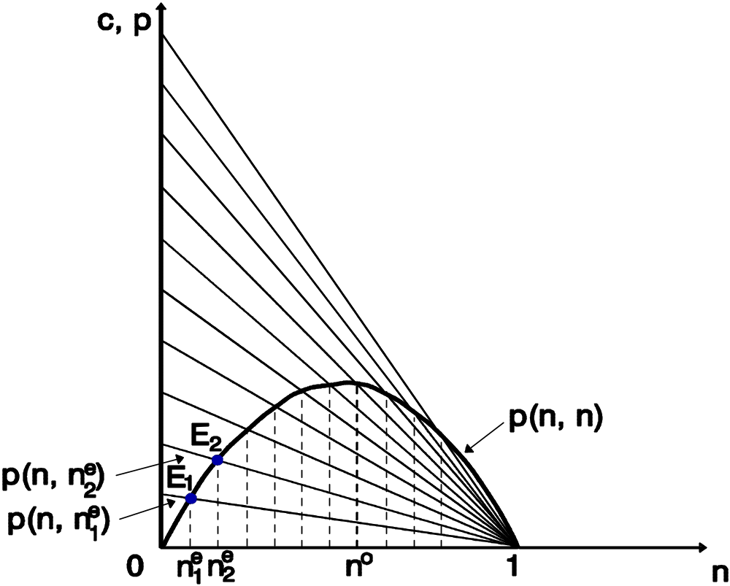
Politiques de la concurrence
Validité de la loi de la demande ?

Slide 72
Monopole et surplus social
Si les externalités de réseaux sont très fortes, il vaut parfois mieux un monopole avec un standard plutôt que deux entreprises fournissant des services et biens incompatibles (mais : économie des médias)
Une situation de position dominante ne signifie pas des entraves à la concurrence
Les politiques de la concurrences ont un effet moindre en situation d’externalités de réseaux fortes (effet d’un concurrent supplémentaire ?); ex: Google+
Concurrence pour le marché > concurrence sur le marché; ex : microsoft

Slide 73
Marchés à deux versants
platform
buyers
sellers
gamers
users
“eyeballs”
cardholders
videogame platform
operating system
portals, newspapers, TV
debit & credit cards
game developers
application developers
advertizers
merchants
Chicken and egg problem. Must get both sides on
board/court each side while making money overall.

Slide 74
Définition
Deux types d’agents intéragissent à travers un intermédiaire ou une plateforme
La décision de chaque ensemblee d’agents influencent le surplus de l’autre groupe d’agents (souvent à travers une externalité croisée)
L’intermédiaire utilise des stratégies sur les deux versants du marché

Slide 75
Type d’externalités
La valeur de la plateforme dépend du nombre d’utilisateurs de l’autre groupe
Indirectes : + (développeurs et utilisateurs de logiciels) ou - (téléspectateurs et publicités)
Directs : - (concurrence sur les plateformes B2B) ou + (joueurs d’une console)

Slide 76
Stratégies de prix
Exploiter les externalités croisées ou indirectes
Les prix dépendent donc de l’ensemble des élasticités et des coûts marginaux.
Augmenter les prix sur un versant a un coût d’oppportunité
Un prix faible sur un versant permet d’augmenter le prix sur l’autre versant
Cet effet est renforcé lorsque les plateformes sont en concurrence.
Subsidier le groupe le plus sensible au prix (PDF reader/writer) = « divide and conquer »
Permet de résoudre le problème de coordination

Slide 77
Stratégies de prix (suite)
Dans le cas de multi-homing, l’intermédiaire devient un monopole qui tarifie l’accès aux agents captifs
Prix faibles pour ceux qui sont captifs et prix élevés pour ceux qui cherchent à les atteindre (Amstrong)
La concurrence entre plateformes a donc surtout un effet sur le prix payé par les agens captifs et peu d’effets sur les autres
Exemple : cartes de paiement (système de fidélisation et de points pour les consomateurs)

Slide 78
Stratégies de prix (suite)
La discrimination par les prix sur un versant permet de générer du surplus et de proposer des prix plus faible sur l’autre versant
Prix d’introduction, augmente après avoir atteint la base installée; exemples : pages jaunes aux US.

Slide 79
Ouverture de la plateforme
Combien de versants ?
Compatibilité ?
Exemple 1 : Apple (logiciel et matériel), Microsoft (logiciel)
Exemple 2 : Amazon + marketplace
Exemple 3 : Microsoft IE, Media Player
Exemple 4 : Distributeur automatique de billets

Slide 80
Ouverture de la plateforme (suite)
Absence de "tipping" si
  Différenciation des services : Apple (graphique), Microsoft (bureautique)
  Plusieurs standards : Jeux vidéo (XBOX, Playsation, Nitendo)
  Pas de produits complémentaires : l’absence de différentation conduit à des standards mutiples (<> DVD, VHS)

Slide 81
Politiques de la concurrence
Définition du marché
On peut observer des prix en dessous du coût marginal <> concurrence déloyale ou prédation
La concurrence entre plateformes n’est pas toujours souhaitable; la concurrence potentielle l’est (marché contestable)

Slide 82
Politiques de la concurrence
Subventions et tying : waterbed effect = subvention croisées entre marché primaire et secondaire
Exemple : lames de rasoirs, cartouches d’encre

