Slide 1
Linear models
Gabriela Ciolek
Gabriela.ciolek@telecom-paristech.fr

Slide 2

Two variables
y = explained variable, dependent
x = explanatory variable, independent
u = non-observed variable, error, disturbance
β₀ = constant, intercept
β₁ = partial effect = ∂y/∂x (slope parameter in the relationship between y and x holding the other factors in u fixed)
Econométrie - Patrick Waelbroeck

Slide 3
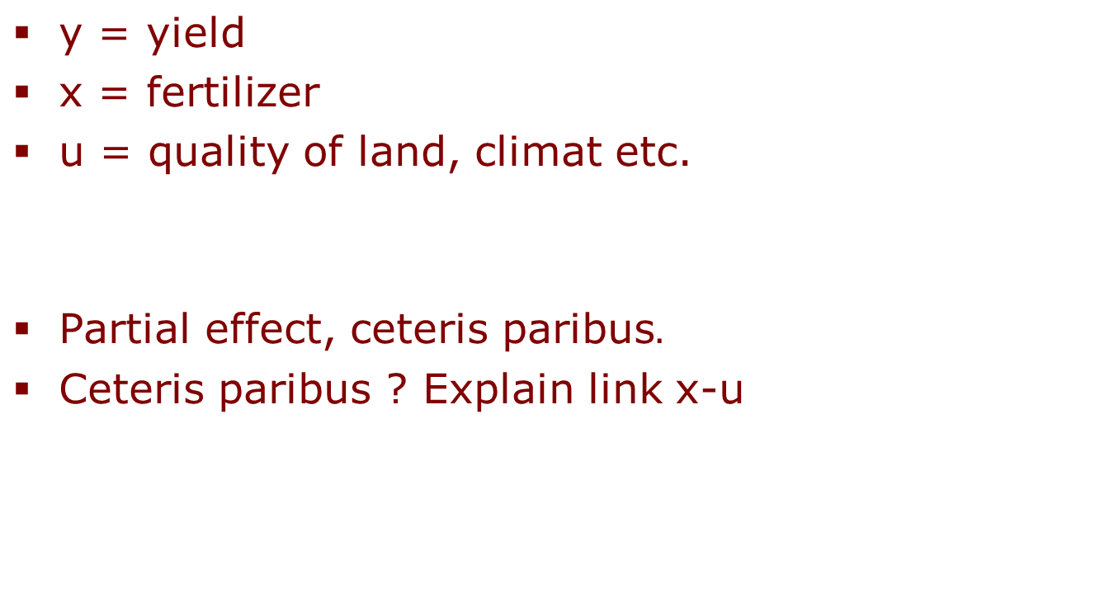


Example 1
Econométrie - Patrick Waelbroeck

Slide 4

Example 2
y = salary
x = education
u = labor force experience, productivity, tenure with current employer
Ceteris paribus ? Explain link x-u
Econométrie - Patrick Waelbroeck

Slide 5

Fundamental hypothesis
Error variables have zero mean
Conditional expectation = unconditional expectation
X and u are uncorrelated
fertizlizer (x) and quality of land (u)
Education (x) and tenure with current employer (u)
Econométrie - Patrick Waelbroeck

Slide 6

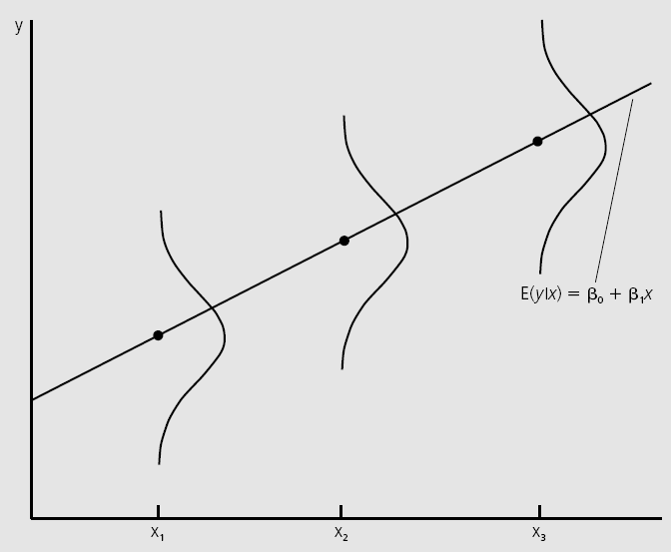
Population regression function
E(y|x) is a linear function of x (the linearity means that a one-unit increase in x changes the expected value of y by ẞ1
Econométrie - Patrick Waelbroeck

Slide 7


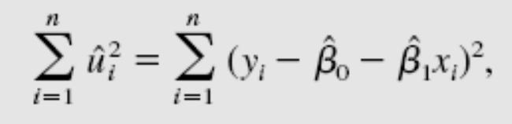
Predictions
Fitted value
Residual
Sum of squared residuals
Econométrie - Patrick Waelbroeck

Slide 8
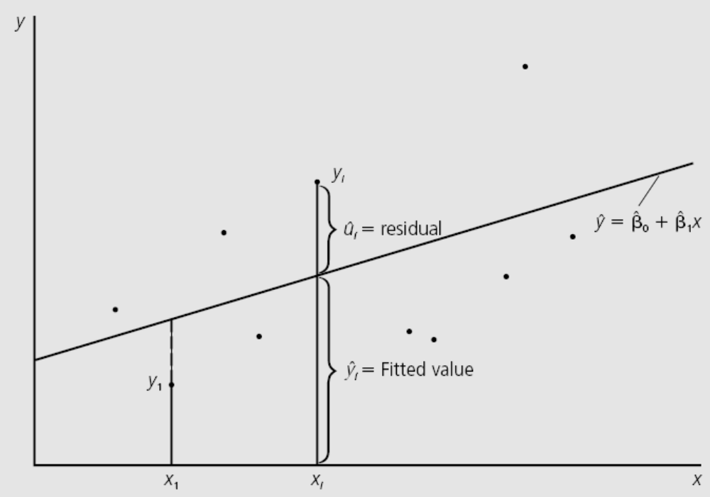
Graphical illustration
Econométrie - Patrick Waelbroeck

Slide 9
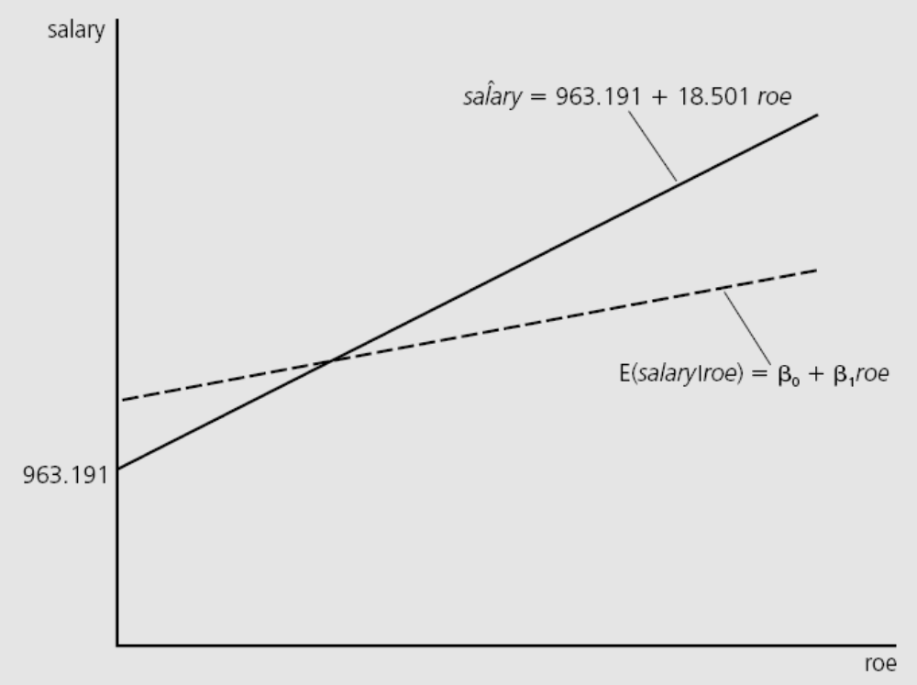
Example
Roe (average return equity) ↑ 1
Salary ↑ 18.501
= $18 501
Roe = 30
Salary = 1517.2
= $1.5 million
Econométrie - Patrick Waelbroeck

Slide 10

K explanatory variables
Multiple linear regression model
Example:
Fundamnetal hypothesis
(all factors in the unobserved error term be uncorrelated with the explanatory variables)
Econométrie - Patrick Waelbroeck

Slide 11

Obtaining the OLS Estimates
We minimize the sum of squared estimators
Matrix notation:
Min (y - xβ)′(y - xβ)
First order conditions (concavity criteria)
(y - xb)′ x = 0
Remark: we assume x₀ = 1
Econométrie - Patrick Waelbroeck

Slide 12
Matrix notation
X′ (y - Xb) = 0
X′y - X′Xb = 0
b = (X′X)⁻¹X′y
Problem if X′X≈0: multicollinearity
(we call this problem collinearity: it looks like we have p different predictor variables, but really some of them are linear combinations of the others, so they don’t add any information)
X′X = "variance"
X′y = "covariance"
Econométrie - Patrick Waelbroeck

Slide 13
Unbiased estimators
The OLS estimators are unbiased estimators of the population parameters
E(b) = E(X′X)⁻¹X′y = E(X′X)⁻¹X′(Xβ+u) = β
Fundamental hypothesis
E(u | X) = 0
Econométrie - Patrick Waelbroeck

Slide 14
Data analysis with Matlab

Slide 15
Loading the data
load crime1.raw
Matlab - Patrick Waelbroeck

Slide 16
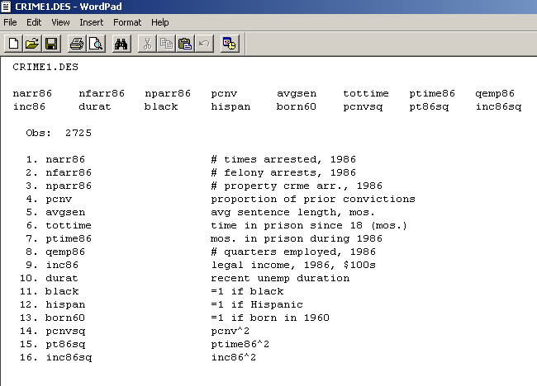
Description of the data
CRIME1.des
Matlab - Patrick Waelbroeck

Slide 17
Exercise
Draw a histogram of incomes in dollars in 1986.
Matlab - Patrick Waelbroeck

Slide 18
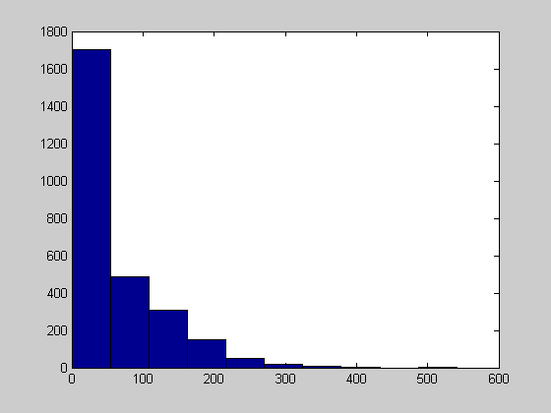
Histogram
hist(crime1(:,9))
Matlab - Patrick Waelbroeck

Slide 19
Exercise
Draw a histogram of number of times when an individual was arrested in 1986.
Matlab - Patrick Waelbroeck

Slide 20
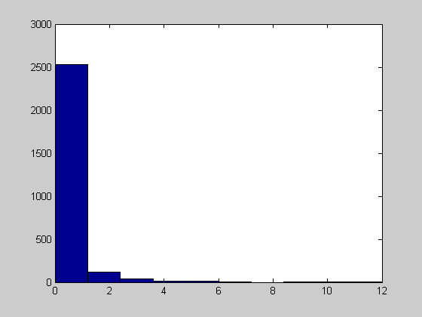
Histograme
hist(crime1(:,1))
Matlab - Patrick Waelbroeck

Slide 21
Exercise
Calculate:
expectation
variance
correlation
between the number of times when the individual was arrested and other variables.
Matlab - Patrick Waelbroeck

Slide 22
Descriptive statistics
mean(crime1)’
mean(crime1(:,1:13))’
std(crime1(:,1:13))’
min(crime1)’
max(crime1)’
cov(crime1)’
corrcoef(crime1(:,1:13))'
Matlab - Patrick Waelbroeck

Slide 23
Exercise
Draw the cloud of points (X,Y) with X the income and Y the numer of arrests
Matlab - Patrick Waelbroeck

Slide 24
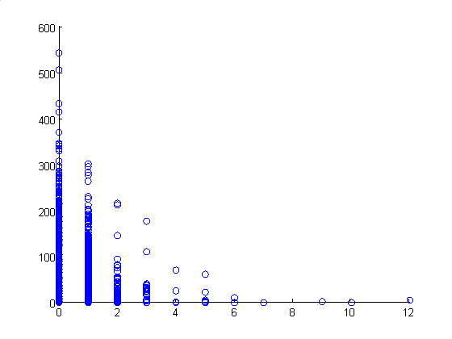
Scatterplots
scatter(crime1(:,1),crime1(:,9))
Matlab - Patrick Waelbroeck

Slide 25
Analysis of the data

Slide 26
Import of the data
load wage1.raw
Matlab - Patrick Waelbroeck

Slide 27
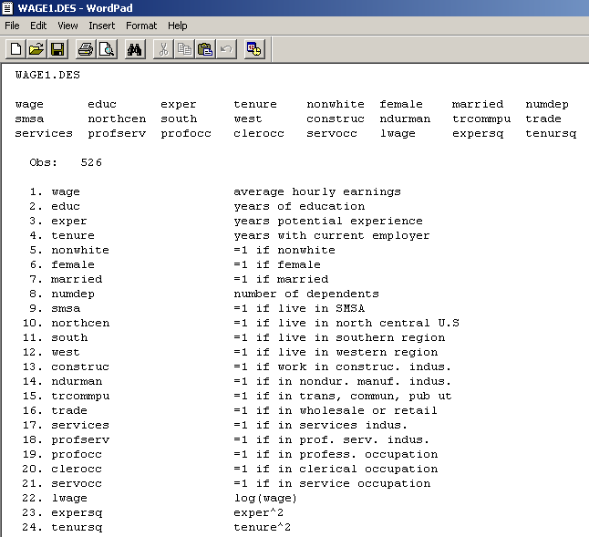
Description of the data
WAGE1.des
Matlab - Patrick Waelbroeck

Slide 28
Comparison of salaries between men and women
Calculate:
The average hourly wage between for two sexes
Average hourly wage for each sex separately
Histograms of the salaries for each sex
Descriptive statistics for other variables for each gender (expected value, variance, etc.)
Matlab - Patrick Waelbroeck

Slide 29
Data selection
s=(wage1(:,6)==1);
sum(s)
wage1f=wage1(s,:)
mean(wage1(s,1:21))'
Women
Number
Matlab - Patrick Waelbroeck

Slide 30
Question
Is there a wage discrimination against women?
Matlab - Patrick Waelbroeck

Slide 31
Response
We can not say based on the histograms of salaries of women and men because the other variables are not fixed.
It is possible that women can be les skilled so can be less paid, etc.
Matlab - Patrick Waelbroeck

Slide 32
Exercise
Recode female (0,1) -> (1,2)
Change educ -> educ - 1
Hourly wage-> log
Matlab - Patrick Waelbroeck

Slide 33
Transformation of variables
dum=1*(wage1(:,6)==0)
+2*(wage1(:,6)==1);
truc=wage1(:,2)-1;
bidule=log(wage1(:,1));
Matlab - Patrick Waelbroeck

Slide 34
Linear model
Patrick Waelbroeck, ENST
waelbroe@enst.fr

Slide 35
Student test
Explain wage | educ, exper, tenure
A t-test is any statistical hypothesis test in which the test statistic follows a Student's t-distribution under the null hypothesis. It can be used to determine if two sets of data are significantly different from each other.
load WAGE1.raw
y=wage1(:,1);
[n,k]=size(wage1)
X=[ones(n,1),wage1(:,[2,3,4])];
[n,k]=size(X)
Matlab - Patrick Waelbroeck

Slide 36
Estimation of parameters
Formula
beta=inv(X'*X)*X'*y
Matlab - Patrick Waelbroeck

Slide 37
Standard deviation
The standard deviation is a measure that is used to quantify the amount of variation or dispersion of a set of data values. A low standard deviation indicates that the data points tend to be close to the mean of the set, while a high standard deviation indicates that the data points are spread out over a wider range of values.
u=y-X*beta
sig2=u'*u/(n-4) car 3 variables+ intercept
std=sqrt(diag(sig2*inv(X'*X)))
Matlab - Patrick Waelbroeck

Slide 38
Exercise
What will happen if:
One will multiply the salairy by 1000?
One will multiply one explanatory variable by 1000?
The coefficients will change? Are they robust to change unit?
Matlab - Patrick Waelbroeck

Slide 39
Exercise
Draw a histogram of residuals u.
What are the proprieties of the distribution?
Matlab - Patrick Waelbroeck

Slide 40
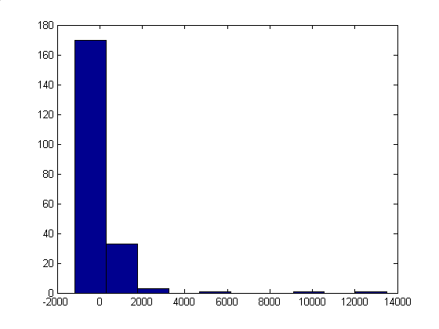
Properties of the distribution
Normal distribution?
hist(u)
Matlab - Patrick Waelbroeck

Slide 41
Exercise
Repeat the regression on the log of the salary and not the salary, calculate the beta parameter.
Do a regression when taking the log of salary, calculate the paremeter.
Draw a new histogram for residuals.
Proprieties?
Detect the outliers, remove them and recalculate beta.
Matlab - Patrick Waelbroeck

Slide 42
Regression with a log transformation
log
y=log(y)
beta=inv(X'*X)*X'*y
u=y-X*beta
hist(u)
beta =
6.7122
0.0139
Matlab - Patrick Waelbroeck

Slide 43
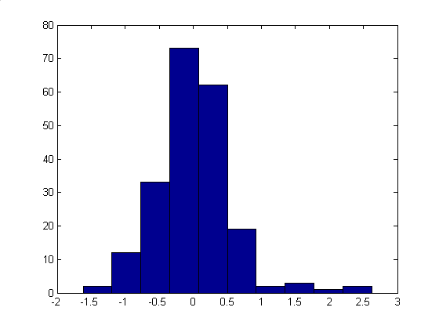
Histogram
Matlab - Patrick Waelbroeck

Slide 44
Exercise
Find observations such as u > 2.5
Remove those observations
Matlab - Patrick Waelbroeck

Slide 45
Modified coefficients
I = find(u>=2.5)
s=(u<=2.5)
sum(s)
X=X(s,:);
y=y(s,:);
Matlab - Patrick Waelbroeck

Slide 46
Aberrant value
beta =
1.670
0.0135
Matlab - Patrick Waelbroeck

