Slide 1
VDS India Hackathon 2015
Team : Code Avengers

Slide 2
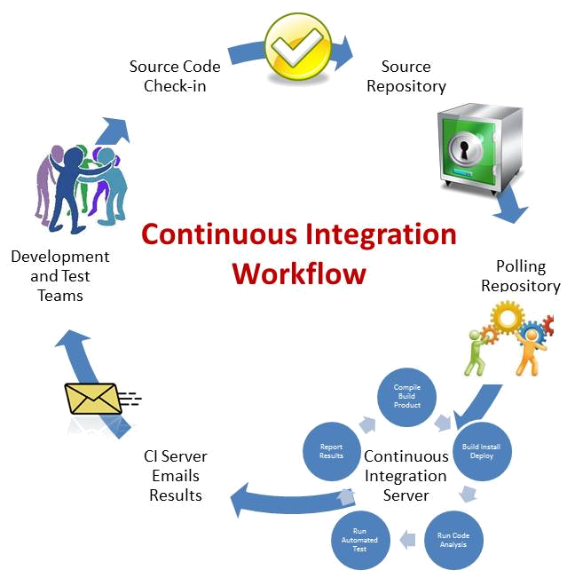
Continuous Integration (Vision)
Deliverables:
  Source code
  Unit Test Case
Repository:
  Github
Constinuous Integration:
  Build
  Test Execution
  Code Metrics
  Deployment
Monitoring:
  Email
  Webhooks

Slide 3
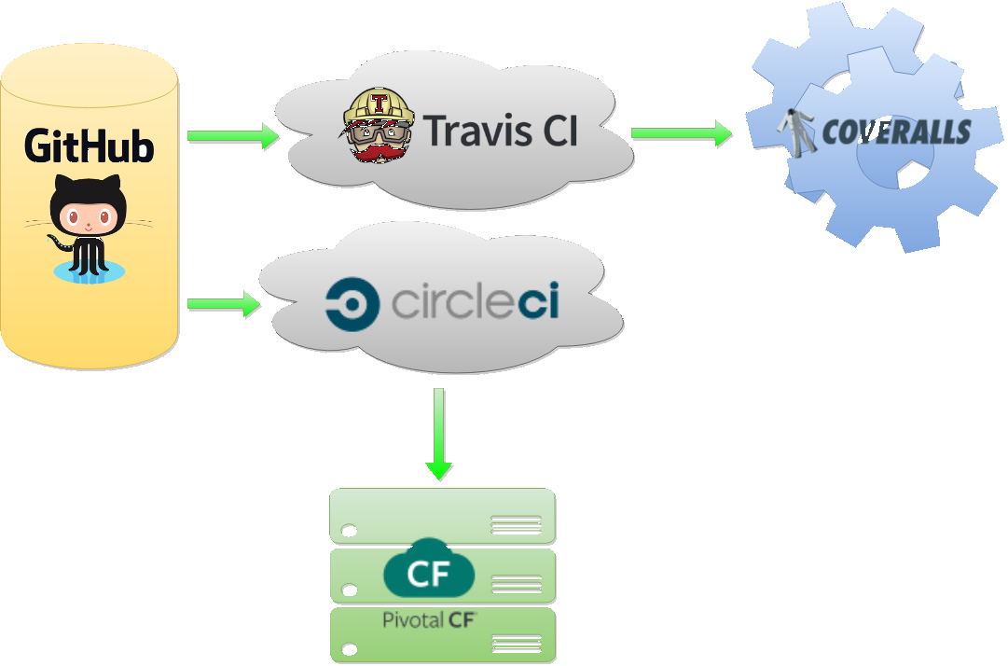


Continuous Integration (Architecture)

Slide 4





Continuous Integration (Links)
Repository:
Github - https://github.com/aroychoudhury/VerizonHackathon2015
Continuous Integration:
Travis CI - https://travis-ci.org/aroychoudhury/VerizonHackathon2015
Circle CI - https://circleci.com/gh/aroychoudhury/VerizonHackathon2015
Deployment:
Pivotal CF - https://console.run.pivotal.io
Metrics:
Coveralls - https://coveralls.io/github/aroychoudhury/VerizonHackathon2015

Slide 5
Tools
Image Manipulation:
Pixlr - https://pixlr.com/editor/
Image Optimizer - http://www.imageoptimizer.net/Pages/Home.aspx
HTML Editing:
Best Online HTML Editor - http://bestonlinehtmleditor.com/
Circle CI - https://circleci.com/gh/aroychoudhury/VerizonHackathon2015
DB Diagram:
Vertabelo - https://www.vertabelo.com/
Diagrams:
Draw IO - http://draw.io
Code Metrics:
Google Code Pro - Eclispe Plugin

Slide 6
Map Dash : an analytics system
A Code Avengers Initiative

Slide 7
Map Dash
Map Dash (Map Analytics Dashboard) is an attempt to add Geographic Context to data analytics. This is an attempt to provide more insight to data such as - Population base across Cities, Accidents within Urban & Rural Areas, Customer Spread across Regions etc.
The below sections provide more information of MapDash system.
Features:
  Data integration with Google Maps
  Charting capability on the Geographic data
  Mobile first UI design and implementation (Bootstrap/jQuery)
  Robust Spring Driven Backend Architecture
  jUnit Based automated Unit Testing capabilities [via Continuous Build]
  Code Metrics Generation capabilities [via Continuous Build]
Best Practices:
  Architecture and Database Schema design diagrams
  Java Docs for all Public and Protected methods
  Metrics Data generated as part of Development process

Slide 8
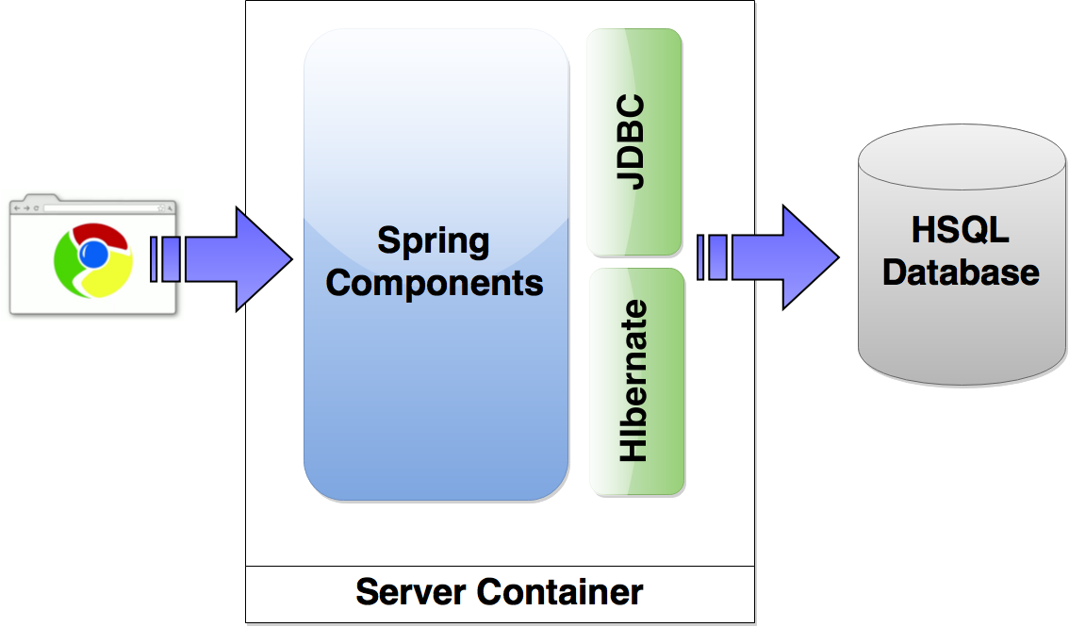
Architecture Design
Spring Components used:
JDBC Template (Spring JDBC)
Rest Controller (Spring MVC)
Java Config (Spring Core)
Bean Injection (Spring Core)
Transaction Management (Spring AOP)
Unit Testing (Spring Test)
Logging:
SLF4j - Log4j
Hibernate:
Hibernate 4
Database:
In memory HyperSQL DB

Slide 9
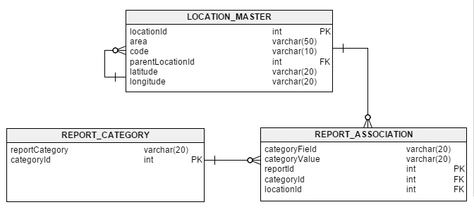
Database Design
LOCATION_MASTER:
Location data and details
REPORT_CATEGORY:
Data Categories and other details
REPORT_ASSOCIATION:
Associations between Locations & Categories

Slide 10
Looking Ahead
Looking ahead, we see a lot more that we can do with this application.
More Features:
  Integration with Enterprise Data Processing systems
  Creating plugins for common Databases/Big Data Systems
  Add dynamic data uploading functionality
  Allow greater interactivity to the user leveraging Google Maps plugin
  Create HTML widgets (similar to MakrMyTrip widgets we see on webpages)
Achieve More Best Practices:
  85% Test Coverage
  Greater Code/Comment Ratio
  Introduce a MVC Framework for future UI work

Slide 11
Map Dash (Links)
Application:
http://codeavengerz.cfapps.io/maps.html
Java Docs:
http://codeavengerz.cfapps.io/docs/index.html
Metrics:
http://codeavengerz.cfapps.io/metrics/metrics.html
Team Blog:
http://codeavengerz.cfapps.io

Slide 12

Thank you !!!!!

