Slide 1
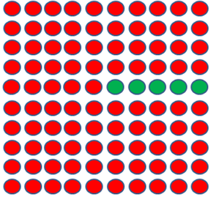
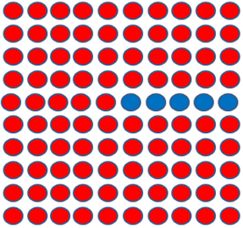
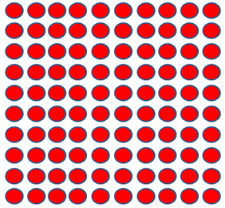
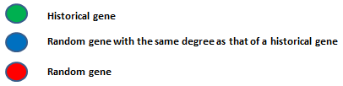
Visualizing the problem
100 iterations of RWR
100 iterations of RWR
100 iterations of RWR
Do high degree historical genes appear frequently in top ten?
Do high degree random genes with degrees matched to historical genes appear in top ten?
Yes
Degree centrality is not a reliable indicator of biological significance

