Slide 1
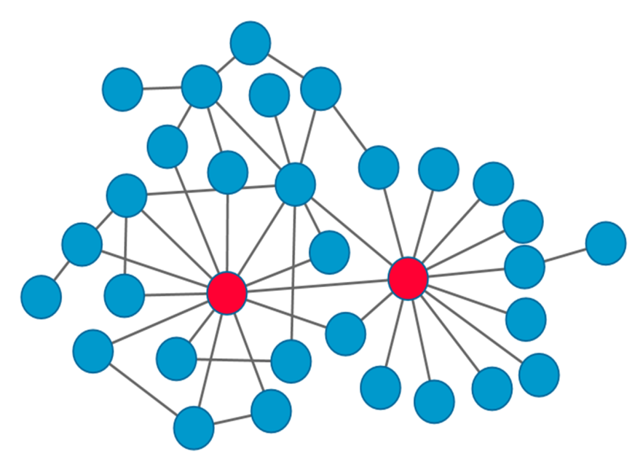
Review of literature
Disease-gene associations were primarily obtained from mutational inferences before the advent of GWAS and microarray technology
Network based methods gained prominence after the information influx that followed such as distance based, information flow based and topological similarity based methods
Scale free networks show a higher number of high degree (or ‘hub’) nodes that are either biologically significant or are artifacts that arise due to literature bias, i.e. well-studied genes tend to have more number of connections
Random Walk with Restart is an iterative method that calculates the probabilistic score of each node. Starting at a source node s, the walker either restarts from the starting node or moves to a randomly selected neighbor. r is P(restarting) and 1-r is P(jumping to neighboring node)
p^{t+1} = (1-r)Wp^{t} + rp⁰
The extent of the bias introduced by degree on gene prioritization was to be investigated using Random Walk with Restart

