Slide 1
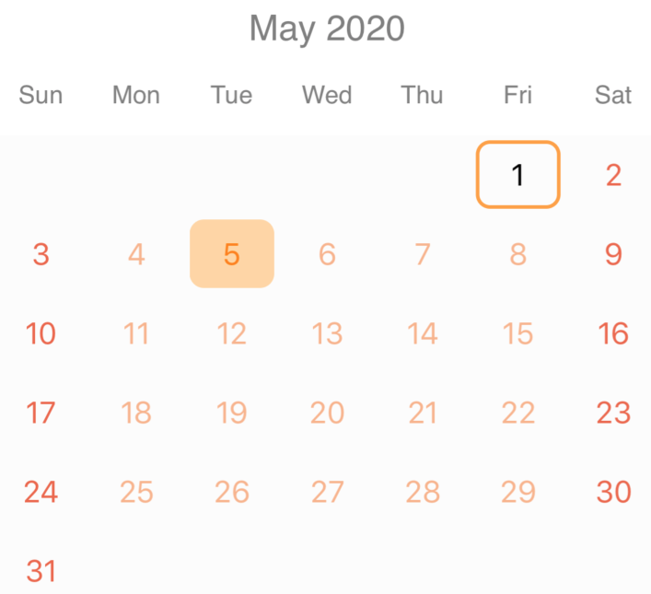
LogIt
By Ellie Parobek

Slide 2
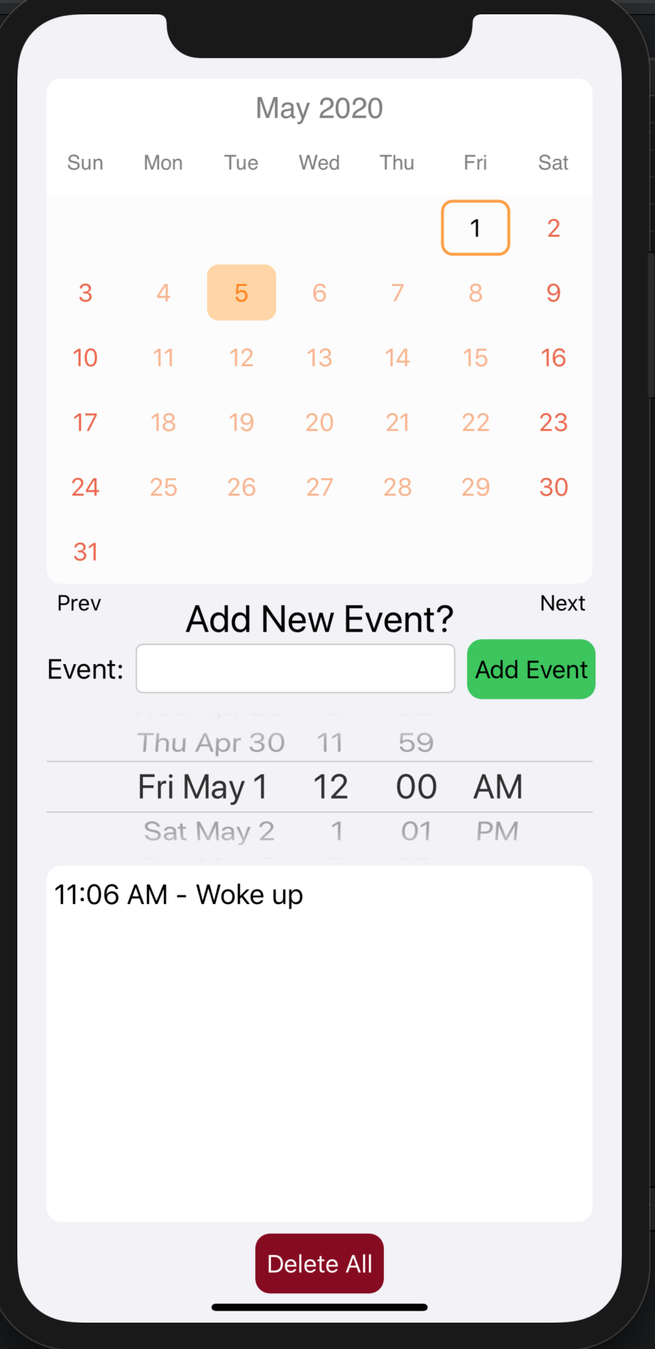
The purpose of this application is to log any events that occur throughout your day.
The main focus was on logging food intake and sickness, to help determine any causes or effects of illness but can also be used to log anything desired.
Calendar view to swipe through days / months
Adding a new event
All of the events of the selected day and the time they occured
Delete all logs for the selected day

Slide 3
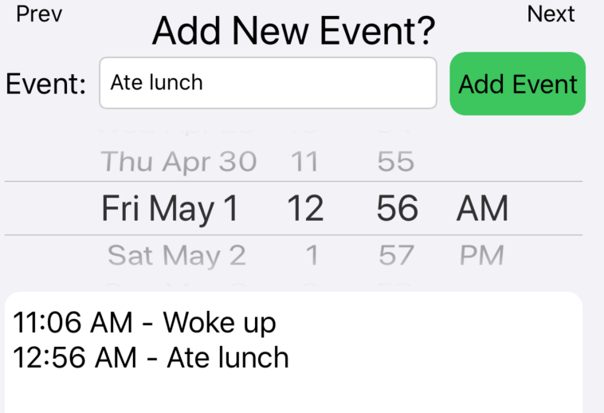
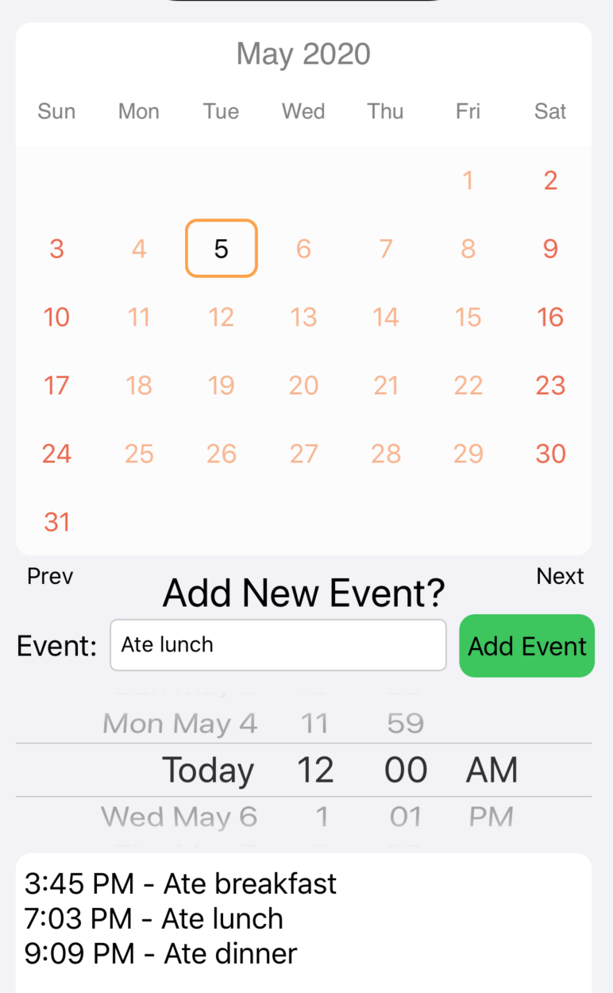
Adding a new event:
Enter the name of the event
Select the date and time
Add the event!
Use the calendar or the date selector in the ‘Add New Event’ section to select a date and view what events are logged for that date.
Data is automatically saved and persisted when a new event is added.

Slide 4
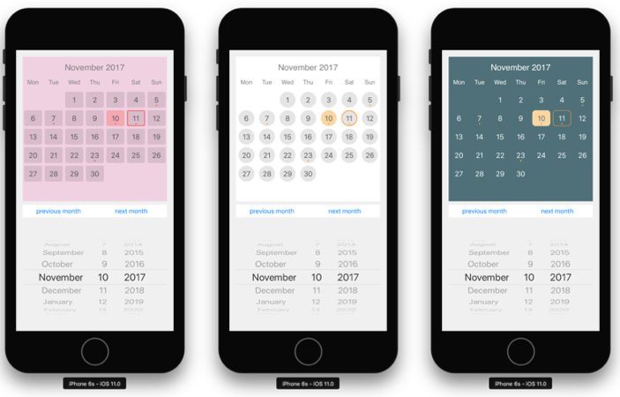
Libraries: Only one used is called ‘KDCalendar’ which is a fully customizable calendar view. Good for selecting a date, scrolling through months, and color coding.
Challenges My main challenge was reading and saving the data so it would persist between app closing and reopening. I also could not navigate to any other views because of the Calendar, a problem which I was unable to solve ending up only using one view.

