Slide 1
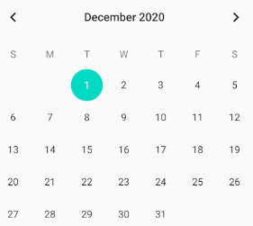
MegaLog
By Lowell Pence and Ellie Parobek

Slide 2
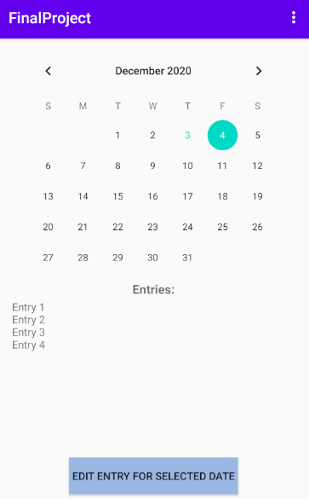
First View
The purpose of this application is to log any events that occur throughout your day along with wake up time, in bed time, and an overall rating of your day.
The main focus was on logging food intake and sickness, to help determine any causes or effects of illness but can also be used to log anything desired.
Calendar view to swipe through days / months
All of the events of the selected day and the time they occured
Adding a new event or editing existing event
Notes:
We used MVVM to maintain state between the views. We don’t support rotation, but if we did, all the data would persist through the UI reloads because of the ViewModel usage.

Slide 3
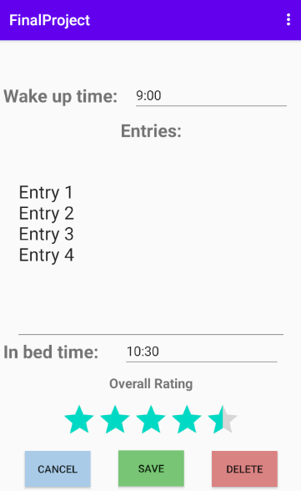
Second View
Use the calendar or the date selector on the main screen on launch to select a date and view what records are logged for that date.
Data is automatically saved and persisted when a new event is added into a local database storage.
Editing and creating records for a day
Adding a ‘wake up’ and ‘in bed’ time for that day.
Set an overall ‘rating’ out of 5 stars for that day.
Notes:
We used the Room database library to set up and store user data. It uses SQLite under the hood. All database operations had to use a background thread, so we used coroutines to implement the operations. It is very similar to querying an API but much faster. The wake-up and bedtime fields use a time picker.

Slide 4
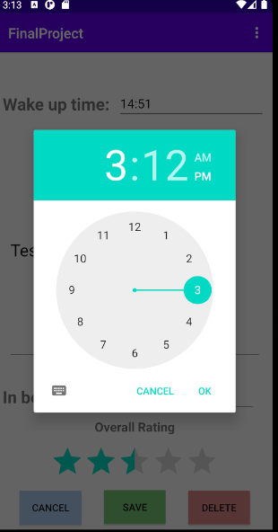
Libraries
We used a default project activity (the ‘Basic Activity’) which included 2 fragments used and a navigation component setup between the two.
The database elements are built into Android but completely new to us to learn how to implement.

Slide 5
Challenges
The main challenge was learning how to save and load all information from a database.
We also had to learn how to use MVVM to display and store the data using a ViewModel which could easily allow database retrieval on any fragment.
Learning how to use the ‘navigation’ part of Android which was different than the usual fragment manager we had learned in class.
Notes:
Getting the LiveData, coroutines, Room db, and ViewModel to all work together was a challenge. We ran into the issue of both fragments instantiating their own ViewModel which was confusing until we realized what was going on.

