Slide 1
Diet Manager
Version 2.0
Brooke Daniels
Ellie Parobek
Lorenzo Romero
Xueqi Lin

Slide 2
Key Features
Use of MVC architectural pattern
Use of design patterns: Composite, Proxy, and Observer
Single screen for adding log entries and changing the user’s weight and calorie limit
Tables to display available food items, exercise activities, and log entries
Auto-save after operations (new food, new log entry)

Slide 3
Architecture
MVC
Multiple controllers to separate similar operations

Slide 4
Patterns
Composite
Food
BasicFood
Recipe
Proxy (data abstraction)
DataController
CSVManager

Slide 5
Class Diagram

Slide 6
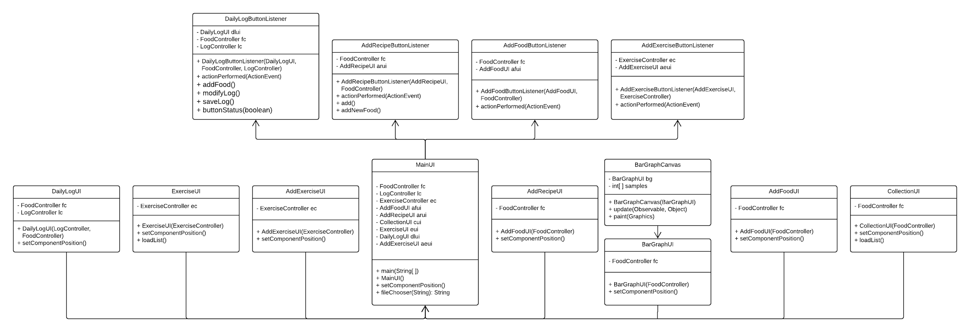
Class Diagram P2

Slide 7
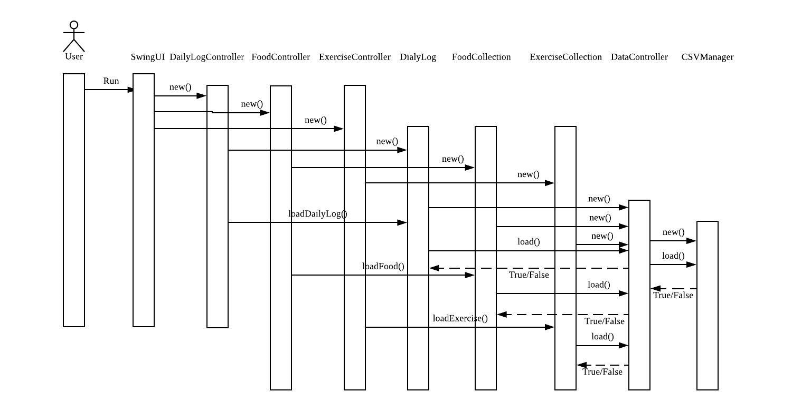
Sequence 1 - Loading Data From a CSV File

Slide 8
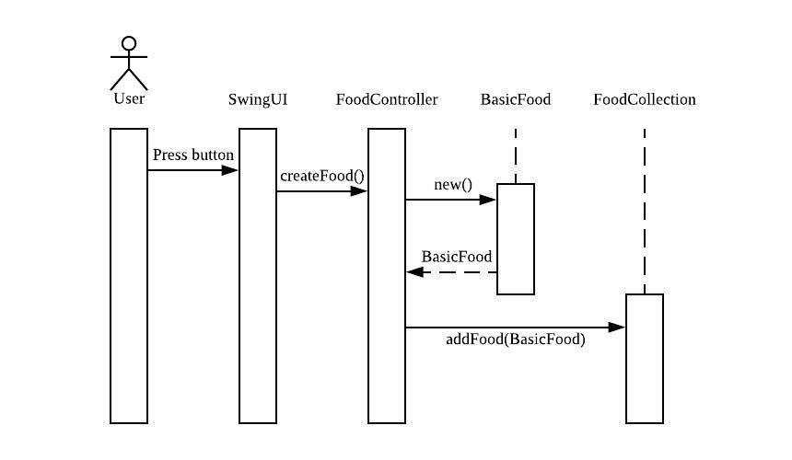
Sequence 2 - Creating a Basic Food

Slide 9
Successes
Adding food, recipes, and exercise to collections successfully
Adding food and recipes to daily log successfully
Utilizing the trello cards in a professional fashion to keep track with what needed to be done
Swing view with multiple tabs for each task

Slide 10
Challenges
Bar Chart
Refreshing the tables
Displaying Recipes correctly in the tables (differentiating from foods)
Formula for exercise, exercises added to daily log

