Slide 1
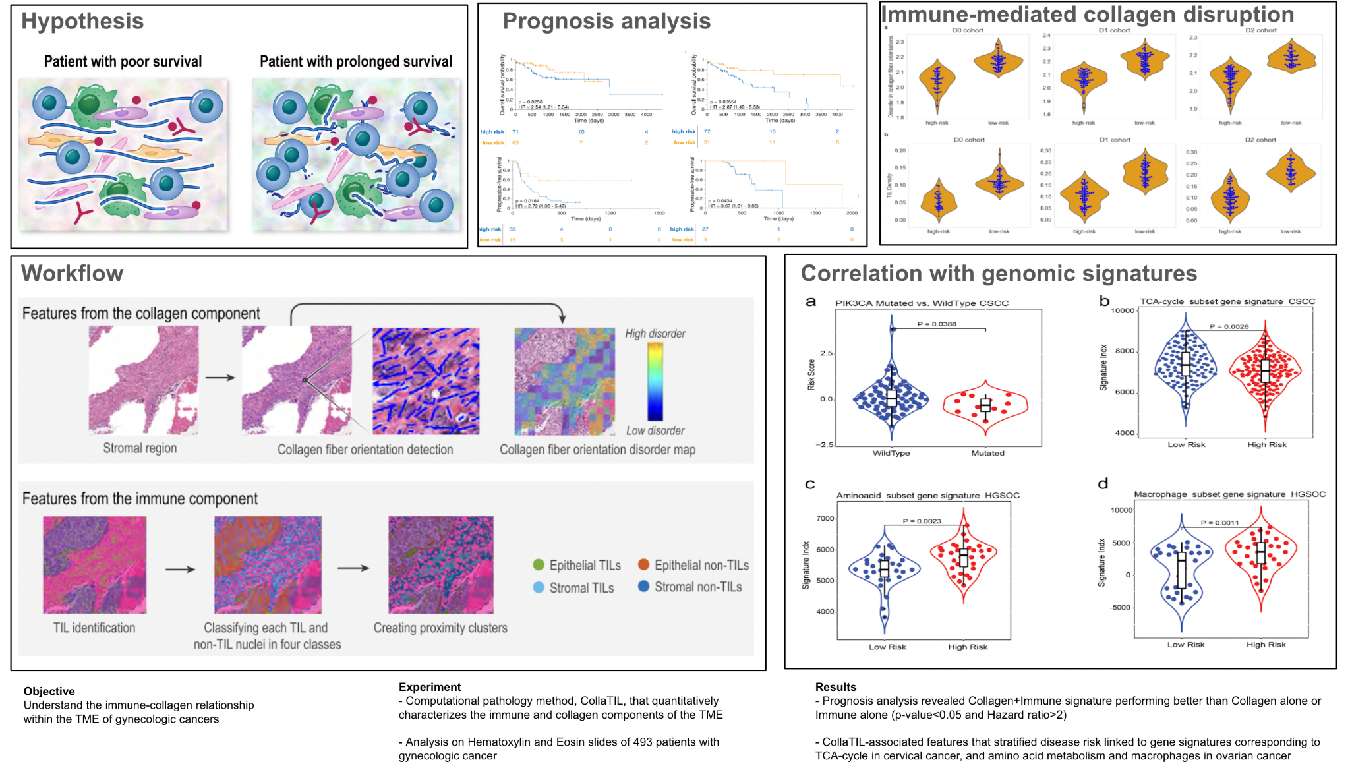
Computational pathology identifies immune-collagen relationship in TME of gynecologic cancers

