Slide 1
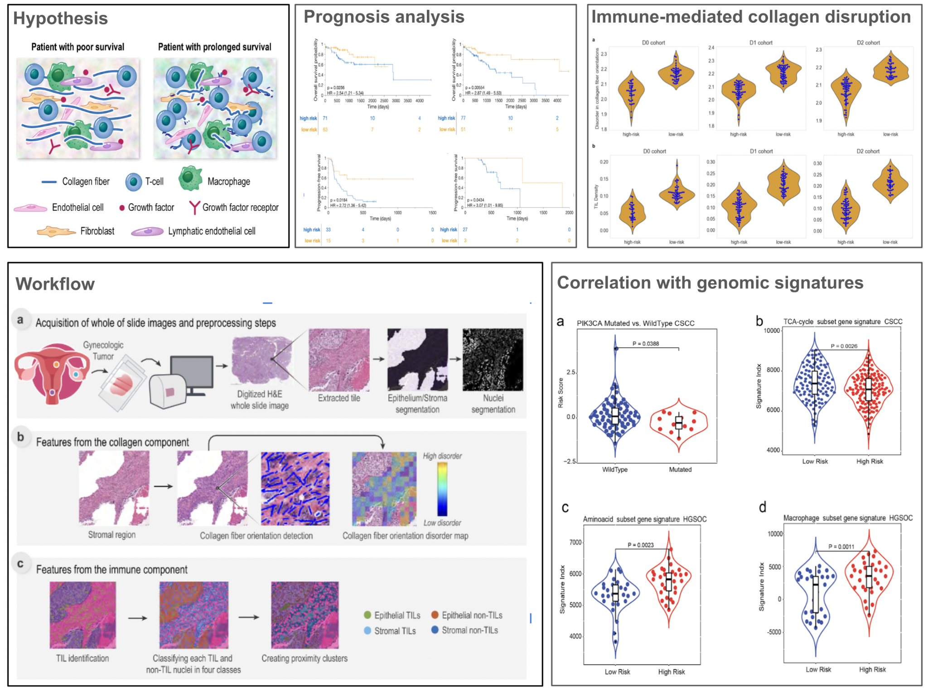
Computational pathology identifies immune-mediated collagen disruption to predict clinical outcomes in gynecologic malignancies
Method
Computational pathology method, CollaTIL, that quantitatively characterizes the immune-collagen relationship within the TME of gynecologic cancers
Main findings
- Increased immune infiltrate is associated with chaotic collagen architecture and higher entropy and vice-versa
- CollaTIL-associated features that stratified disease risk linked to gene signatures corresponding to TCA-cycle in cervical cancer, and amino acid metabolism and macrophages in ovarian cancer
*Published in Nature Communications Medicine
(Work led by Arpit Aggarwal)

