Slide 1
Adversarial Attack detection Using
LIME & SHAP
Presentation by Tushar Prakash & Arpajit Adhikary
2021

Slide 2
Content
Working of LIME
Working of SHAP
Example of an Outcome
Adversarial Attacked
Conclusion

Slide 3
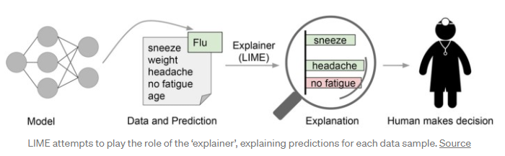
Working of LIME
The technique attempts to understand the model by perturbing the input of data samples and understanding how the predictions change.
LIME modifies a single data sample by tweaking the feature values and observes the resulting impact on the output.
It allows verification of hypotheses and whether the model is overfitting to noise
But it is hard to diagnose specific model predictions.

Slide 4
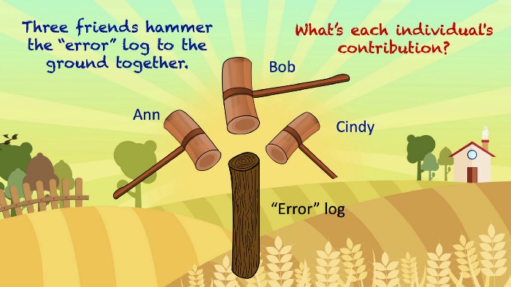
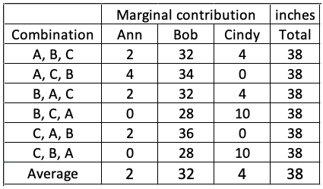
Working of SHAP
It is the average of the marginal contributions across all permutations.
Advantages of SHAP
Global interpretability
Local interpretability
SHAP values can be calculated for any tree-based model
SHAP values do not provide causality

Slide 5
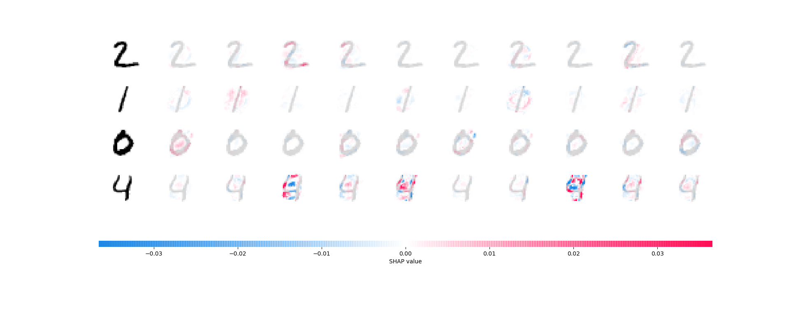
Example of an Outcome

Slide 6
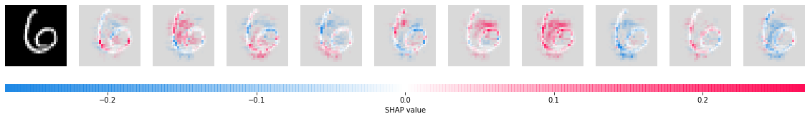
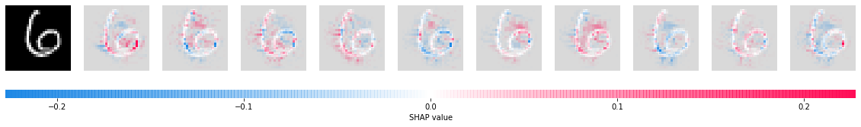
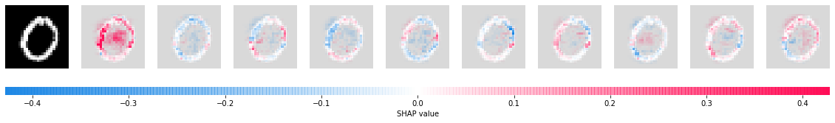
REAL ATTACKED REAL
Adversarial Attacked
Image 0 1 2 3 4 5 6 7 8 9

Slide 7
Conclusion
SHAP is an improved version of LIME.
Although LIME has the desirable property of additivity, it has got some criticism on lack of stability, consistency and missingness.
All three properties are fulfilled by SHAP.
On the other hand, SHAP-ley value requires a lot of computing time.
The Shapley value can be misinterpreted and needs access to the data to calculate the value for a new data instance.

Slide 8
Thank You!

