Slide 1
Adversarial Attack detection Using SHAP
SHAP
Presentation by Tushar Prakash & Arpajit Adhikary
2021

Slide 2
Content
Working of SHAP
Code Implementation
Example of an Outcome
Conclusion

Slide 3
Working of SHAP
It is the average of the marginal contributions across all permutations.
Advantages of SHAP
Global interpretability
Local interpretability
SHAP values can be calculated for any tree-based model
SHAP values do not provide causality

Slide 4
Code Implementation

Slide 5
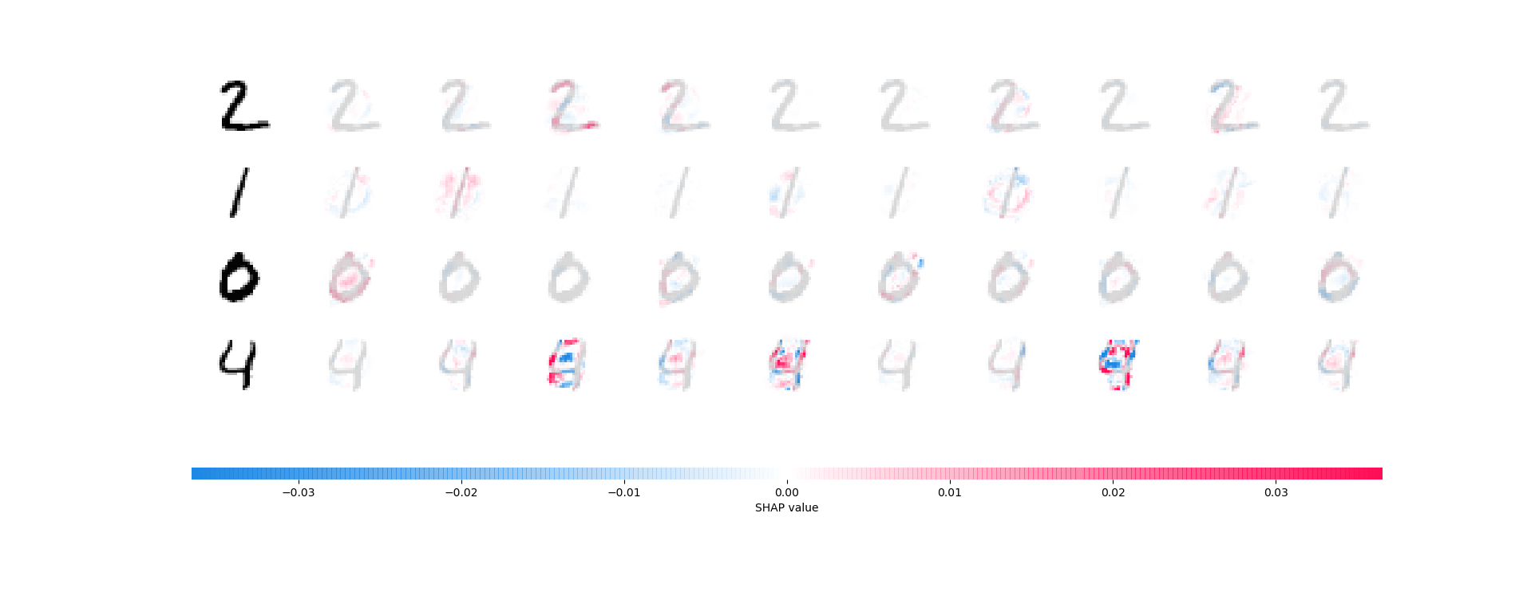
Example of an Outcome

Slide 6
Conclusion

Slide 7
Thank You!

