Slide 1
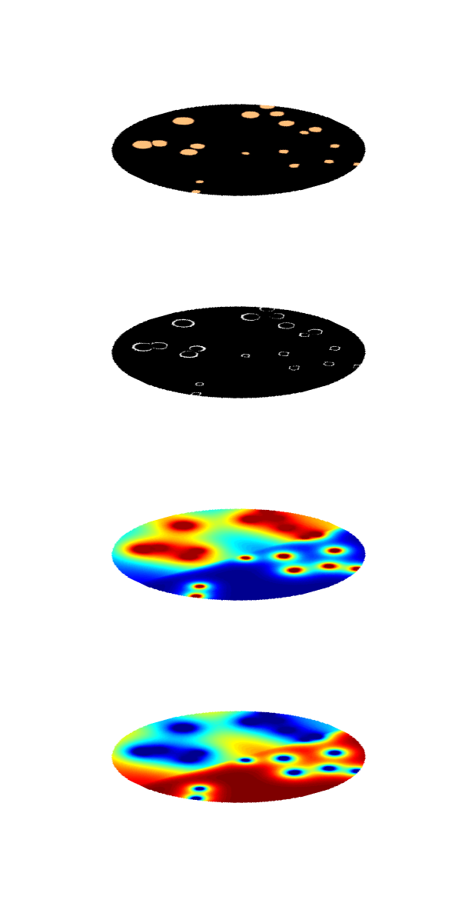
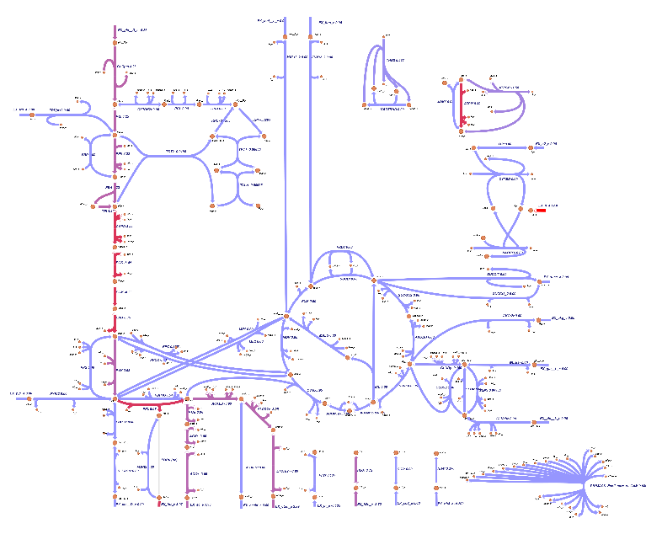
a)
e)
biomass
b)
growth rate
c)
acetate
d)
glucose

Slide 2
a)
e)
biomass
b)
growth rate
c)
acetate
d)
glucose

Slide 3
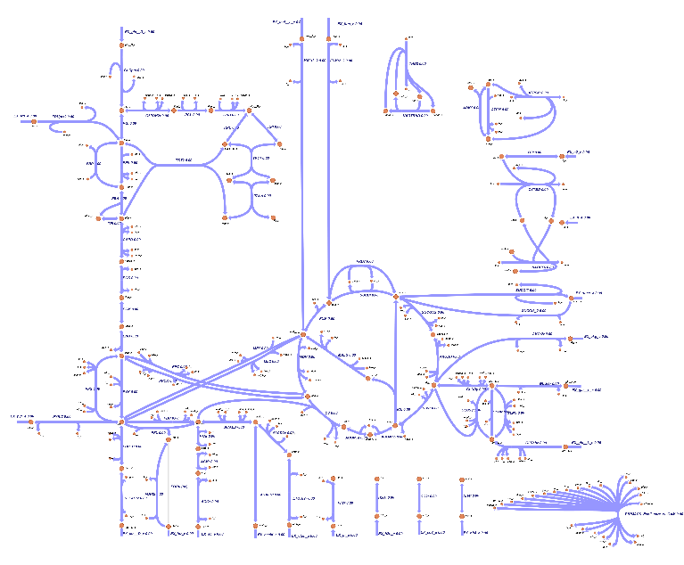
biomass
X=85 Y=150
growth rate
X=63 Y=113
acetate
glucose

Slide 4
biomass
X=85 Y=150
growth rate
X=63 Y=113
acetate
glucose

