Slide 1

iPerl - next generation REPL for Perl
Árpád Szász
Freelance Perl Developer
Twitter: @arpadszasz
Blog: http://arpi.plenum.ro

Slide 2
Introduction

Slide 3
Introduction
iPerl is a GUI based REPL

Slide 4
Introduction
iPerl is a GUI based REPL
iPerl has live-coding features

Slide 5
REPL
Read-Eval-Print-Loop

Slide 6
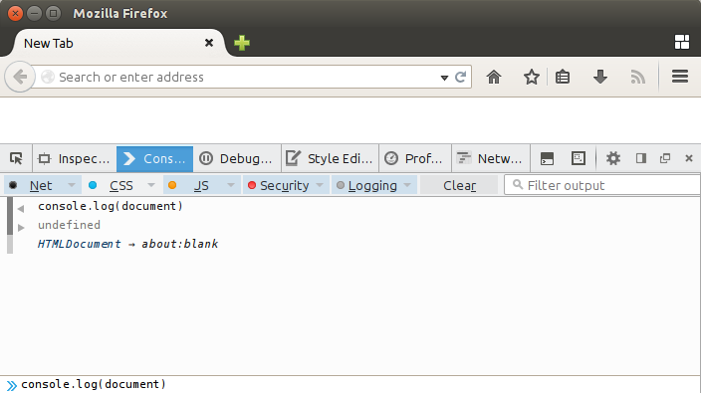
REPL
Read-Eval-Print-Loop

Slide 7
REPL
CPAN already has a lot of REPLs

Slide 8
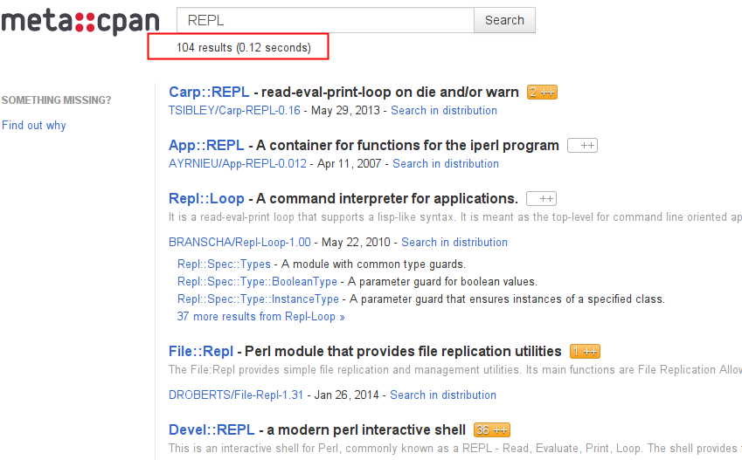
REPL
CPAN already has a lot of REPLs

Slide 9
REPL
Features of iPerl as a REPL
  GUI based

Slide 10
REPL
Features of iPerl as a REPL
  GUI based
  Simple to install and use

Slide 11
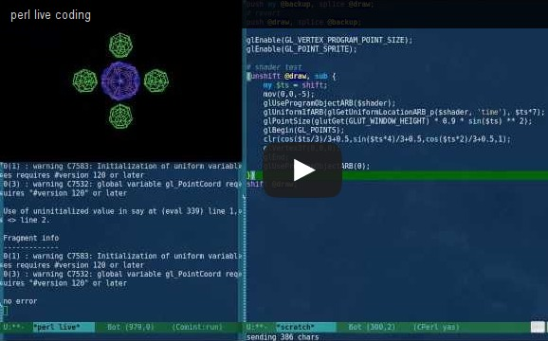
Live coding
Idea and demo by vividsnow on blogs.perl.org

Slide 12
Live coding
Idea and demo by vividsnow on blogs.perl.org
  Emacs perl-live mode

Slide 13
Live coding
Idea and demo by vividsnow on blogs.perl.org
  Emacs perl-live mode
  AnyEvent loop

Slide 14
Live coding
Idea and demo by vividsnow on blogs.perl.org
  Emacs perl-live mode
  AnyEvent loop
  PadWalker + Package::Stash

Slide 15
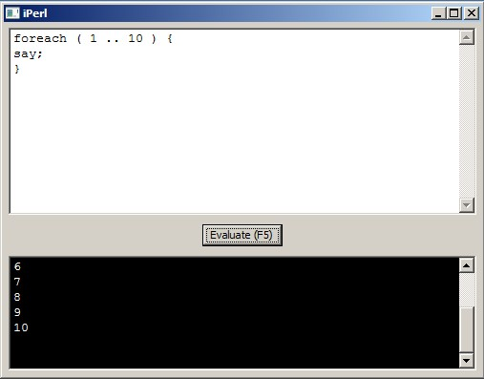
Current status of iPerl
It works

Slide 16
Current status of iPerl
It works
  wxPerl based GUI

Slide 17
Current status of iPerl
It works
  wxPerl based GUI
  1 thread for GUI, 1 thread for eval-ing code

Slide 18
Current status of iPerl
It has bugs!

Slide 19
Current status of iPerl
It has bugs!
  'exit' stops the whole program

Slide 20
Current status of iPerl
It has bugs!
  'exit' stops the whole program
  'exec', 'sleep', 'while' will hang the whole program

Slide 21
Current status of iPerl
It has bugs!
  'exit' stops the whole program
  'exec', 'sleep', 'while' will hang the whole program
  More unknown bugs!

Slide 22
Current status of iPerl
It has bugs!
  'exit' stops the whole program
  'exec', 'sleep', 'while' hang the whole program
  More unknown bugs!
  ALPHA level quality!

Slide 23
Future plans for iPerl
General plans
  Syntax-highlighting

Slide 24
Future plans for iPerl
General plans
  Syntax-highlighting
  Code auto-complete

Slide 25
Future plans for iPerl
General plans
  Syntax-highlighting
  Code auto-complete
  Colorized output

Slide 26
Future plans for iPerl
General plans
  Syntax-highlighting
  Code auto-complete
  Colorized output
  Restrict “un-safe” commands (Safe.pm)

Slide 27
Future plans for iPerl
General plans
  Syntax-highlighting
  Code auto-complete
  Colorized output
  Restrict “un-safe” commands (Safe.pm)
  Load/save edited code

Slide 28
Future plans for iPerl
Advanced plans
  Replace subroutines on-the-fly

Slide 29
Future plans for iPerl
Advanced plans
  Replace subroutines on-the-fly
    symbol table manipulation

Slide 30
Future plans for iPerl
Advanced plans
  Replace subroutines on-the-fly
    symbol table manipulation
    optree manipulation using B:: modules (EVIL!)

Slide 31
Future plans for iPerl
Advanced plans
  Replace variables on-the-fly

Slide 32
Future plans for iPerl
Advanced plans
  Replace variables on-the-fly
    “visible” package variables (mostly safe)

Slide 33
Future plans for iPerl
Advanced plans
  Replace variables on-the-fly
    “visible” package variables (mostly safe)
    lexical “private” variables (EVIL!)

Slide 34
Code contributions/ideas welcome! http://bit.ly/iperl

Slide 35
Thank You!

