Slide 1
“WSDL”
Presented By:
Navina Budhathoki

Slide 2
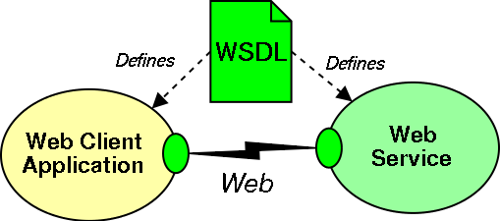
What is WSDL?
Web Services Description Language(WSDL) is an XML-based file that basically tells the client application what the service does.
WSDL is written in XML.
It is standard format for describing a web service.
1

Slide 3
Features of WSDL
WSDL is an XML-based protocol for information exchange in decentralized and distributed environments.
WSDL definitions describe how to access a web service and what operations it will perform.
WSDL is a language for describing how to interface with XML-based services.
2

Slide 4
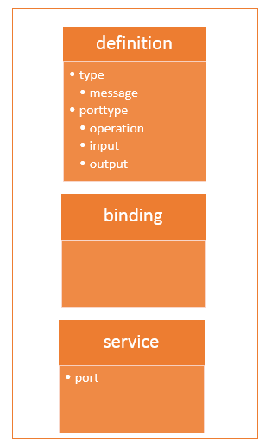
Structure of a WSDL Document
The WSDL file contains the location of the web service.
The methods which are exposed by the web service.
The WSDL is very complex to any user, but it contains all the necessary information that any client application would require to use the relevant web service.
3

Slide 5
WSDL Elements
Definition– Contains the definition of one or more services.
Data Type- The data types to be used in the message are in the form of XML schemas.
Message- An abstract definition of the data being communicated.
Operation- An abstract description of the action supported by the service
Port Type- An abstract set of operations supported by one or more endpoints.
4

Slide 6
WSDL Elements
Binding- Describes how the operations is invoked by specifying concrete protocol and data format specifications for the operations and messages.
Port- Specifies a single endpoint as an address for the binding, thus defining a single communication endpoint.
Service- Specifies the port address of the binding. The service is a collection of network endpoint or ports
5

Slide 7
Why WSDL ?
A web service is important component in building modern day web applications.
Their main purpose is to allow multiple applications built on various programming languages to talk to each other.
The WSDL file is written in plain old XML. The reason that it is in XML is so that the file can be read by any programming language.
6

Slide 8
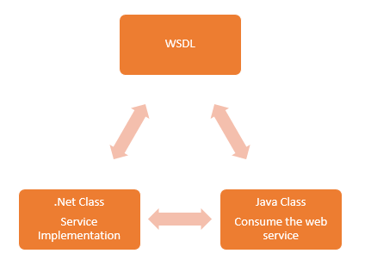
Why WSDL ?
7

Slide 9
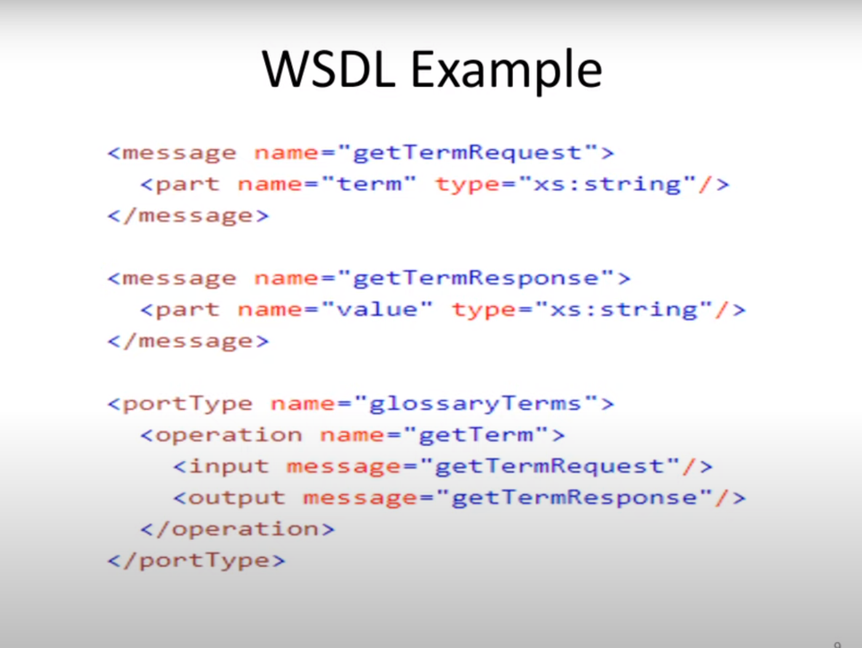
The message element defines the parts of each message and the associated data types.
8

Slide 10
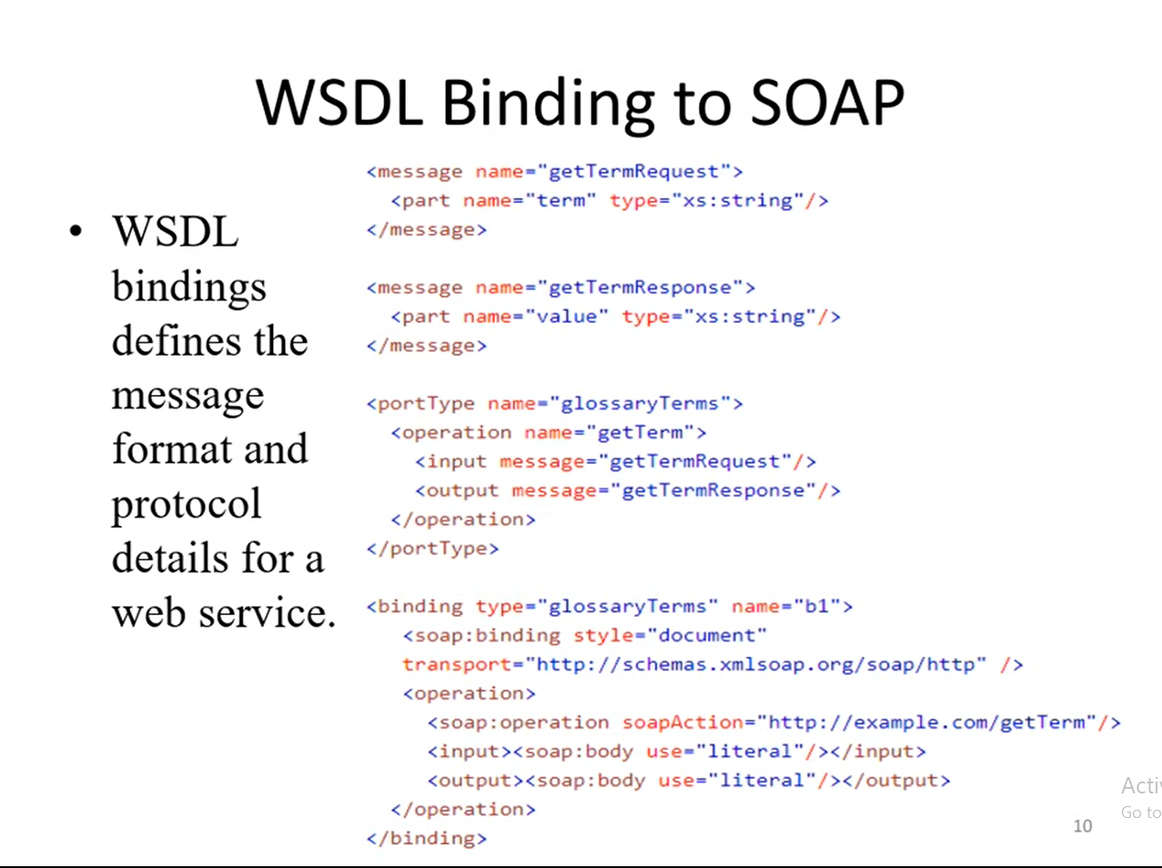
The binding element has two attributes: name, type.
Name- Defines the name of binding
Type- Points to the port for the binding.
In this case soap:binding element has two attributes :style and transport. Style attribute can be RPB or document.
In this case we use document.
Transport attribute defines soap protocol to use.The operation element define each operation that the port type is processing.For each operation a corresponding soap action has been defined.You must also specify how the input and output are encoded. In this case we use literal.
9

Slide 11


