Slide 1
“MyMED”
Presented By:
Arpan Pokhrel
Navina Budhathoki
Suman Devkota
Anish Thapa

Slide 2
Introduction
“MyMed” is a platform that provides personalized medical solutions and services to patients.
With its user-friendly interface and intuitive features, it will enable medical professionals to efficiently manage patients records, treatment plans.
This innovative software will streamline the workflow and improves patient care by ensuring accurate and up-to-date records of their medical history. It will offer a secure and reliable which is a game-changer in the healthcare industry.
1

Slide 3
Problem Statement
Patients are often required to fill out the same information repeatedly.
Improper categorization of patient records can lead to difficulties.
2

Slide 4
OBJECTIVES
Customize and deploy an integrated system of management of doctor and patient record.
To design, develop a system for doctor appointment.
3

Slide 5
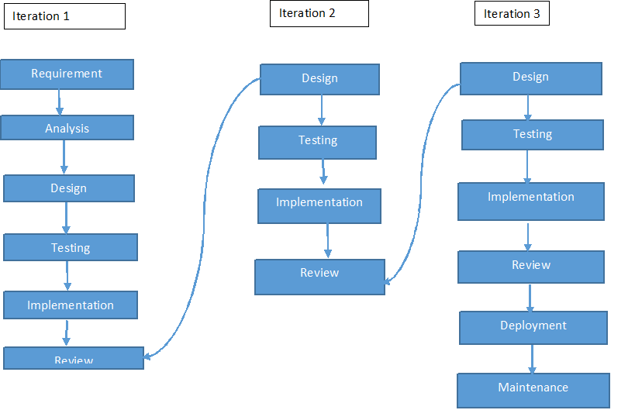
Methodology
Fig: Iterative Model of MyMed
4

Slide 6
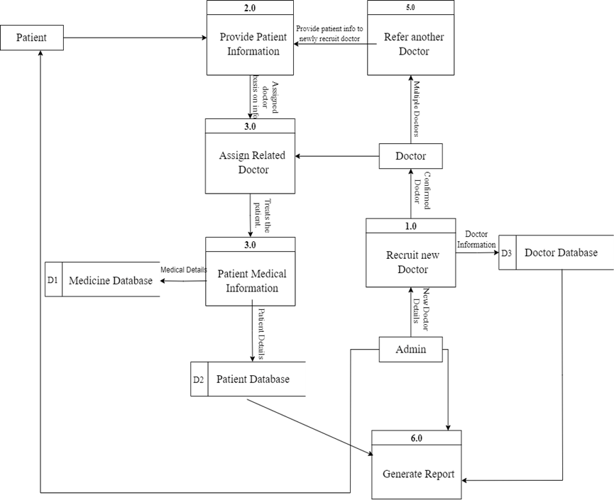
Data flow diagram
5
Fig: DFD of MyMed

Slide 7
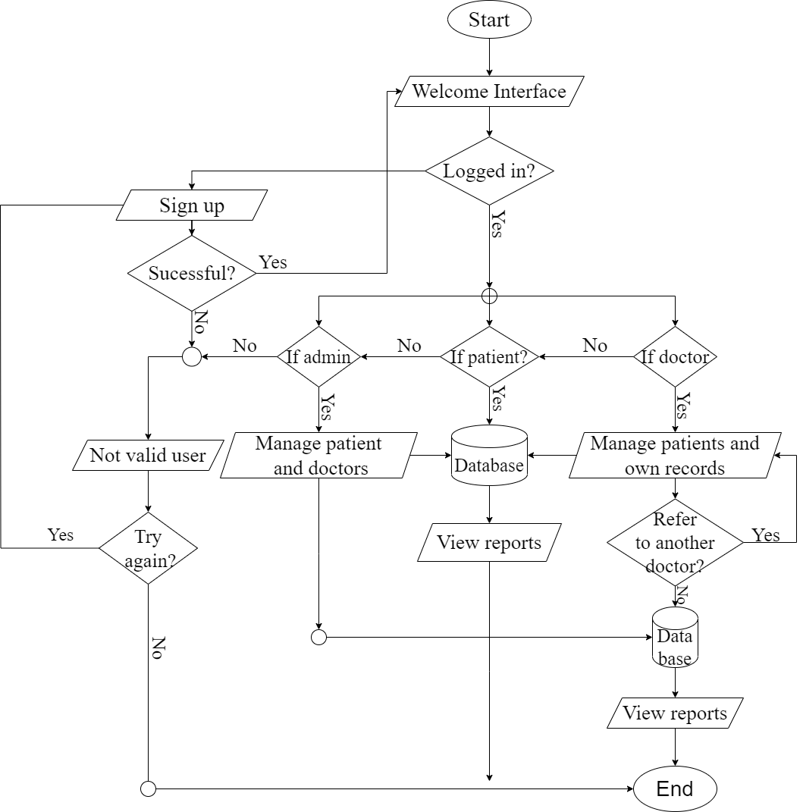
FLOWCHART
Fig: Flowchart of MyMed
6

Slide 8
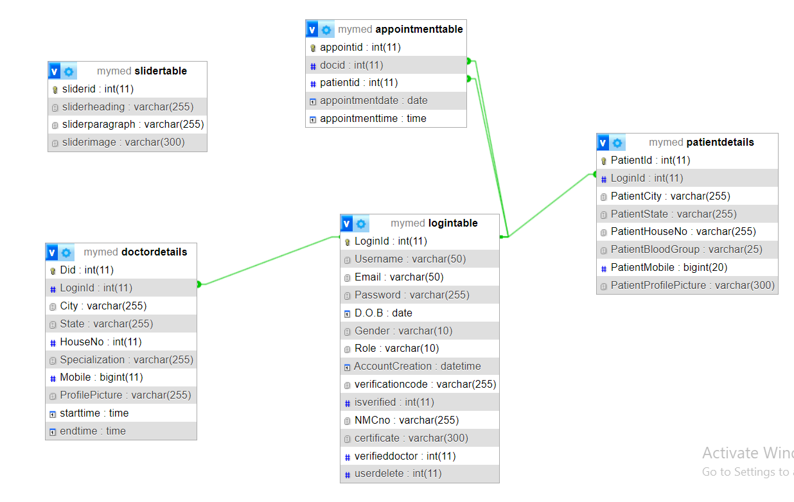
DATABASE SCHEMA
Fig: Database Schema of MyMed
7

Slide 9
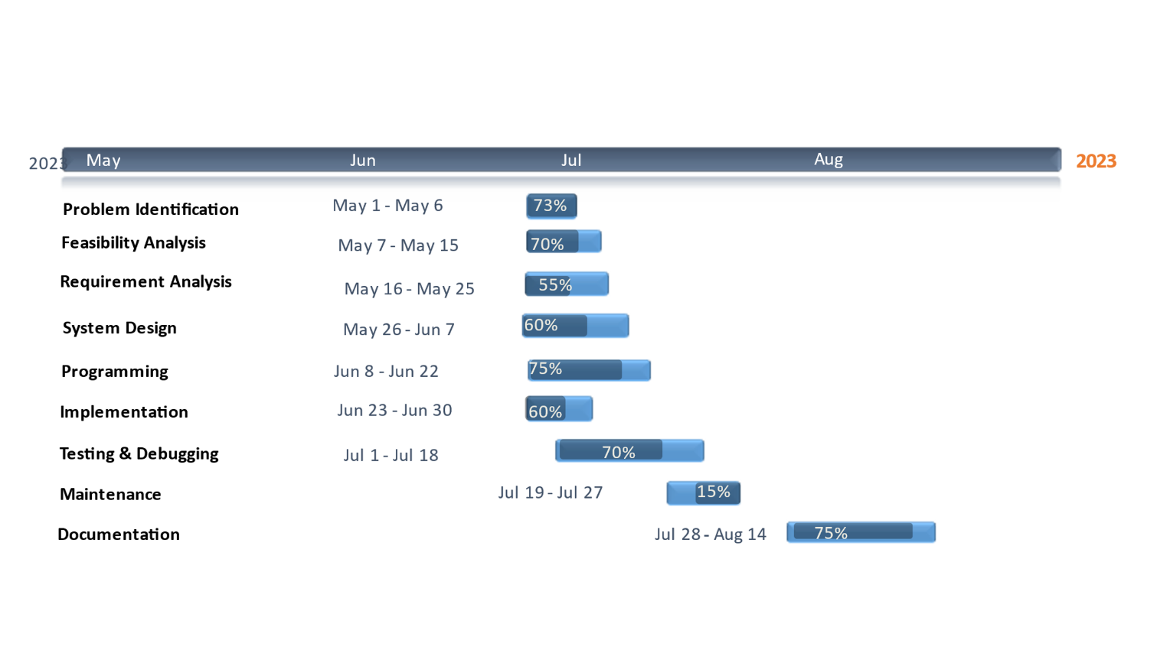
Gantt chart
Fig: Gantt Chart of MyMed
7

Slide 10
Deliveriables
Easy to use interface.
Creating a dashboard.
Software security.
8

Slide 11
Conclusion
My Med will be invaluable, as it not only reduces the amount of manual labour required but also increases accuracy and organization.
It will ensure that the software is secure and maintains patient confidentiality.
My Med is the answer to the increasing demands of the healthcare industry, ensuring that no patient’s record is lost, misplaced of forgotten.
9

Slide 12


