Slide 1
Text Classification by Artificial Neural Network

Slide 2
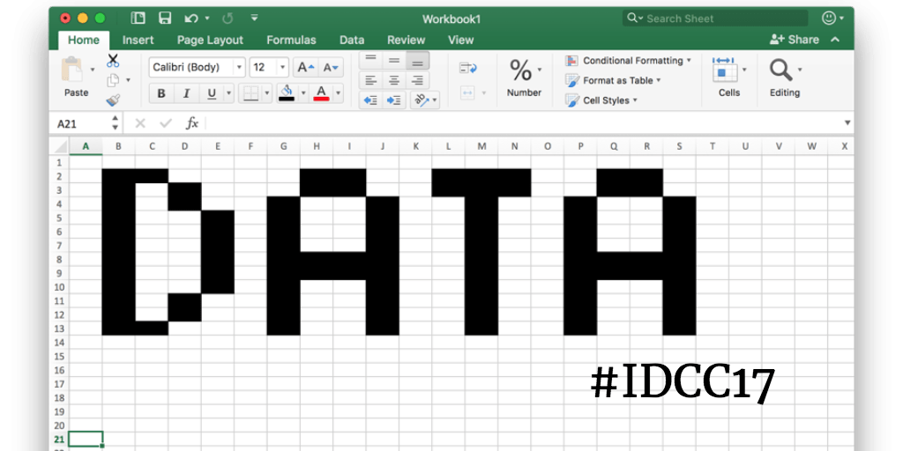
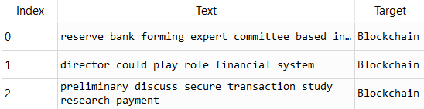
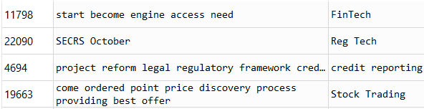

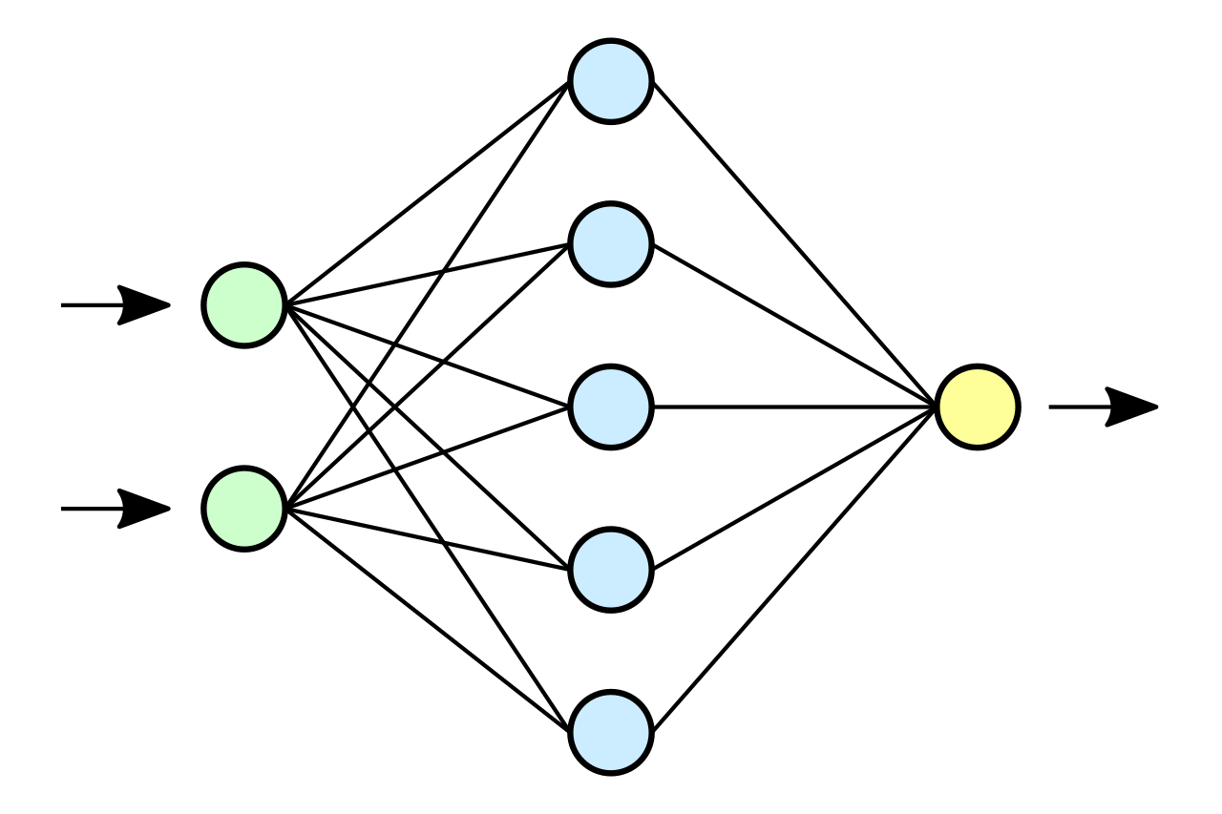
Structure of the Project
Raw Data
Filter the Data
Shuffle the Data
(To ensure there is training and testing over all classes of Data)
(Drop Null Values and Delete unwanted Data Types)
Vectorize the Data
Fit the Data into an ANN

Slide 3
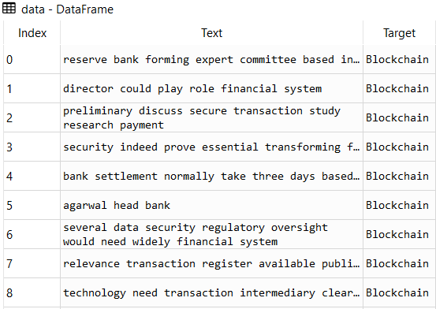
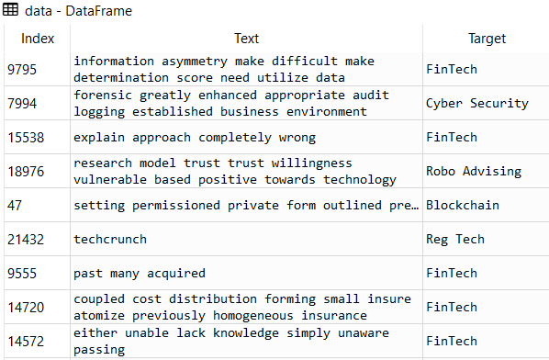
Preparing the ‘Text’: Part1- Shuffling and Filtering
The excel file was downloaded and read using Pandas library from python
The data was filtered to eliminate out any null and Boolean values.
Since the Data was thoroughly ordered, a random shuffling was needed to ensure that when the data is trained, all the classes are included in training, validation and test set.
Ordered un-shuffled Data
Shuffled and Filtered Data

Slide 4
Part 2- Vectorizing the ‘Text’
From the SciKit Library in python, a vectorizer is imported to convert the English words into floating numbers. The vocabulary is auto-detected by the system, which came out to be 11,202. Which would be the dimension of each of our ‘Text’ data.
The above matrix is taken, and its one-hot vectorized, i.e. a binary form of vectorization.
An illustration of how one-hot vector encoding works:-
Suppose we have a vocabulary of only three words. {hello, hi, there}
Then, one-hot vector representation of a sentence: “hi there” :
Similarly, for “hello there”, it will be:
The data is vectorized by searching for non-zero values and simply replacing them by 1.
The vectorization results in a sparse matrix; since there are only a handful of words used in each
data out of the entire dictionary.
[0, | 1, | 1]
[1, | 0, | 1]

Slide 5
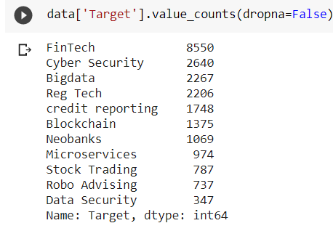
Preparing the labels: Part 1:Accessing and Assigning
The number of distinct elements in the “Target” column is accessed and displayed.
From the above, each element is assigned a distinct integer, from 0 to 10.
data['Target']=data['Target'].map({'FinTech': 0, 'Cyber Security': 1, 'Bigdata': 2, 'Reg Tech': 3, 'credit reporting': 4, 'Blockchain': 5, 'Neobanks': 6, 'Microservices': 7, 'Stock Trading': 8, 'Robo Advising': 9, 'Data Security': 10})

Slide 6
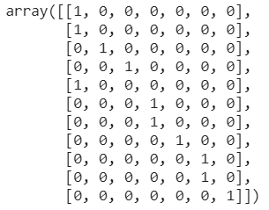
Part 2: Vectorizing the ‘Target’ to form a matrix of labels
From the Scikit library, pre-processing is imported, and the Label Binarizer is fitted to the ‘labels’ to binarize the labels.
Here is how the Label Binarizer works:
from sklearn import preprocessing
lb = preprocessing.LabelBinarizer()
a=[1, 1, 2, 3, 1, 4, 4, 5, 6, 6, 7]
lb.fit(a)
lb.transform(a)

Slide 7
Making the ANN and fitting the Data
From the main data, i.e. 22,700 the first 20,000 is kept for training and validation, and the rest 2,700 are kept for testing.
Accordingly the test data is split too.
From the 20,000 training data, first 13,000 is kept for training and the rest 7,000 are kept for validation.
From the Keras library, models and layers and imported.
An ANN is created, with 11, 202 input layers (dimension of each data), and two hidden layers are added of 70 neurons each, and a ReLU (Rectified Linear Unit) activation.
Final layer is made of 11 neurons representing 11 classes with a soft-max layer before it.
The model is compiled with rmsprop optimizer and categorical cross-entropy loss.
Finally, the training data is fit into it, with batches of 512, and the network is made to run for 20 epochs.

Slide 8
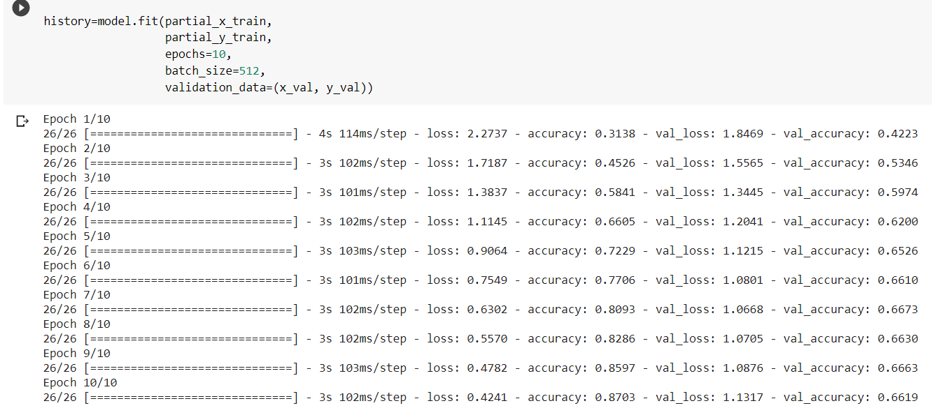
Results through 10 epochs

Slide 9
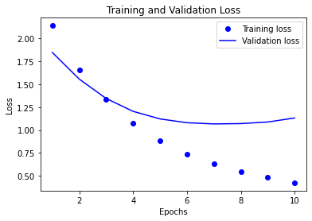
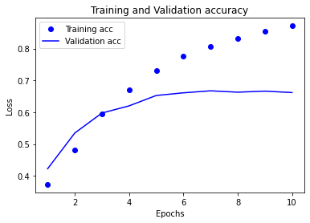
Plotting the Training and Validation Loss and Accuracy
From the plot of Training and Validation accuracy it
seems clear that within this 20 epochs, there is no overfitting

Slide 10

Testing the Network
After putting the above trained ANN through a test with the data prepared in the test set, it gives an accuracy of around 67%.
results=model.evaluate(test_data, one_hot_test_labels)

Slide 11
THANK YOU!

