Slide 1
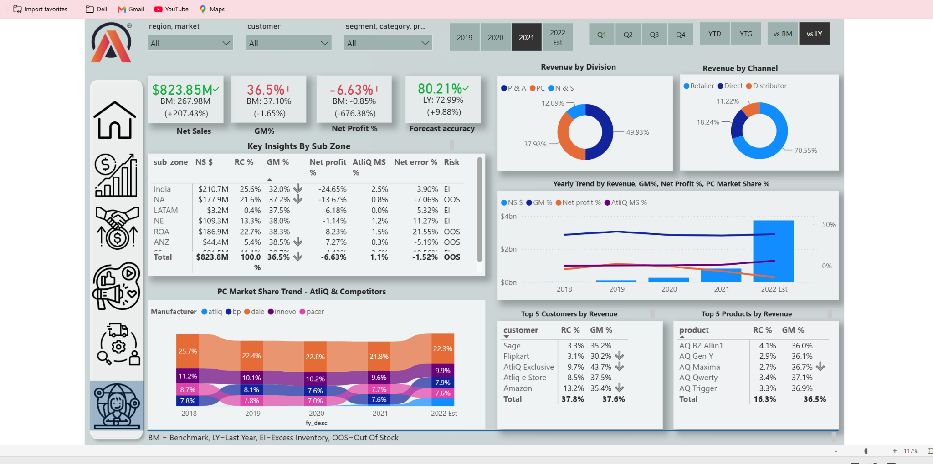
BUSINESS INTELLIGENCE • POWER BI
ATLIQ
BUSINESS INSIGHTS 360
From raw data to sharper business decisions
A multi-function analytics solution across Finance, Sales,
Marketing, Supply Chain and Executive reporting.
PORTFOLIO PROJECT | ARPAN DAS
POWER BI

Slide 2
01 | PROJECT SNAPSHOT
One connected view of business performance
THE BUSINESS NEED
5
360°
KPI-led
Teams need more than isolated reports. They need a consistent view of revenue, margins, customers, products and operational risks.
Business perspectives
Consolidated view
Performance monitoring
WHAT A DECISION-MAKER CAN EXPLORE
Where revenue is coming from — by region, customer, product and channel
PROJECT RESPONSE
How sales translate into gross margin and net profitability
A consolidated, interactive Power BI solution with five analytical perspectives.
Which products or customers show stronger or weaker performance
How forecast accuracy and inventory-related risk vary across the business
ATLIQ BUSINESS INSIGHTS 360 | PORTFOLIO CASE STUDY
02

Slide 3
02 | APPROACH
A practical analytics workflow
01
02
03
04
05
Understand
Prepare
Model
Measure
Communicate
Translate business questions into measurable KPIs.
Transform and shape source data in Power Query.
Build relationships and a reusable analytical model.
Create DAX measures for business performance.
Design interactive views for exploration and decisions.
TOOLS
Power BI • Power Query • DAX • Data Modelling • Interactive Visuals
ATLIQ BUSINESS INSIGHTS 360 | PORTFOLIO CASE STUDY
03

Slide 4
03 | DASHBOARD WALKTHROUGH
Executive Analytics
WHAT THIS VIEW HELPS ANSWER
A leadership-level snapshot of sales, margin, profitability, channel mix and forecast accuracy.
Net Sales and Gross Margin % at a glance
Revenue mix across divisions and channels
Market-share movement and key customer/product contributors
ATLIQ BUSINESS INSIGHTS 360 | PORTFOLIO CASE STUDY
04

Slide 5
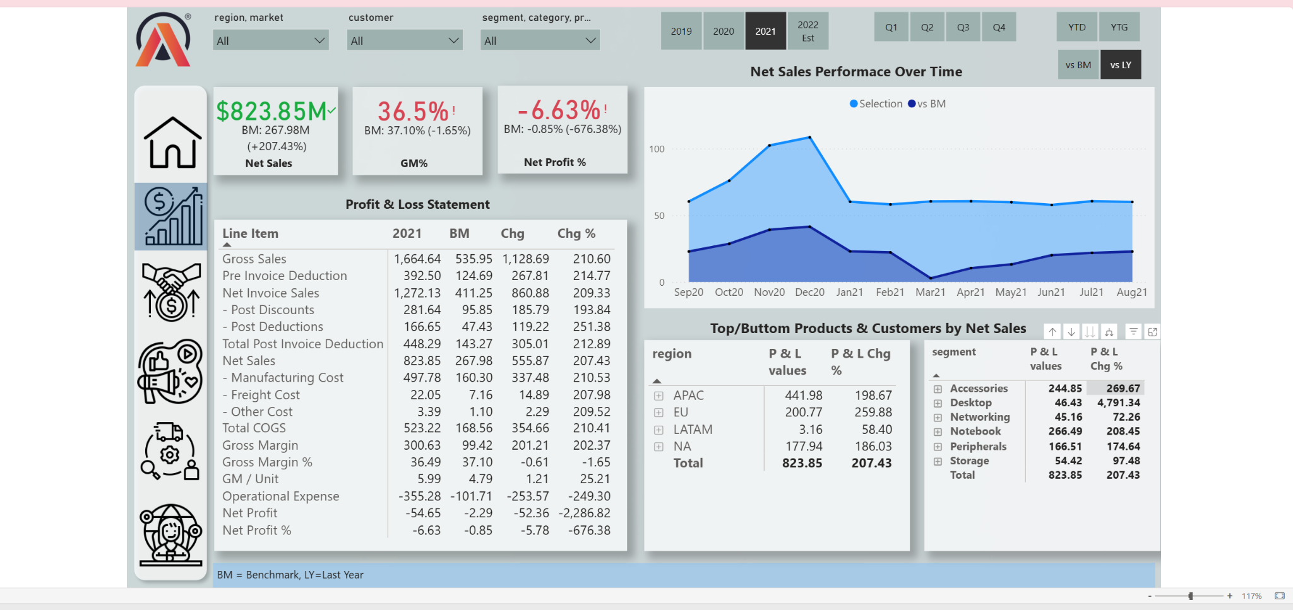
04 | DASHBOARD WALKTHROUGH
Finance Analytics
WHAT THIS VIEW HELPS ANSWER
A closer look at the Profit & Loss structure and financial performance versus benchmark.
Gross sales bridge through deductions to net sales
Cost of goods sold, gross margin and operating expenses
Net profit and margin highlight where performance needs attention
ATLIQ BUSINESS INSIGHTS 360 | PORTFOLIO CASE STUDY
05

Slide 6
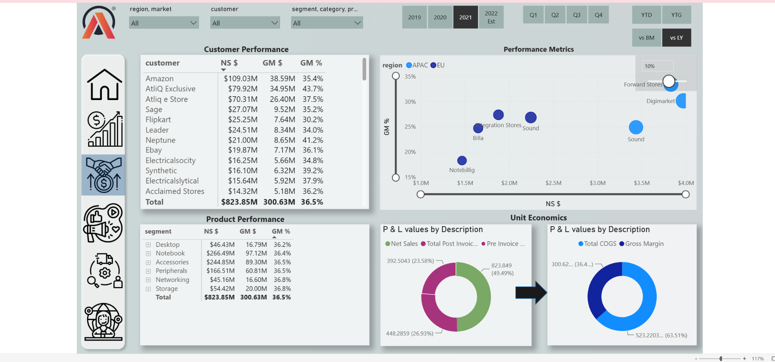
05 | DASHBOARD WALKTHROUGH
Sales Analytics
WHAT THIS VIEW HELPS ANSWER
Explore customer, product, regional and segment performance to understand sales contribution.
Customer and product performance tables
Net sales and gross margin comparison
Regional and segment-level performance patterns
ATLIQ BUSINESS INSIGHTS 360 | PORTFOLIO CASE STUDY
06

Slide 7
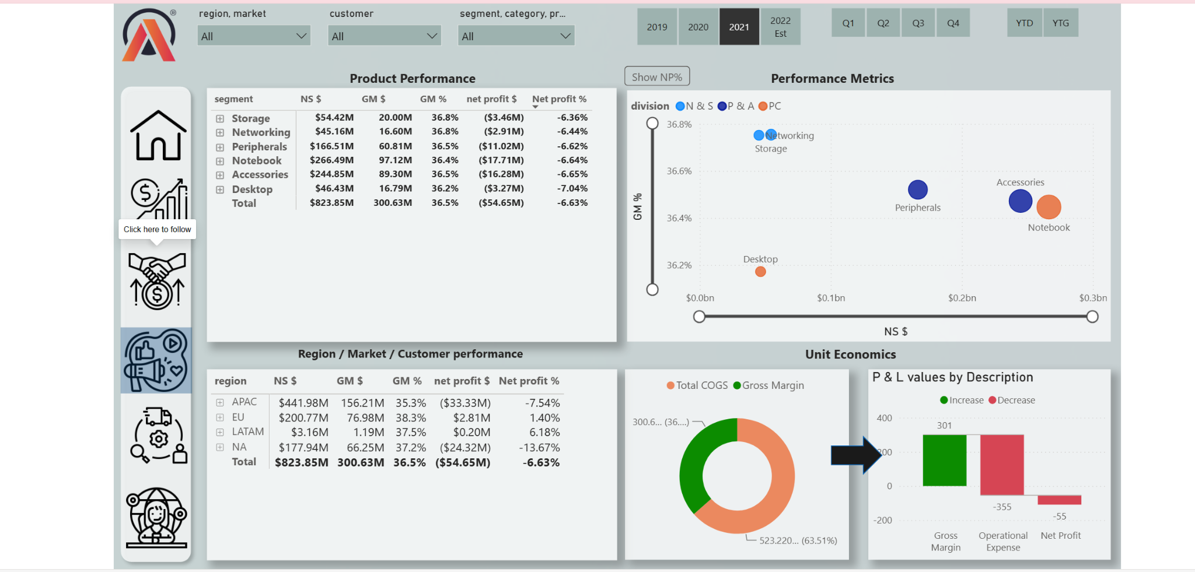
06 | DASHBOARD WALKTHROUGH
Marketing Analytics
WHAT THIS VIEW HELPS ANSWER
Compare product and market performance using revenue, gross margin and net-profit indicators.
Product segment contribution and profitability
Market and region performance comparisons
Unit-economics views to support prioritisation
ATLIQ BUSINESS INSIGHTS 360 | PORTFOLIO CASE STUDY
07

Slide 8
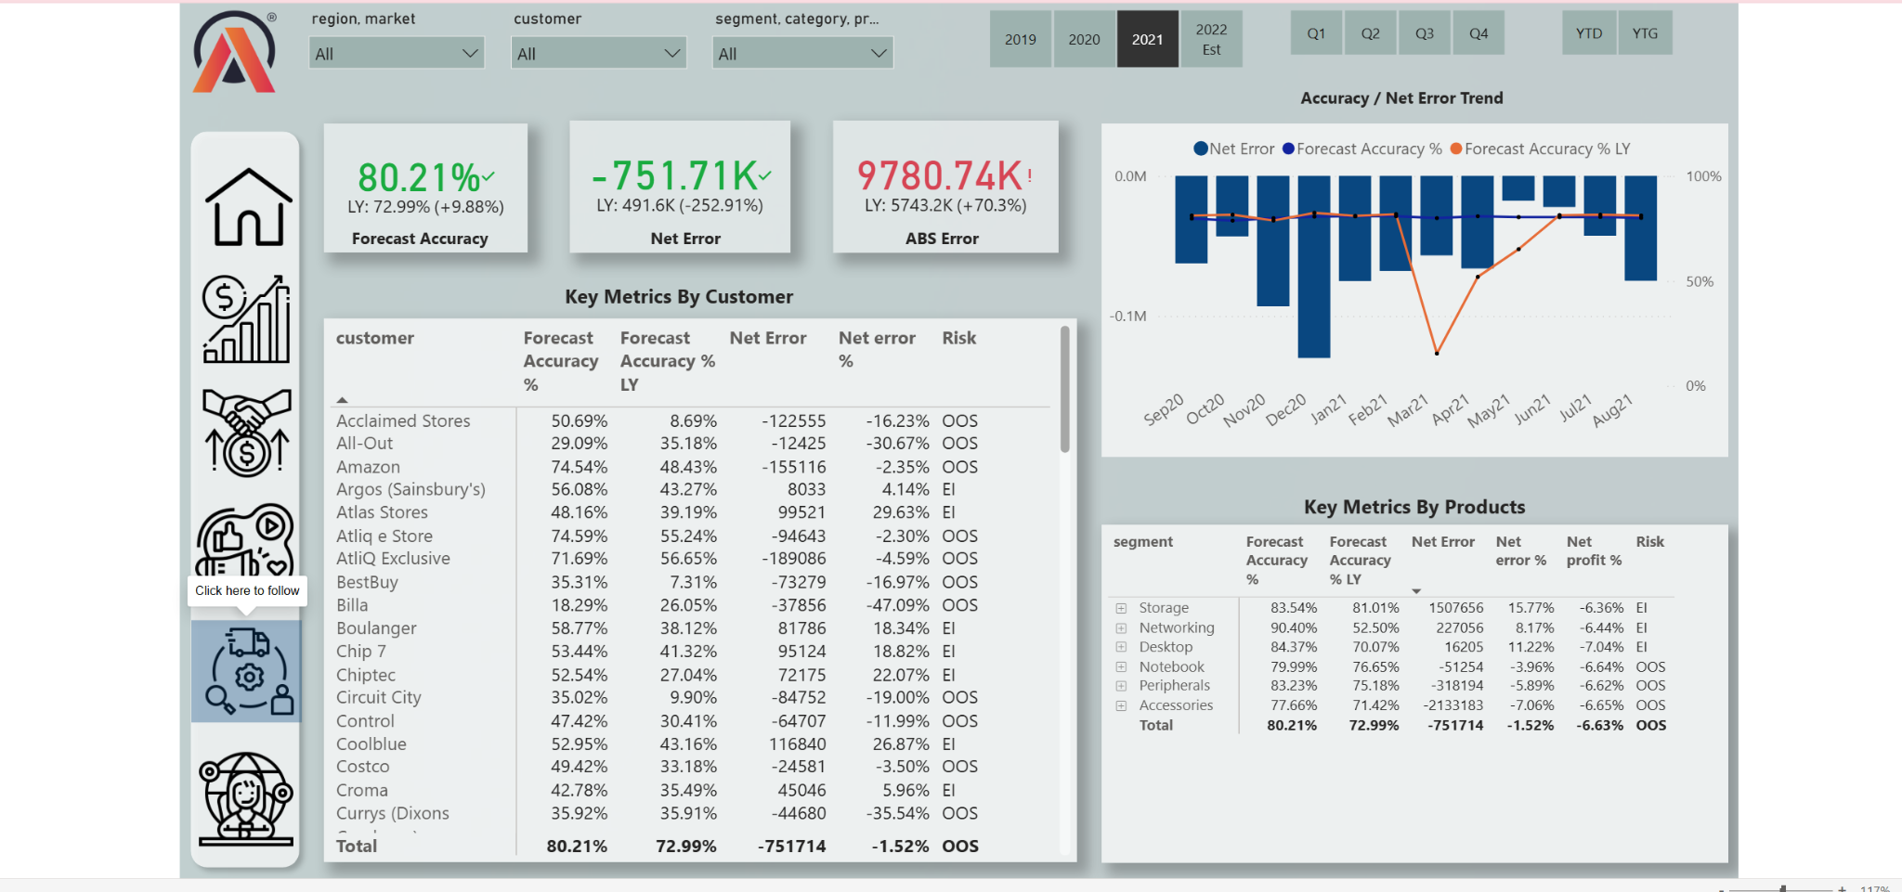
07 | DASHBOARD WALKTHROUGH
Supply Chain Analytics
WHAT THIS VIEW HELPS ANSWER
Monitor forecast quality and identify customers or products with potential inventory risk.
Forecast accuracy, net error and absolute error KPIs
Customer- and product-level forecast metrics
Risk indicators including excess inventory and out-of-stock labels
ATLIQ BUSINESS INSIGHTS 360 | PORTFOLIO CASE STUDY
08

Slide 9
08 | BUSINESS INTERPRETATION
Turning metrics into business questions
PROFITABILITY
Are sales growth and gross margin moving in the same direction?
CUSTOMER MIX
Which customers contribute most to revenue, and what is their margin profile?
PRODUCT MIX
Which product segments combine meaningful scale with healthy margins?
MARKET PRIORITY
Which regions show stronger performance and where is attention needed?
FORECAST RISK
Where do forecast errors signal possible excess inventory or stock-outs?
ATLIQ BUSINESS INSIGHTS 360 | PORTFOLIO CASE STUDY
09

Slide 10
09 | KPI LITERACY
Understand the measures behind the visuals
Net Sales
Revenue after applicable invoice deductions and discounts.
Gross Margin
Net Sales minus cost of goods sold (COGS).
Gross Margin %
Gross Margin expressed as a percentage of Net Sales.
Net Profit %
Net Profit divided by Net Sales; indicates bottom-line profitability.
Forecast Accuracy
A measure of how closely forecast demand aligns with actual demand.
Net Error / Absolute Error
Forecast error direction and magnitude; useful for spotting planning issues.
ATLIQ BUSINESS INSIGHTS 360 | PORTFOLIO CASE STUDY
10

Slide 11
10 | TAKEAWAYS
What the analysis brings together
KEY TAKEAWAYS
INTERPRETATION NOTE
A single view can connect financial, commercial and operational performance.
This is a portfolio case study built using the provided AtliQ dataset and learning brief. The dashboard supports exploration and discussion; recommendations should be validated with business owners, data definitions and operational context before real-world action.
Revenue alone is not enough; margin and profitability add context.
Customer and product mix can reveal concentration and prioritisation opportunities.
Forecast metrics can help teams investigate inventory and service risks.
The displayed figures are dataset outputs, not claims about a live company's current performance.
ATLIQ BUSINESS INSIGHTS 360 | PORTFOLIO CASE STUDY
11

Slide 12
11 | TECHNICAL TOOLKIT
Skills demonstrated
POWER BI
Interactive report design • Drill-down exploration • KPI cards • Cross-filtering
POWER QUERY
Data cleaning • Transformation • Shaping • Repeatable preparation
DAX
Business measures • Ratios and percentages • Time and comparison logic
DATA MODELLING
Relationships • Analytical structure • Consistent metric definitions
BUSINESS ANALYSIS
Finance • Sales • Marketing • Supply Chain • Executive reporting
ATLIQ BUSINESS INSIGHTS 360 | PORTFOLIO CASE STUDY
12

Slide 13
12 | PORTFOLIO & NEXT STEPS
Explore the project
PROJECT REPOSITORY
THANK YOU
github.com/arpan-data/
atliq-business-insights-360-powerbi
I’m keen to discuss the business questions, KPI choices, data preparation and design decisions behind this project.
Interactive Power BI report
https://app.powerbi.com/view?r=eyJrIjoiMTY3NzY4NDItMmFhYi00MzZlLTkwNjYtMGNkOGY4ZjBkOTlhIiwidCI6ImM2ZTU0OWIzLTVmNDUtNDAzMi1hYWU5LWQ0MjQ0ZGM1YjJjNCJ9
ARPAN DAS | DATA ANALYTICS PORTFOLIO
ATLIQ BUSINESS INSIGHTS 360 | PORTFOLIO CASE STUDY
13

